Slide 1

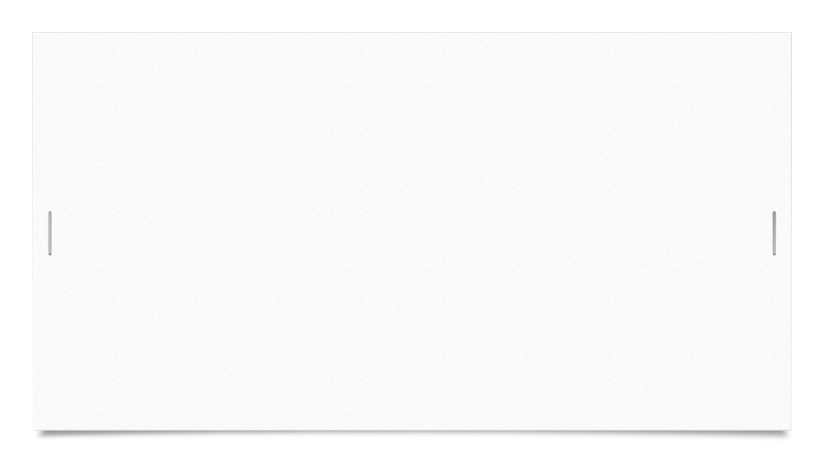
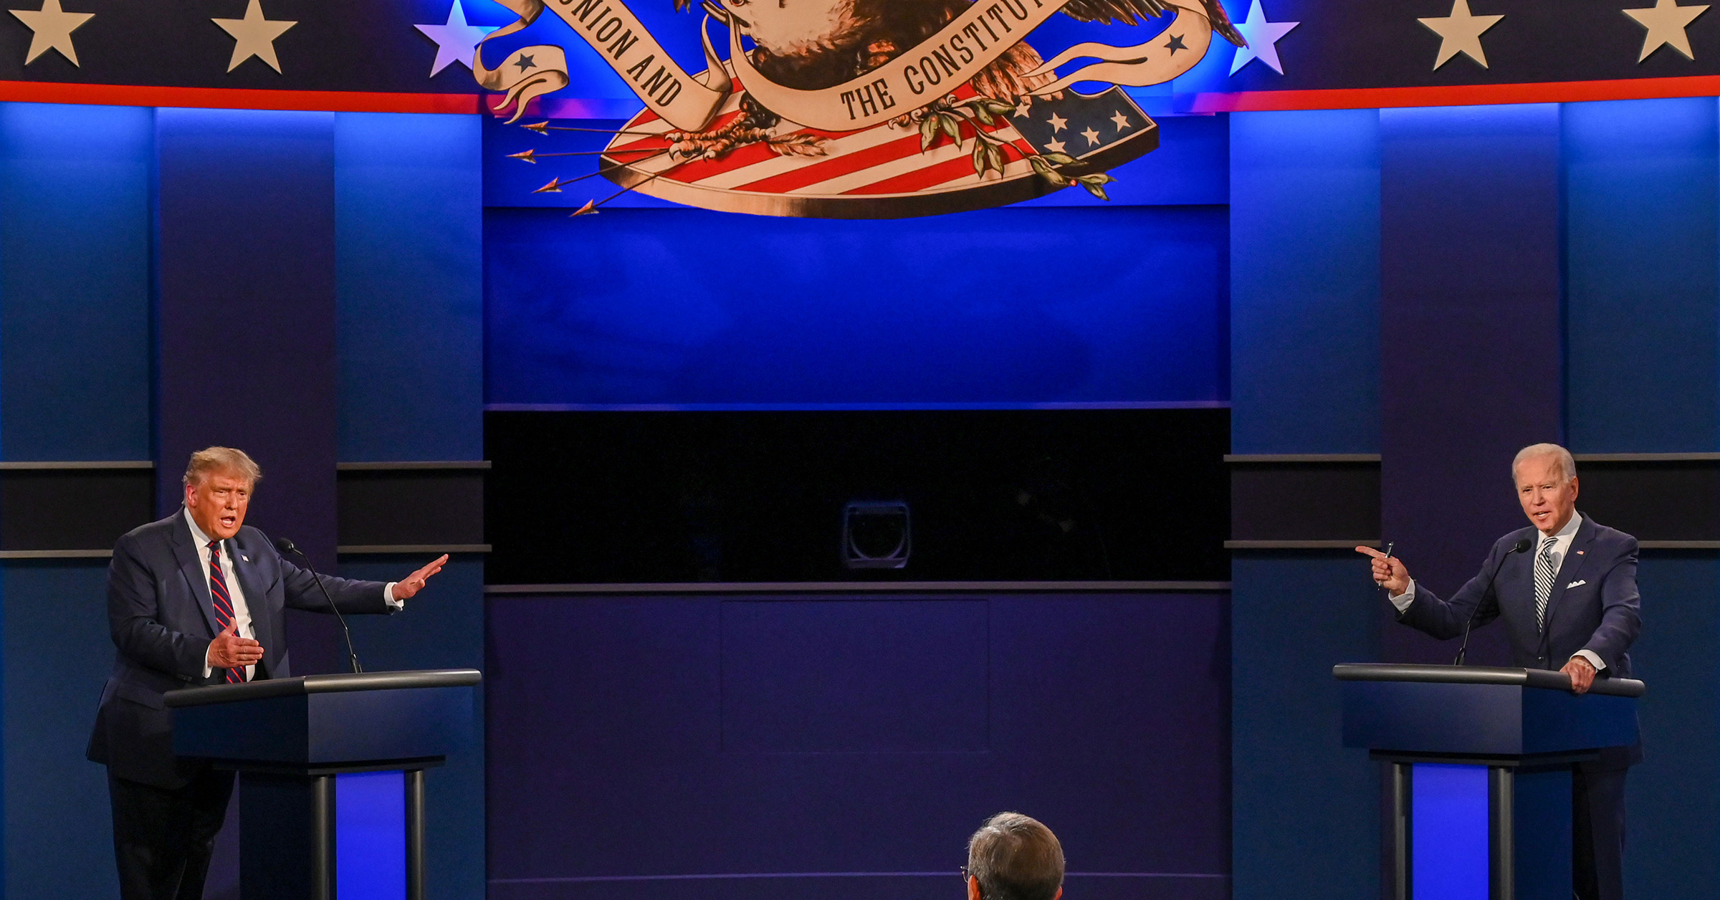

ANALYSIS ON US ELECTION USING SOCIAL MEDIA
TEAM MEMBERS
NIKHITHA, KOLLURI
ESWAR, VALLURU
CHAITANYA, MALLEPUDI
SRI SAI NITHIN CHOWDARY, DUKKIPATI

Slide 2
MOTIVATION
The world has been advancing significantly day by day, so as the data. Nowadays the data has become so vast such that it could not be stored in a single cluster or a machine, thus the concept of big data arisen and its services have been implemented in various sectors. Many tools and technologies are arriving in the market very frequently to work with this big data. We thought of analysing social media using the existing techniques, visualize the data, aggregate, and model it in a user-friendly way.

Slide 3
Idea
Since the media is biased most of the times, it is difficult for the users to get the aggregation of all the views across the globe. We have BigData technologies to deal with large amount of data and perform analytics. So we choose the collect the social media(twitter) data, analyse the views on US Elections and make it presentable to the user using some kind or user friendly interface.

Slide 4
WHO?
People who are curious about the 2020 US Elections inside as well as outside the United States.

Slide 5
WHAT ?
People want to get awareness on the Elections; since the media is always biased, people are unable to get the aggregate information and make the decision.

Slide 6
WHEN?
When people want to know whether the media and people are on the same stand.

Slide 7
WHERE?
Across the globe where ever the media is highly influenced.

Slide 8
WHY?
Since the Media is biased and mainly focusing on their ratings instead of the ground truth being represented to the people.

Slide 9
HOW & WHAT DATA?
Streaming the Twitter data using tweepy.
Retrieving data using keywords which are related to both.
Filtering the extracted data for vital columns.
Performing Sentimental analysis on filtered data.

Slide 10
TOOLS & TECNOLOGIES
PYTHON : Extracting data.
HIVE/SPARK : Filtering data.
HADOOP : Storing the data.
SQOOP : Loading the data.
TextBlob: Sentimental analysis.
FLASK: Web Interface.
AZURE : Cloud platform.

Slide 11
OBJECTIVES
Our Undertaking fundamental thought is to do the ETL cycle utilizing Hive/Spark Query Handling, Cleaning the data, performing sentimental analysis, visualizing the data, and Incorporating visualization with Web UI. The wellspring of our framework is Twitter information and we would utilize Tweepy API to gather the information. We would deploy the web UI incorporating the visualizations in the Cloud environment.

Slide 12
SIGNIFICANCE
People are very curious about the recent trending issues across the globe, Since the 2020 US elections have been trending now the people want to know about the different views across the country on participating election candidates. So, we are collecting social media data to analyse different views and opinions, so that people can get awareness.

Slide 13
FEATURES
This project includes streaming of live twitter data and processing it through HIVE/SPARK ETL and using TextBlob from NLTK to process the data and predict the sentiment and Creating a Web UI incorporating the visualization of data and deploying it to the Cloud environment.

Slide 14
APPLICATIONS
Getting out the collaborative results.
To know what’s going around the US elections.
To get radical updates on the candidates.

Slide 15
PROJECT WORKFLOW

Slide 16
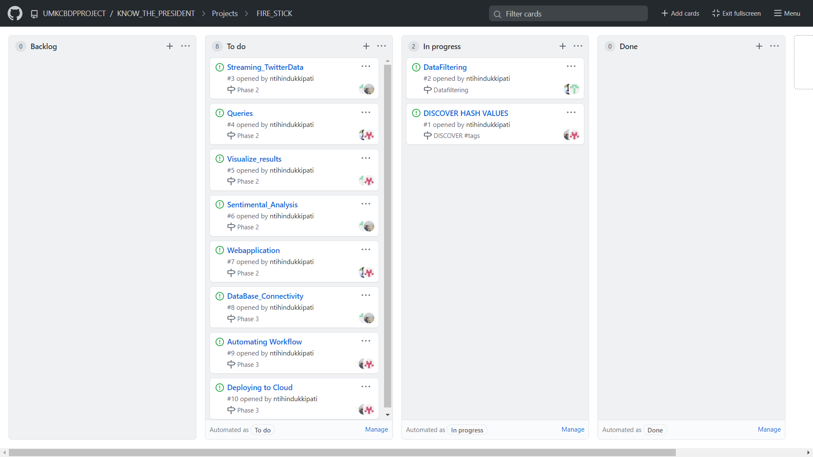

Slide 17
PHASE 1
Twitter Data Streaming ( Chaitanya & Nikhitha)
Dataset Cleaning & Analysis ( Eswar & Nithin )

Slide 18
Twitter Data Streaming
Before Streaming:
R&D on hashtags that relates to our source(Biden & Trump)
So far Findings #DonaldTrump, #CNN, #BCC, #JOEBIDEN, #US2020Elections

Slide 19
DATA ANALYSING & CLEANING
Playing with data and get to know what can be used.
Dealing with Special Characters and emojis.
Dealing with unlinked data.

Slide 20
PHASE 2
Spark ETL
NLP
Visualization

Slide 21
PHASE 3
Web Framework
Deploying in Cloud

Slide 22
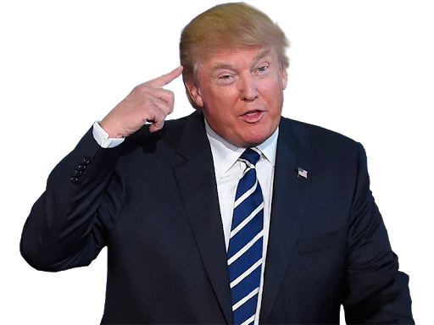
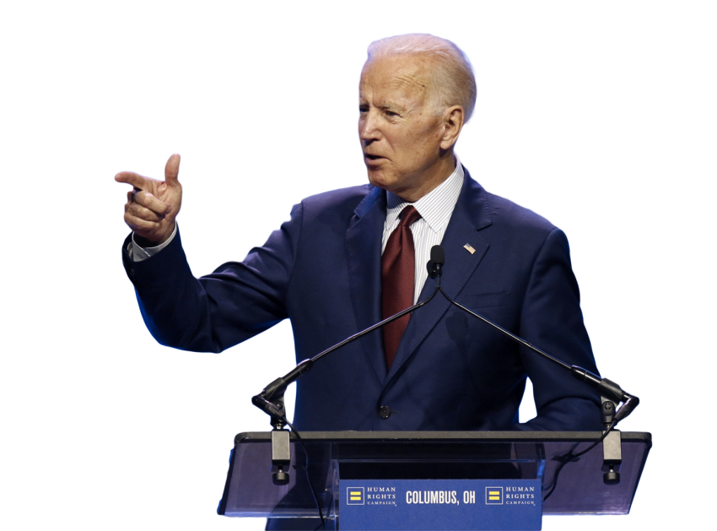
THANK YOU

