Slide 1
Git
The important parts

Slide 2
What is git?
Git is a distributed version control system
It's a tree of snapshots
  A snapshot is a saved 'state' of our code
Usually cloud hosted
  That's what github is for us

Slide 3
Why use git?
Allows us to edit code “simultaneously”
  You won't see their edits like google docs, but it actually works better for more people
Allows us to show what tasks were on
Allows us to easily show progress
Allows us to easily review
Allows us to figure out what works best in terms of implementations
Allows us to roll back changes

Slide 4
What do I need to get started?
Internet connection
A github account
To be added to the organization
  Called UMKCRobotics
To be added to a team on that
  Either my team, The fun team
  Or their team, Drunk Uncles
  Or Shared team
Some way to access git

Slide 5
Methods to use git
Comand line
  What eric and I use, what we're most familiar with.
  Git was designed for this so it usually works best with it
  A bit arcane
“gitk”
  A gui for git that will show you a lot of information at once
Whatever gui program you want
  There are a ton online, just find one that you fancy if you don't want to learn command line
  They're all compatible with every other type of git so don't worry

Slide 6
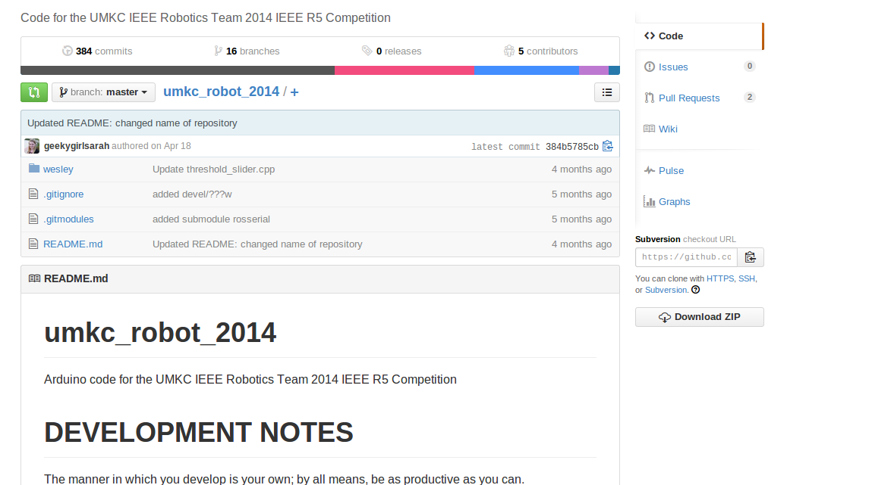
What does a git repo look like?

Slide 7
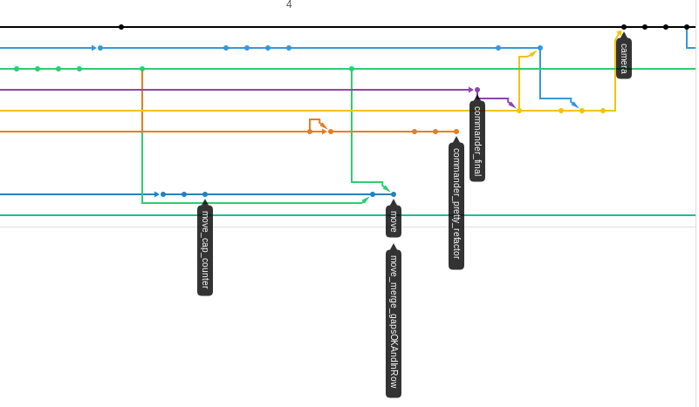
What does a git branch look like?

Slide 8
Commit process
Commiting creates a snapshot of what changes you want to add to the repo
Three steps
  Add the files you want to track the changes on
  Create a commit and name it
  Push it to the branch you're working on

Slide 9
Branching
Branching is what git uses to have work done on a part of the code
Whenever you want to work on a new component make a branch
Always make sure you're on the correct branch
Our branch architecture will be master, dev, other
  Other is any branch you create
  Other always merges into dev
  Dev always merges into master

Slide 10
Merge Process
Merge the changes on one branch into another branch
Steps:
  Switch to the branch you want to merge from
  Issue Merge command to branch you want to merge into
  Resolve merge conflicts
  Commit changes

Slide 11
Creating projects
$ git init
  Creates a git repo in the current directory
$ git clone url
  Copies the files and logs at the url to the current directory
  Makes a new folder

Slide 12
Basic snapshotting
$ git add file
  Adds a file to the staging area for a commit
  $ git add -A
    Adds all files in and under the directory you're currently in
$ git commit
  Creats a commit that includes your currently added files
  Will prompt you to review and name your commit
    This name should describe what you've done in this commit
  $ git commit –amend
    Ammends your current changes to the last commit, useful if you screwed your last commit up

Slide 13
Basic snapshotting (contd)
$ git status
  Shows what you've changed since the last commit
$ git reset file
  Allows you to roll back to the last commit on a file
  $ git reset –hard
    Rolls back all changes to last commit, erases all your work
    Use with caution
$ git diff file
  Shows the differences between the files current state and the file in the last commit
  Can also be used on branches and commits

Slide 14
Branching and merging
$ git branch
  Lists all the branches you have locally
$ git branch new_branch_name
  Creates a new branch with new_branch_name
$ git checkout existing_branch
  Switches your current branch to existing_branch

Slide 15
Sharing and updating projects
$ git fetch
  Downloads all changes from cloud repo
$ git pull
  Pulls down changes on current branch
$ git push
  Pushes up changes to cloud repo
  Will ask you to login

Slide 16
Reference
Me
  I can answer questions of when to branch and when to merge, it's hard to say specifically until you get a feeling for it
http://gitref.org/basic/
  Best reference material on internet for commands
This slideshow
  Online: https://github.com/UMKCRobotics/Chris-Git-Presentation

