Slide 1
Tour Guide App
Eric Ellison, DANIEL GALARZA, REGGIE ROBY, STEVEN WARD, MATT YALE

Slide 2
Goals
Increase foot traffic in museum
Increase effectiveness of museum content
Decrease confusion finding museum content

Slide 3
Goal Execution
Goal: increase foot traffic in museum
social media participation
post a visit to the museum
take a "money selfie"
increase awareness of museum
Goal: increase effectiveness of museum content
easy to find exhibit content
exhibit overviews for easy browsing
details for big groups
easy to find what you are interested in
increase enjoyment

Slide 4
Goal execution
Goal: Decrease confusion finding museum content
exhibit overviews
guided tour
location beacons
bird's eye view of museum
smart exhibits

Slide 5

Tour Guide App
A personal app driven tour guide that uses location beacons and a bird's eye view of the exhibits to guide users through with options to browse exhibit content to find exhibits interesting to you.

Slide 6
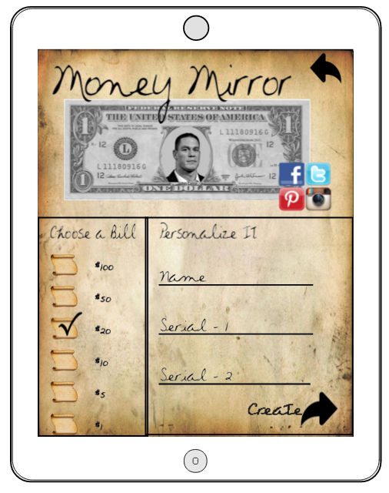
Style
Paper background and scroll style buttons to match the regal and constitutional feel of the Federal Reserve
Easy to read cursive style writing to match paper theme

Slide 7
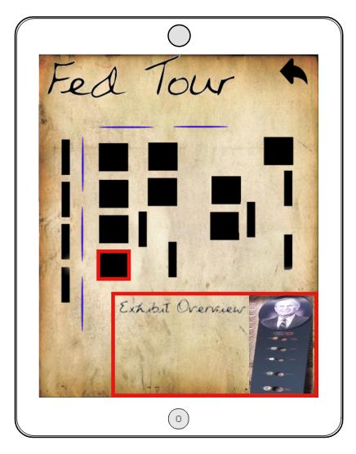
Tour
Birds eye view with google maps feel for user familiarity
Location beacons to alert users in app when they are close to an exhibit to guide them through museum

Slide 8
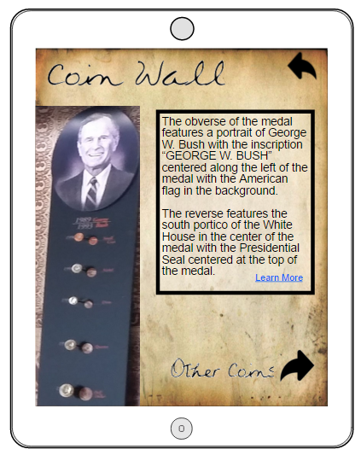
Exhibit
Additional information for big groups when not everyone can see up close
Also allows for easier access to the hidden gems within exhibits

Slide 9
Location Beacons
Helps to guide user throughout the museum in coordination with the app
Important exhibit data
how long users stay at certain exhibits
which exhibits get the most traffic
what areas of the museum are getting ignored
Very powerful in allowing for museum to rearranged and redesigned with the consumer's interests in mind

Slide 10
Future Scope
Maintainability
Bird's eye view is easy to maintain due to minimalistic nature
Database with each exhibit and info will allow for easy rearrangement in app

