Slide 1
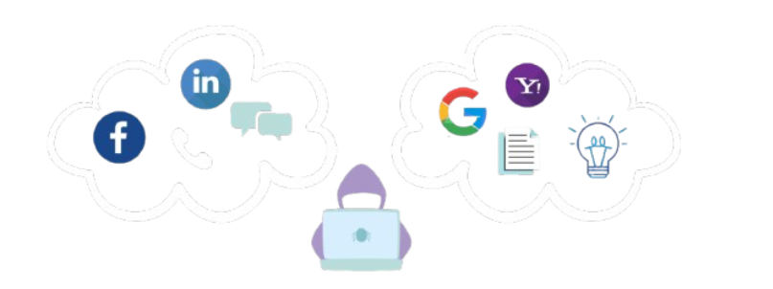

OSINT
Open Source Intelligence

Slide 2
Introduction to OSINT
OSINT (Open Source Intelligence) is key to every hack or digital investigation
OSINT has played a role for intelligence since the 1940s during WWII
There are not a lot of requirements needed for OSINT
You just need to be able to access the internet
OSINT is the collection, analysis and dissemination of information that is legally and publicly accessible via open sources
There are various ways to conduct OSINT
Passive and Active OSINT
Passive is using sources that you find on the internet. Active is going up to the source and gathering more info.

Slide 3
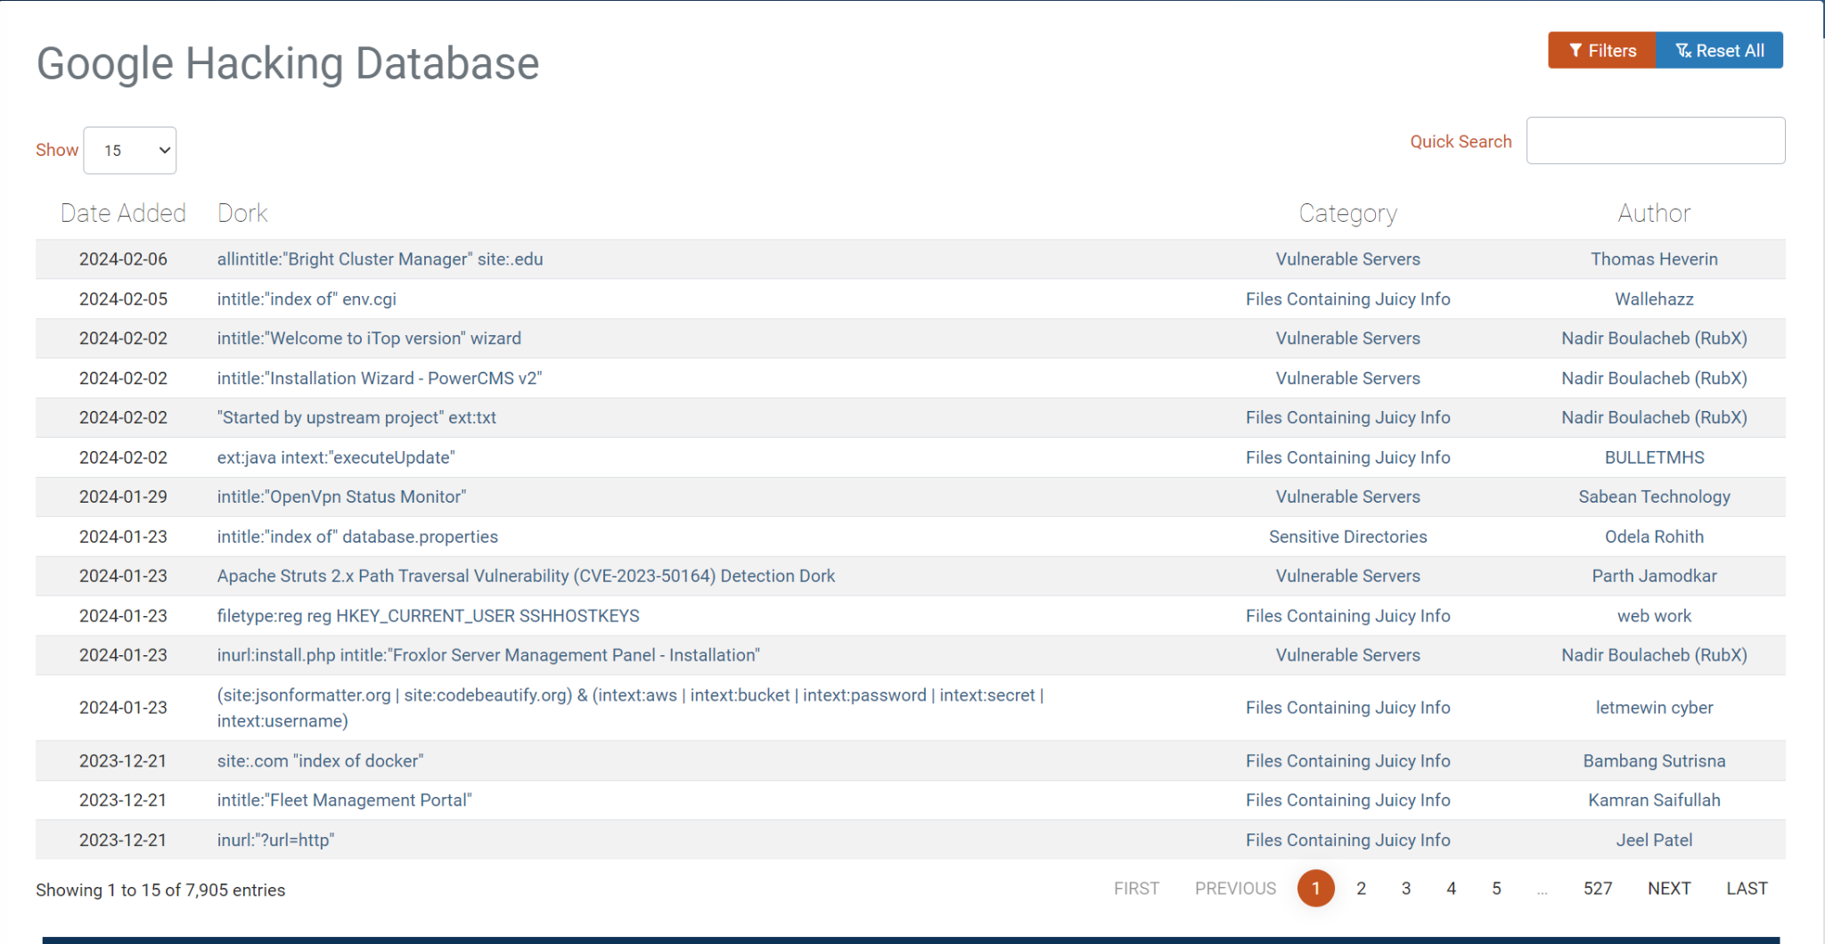
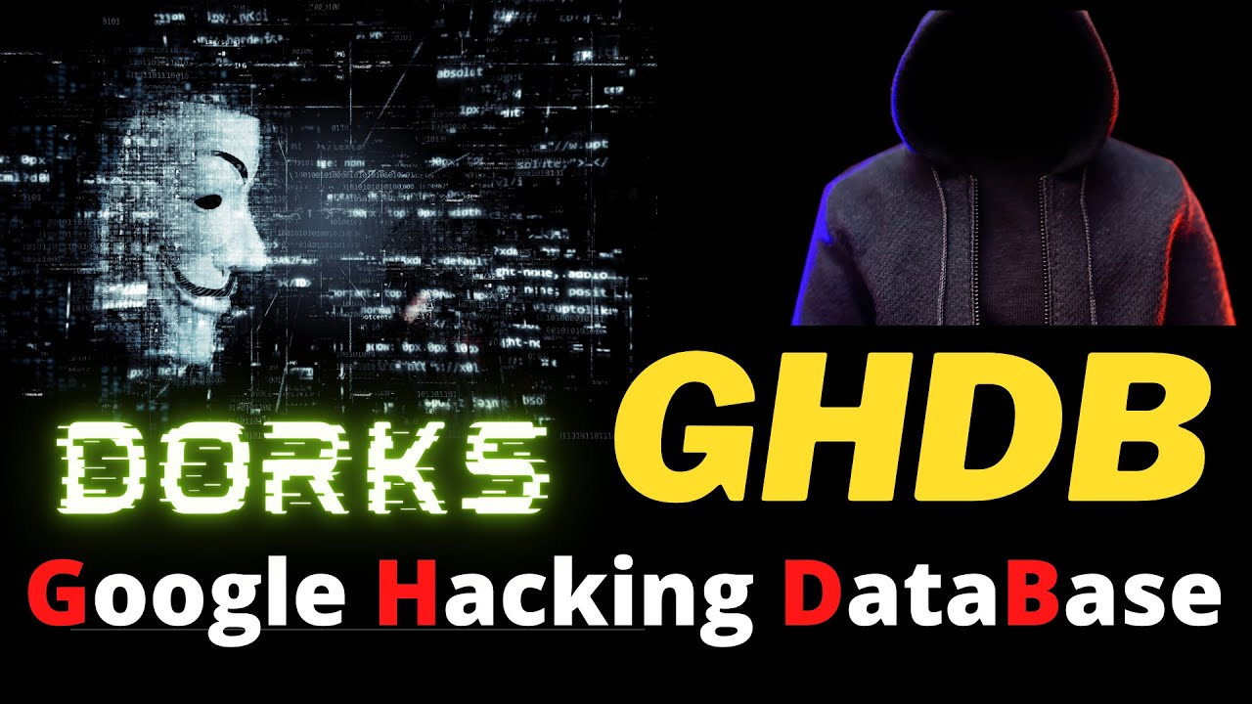
Commencing OSINT
You can use your own devices (Mobile/PC) or the computers at the CR
Open your desired browser and go to the Google Hacking Database
We will be doing Google Dorking
There will be links there which you can click and paste the command into Google.
These are the Google Dorks! They can find information that is already on the internet
Explore the GHDB, there are a ton of dorks!

Slide 4
Google Dorking
Google is the ultimate tool for hacking
There is wide variety of tutorials but also information that is available for OSINT
Google Dorking revolves around using operators to find certain info
For example, site:.com or inurl: allows you to find websites that end in .com or find info within a url.
Google Dorking & OSINT is legal
However how you use the info is where you can get in trouble.
To look for targets use the search operators and add quotes around what you want
site:.com “Jeff Bezos”
Google is a gold mine but there are other tools as well!
FaceCheck.id, PimEyes, Shodan, etc

Slide 5
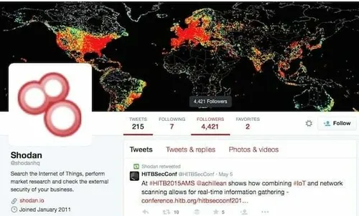
Shodan
Shodan is the Google of IOT (Internet of Things)
Shodan is a website where you can look for every device connected to the internet
You can create an account and explore a variety of devices
If you don’t want to, there are still a ton of devices that don’t require an account but might be harder to find.
Shodan can find unsecured devices like webcams or cameras in public areas
Shodan can be used like Google Dorking
There are similar search operators to use
They will provide them to you in their cheat sheet

Slide 6

Human Targets
Sometimes you won’t do OSINT on a company or a machine. There will be cases where your target is another person
Many digital investigators often look for missing people using OSINT
If you have the target name, use dorks to find more info on them
Sites like thatsthem.com or whitepages will help in finding more info on them
thatsthem.com does a full background check on the target, as well as whitepages
If you have a picture of their face, use tools like Facecheck.id or PimEyes
These use facial recognition software to scrape the internet and search for their face or similar faces.
If you find an email tools like haveibeenpwned or epios will search for emails
You can use haveibeenpwned to see if your emails have been found in data breaches!

Slide 7


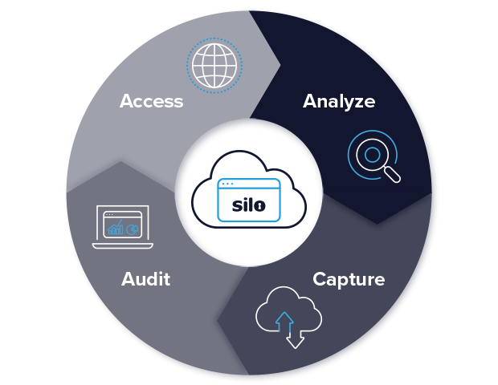
OSINT OPSEC
In all things cyber security related, OPSEC (operational security) is needed for personal protection
Hiding your IP, changing how you type, device fingerprinting, etc
There are ways to protect yourself from being identified
VPN’s, TOR, cryptocurrencies, virtual machines, proxies, RDP
The best tool to use is the Silo Browser
This browser is very expensive! Costs $1000 dollars per year, but allows you to have a containerized browser that can be spun up from anywhere!
It has access to TOR, multiple proxies in multiple countries, and can change device fingerprint. There are hundreds features for OSINT. Check it out here.
If you can’t afford that then setting up cloud machines or virtual machines will be cheaper or free.
VM’s, TOR, Monero, Mullvad VPN, and browser extensions are perfect for OPSEC

Slide 8
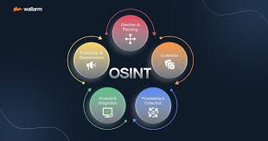
Objective
Conduct your own OSINT investigation! Research yourself or a consenting friend or family member and find as much info as you can!
Use the tools mentioned earlier or other tools if you wish
There is an OSINT framework, with hundred of sites and tools
Try using some of the Kali Linux OSINT tools
There are tools like inspy, recon-ng, instaloader, and many more
Find hidden web pages or information with Google Dorks
Use the search operators to find juicy info!
Think of yourself like a digital investigator
In other words how would you find your target and their info?
(Optional) Join Trace Labs
OSINT community that finds missing people

