Slide 1
Installing Windows Server and AD

Slide 2
Installing Windows Server

Slide 3
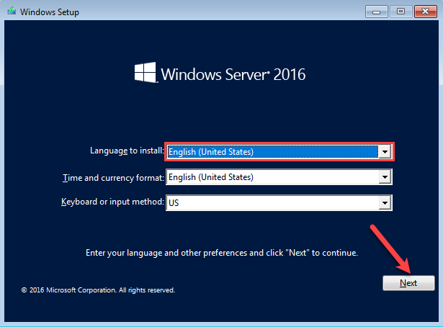
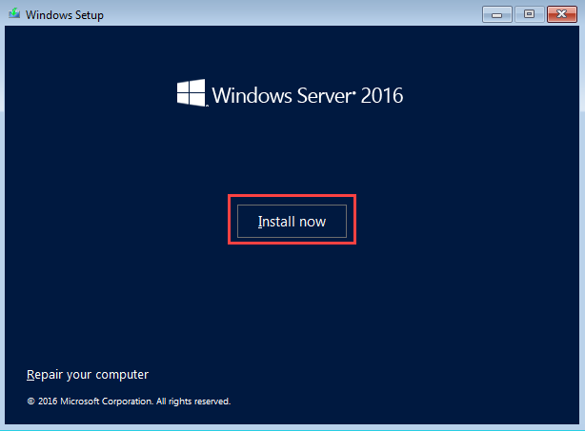
Step 1
Plug in USB and Boot the computer.
Select Language and Time Zone.
Click Next.
Then install.

Slide 4
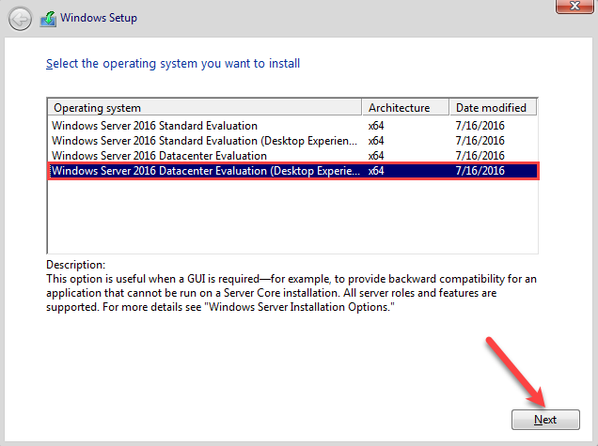
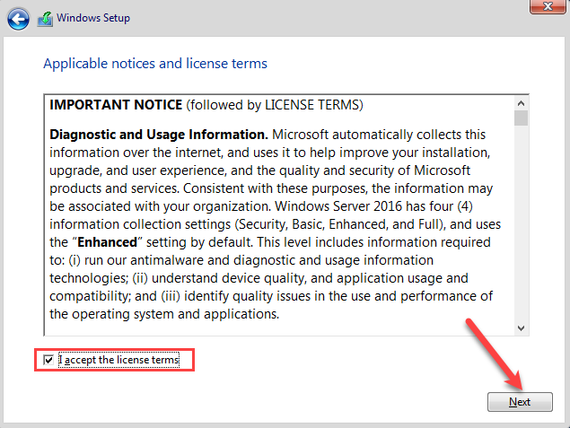
Step 2
Select the Appropriate version.
Accept License Terms and Agreements.
Click Next.

Slide 5
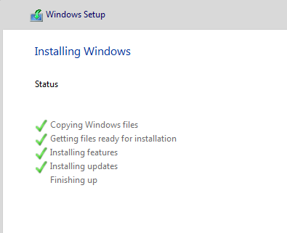
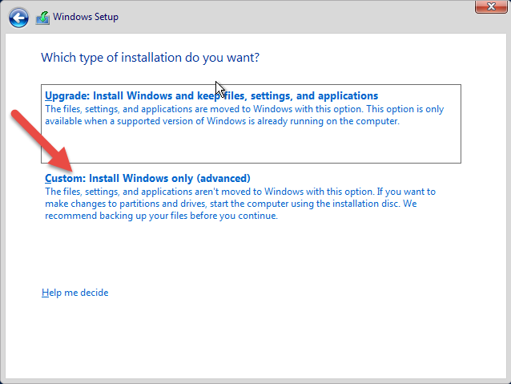
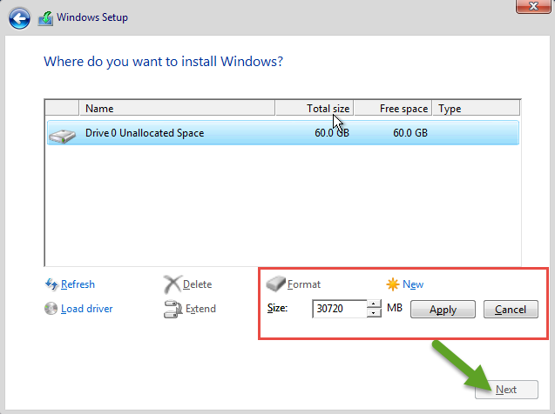
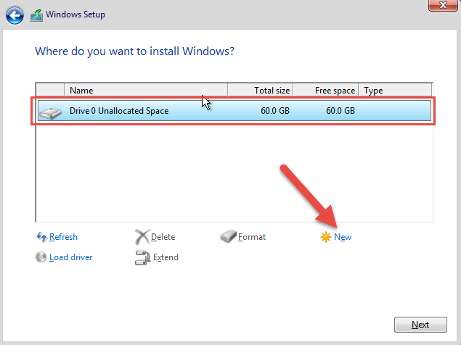
Step 3
Chose a custom install option.
Make a new partition, make the size that you need.
Then click next and let the Windows Server Install.

Slide 6
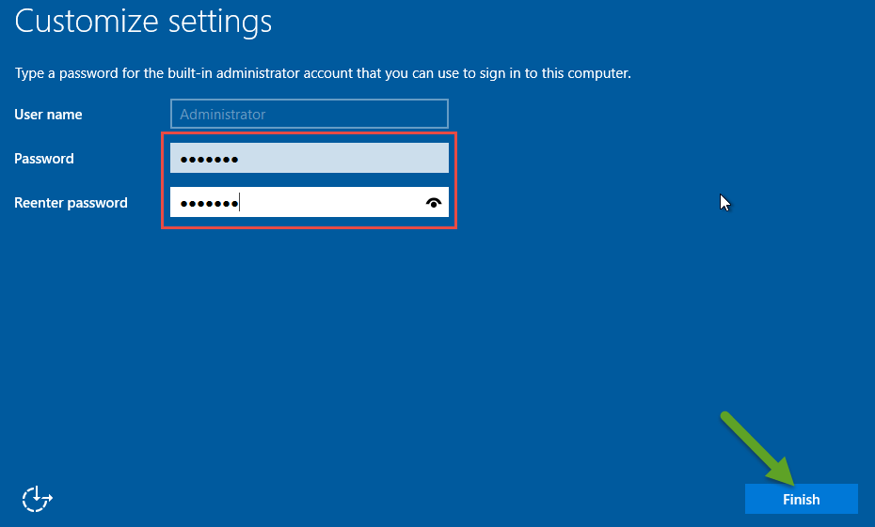
Step 4
Once everything has restarted create your own complex password.

Slide 7
Installing Active Directory (AD)

Slide 8
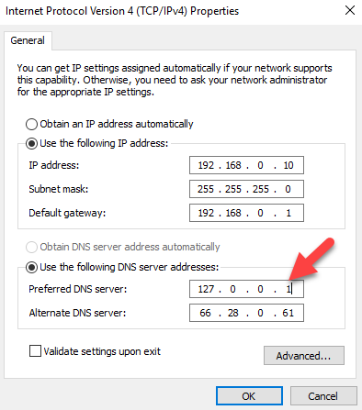
Step 1
Log in as admin of the server.
Configure the DNS Settings.
AD = DNS
Set Server IP Address as DNS Address.

Slide 9
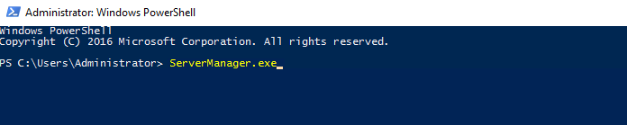
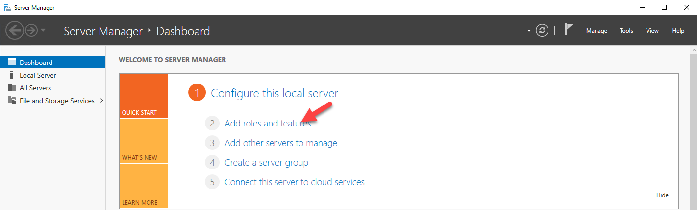
Step 2
Open PowerShell as admin.
ServerManager.exe
Then Click on Add Roles and Features.

Slide 10
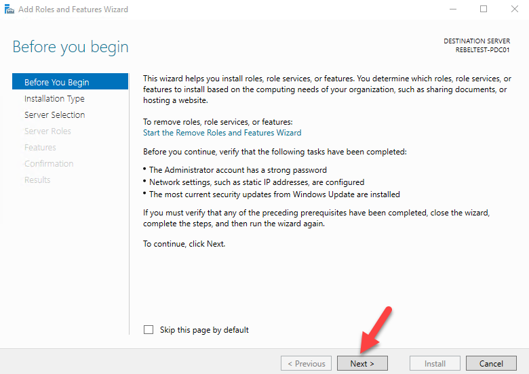
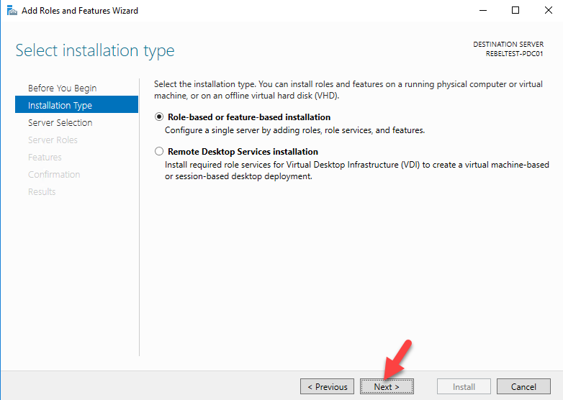
Step 3
In the add roles and features wizard just accept defaults.

Slide 11
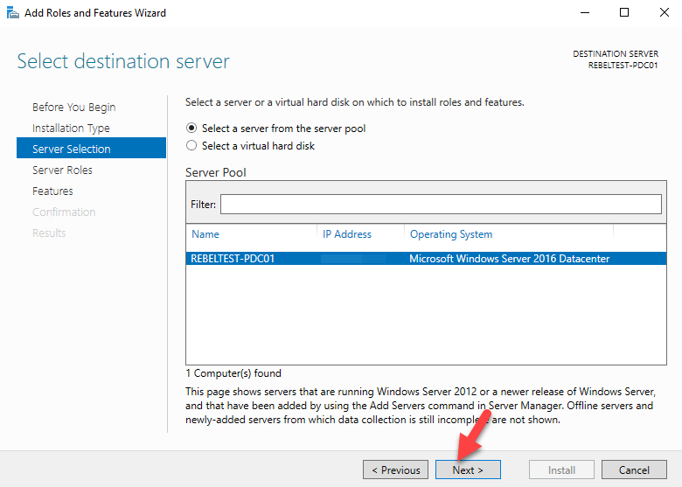
Step 3 (cont.)

Slide 12
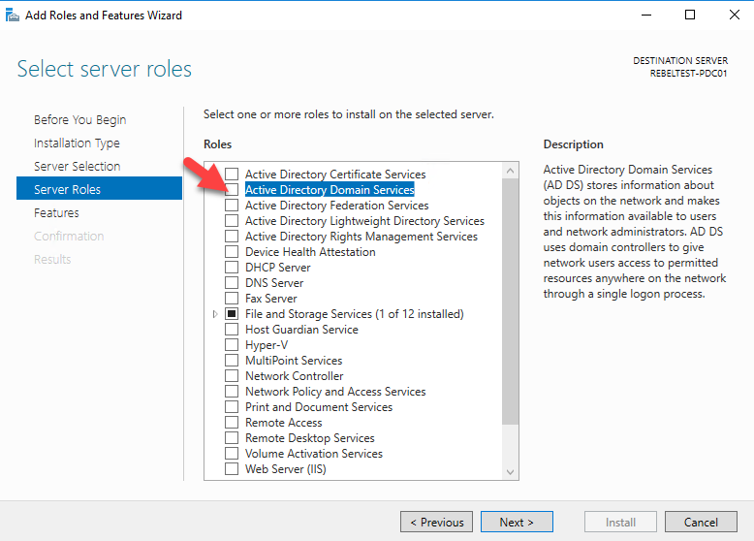
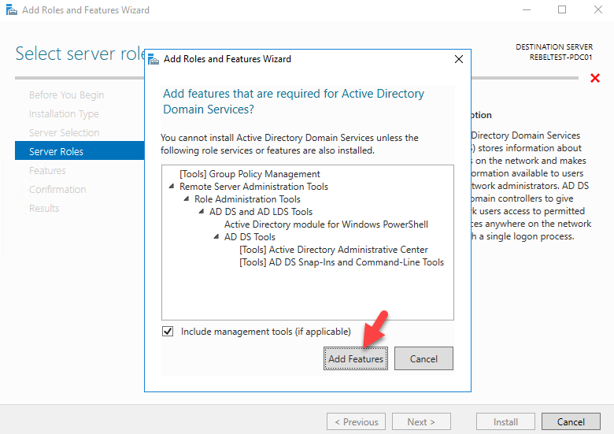
Step 4
Put a tick in the box next to Active Directory Domain Service.
Then add all of the features with it by clicking add features then click next.

Slide 13
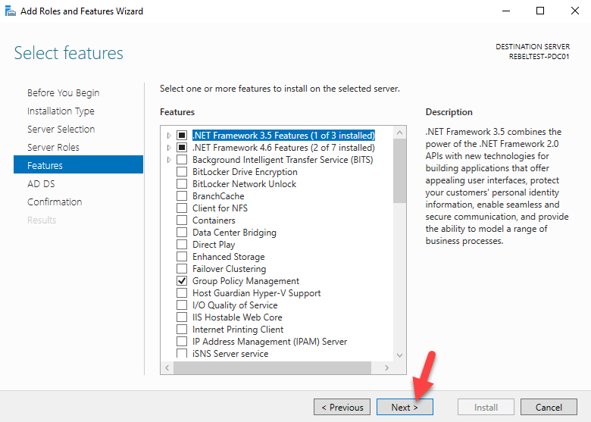
Step 5
Another Feature page will appear just keep the defaults. Click Next.

Slide 14
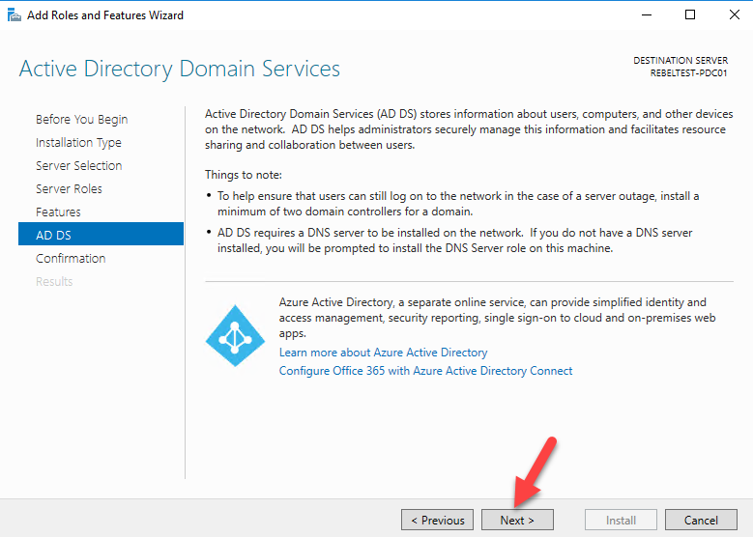
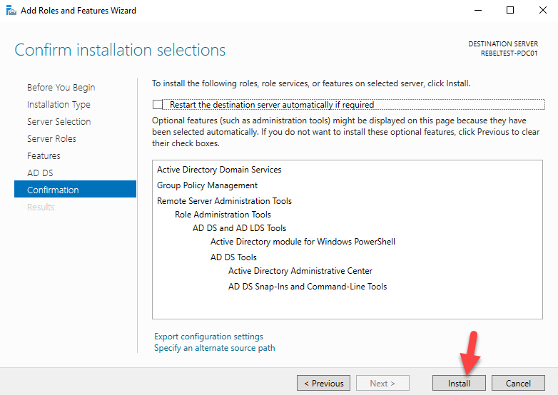
Step 6
You will see a page giving a brief description about AD. Click Next.
Then you will be prompted to install.

Slide 15
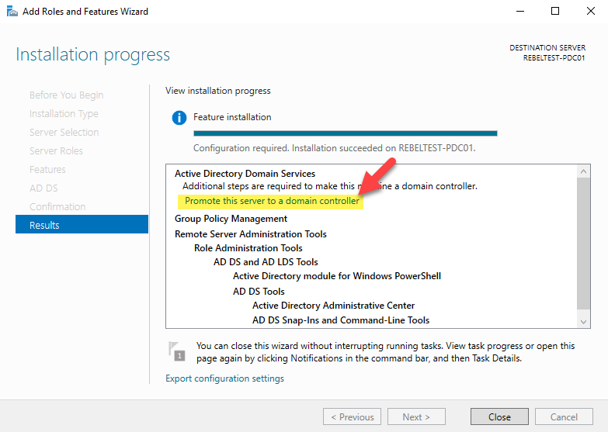
Step 7
Once done installing click on “Promote this server to a domain”.

Slide 16
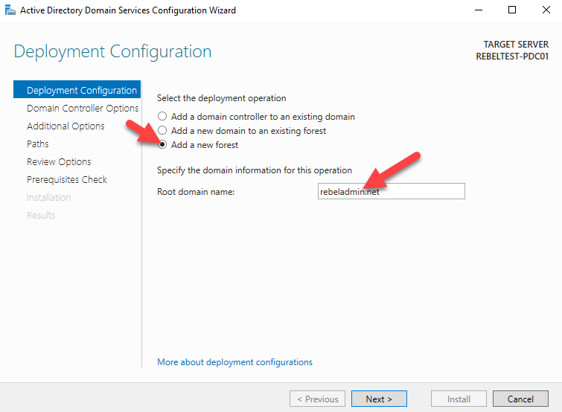
Step 8
Now in the AD Config Wizard, select create new forest and add the full domain name.

Slide 17
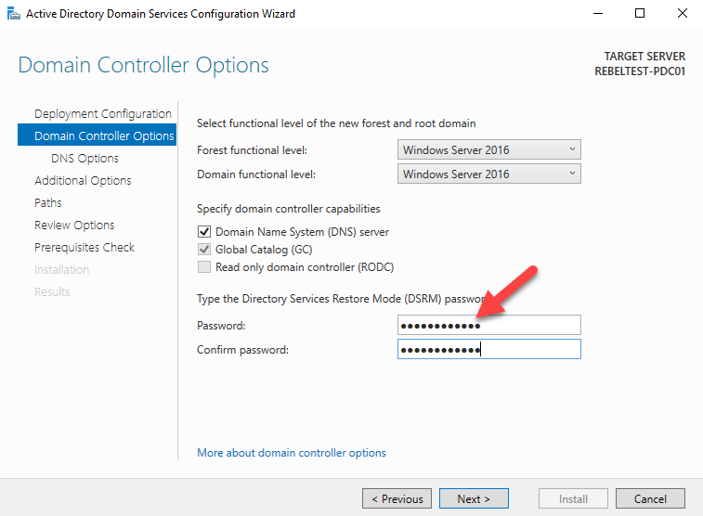
Step 9
Select the Domain and Forest functions.
Then create a password to use for restore mode.

Slide 18
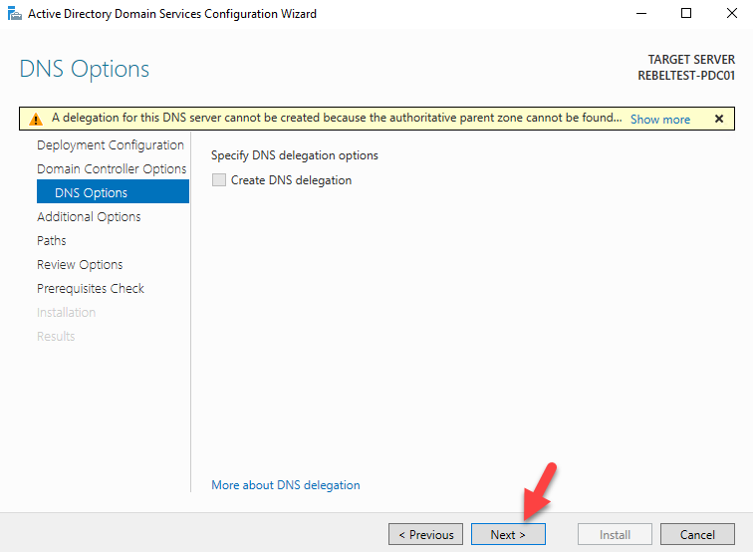
Step 10
When prompted about DNS option, just click Next.

Slide 19
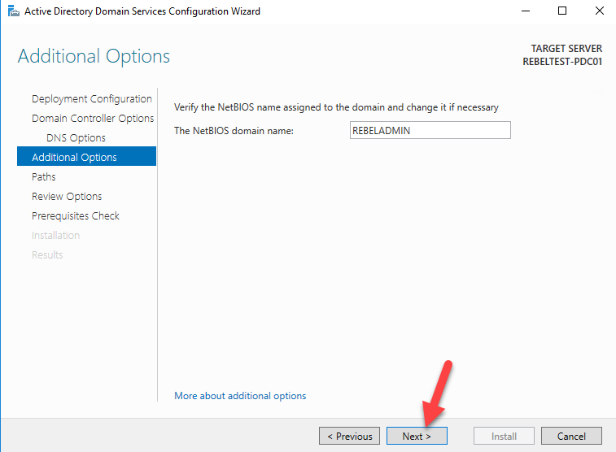
Step 11
For the BIOS name, just keep the default, click next.

Slide 20
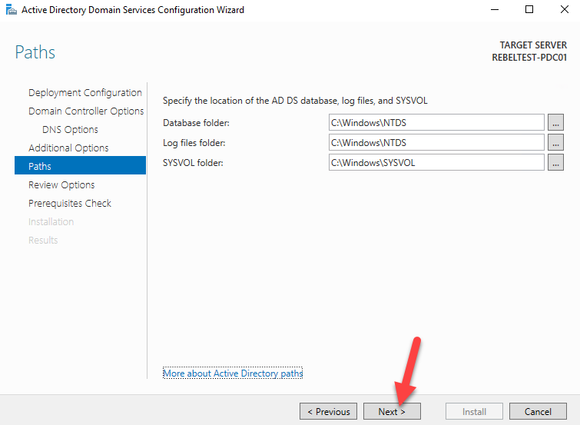
Step 12
To determine the folder names for the database, log file and SYSVOL, you can keep it either default or change it to fit your preference.

Slide 21
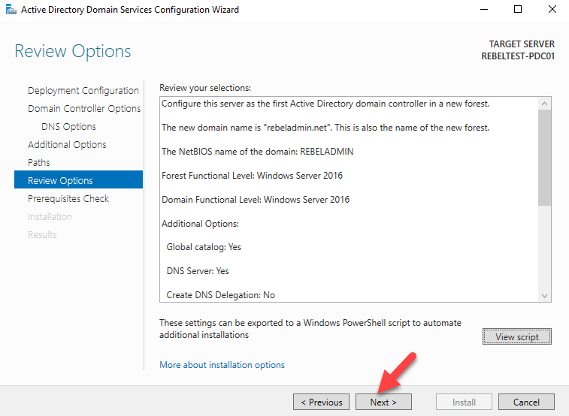
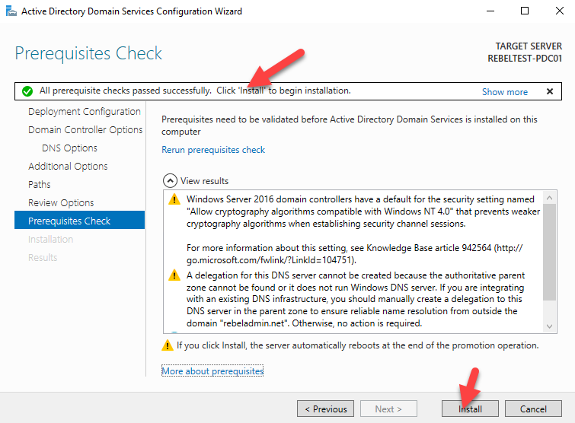
Step 13
You will be prompted to configure if the configurations are all set. Click Next.
It will then do a prerequisite check, if it passes, click install.

Slide 22
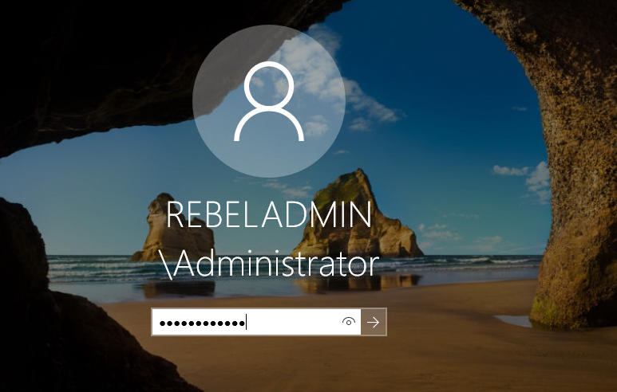
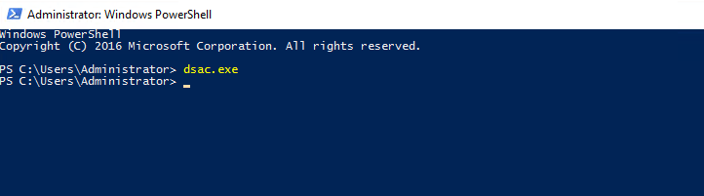
Step 14
It will automatically restart the server.
Log in as Admin.
Open up PowerShell as Admin and type dsac.exe to open up AD Admin Center to configure and mange resources

Slide 23
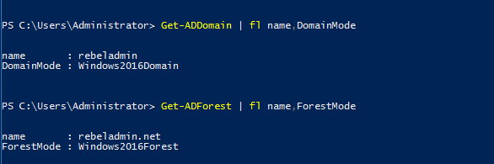
To Double Check Installation and Configuration
Open up PowerShell as admin in put the following text to confirm domain and forest levels.
Get-ADDomain | fl Name,DomainMode
Get-ADForest | fl Name,ForestMode

