Slide 1
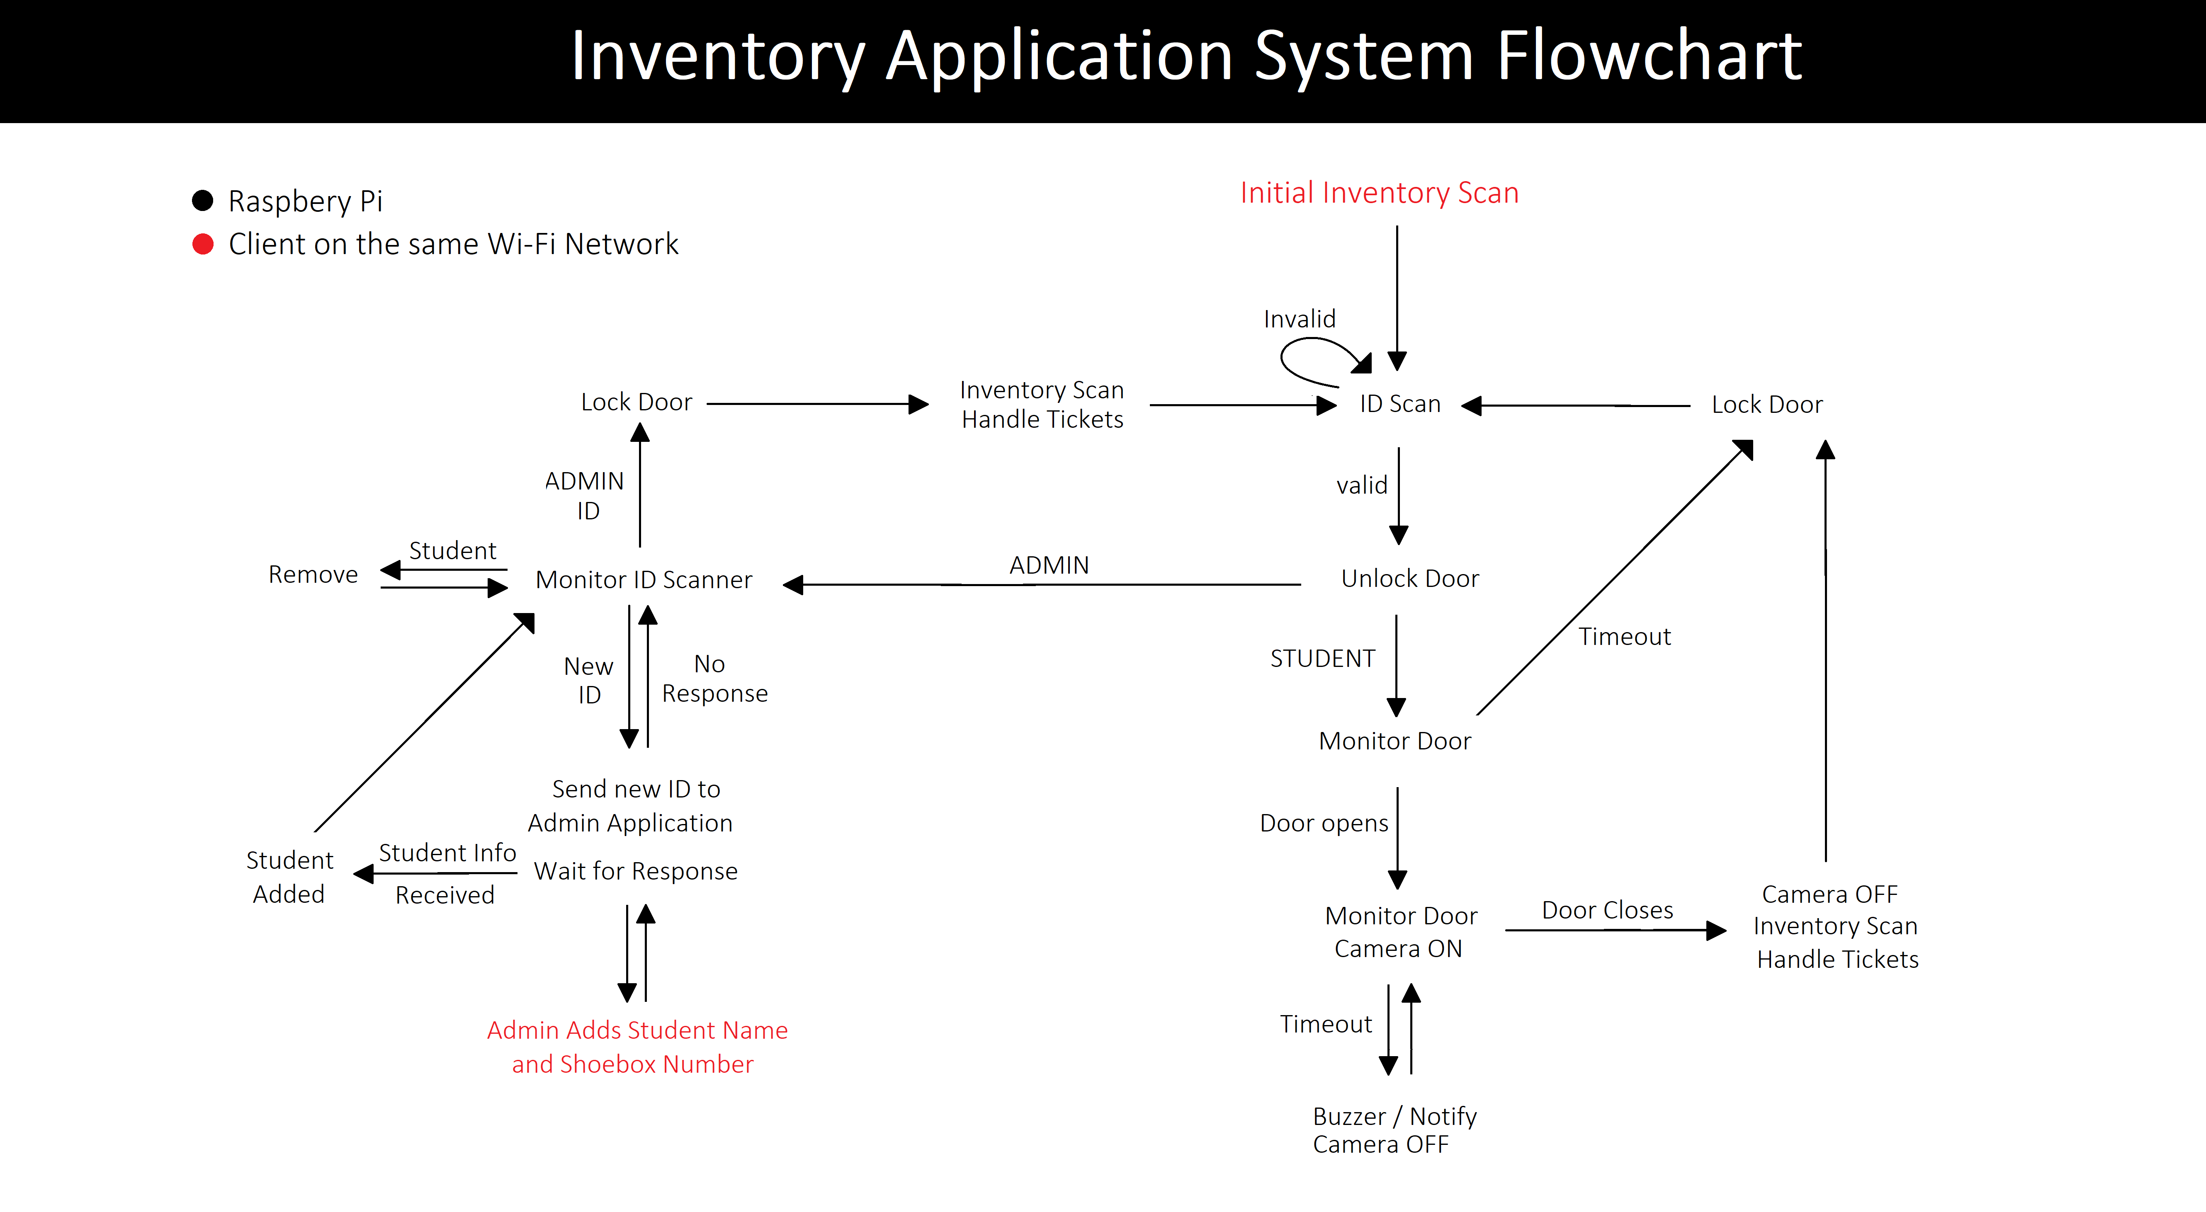

Slide 2
Scenarios
Normal Use
Student borrows shoebox Outside lab hours
Student Using Shoebox During lab hours
Students get Admitted into the system at the semester’s beginning
Students get Removed from the system on lab Final’s day
“Abnormal” Use
Student/Admin scans ID but never opens Cabinet door
Student opens door but never closes it
Student/Admin borrows and/or returns multiple shoeboxes

