Slide 1

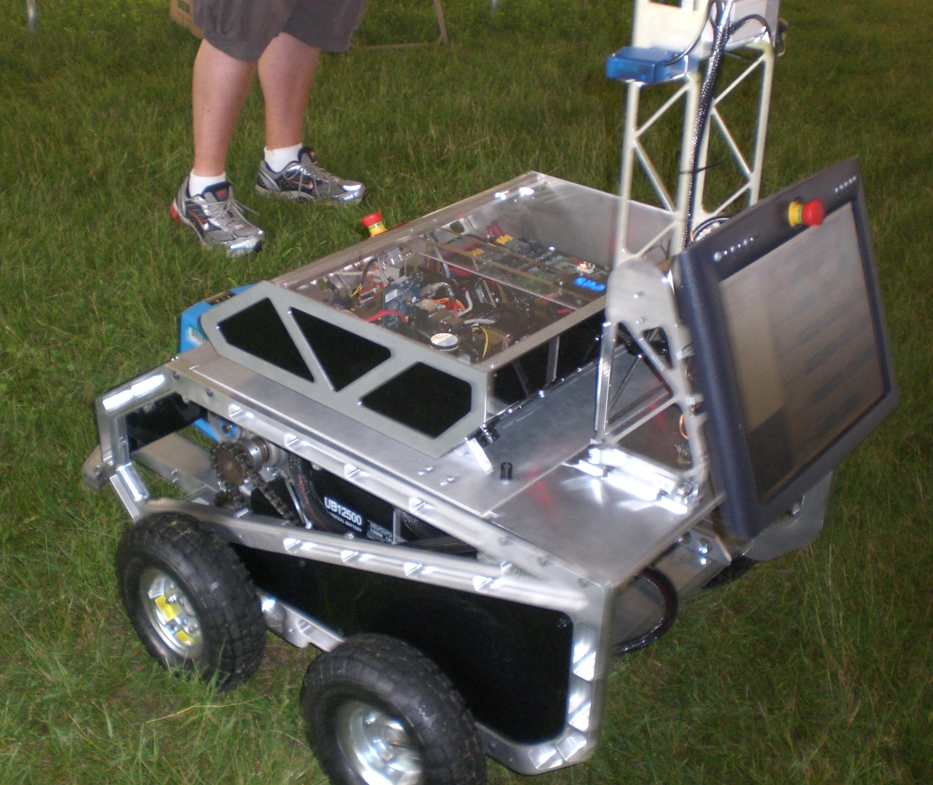
University Of Massachusetts Lowell
STARK

Slide 2

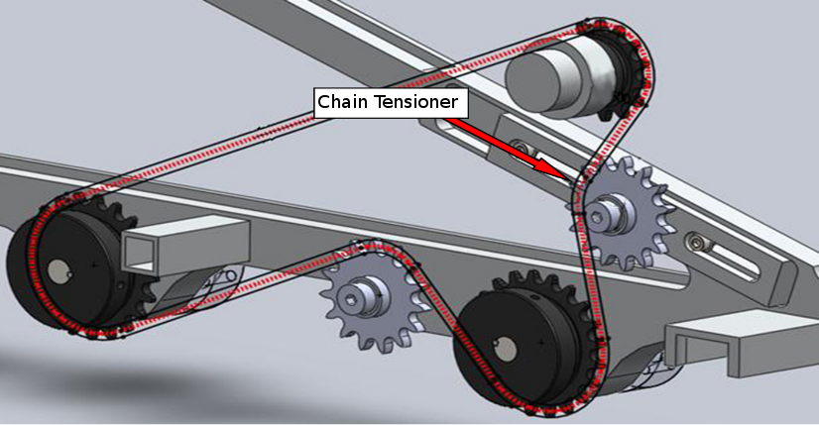
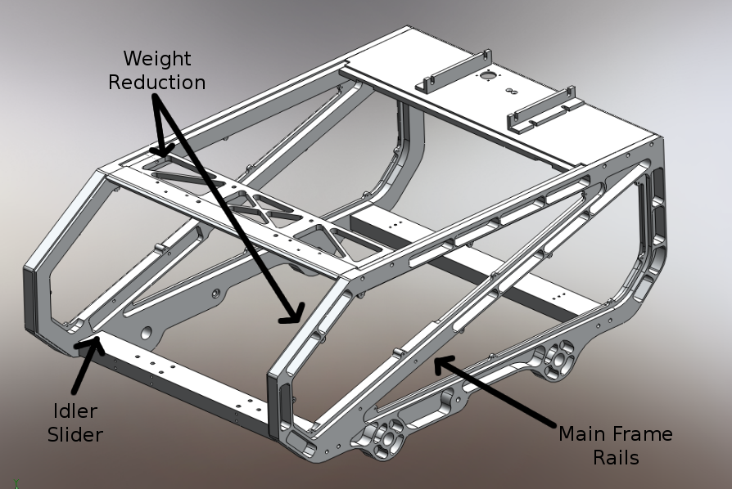
Chassis
4 wheel tank steering
All aluminum chassis
Detachable electronics case
Detachable sensor mast

Slide 3
Power System
Batteries
  2x 50Ah 12v SLA batteries in series
Motor Power
  Raw 24v
Logic Power
  12v powered by 24-12v high efficiency Vicor DC-DC inverter.
  M2ATX smart automotive PSU
Sensor Power
  SICK Lidar powered by 24-24v high efficiency Vicor DC-DC inverter.
  GPS/Camera/Compass powered by computer

Slide 4
Safety System
On board
  Front and rear mounted kill switches
  Easily reachable from all sides
Wireless
  900mhz Xbee based
  1/4 mile range
  Heartbeat
  Feedback on remote

Slide 5
Sensors
Obstacle Detection
  SICK LMS Lidar
  Sony Playstation-eye Camera
Localization
  USGlobalsat GPS
  MediaTek GPS
  Ocean Server 0S5000 Compass
  US Digital E5 encoders (512 c/r)

Slide 6
Robot Operating System
(ROS)
Package management
Distributed message passing system
Hardware abstraction
Transformations

Slide 7
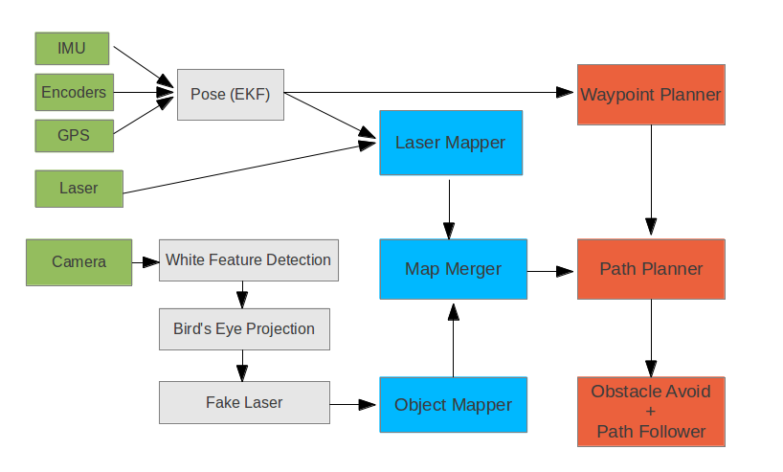
Software Architecture

Slide 8
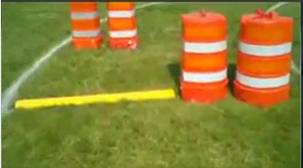
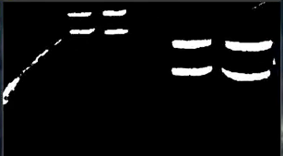
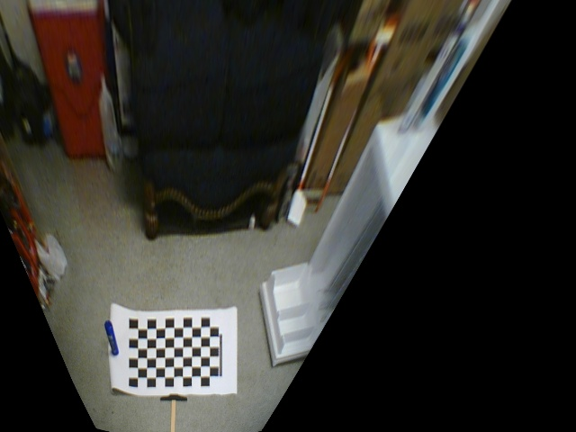
Vision
White Feature Detection
  White Lines
  Barrels
  Saw horses
Birds Eye Projection
Laser Scan
  Ray casting to white pixels
  Generate Laser Scan
  Merge with laser map

Slide 9
Navigation

Slide 10
Cost
Component | Cost
Aluminum Frame | $1500
Motors | $700
Motor Controller | $350
Batteries | $200
Battery Charger | $250
Power Distribution System | $300
E-Stop System | $250
Computer System | $350
Camera | $50
Compass | $300
GPS | $150
Lidar | $5000
TOTAL | $9400

Slide 11





Thank You

