Slide 1
Introduction to docker
Matthew Harper

Slide 2
Disclaimer
I am not an expert
Generalization of Terms and Systems
Simplifications!
I cannot spell
Presentation will not consist only of slides.

Slide 3
Outline
Planning Who Needs it?
Containerization - The Basics
What are containers and images
What is a container Runtime
How Do Containers Work
Dockerfiles
Create your own Images and containers
CLI commands - The Basics
Short demo!
LXC Containers
Notes:
I am not going to go over the installation of Docker, there will be a slide and I will point you to the website; however the hope is you are all capable of following the guides provided online for your chosen container runtime.
I will go over the basic terminology required to understand and work with containers, at least from my point of view. This includes what a container is by comparing it to alternatives, what a runtime is (Including a discussion of different runtimes), and a short overview of how containers actually work.
I will then go over the basics of a docker file, creating an image from **scratch** and more commonly using pre-made base image that is *often* hosted on Docker Hub or some other registry. You can also create your own base images!
Finally I will go over the basic CLI commands in order to build and run some containers… This should be easy… right?
If there is time I will *try* to cover an interesting technology I was introduced to known as LXC containers (Linux Containers!)

Slide 4
Installation
Windows/Mac
Look at the docker reference for docker engine
Spin up an ec2 instance and use the Linux guide
Be sure to set up the security groups correctly
Linux
Follow Install Guide
Use the Docker install script (Github Repo)
It is bad – and thus written by me
Docker group
sudo usermod -aG docker <user>
sudo -u $(logname) newgrp docker
Notes:
Again I will not cover this in detail.
Will explain the Sudo File Sudo visudo
%docker ALL=(ALL) /usr/bin/docker
Anyone in the DOCKER GROUP
Any Hostname
They can be ran as Any user
They can run **Only the Docker command**
Installation Guide
https://docs.docker.com/engine/install/

Slide 5
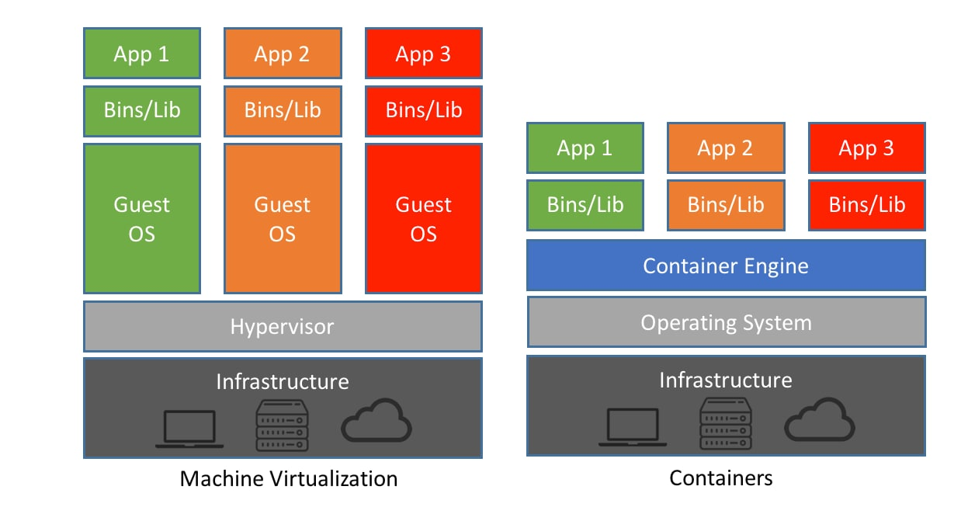
Containerization - The Basics
Container Architecture
Containers
Notes:
Hypervisor: There are two primary types of hypervisors
Type 0: More of a theoretical thing orif they are used they are not too common; they are a hardware based hypervisor
Type 1: As shown on the screen here the *Host* operating system is the Hypervisor, and it hosts the guest systems
Type 2: This is likely what you would run on your desktops or laptops, the hypervisor
Container Runtime:
https://blog.purestorage.com/purely-informational/containerd-vs-docker-whats-the-difference/

Slide 6
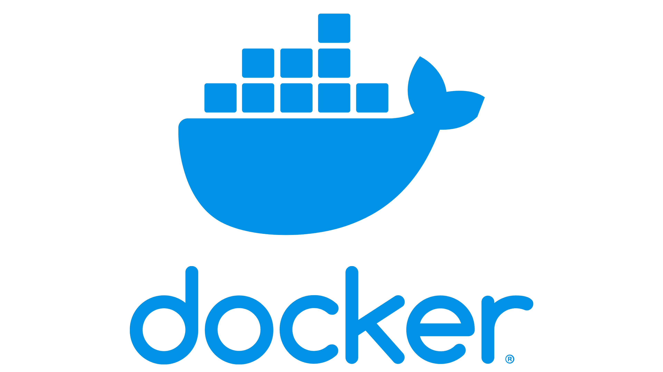

Containerization - The Basics
Container Engines
These are the programs that users often (prefer) to interface with
What do they do for us?
They interprate GUI, CLI, or API calls to the lower levels
They pull and manage Container Images
They interface with lower level programs
They mange the copy-on-write memory of a container
Notes:
The container engine

Slide 7

Containerization - The Basics
Container Runtime
This is the software responsible for the creation and management of Processes
What does this involve?
Management of Resources
Management of Images
Management of Permissions
What do they leverage
The host operating system and kernel often through runc
Notes:
These are the “base” layer of a containerization platform. That is if you ignore the host operating system and the kernel primitives it provides. We opaquely (That is we often do not directly use) these programs such as ContainerD in the case of Docker and podman or something like `CRI-O` a runtime that may be used with K8s, these runtimes manage the lifecycle of the container.
They set the Resource Limitations on the container, this is often done to prevent the process from using up more resources than it should.
They configure the execution environment of the container, this is the read-only filesystem and the writable scratch space of the container; this also includes the process and system isolation. The lowest level (That I will not talk about) in this chain is the runc process. This is what directly manages the container. Depending on the Container engine (If you chose to use it) there may be a series of steps between your command and the runc process that actually creates and interfaces with the running (or soon to be) container
For example we: Docker CLI -> Docker Socket -> Docker Daemon -> ContainerD -> RunC
Podman -> RunC
ContainerD
The tool that really runs your containers: deep dive into runc and OCI specifications (mkdev.me)
cri-o

Slide 8
Containerization - The Basics
System Constructs
Ports
Virtual interface used to manage connections
Well known 1, 20/21, 22, 23, 53, 80, 443
Can you name them
Dynamic and Static linking
Static – Libraries are compiled into the exe
Dynamic – Loading and linking handed by OS to shared libraries
Notes:
Ports are a construct we use in socket based networking. We assign a Port, and IP tuple to a process, we can run something like `ss –tulpns`. They are what allows s to differentiate between the processes running on a system. The Internet Assigned Numbers Authority (IANA) is the authority which assigns uses to ports, the first 1023 so ports are considered “well known” and are reserved, above this you can bind to any port that is unused, however you should be aware that processes may use specific ports within the free ranges (Look at K8s!) Ports and Protocols | Kubernetes
Answers to Ports:
ICMP
FTP (20 = command 21 = data)
SSH
TELLNET
DNS
HTTP
HTTPS
Next is Dynamic and Static Linking, I mention this because it comes into play during the creation of container images. If you have a program and you run `gcc –std=c11 …` Then you are using dynamic linking when you compiled the executable. That is the dlls in Windows (Aside Windows) or in the case of Linux the shared libraries will be located and linked against the executable at runtime, this allows us to save space by sharing common functions located in read-only segments of memory between multiple processes. As for static linking, this is the opposite, you take all the libraries we would use and link them into the final executable. The single executable will contain all it needs to function, it will make no calls to the shared libraries loaded elsewhere in memory. Show this: gcc -static main.c -o program # Static
gcc main.c -o program # Non-Static
We can compare the size with a basic
ls –l
We can see that one has a dynamic linker with the following
file program
What is a computer port? | Ports in networking | Cloudflare
Ports and Protocols | Kubernetes

Slide 9
Terminology
Linux System
Namespaces
This is used to provide isolation between processes
Cgroups
This is used to control the amount of resources assigned to a process
Capabilities
This is used to control the privileges assigned to a process
Notes:
Namespaces – Kernel objects/feature used to isolate different resources on the machine (partition them to give an appearance and effective isolation) this is the object/feature that allows for the creation of containers due to the isolation features they provide. A good definition that is provided (On Wikipedia) is “Namespaces are a feature of the Linux kernel that partitions kernel resources such that one set of processes sees one set of resources and another set of processes sees a different set of resources. The feature works by having the same namespace for a group of resources and processes, but those namespaces refer to distinct resources.”
PID – Process Namespaces
IPC – Inter Process Communication Namespaces
Network – Networks!
MNT – Mounted filesystems
There are others
The 7 most used Linux namespaces | Enable Sysadmin (redhat.com)
We can run `sudo unshare –fp --mount-proc /bin/bash` and observe the results
Cgroups are used to limit the resources available to a process, in this case all those used in the container from the RAM a container or process can utilize, CPU utilization, IO/Block reads and writes… It gets quite granular. We have a Cgroup namespace as well which is mainly used to provide additional security, as we would otherwise be able to see all Cgroups allocated on the system (Including our own) from within a container, giving attackers potentially useful information, and it is apparently possible for attackers in certain scenarios to gain access to the parent cgroup class.
Capabilities are used to precisely control the
Capabilities define what the container can an cannot do (It uses the host kernel and in docker will run as the root user unless rootless mode is enabled)

Slide 10
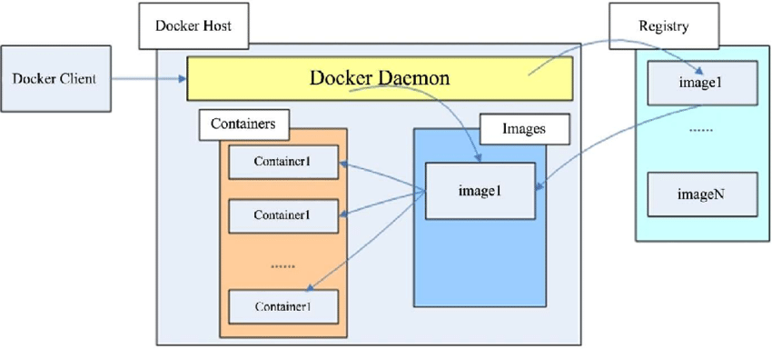
Terminology
Container Constructs
Images
Static and (relatively) unchanging
Built based off of a Dockerfile (or some equivalent)
Containers
Running instances of images
Changes are not (necessarily) persistent
Volumes
Named or Bind Mounts to a location host filesystem
Networks
Defined by docker – separate from the host but routed through the host
Notes:
Images, these are static read-only templates, these provide the base image or configuration for a container. An interesting note is that if you have 40 containers, they will all refer to the same base image, with a relatively small scratch space where the modification actually occur. An image is like a statically linked binary, it contains everything the process it will be running needs in order to function. This does not mean a container for running something like nginx will contain a database too in the event a webserver we end up running on the container would need one, just that the container has all the libraries, and programs needed to run Nginx. * Tend to be based off of the Open Container Initiative Standard (Based on docker)
* There are online registries with pre-built images.
Containers, these are the running instance of the images, they have a writable scratch space. Changes made in them are not necessarily persistent, and will not be reflected across other running instances of the container, as they have distinct scratch spaces. These are meant to be temporary, being created and destroyed as needed (Often referred to as ephemeral)
Volumes are used to provide persistence to a container, as we mount or attach a portion of the host’s filesystem to the container, this means the modifications we make to files within a volume mounted to the container will be persisted between instances of the container.
Docker containers have their own networks, (namespaces) you can create internal networks and those bridged through the host’s interface. If you want to see something interesting we can look at the iptables rules `iptables -Lnv https://opencontainers.org/about/overview/

Slide 11
Terminology
Other
Docker Socket
Management interface
Rootless docker
Docker running processes with a uid > 0
Daemon
Generally, some background management process
Notes:
This is the socket the docker daemon listens on and is what the docker command (And other interfaces) will communicate with
Should this be exposed to the public?
Why or why not?
Docker containers by default run as a root process, is this a bad thing? Is it a good thing? Rootless docker allows you to configure it such that the containers will run with a non-root uid.
Daemons will run in the background often on system startup to

Slide 12
Docker Files
Basics – More online!
Named Dockerfile
Contain the basic instructions used to construct an image
Built layer by layer
Notes:
Docker files are more like the assembly of container images. They provide the commands to build a container layer by layer, for simplicity each line in the Docker file can be considered its own layer.
You can build a container from scratch (Not recommended) and more commonly from a base image.
Dockerfile reference | Docker Docs

Slide 13
Docker CLI
DEMO
☺ ☺
Notes:
This will be an attempt at doing a demo for the Docker CLI

Slide 14
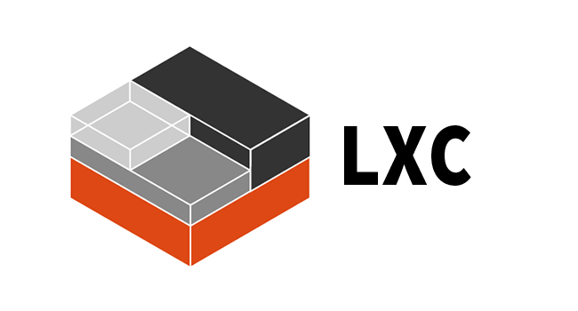
Docker Alternatives
LXC
Look at the documentation for how to install it
This will create a container or VM just as Docker does but with some differences
Images are different
You can use systemctl
There is additional isolation

Slide 15
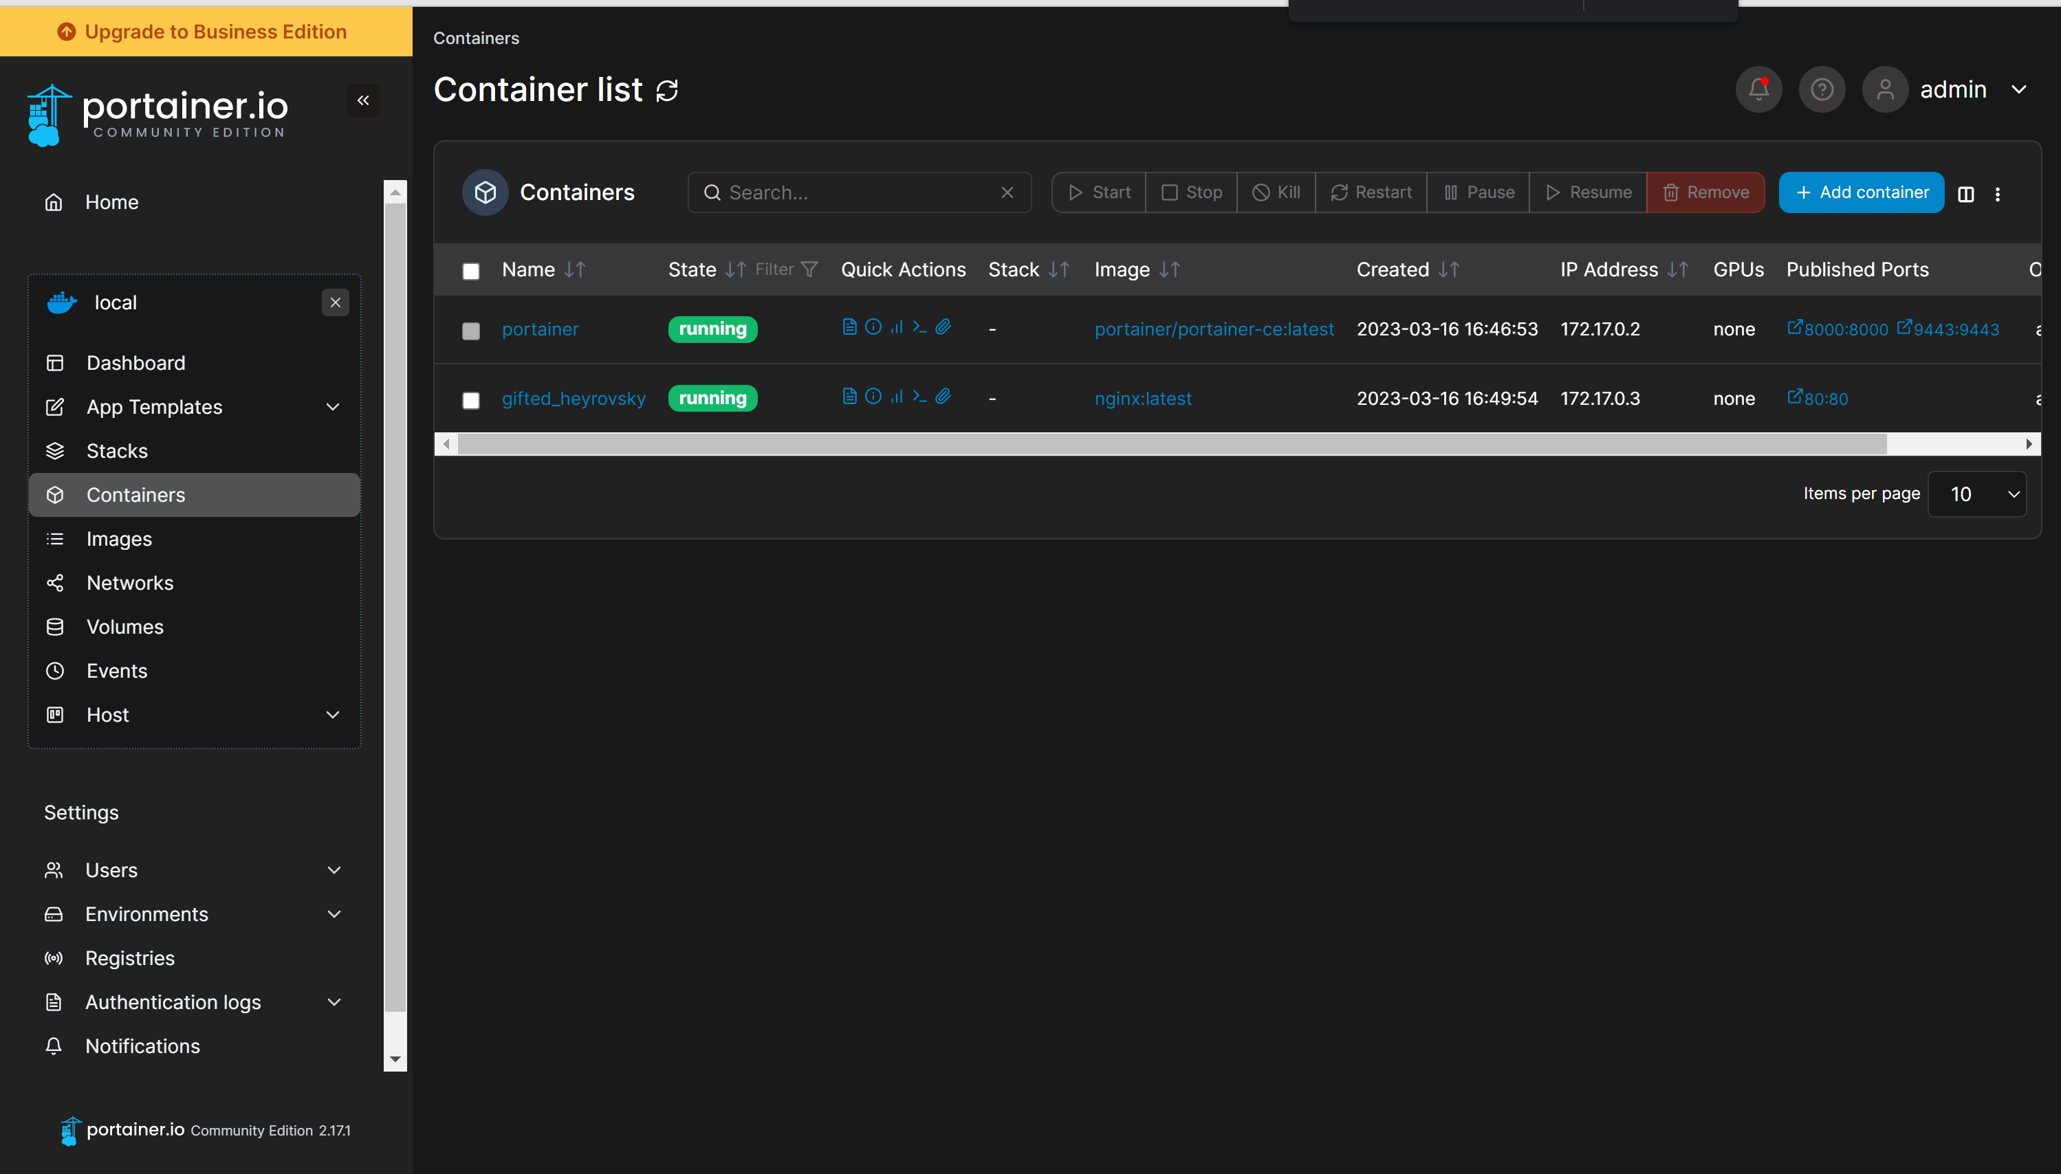
Portainer
This is a GUI management tool for containers and orchestrated systems
There are enterprise and community versions
This is a Web application that allows us to more easily manage containers
Notes:
https://docs.portainer.io/start/install-ce/server/docker/linux

