Slide 1
Introduction to docker
Matthew Harper

Slide 2
Disclaimer
I am not an expert
Generalization of Terms and Systems
Simplifications!
I cannot spell
Presentation will not consist only of slides.

Slide 3
Outline
Planning Who Needs it?
Containerization - The Basics
What are containers and images
What is a container Runtime
How Do Containers Work
Dockerfiles
Create your own Images and containers
CLI commands - The Basics
Short demo!
LXC Containers
Notes:
I am not going to go over the installation of Docker, there will be a slide and I will point you to the website; however the hope is you are all capable of following the guides provided online for your chosen container runtime.
I will go over the basic terminology required to understand and work with containers, at least from my point of view. This includes what a container is by comparing it to alternatives, what a runtime is (Including a discussion of different runtimes), and a short overview of how containers actually work.
I will then go over the basics of a docker file, creating an image from **scratch** and more commonly using pre-made base image that is *often* hosted on Docker Hub or some other registry. You can also create your own base images!
Finally I will go over the basic CLI commands in order to build and run some containers… This should be easy… right?
If there is time I will *try* to cover an interesting technology I was introduced to known as LXC containers (Linux Containers!)

Slide 4
Installation
Windows/Mac
Look at the docker reference for docker engine
Spin up an ec2 instance and use the Linux guide
Be sure to set up the security groups correctly
Linux
Follow Install Guide
Use the Docker install script (Github Repo)
It is bad – and thus written by me
Docker group
sudo usermod -aG docker <user>
sudo -u $(logname) newgrp docker
Notes:
Again I will not cover this in detail.
Will explain the Sudo File Sudo visudo
%docker ALL=(ALL) /usr/bin/docker
Anyone in the DOCKER GROUP
Any Hostname
They can be ran as Any user
They can run **Only the Docker command**
Installation Guide
https://docs.docker.com/engine/install/

Slide 5
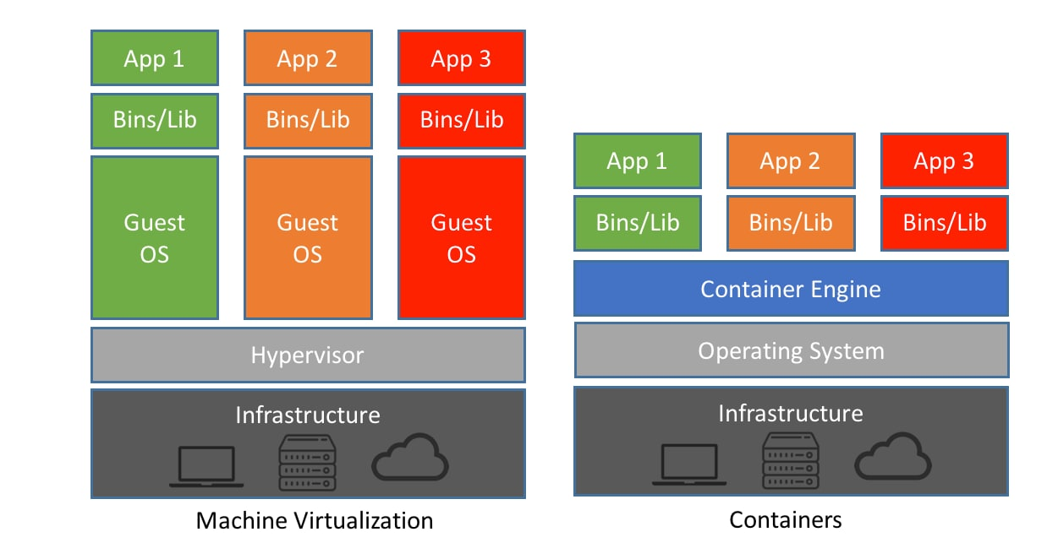
Containerization - The Basics
Container Architecture
Containers
Notes:
Hypervisor: There are two primary types of hypervisors
Type 0: More of a theoretical thing orif they are used they are not too common; they are a hardware based hypervisor
Type 1: As shown on the screen here the *Host* operating system is the Hypervisor, and it hosts the guest systems
Type 2: This is likely what you would run on your desktops or laptops, the hypervisor
Container Runtime:
https://blog.purestorage.com/purely-informational/containerd-vs-docker-whats-the-difference/

Slide 6
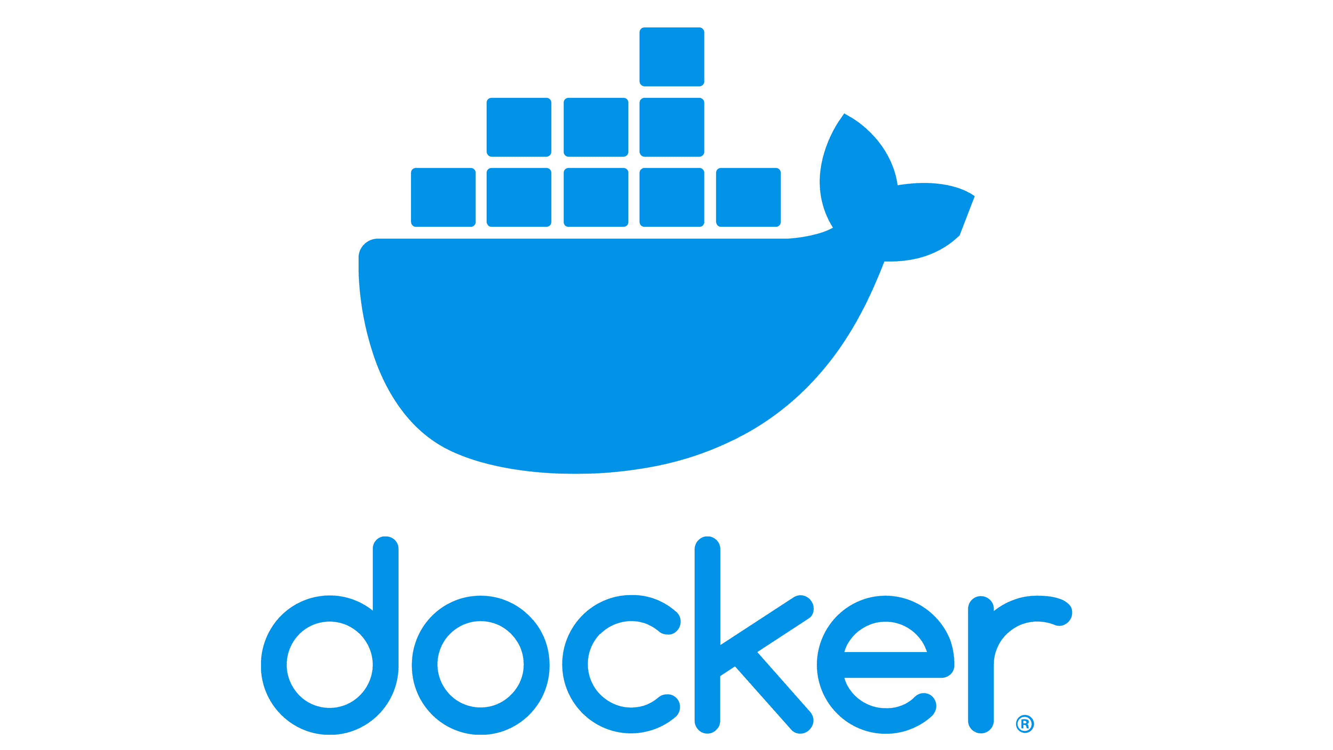

Containerization - The Basics
Container Engines
These are the programs that users often (prefer) to interface with
What do they do for us?
They interprate GUI, CLI, or API calls to the lower levels
They pull and manage Container Images
They interface with lower level programs
They mange the copy-on-write memory of a container
Notes:
The container engine

Slide 7

Containerization - The Basics
Container Runtime
This is the software responsible for the creation and management of Processes
What does this involve?
Management of Resources
Management of Images
Management of Permissions
What do they leverage
The host operating system and kernel often through runc
Notes:
These are the “base” layer of a containerization platform. That is if you ignore the host operating system and the kernel primitives it provides. We opaquely (That is we often do not directly use) these programs such as ContainerD in the case of Docker and podman or something like `CRI-O` a runtime that may be used with K8s, these runtimes manage the lifecycle of the container.
They set the Resource Limitations on the container, this is often done to prevent the process from using up more resources than it should.
They configure the execution environment of the container, this is the read-only filesystem and the writable scratch space of the container; this also includes the process and system isolation. The lowest level (That I will not talk about) in this chain is the runc process. This is what directl manages the container. Depending on the Container engine (If you chose to use it) there may be a series of steps between your command and the runc process that actually creates and interfaces with the running (or soon to be) conrainer
For example we: Docker CLI -> Docker Socket -> Docker Daemon -> ContainerD -> RunC
Podman -> RunC
ContainerD
The tool that really runs your containers: deep dive into runc and OCI specifications (mkdev.me)
cri-o

Slide 8
Terminology
Container Structures
Images
Static and (relatively) unchanging
Built based off of a Dockerfile (or some equivalent)
Containers
Running instances of images
Changes are not (necessarily) persistent
Volumes
Named or Bind Mounts to a location host filesystem
Networks
Defined by docker – separate from the host but routed through the host
Notes:
https://opencontainers.org/about/overview/

Slide 9
Terminology
Linux System
Ports
Virtual interface used to manage connections
Well known 1, 20/21, 22, 23, 53, 80, 443
Can you name them
Dynamic and Static linking
Static – Libraries are compiled into the exe
Dynamic – Loading and linking handed by OS to shaired libraries
Namespaces
Cgroups
Capabilites
Notes:
ICMP
FTP (20 = command 21 = data)
SSH
TELLNET
DNS
HTTP
HTTPS
Privlaged are up to 1023
(Ports can be UDP or TCP)
Namespaces – Keneral objects/feature used to isolate different systems on the machine (partition them to give the appearance and effective isolation)
This is the object/feature that allows for the creation of contienrs
Cgroups are used to limit the resources avable to a process, in this case all those used in the container
Capabilities define what the container can an cannot do (It uses the host kernel and in docker will run as the root user unless rootless mode is enabled)

Slide 10
Terminology
Other
Docker Socket
Management interface
Rootless docker
Docker running processes with a uid > 0
Daemon
Generally some background management process
Notes:
This is the socket the docker daemon listens on and is what the docker command will communicate with
Should it be exposed to the public?
Why?
Daemons will run in the backround often on system startup to

Slide 11
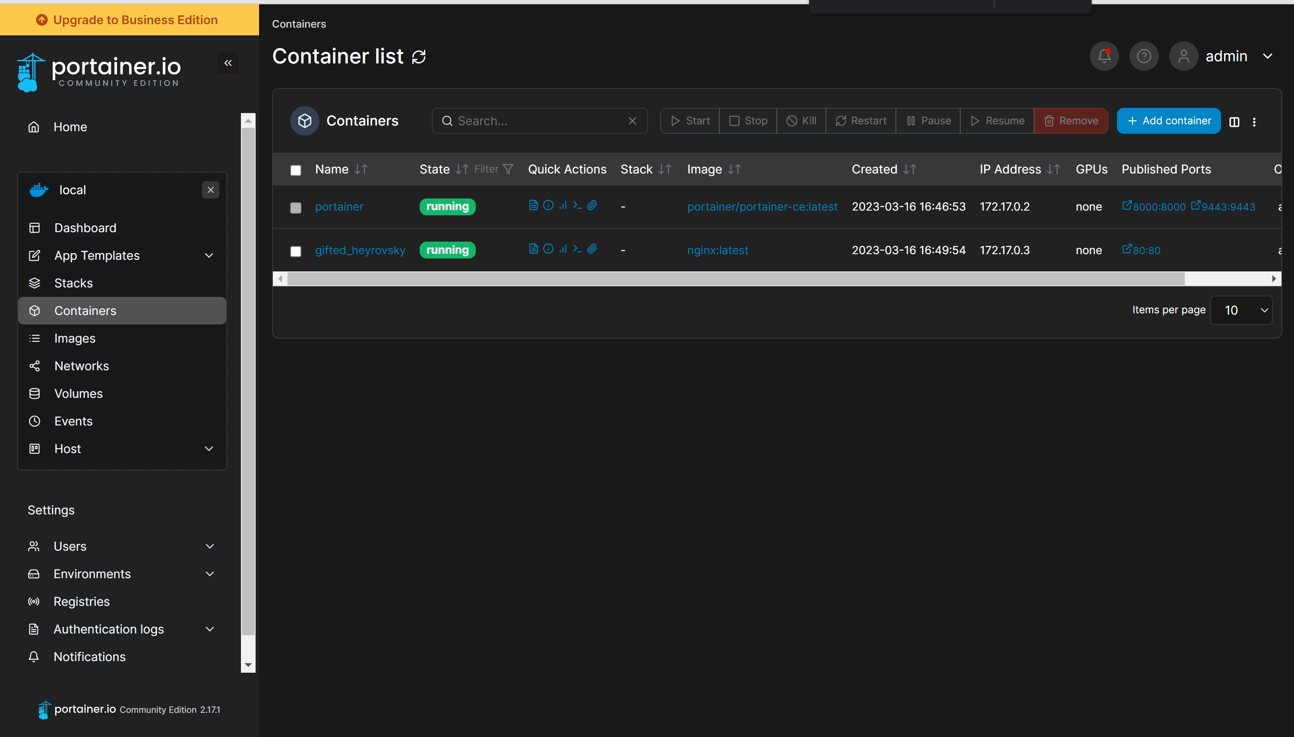
Portainer
This is a GUI management tool for containers and orchestrated systems
There are enterprise and community versions
This is a Web application that allows us to more easily manage containers
Notes:
https://docs.portainer.io/start/install-ce/server/docker/linux

