Slide 1
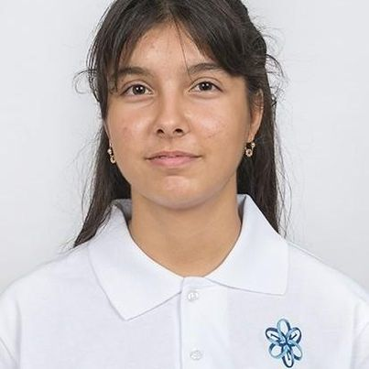
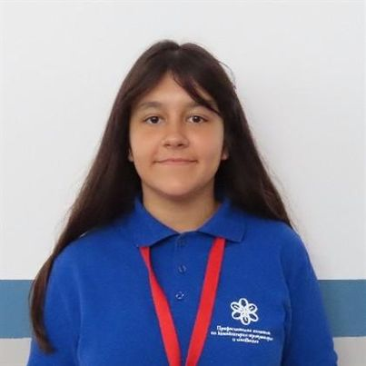
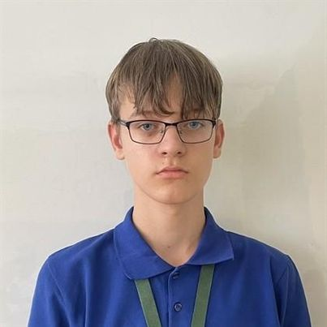
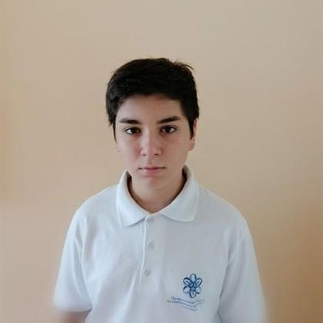
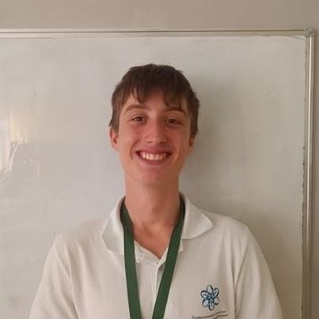






CodiMath
Ulvie Mustafa 8g
Scrum Trainer
CSS Deceloper
Sheniz Ali 8b
Backend
Developer
Christian Andreev 8g
HTML Developer
Christian Andreev 8g
HTML Developer
Martin Dimarov 8v
Designer
Bojdar Dukov 10v
Mentor
Coding and Maths basics

Slide 2
WHAT’S OUR IDEA?
WHY THIS IDEA?
CodiMath
People are going to have basic knowlage in Maths and Programming without even having to pay.
Coding and Maths basics
Ulvie Mustafa 8g
Scrum Trainer
CSS Deceloper
Sheniz Ali 8b
Backend
Developer
Christian Andreev 8g
HTML Developer
Martin Dimarov 8v
Designer
Bojdar Dukov 10v
Mentor
People will practice what they learned by using our tests. And then check how much they’ve learned.

Slide 3
Bojdar Dukov 10v
Mentor
Martin Dimarov 8v
Designer
Christian Andreev 8g
HTML Developer
Sheniz Ali 8b
Backend
Developer
Ulvie Mustafa 8g
Scrum Trainer
CSS Deceloper
WHAT’S OUR IDEA?
STAGES OF REALIZATION
People are going to have basic knowlage in Maths and Programming without even having to pay.
People will practice what they learned by using our tests. And then check how much they’ve learned.
3rd week
- Maths 6th, 7th, 8th grade
- C++
- Tests
- Presentation
2nd week
- Menue page
- Register page
- About us page
1st week
- Found a team
- Came up with an idea
- Chose a name
- Assigned roles
Ulvie Mustafa 8g
Scrum Trainer
CSS Deceloper

Slide 4






WHAT’S OUR IDEA?
TECHNOLOGIES WE USED
STAGES OF REALIZATION
People are going to have basic knowlage in Maths and Programming without even having to pay.
1st week
2nd week
3rd week
- Found a team
- Came up with an idea
- Chose a name
- Assigned roles
- Maths 6th, 7th, 8th grade
- C++
- Tests
- Presentation
- Menue page
- Register page
- About us page
People will practice what they learned by using our tests. And then check how much they’ve learned.

Slide 5
3rd week
- Maths 6th, 7th, 8th grade
- C++
- Tests
- Presentation
2nd week
- Menue page
- Register page
- About us page
NOW LET’S SEE OUR SITE
1st week
- Found a team
- Came up with an idea
- Chose a name
- Assigned roles
TECHNOLOGIES WE USED
STAGES OF REALIZATION

Slide 6
TECHNOLOGIES WE USED
NOW LET’S SEE OUR SITE
file:///C:/Users/PC/OneDrive/Документи/CodiMath/Project/menue/index.html

