Slide 1
Predicting CI/CD Pipeline Failures Using Build and Test Logs

Slide 2
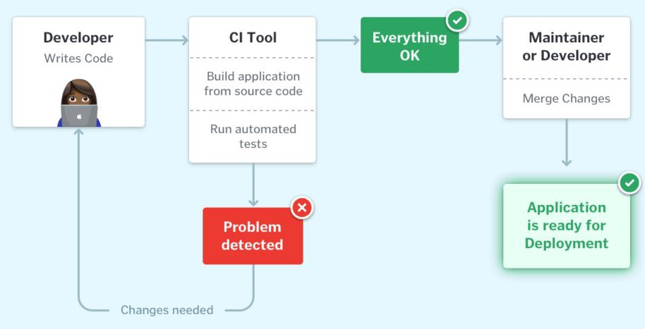
Understanding CI/CD Failures in DevOps Pipelines
Problem: Automated CI/CD pipelines occasionally fail due to unstable builds, code issues, or misconfigurations.
Goal: Identify and prepare a dataset that reveals patterns leading to pipeline failures.
Relevance: Represents the Data Pipeline stage in MLOps — where data is collected, cleaned, and prepared for predictive modelling.
Dataset Source: AI-Driven CI/CD Logs (Kaggle, 800 records, 11 columns).

Slide 3
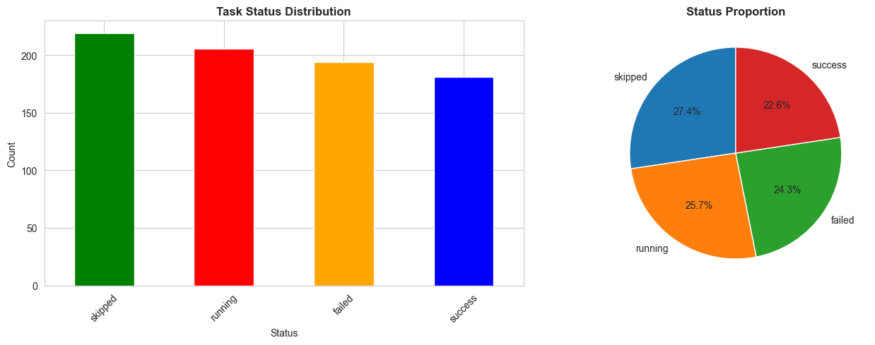
Dataset Overview and Initial Observations
Dataset includes: timestamp, pipeline_id, stage_name, job_name, task_name, status, user, environment.
Data quality issues:
  Missing values → user (49.6 %), environment (77.4 %).
  Duplicates: None detected.
  Status Distribution: 24.3 % failures, majority “skipped” or “running.”
Significance:
Represents realistic DevOps automation data suitable for analyzing how workflow conditions affect reliability.

Slide 4
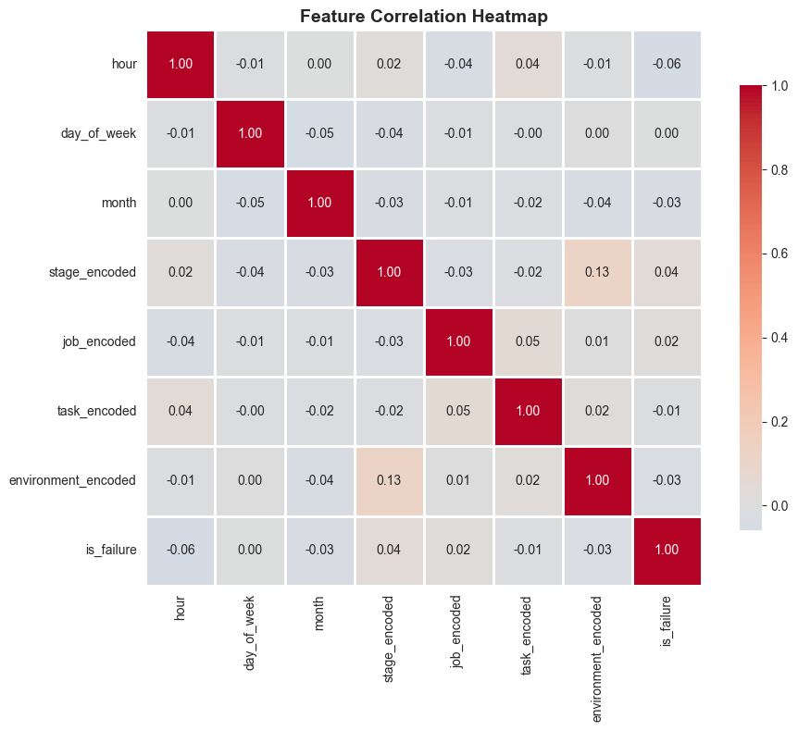
Data Cleaning and Feature Engineering Process
Preprocessing Steps:
  Filled missing user with “automated” and environment with “not_specified.”
  Removed duplicates (none found).
  Converted timestamp into datetime to extract temporal features.
Feature Engineering:
  Derived new temporal variables → hour, day_of_week, month
  Created target variable → is_failure (1 = failed)
  Encoded categorical features (stage_name, job_name, task_name, etc.)
  Standardized numeric features for consistency
Purpose:
  To transform unstructured pipeline logs into analytical data ready for model development.

Slide 5
Outcomes and Key Insights
Findings:
Failures distributed almost evenly across Build, Test, Deploy, and Analysis stages (~25% each).
Most error-prone jobs: run_unit_tests, run_integration_tests, deploy_to_dev.
Failures mostly under “not_specified” environments → possible logging or config issues.
Peak failure window: 00:00–08:00, suggesting automation-related instability.
Final Dataset Summary:
After cleaning and feature engineering, the dataset now contains 19 features across 800 records, fully ready for machine-learning modeling.
Failure rate = 24.25%.

Slide 6
Thank You

