Slide 1
A few words on spatial data

Slide 2
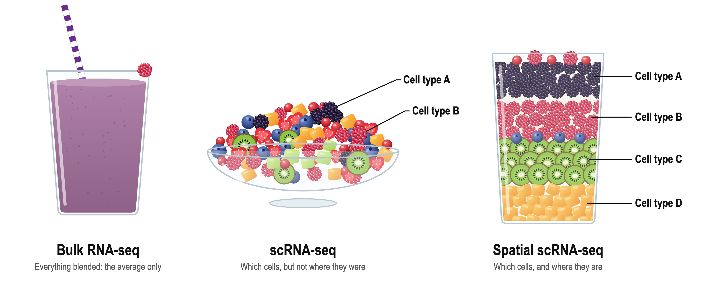
Idiosyncrasies of s.c. data
 | Sample | Sample | Sample | ….
Gene1 | Read counts | … | … | …
Gene1 | …
Gene1 | …
 | Sample_cell | Sample_cell | Sample_cell | ….
Gene1 | Read counts | … | … | …
Gene1 | …
Gene1 | …
 | X | Y
Sample_cell | Read counts | …
Sample_cell | …
Sample_cell | …

Slide 3
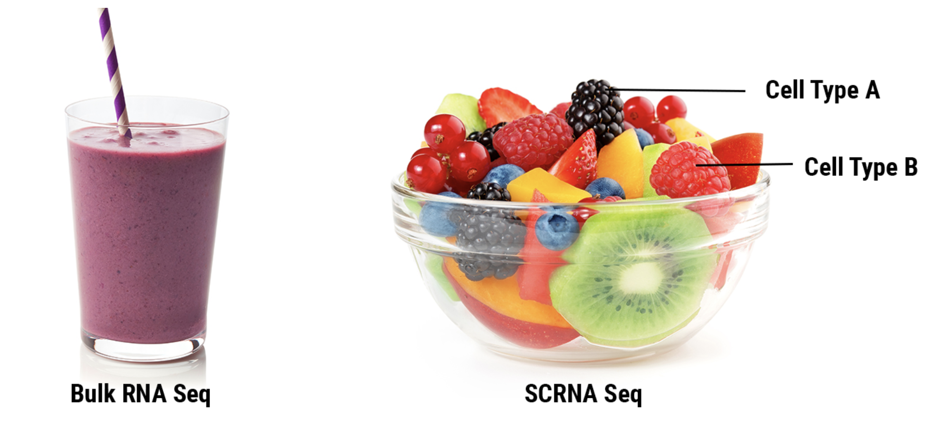
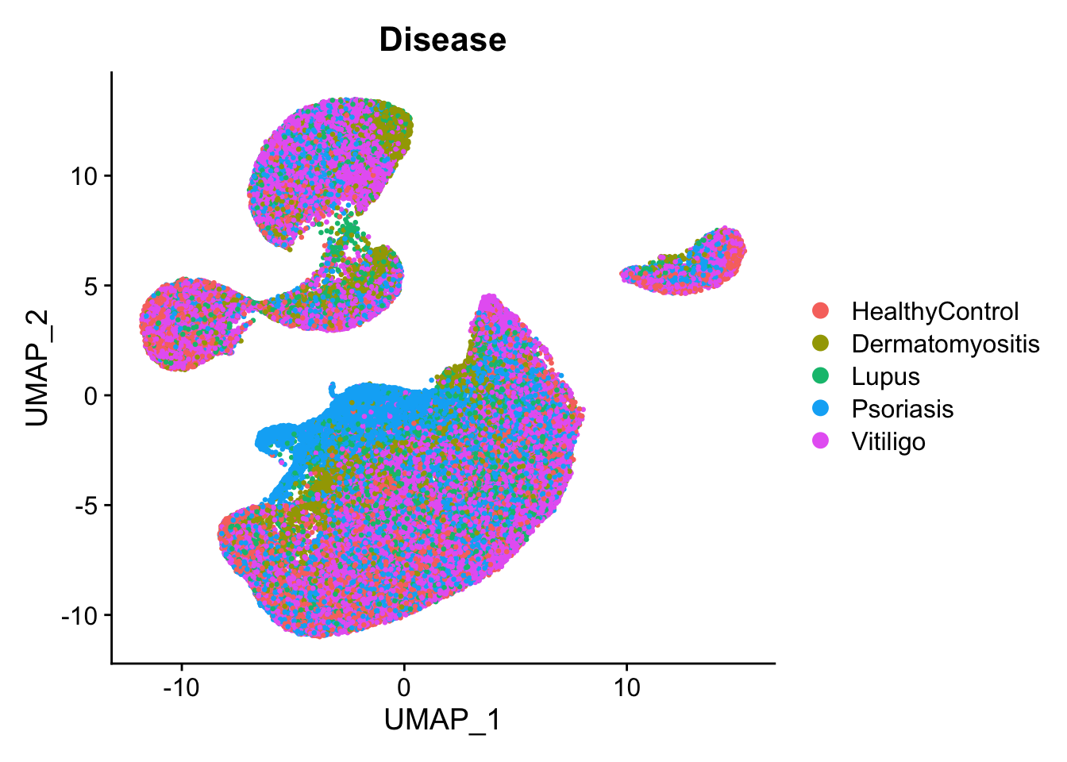
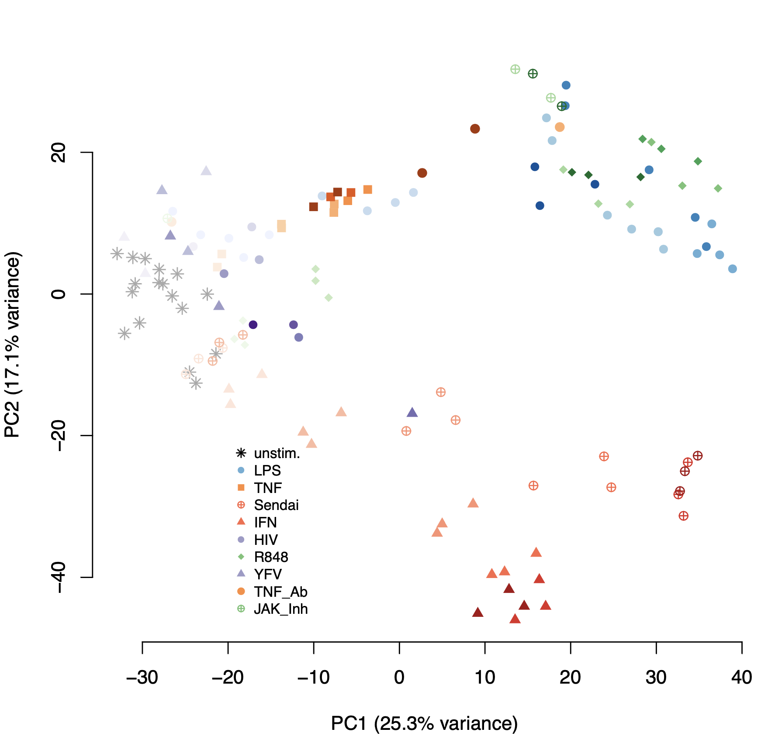
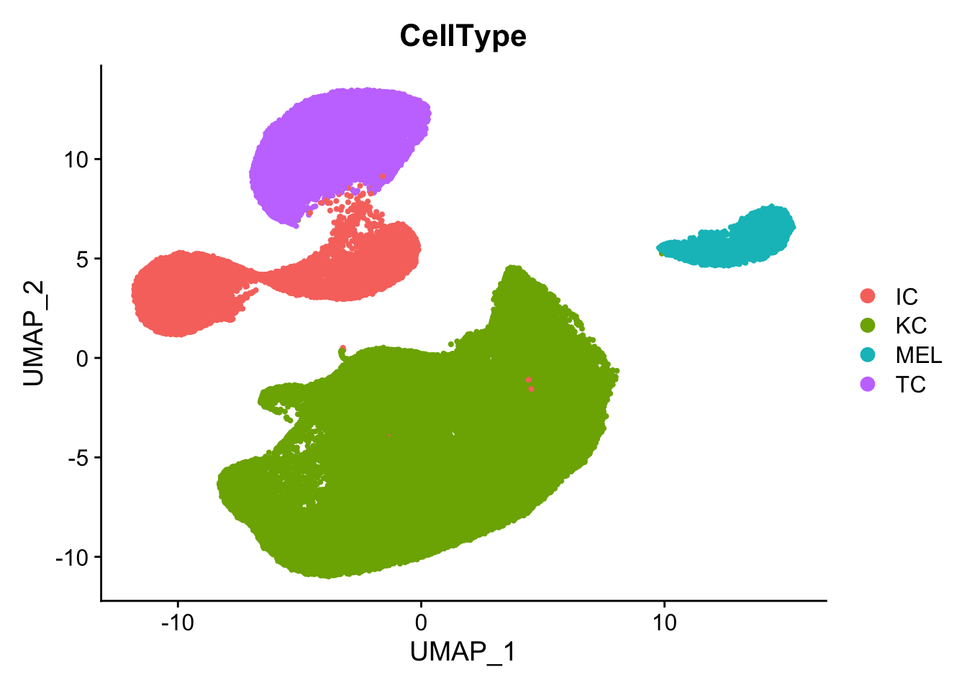
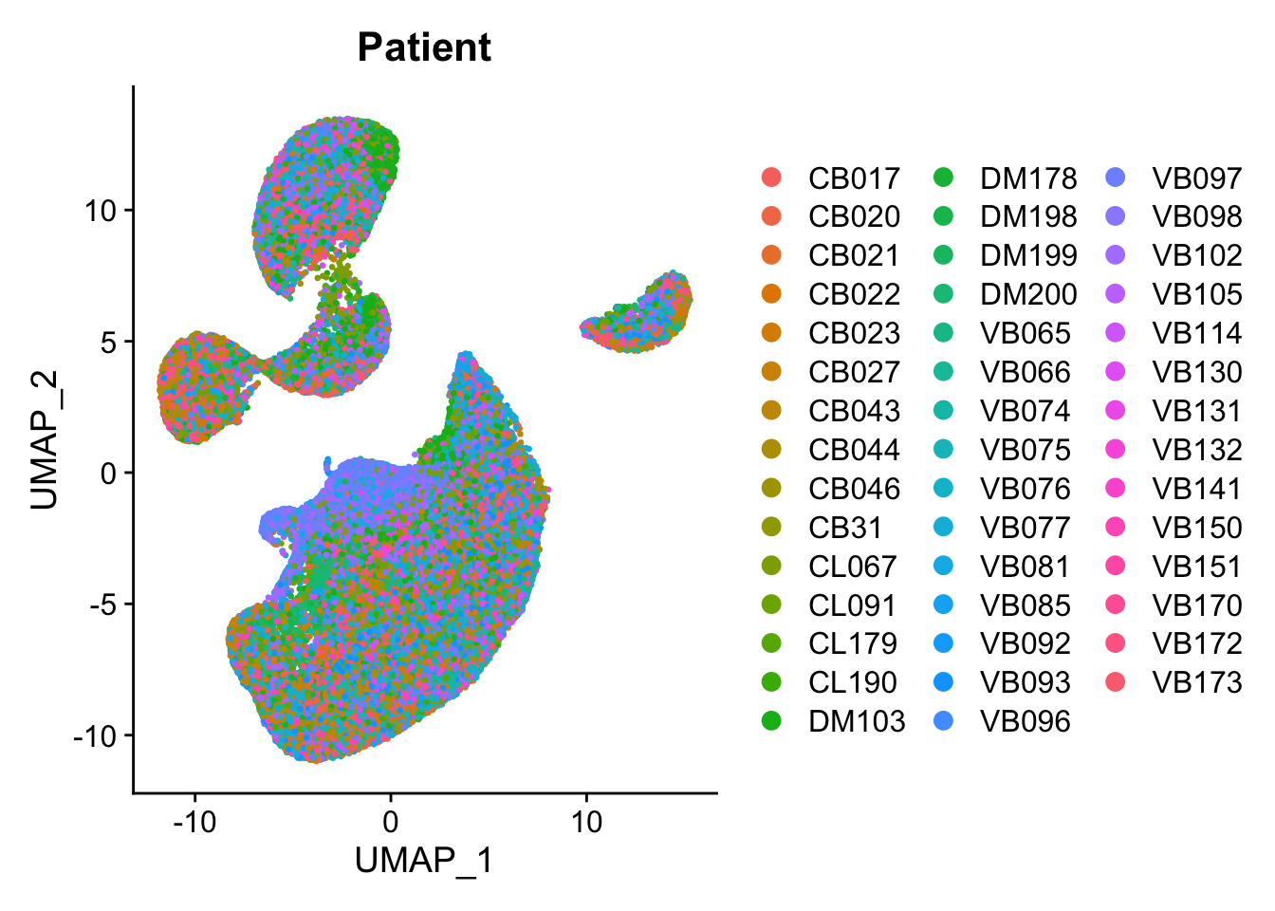
Idiosyncrasies of s.c. data

Slide 4
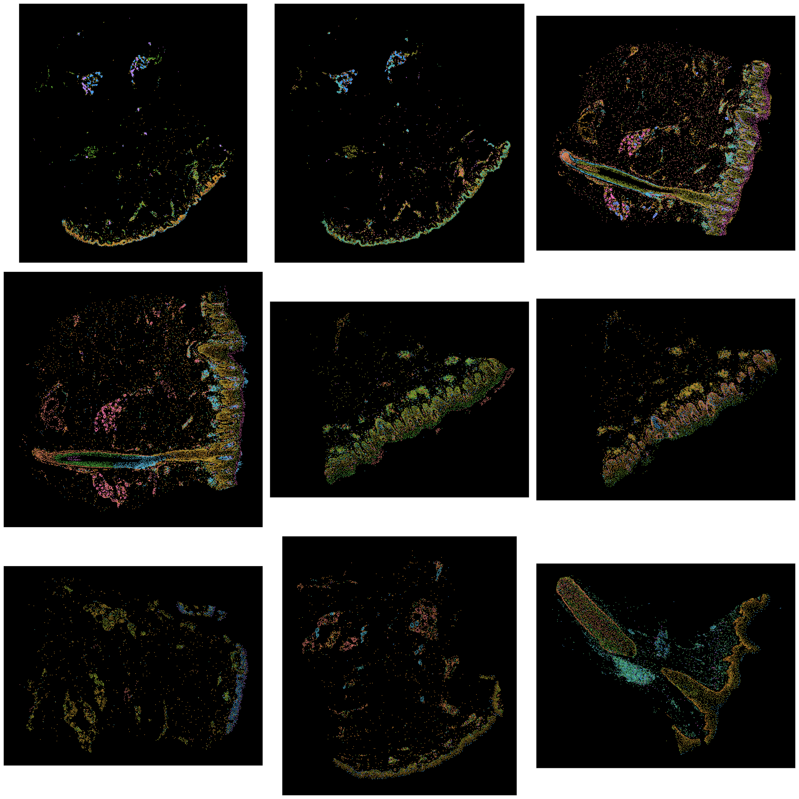
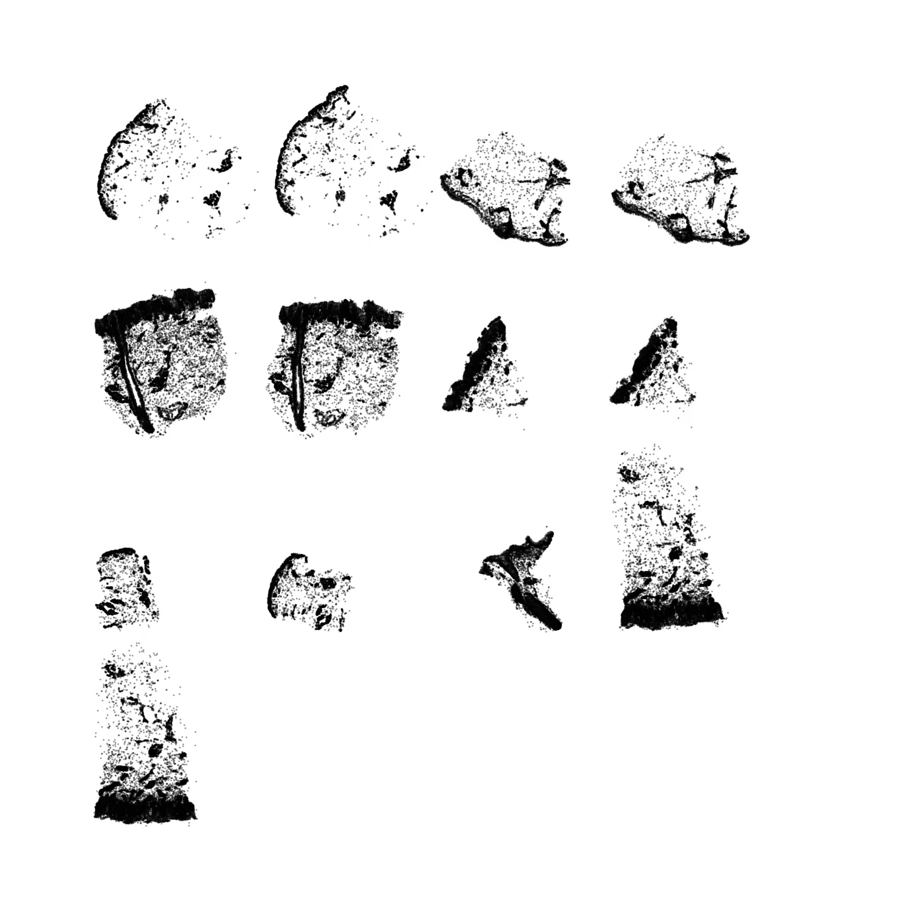
Spatial single cell omics builds on regular single cell analysis

Slide 5
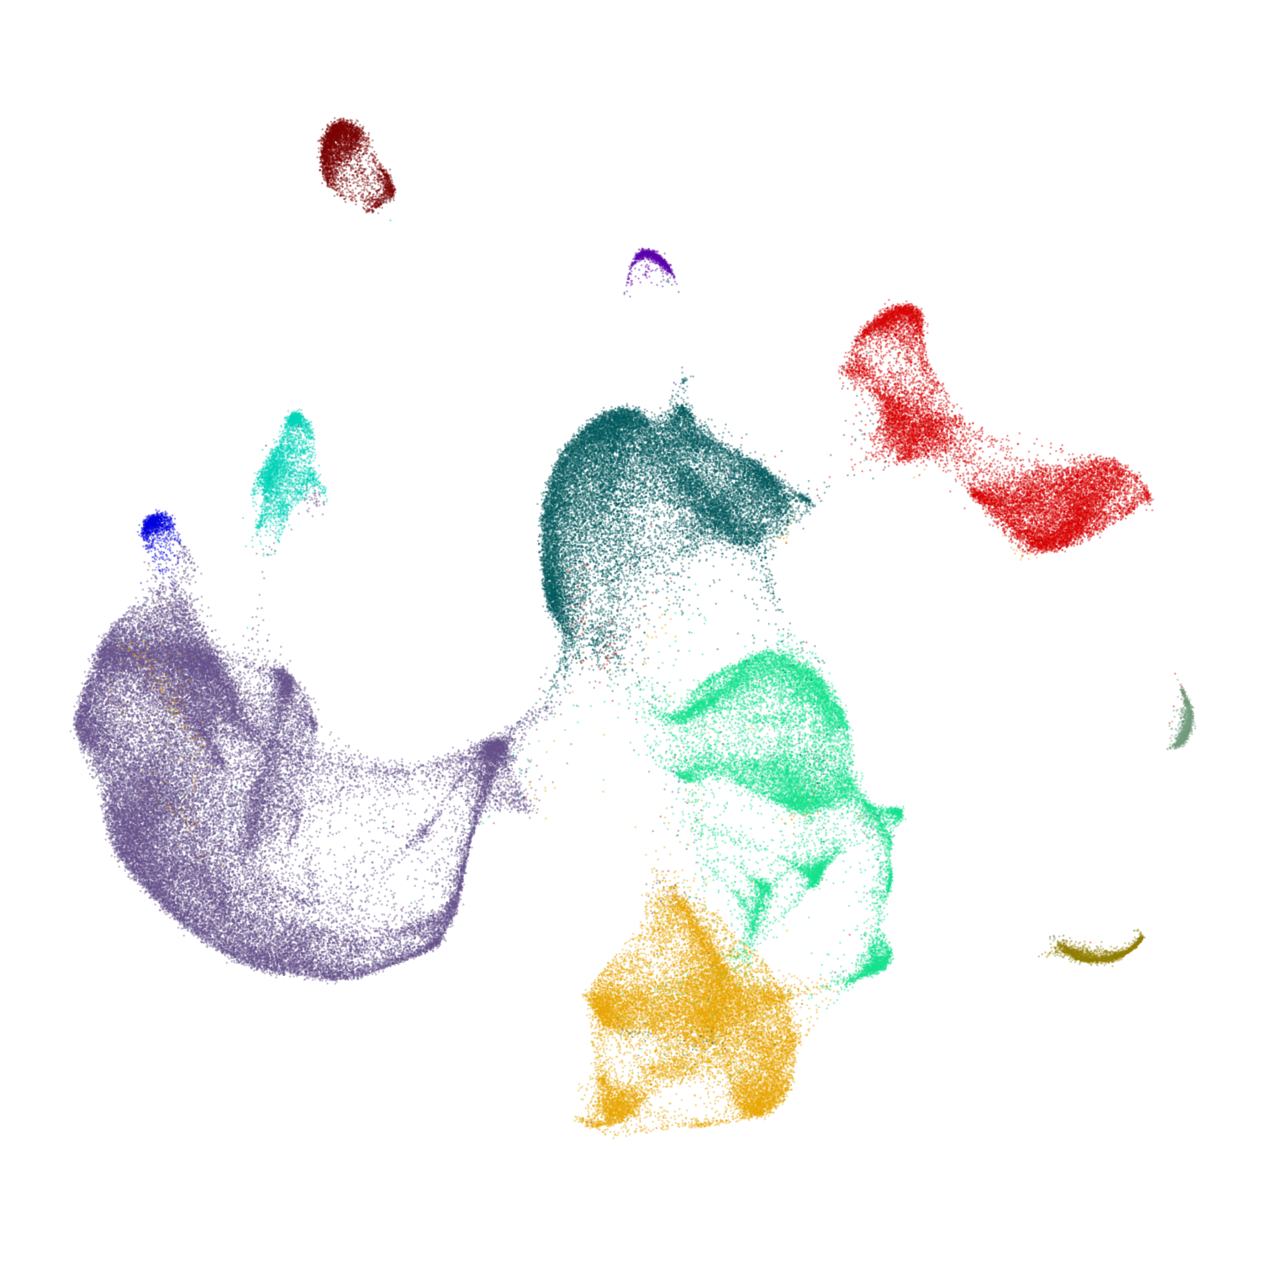
Spatial single cell omics builds on regular single cell analysis

Slide 6

Spatial single cell omics builds on regular single cell analysis

Slide 7
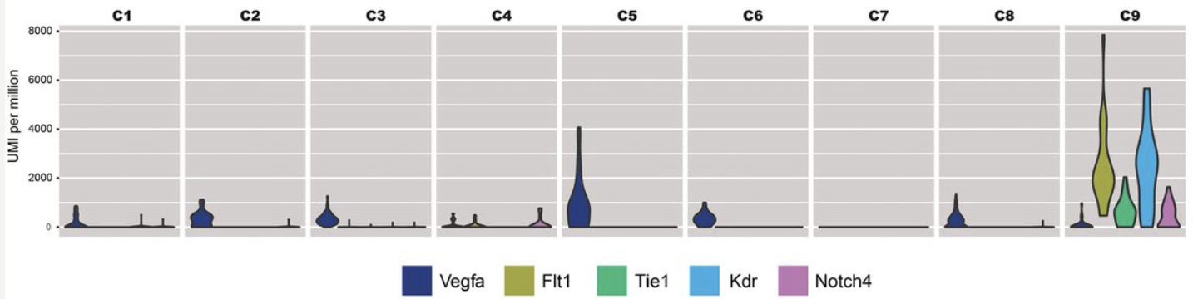
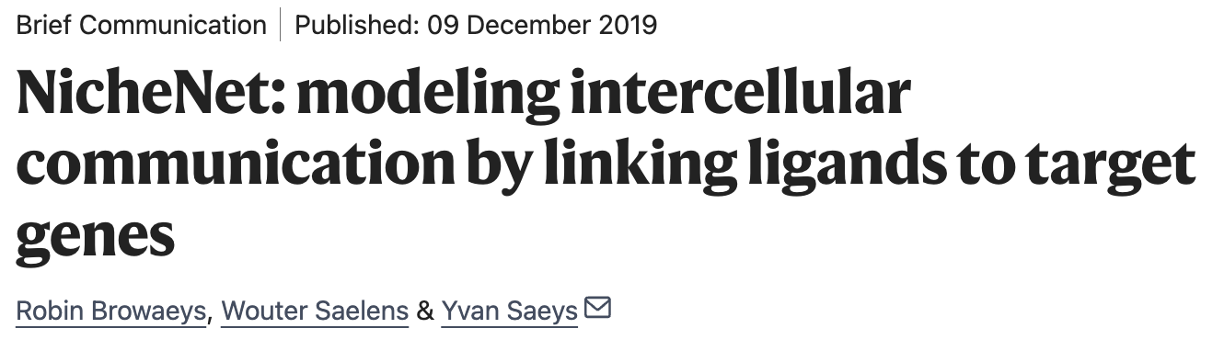
Why spatial?
Inferring communications based on ligand and receptor expression or even downstream targets is far from optiomal

Slide 8
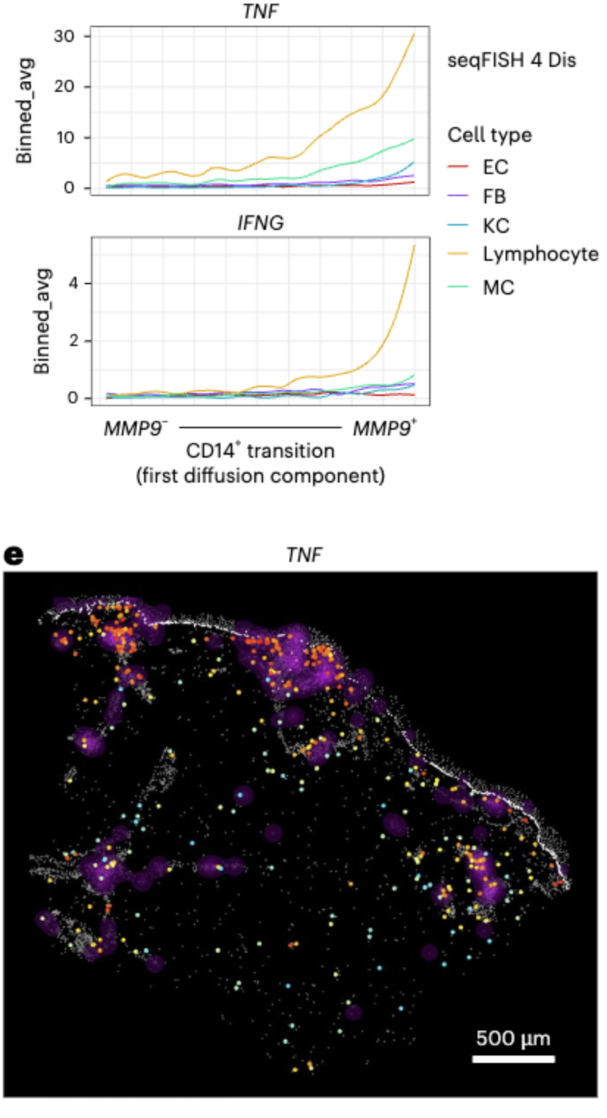
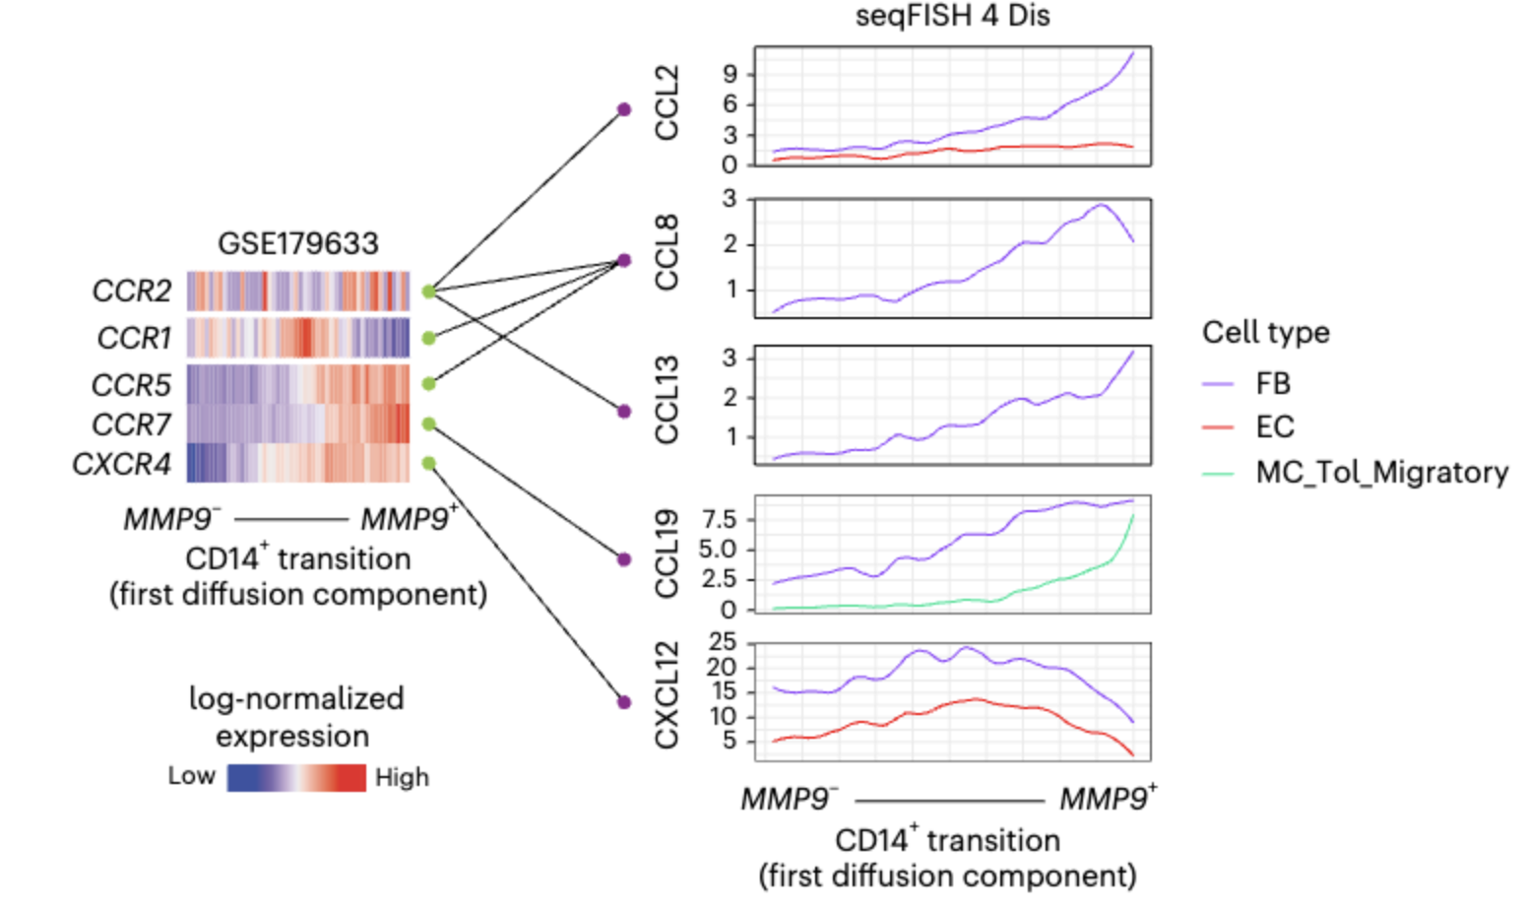
Spatial can include proximity

Slide 9
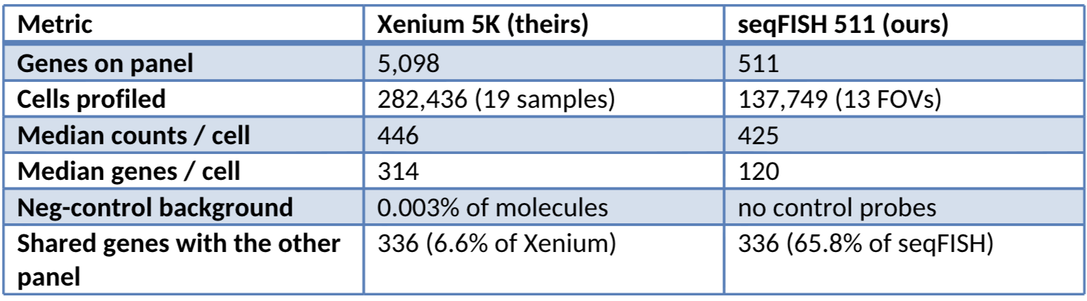
Not all technologies work the same way

