Slide 1
Brief introduction to scRNA-Seq analysis

Slide 2
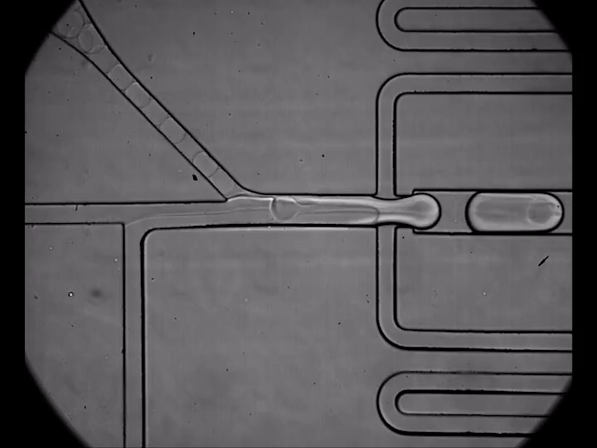
Most common source: a microfluidic device

Slide 3
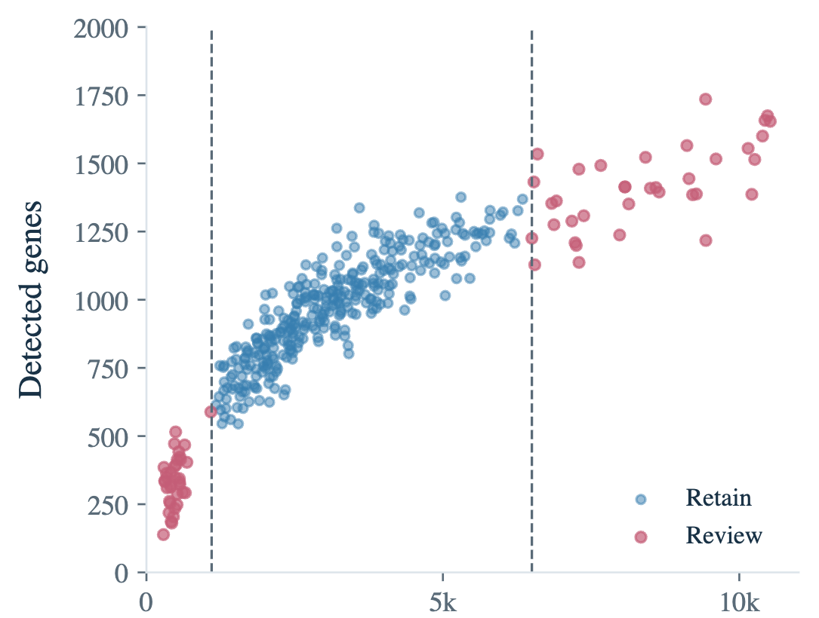
QC – filtering cells
Notes:
Remake for specific types of sequencing

Slide 4
Atlas building: What cell types I got
Goal: Identify cell types with the aim of:
  Annotate a tissue
  Identify changes in their proportions across samples and conditions
  Identify state changes
    Along a continuous trajectory
    Regulatory programs

Slide 5
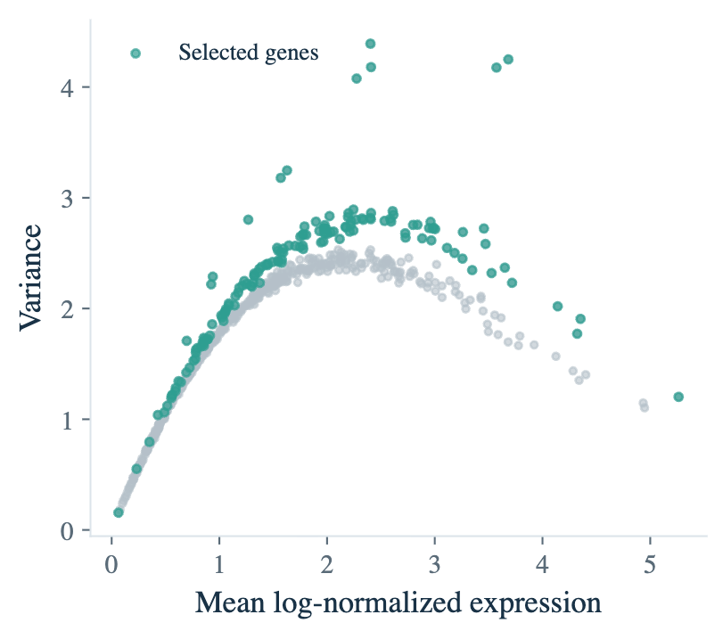
Special care selecting variable genes
Notes:
Remake for specific types of sequencing

Slide 6
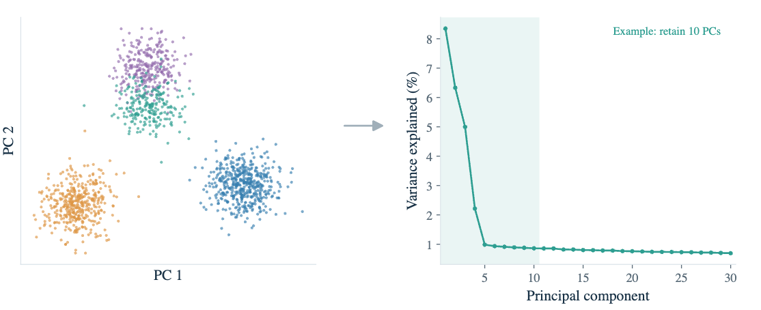
Dimensionality reduction

Slide 7
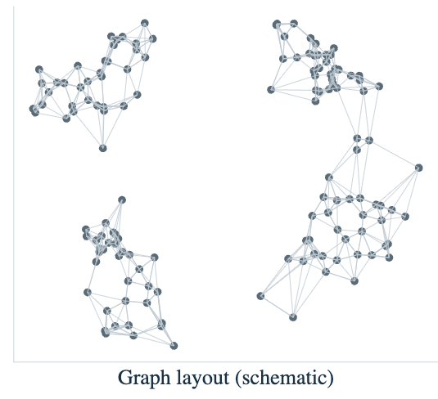
Group (cluster) cells by their transcriptional similarity

Slide 8
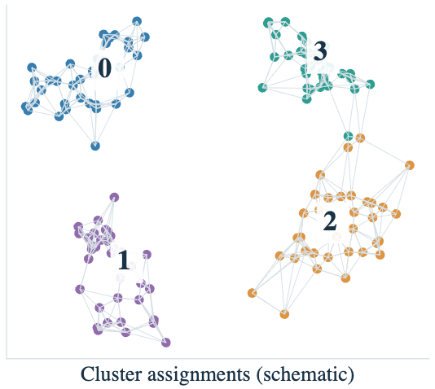
Group (cluster) cells by their transcriptional similarity
Graph based clustering (Leiden/Louvain)

Slide 9
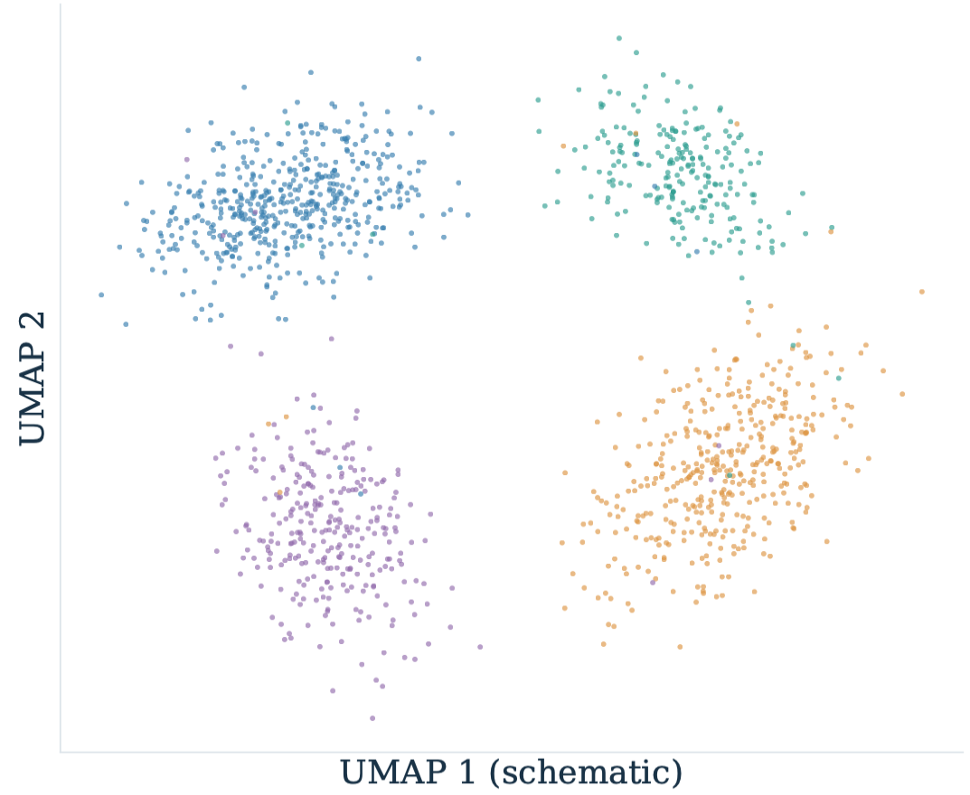
Group (cluster) cells by their transcriptional similarity

Slide 10
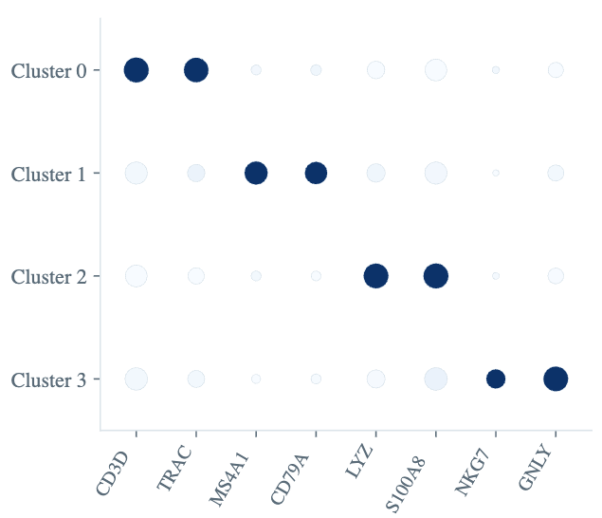
Strict differential expression → Marker genes

Slide 11
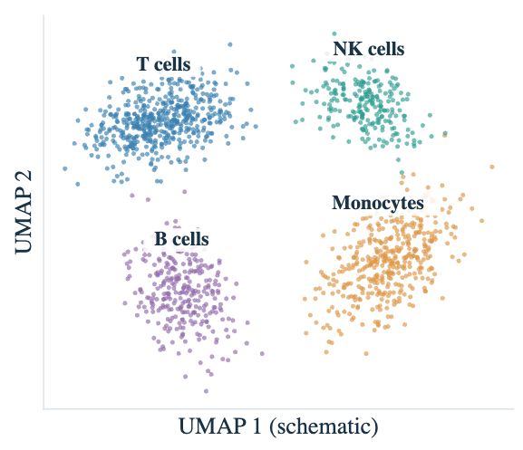
Biological intuition/ask your friend

Slide 12
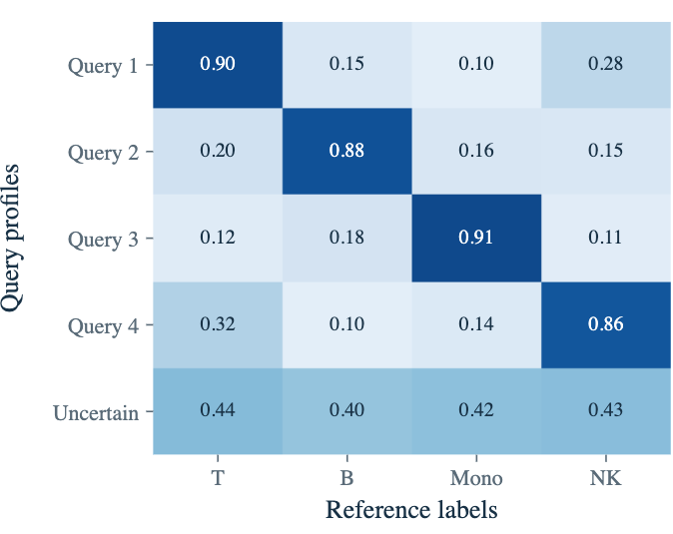
Label transfer from another set /use foundational models

Slide 13
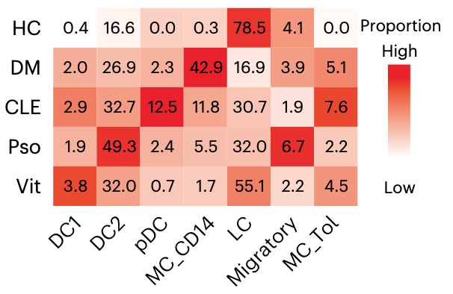
Analysis – Proportion analysis

Slide 14
DGE – An unsolved problem

Slide 15
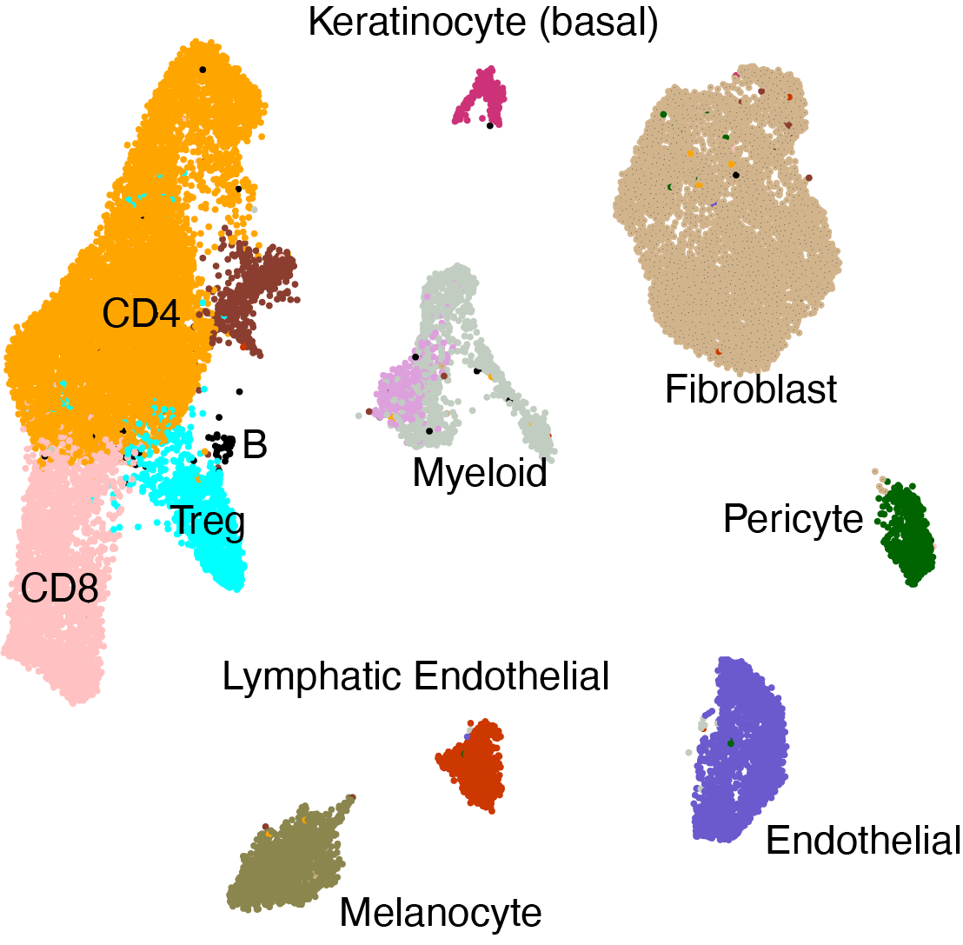
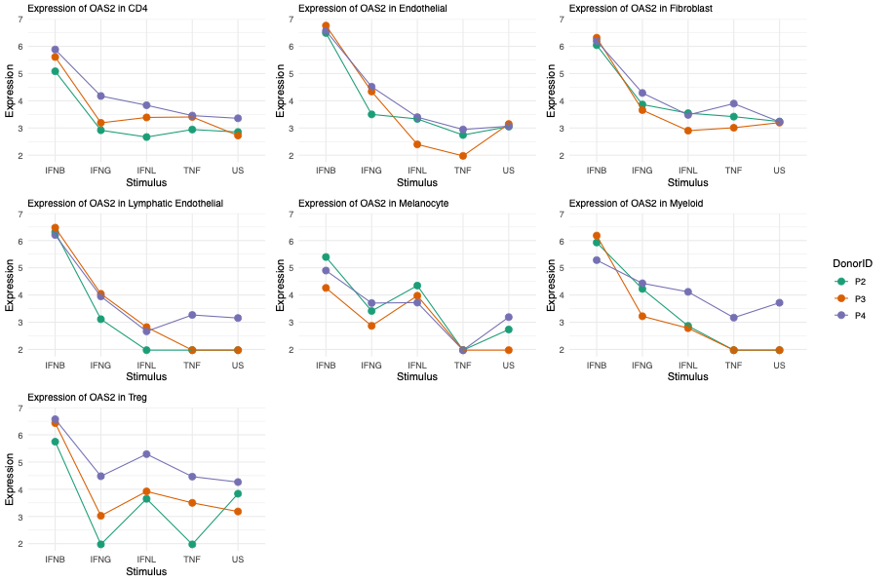
Option 1 → Back to RNA-seq; pseudobulking
e.g. 3 different donors, 6 stimuli
Pros:
Conservative
well calibrated tools
Cons:
Conservative
Lots of thresholds needed
  How few is to few cells
  At what level to pseudobulk
  Needs more samples

Slide 16
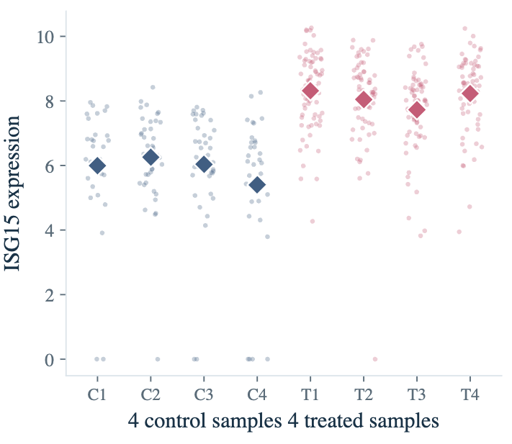
Option 2 → Every cell is a replicate
Pros:
Increased power
Uses the full data
Less ad-hod decisions
Works well for highly expressed genes
Cons:
Always unbalanced
Sparsity an issue for models
Lots of false positives
Rely on the model to handle sample of origin

