Slide 1
Notes:
Quality control and informative genes
All observations and numerical results are simulated. These figures illustrate methods rather than report biological findings. The named production packages are method examples unless explicitly stated otherwise.
QC panel is a separate schematic. Normalization shows the simulated study. Variable genes in this example use residual variance above a simple polynomial mean-variance trend; production HVG implementations differ. SCTransform is an alternative preprocessing path, not an additional required step.
Method references:
https://scanpy.scverse.org/en/stable/tutorials/basics/clustering.html
https://satijalab.org/seurat/articles/sctransform_vignette

Slide 2
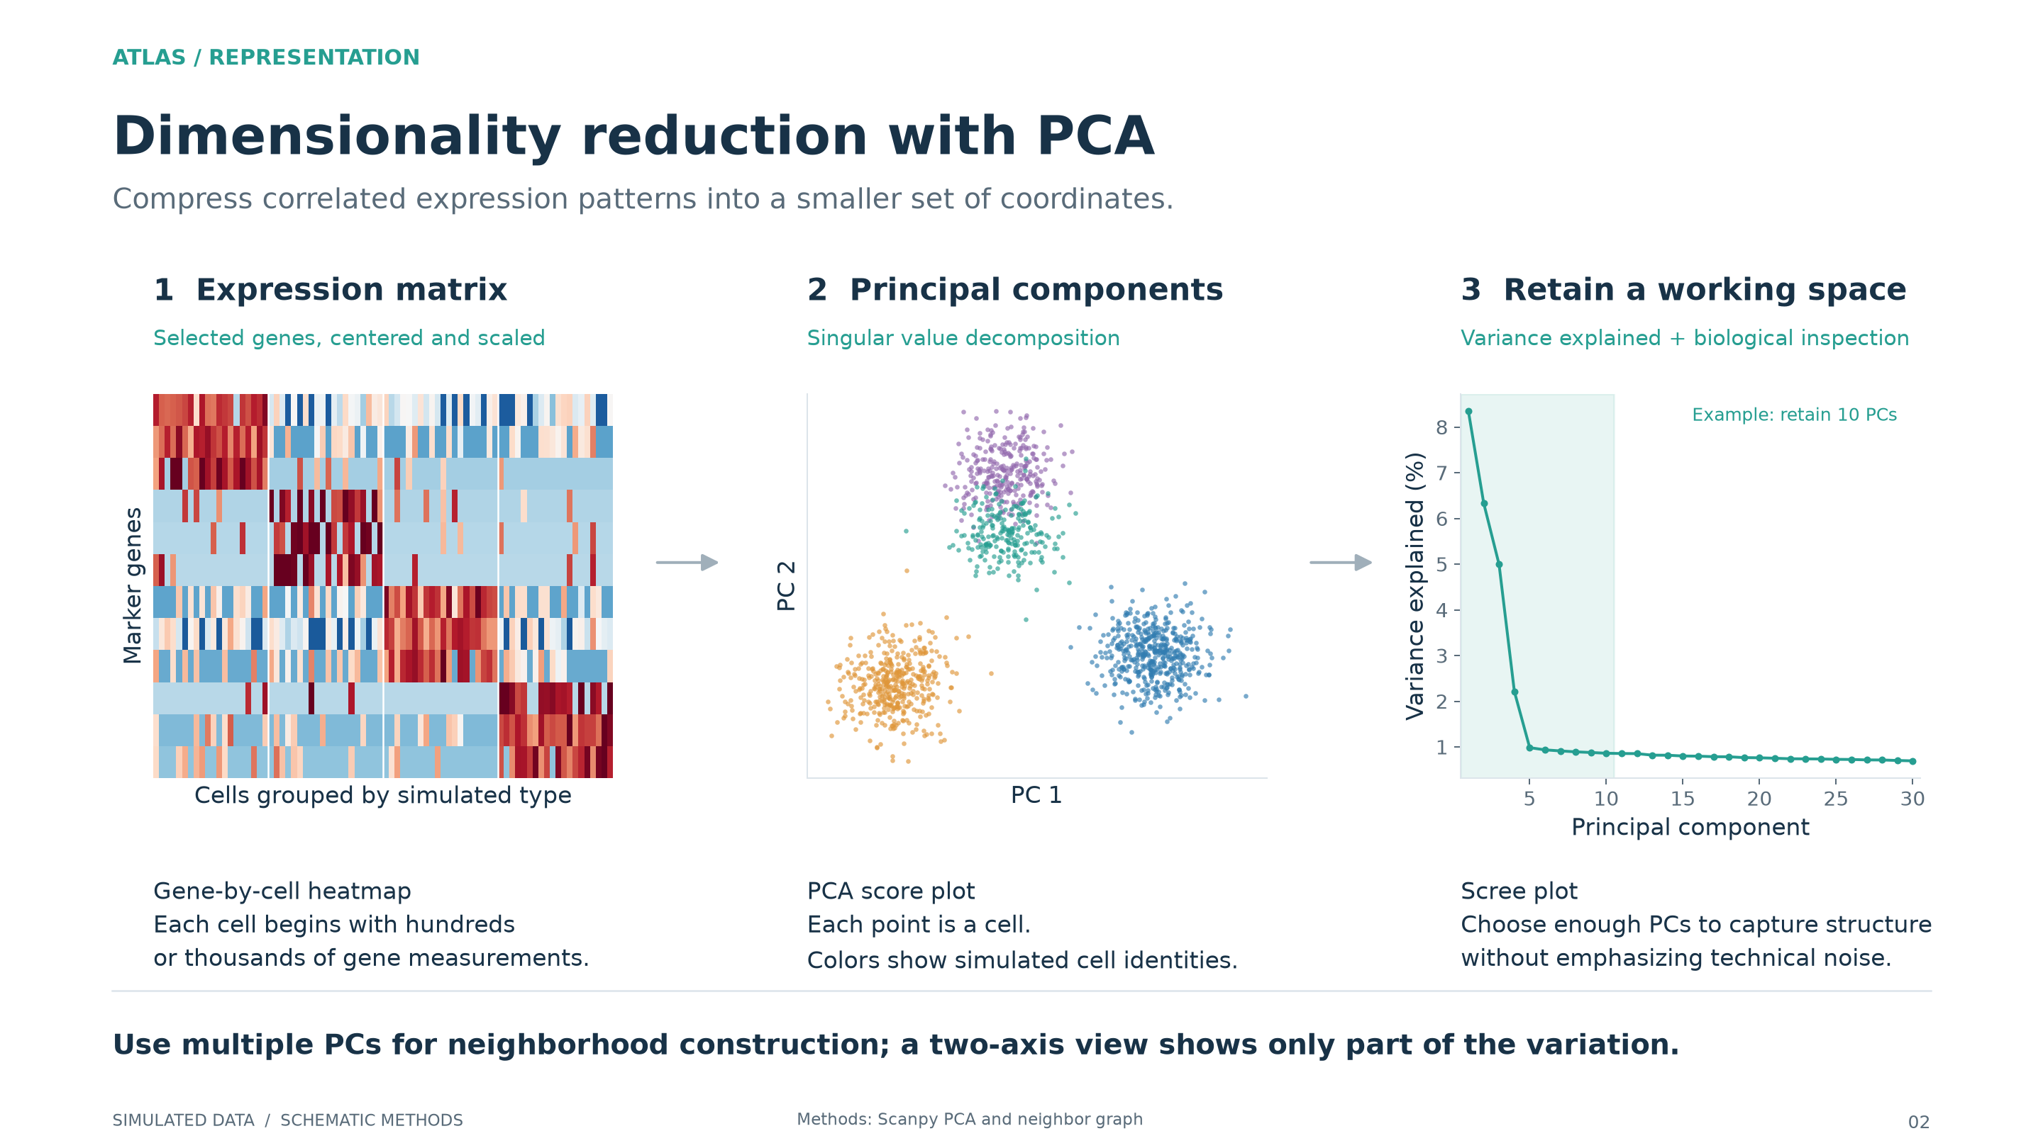
Notes:
Dimensionality reduction with PCA
All observations and numerical results are simulated. These figures illustrate methods rather than report biological findings. The named production packages are method examples unless explicitly stated otherwise.
The PCA and scree plot are computed on simulated normalized expression. The shaded cutoff is illustrative, not a recommended universal number of PCs.
Method references:
https://scanpy.scverse.org/en/stable/tutorials/basics/clustering-2017.html

Slide 3
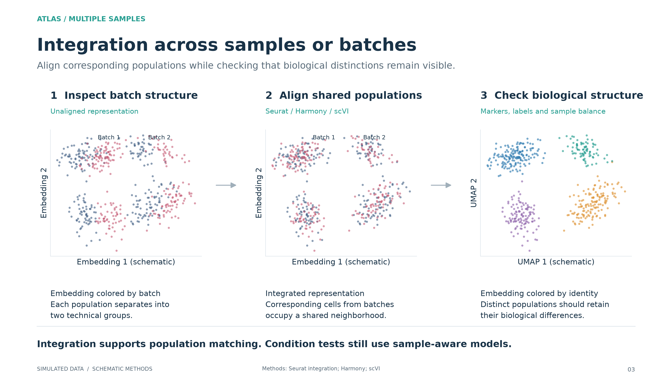
Notes:
Integration across samples or batches
All observations and numerical results are simulated. These figures illustrate methods rather than report biological findings. The named production packages are method examples unless explicitly stated otherwise.
All embeddings on this page are schematic. The before/after positions illustrate a known artificial batch shift, not an execution of any named integration package. Batch colors do not denote biological conditions. Inspect unintegrated and integrated results to assess loss of genuine biological structure.
Method references:
https://satijalab.org/seurat/articles/integration_introduction

Slide 4
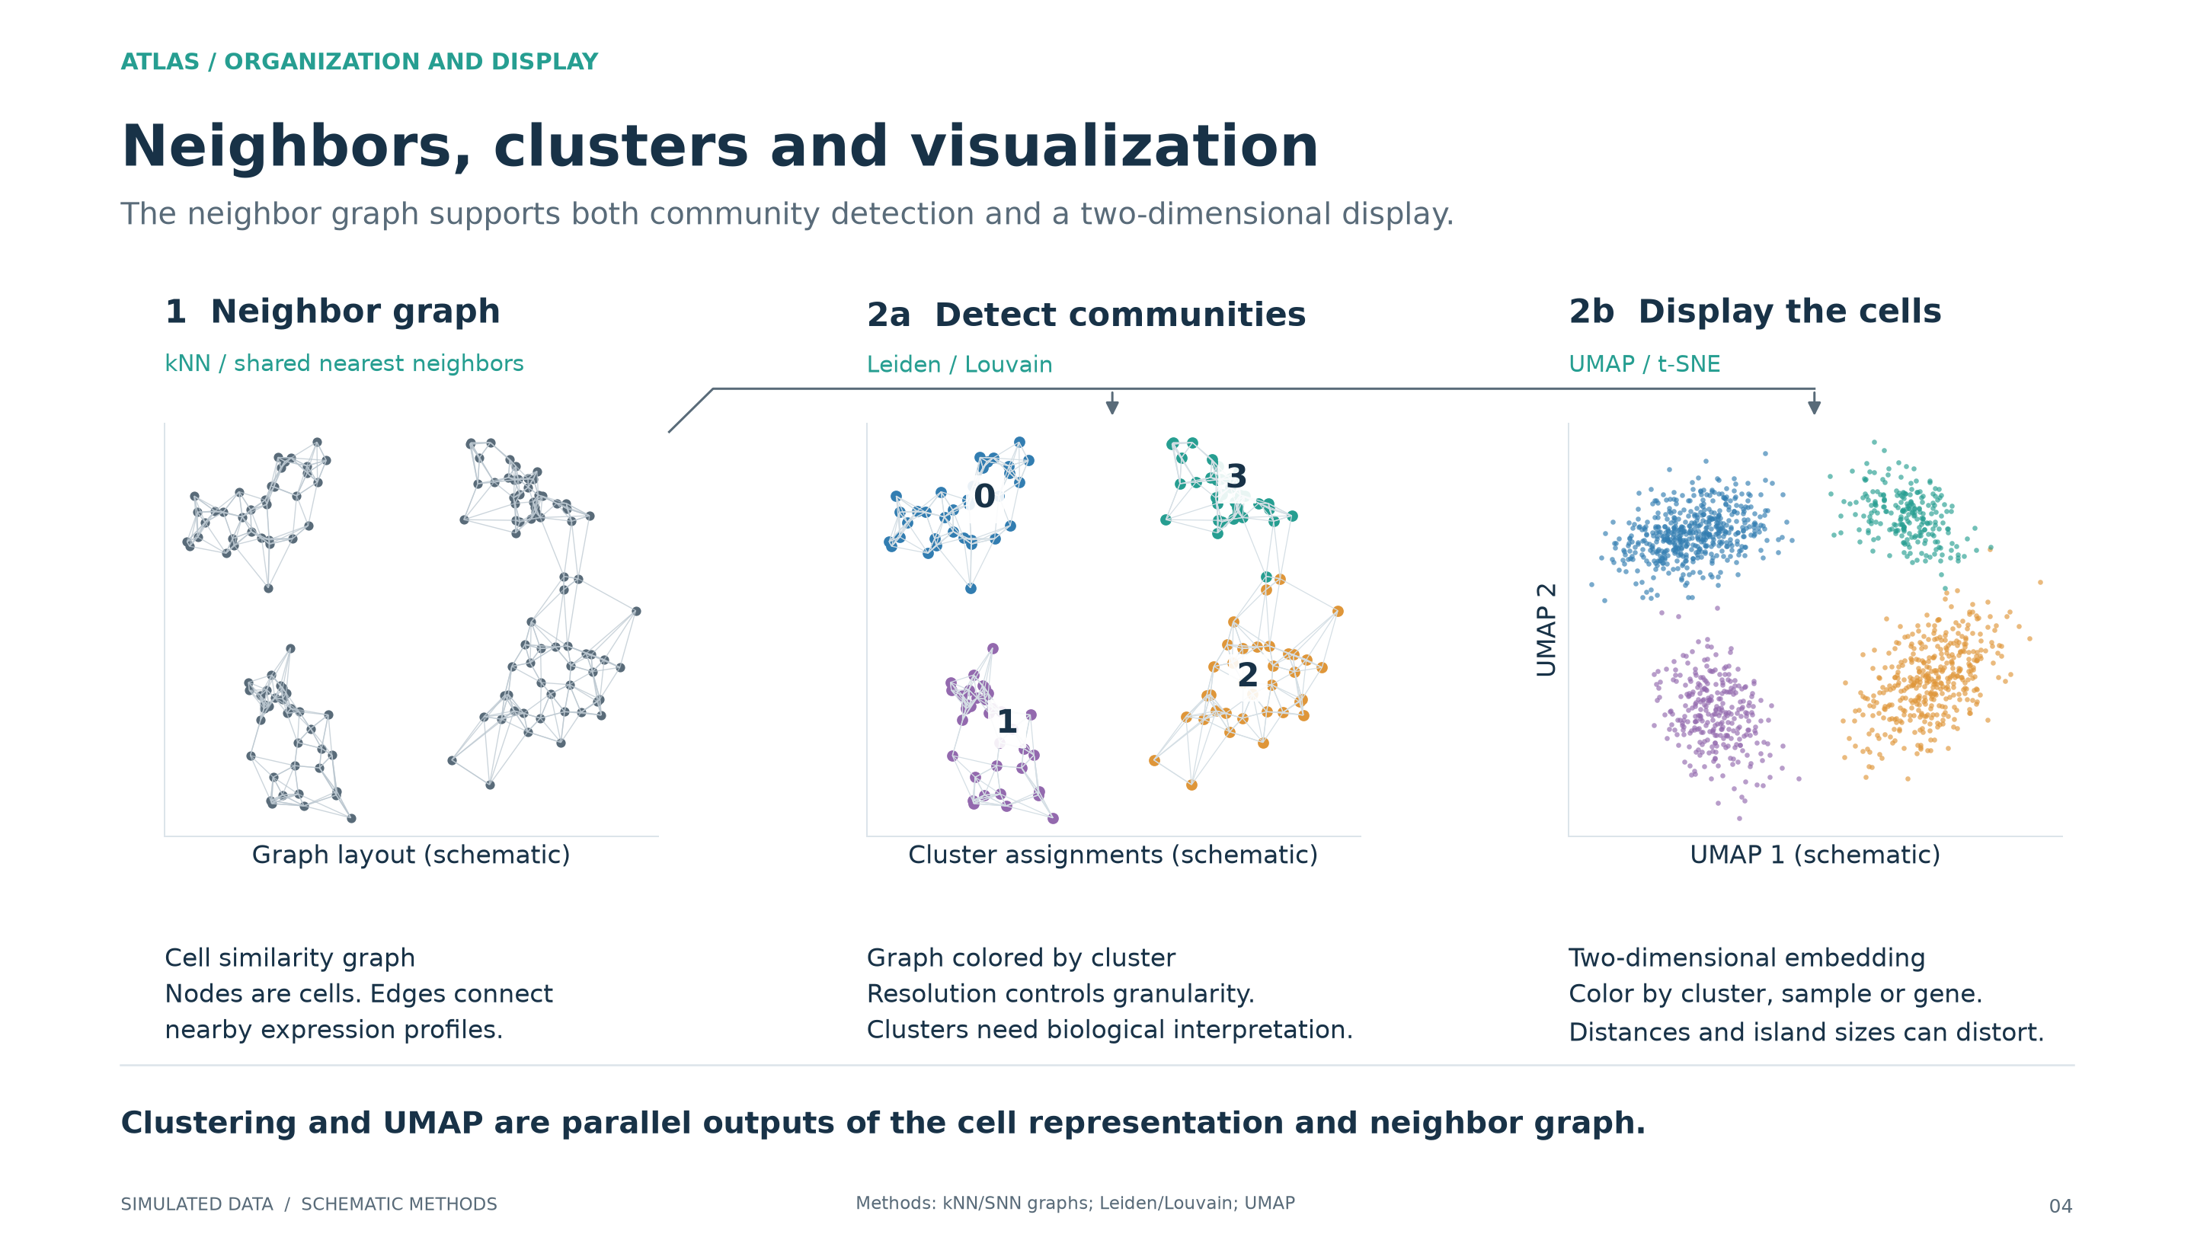
Notes:
Neighbors, clusters and visualization
All observations and numerical results are simulated. These figures illustrate methods rather than report biological findings. The named production packages are method examples unless explicitly stated otherwise.
The graph is drawn from synthetic two-dimensional coordinates to make its structure visible. Real workflows construct neighbors in a multi-PC or latent space. Cluster colors here are schematic known simulation labels; no Leiden or Louvain run is implied. UMAP-style positions are illustrative, not an actual UMAP computation.
Method references:
https://scanpy.scverse.org/en/stable/tutorials/basics/clustering-2017.html
https://scanpy.scverse.org/en/stable/tutorials/basics/clustering.html

Slide 5
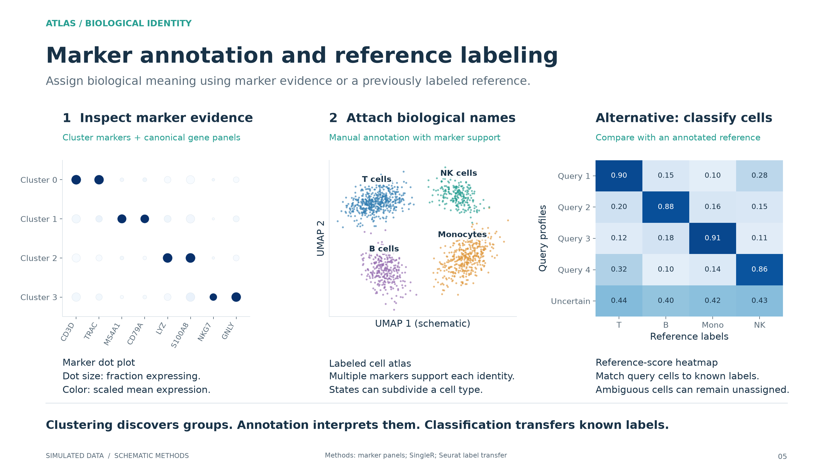
Notes:
Marker annotation and reference labeling
All observations and numerical results are simulated. These figures illustrate methods rather than report biological findings. The named production packages are method examples unless explicitly stated otherwise.
Dot-plot values are calculated from simulated expression. Color is scaled separately per marker. Reference scores are schematic similarity scores, not calibrated probabilities or actual SingleR output. A real reference must cover the relevant tissue and states; out-of-reference cells need additional inspection.
Method references:
https://www.bioconductor.org/packages/release/bioc/vignettes/SingleR/inst/doc/SingleR.html

Slide 6
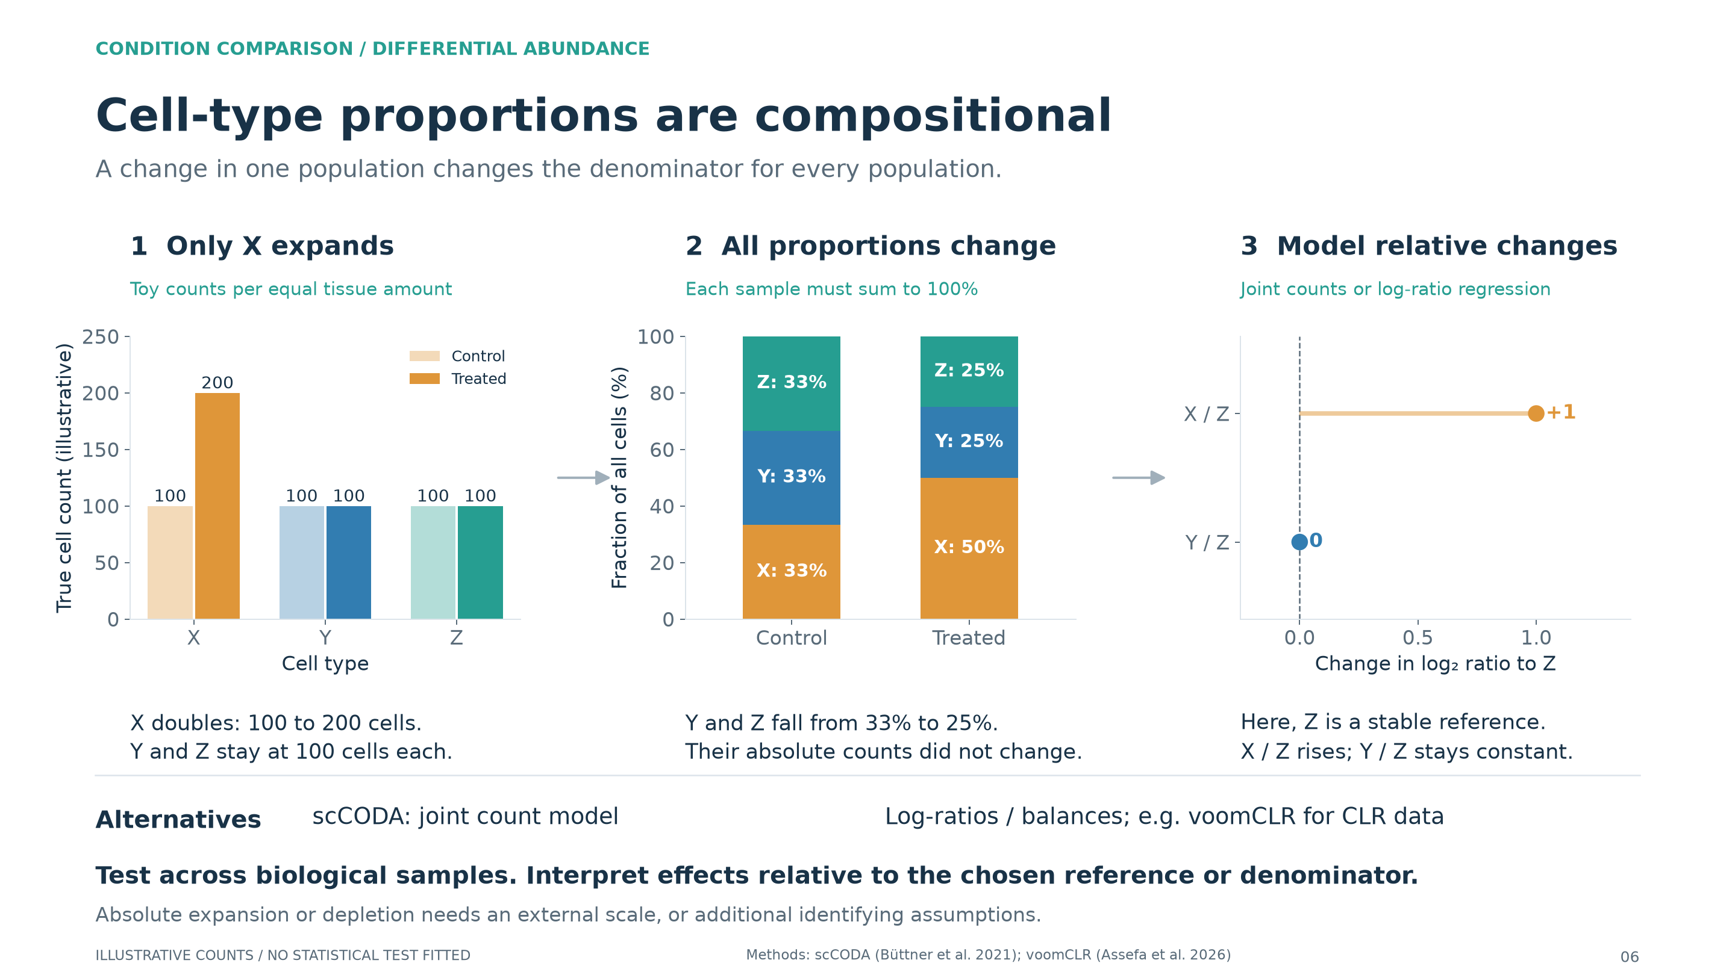
Notes:
Cell-type proportions are compositional
The teaching point is closure: fractions share a denominator and sum to one. In this toy example, true cell counts per equal tissue amount change from X=100, Y=100, Z=100 to X=200, Y=100, Z=100. The composition changes from one third each to 50%, 25%, 25%. A lower fraction for Y or Z therefore does not establish absolute depletion.
Separate, well-calibrated sample-level tests can correctly detect changes in marginal fractions. Dependence among cell types does not automatically invalidate all separate tests. The key is the estimand and its interpretation. Methods such as propeller test transformed fractions with biological replication and multiple-testing adjustment. Such tests do not identify which populations changed on an absolute scale. Multiple-testing correction alone does not resolve this ambiguity.
Alternative 1: joint compositional count regression. scCODA uses a Bayesian Dirichlet-multinomial regression with sparse effects and a reference population. It jointly models the count vector, accommodates experimental covariates, and reports effects relative to the reference. Reference choice and model assumptions matter; a joint model does not by itself recover absolute tissue counts. tascCODA extends the framework to known cell-type hierarchies.
Alternative 2: model log-ratios or balances across samples. A prespecified ratio such as log(X/Z) makes the denominator explicit; ILR balances can compare groups of related populations. CLR contrasts use the geometric mean as the denominator, and their interpretation differs from a fixed-reference ratio. voomCLR combines CLR-based linear modeling with compositional bias correction, precision weights and uncertainty for the correction. The bias correction requires identifying assumptions. Zero counts need suitable handling. The third panel is the exact log-ratio change in this toy example with a known stable Z; it is not output from scCODA or voomCLR and has no fitted confidence intervals.
Alternative 3: add an absolute scale when that is the biological question. Examples include calibrated cell counts per tissue mass or blood volume using appropriate counting measurements. Sequenced cell yield alone usually does not supply this scale, and sampling or recovery bias must still be considered.
Both conditions in this example summarize a hypothetical mechanism rather than a replicated experiment. Real hypothesis tests require independent biological samples and appropriate donor, pairing and batch structure. The original study's replicated count-table workflow remains relevant; this slide highlights the compositional modeling decision that follows that table.
Method references:
https://www.nature.com/articles/s41467-021-27150-6
https://doi.org/10.1093/bioinformatics/btaf637
https://bioconductor.org/packages/devel/bioc/vignettes/speckle/inst/doc/speckle.html
https://doi.org/10.3389/fgene.2021.766405

Slide 7
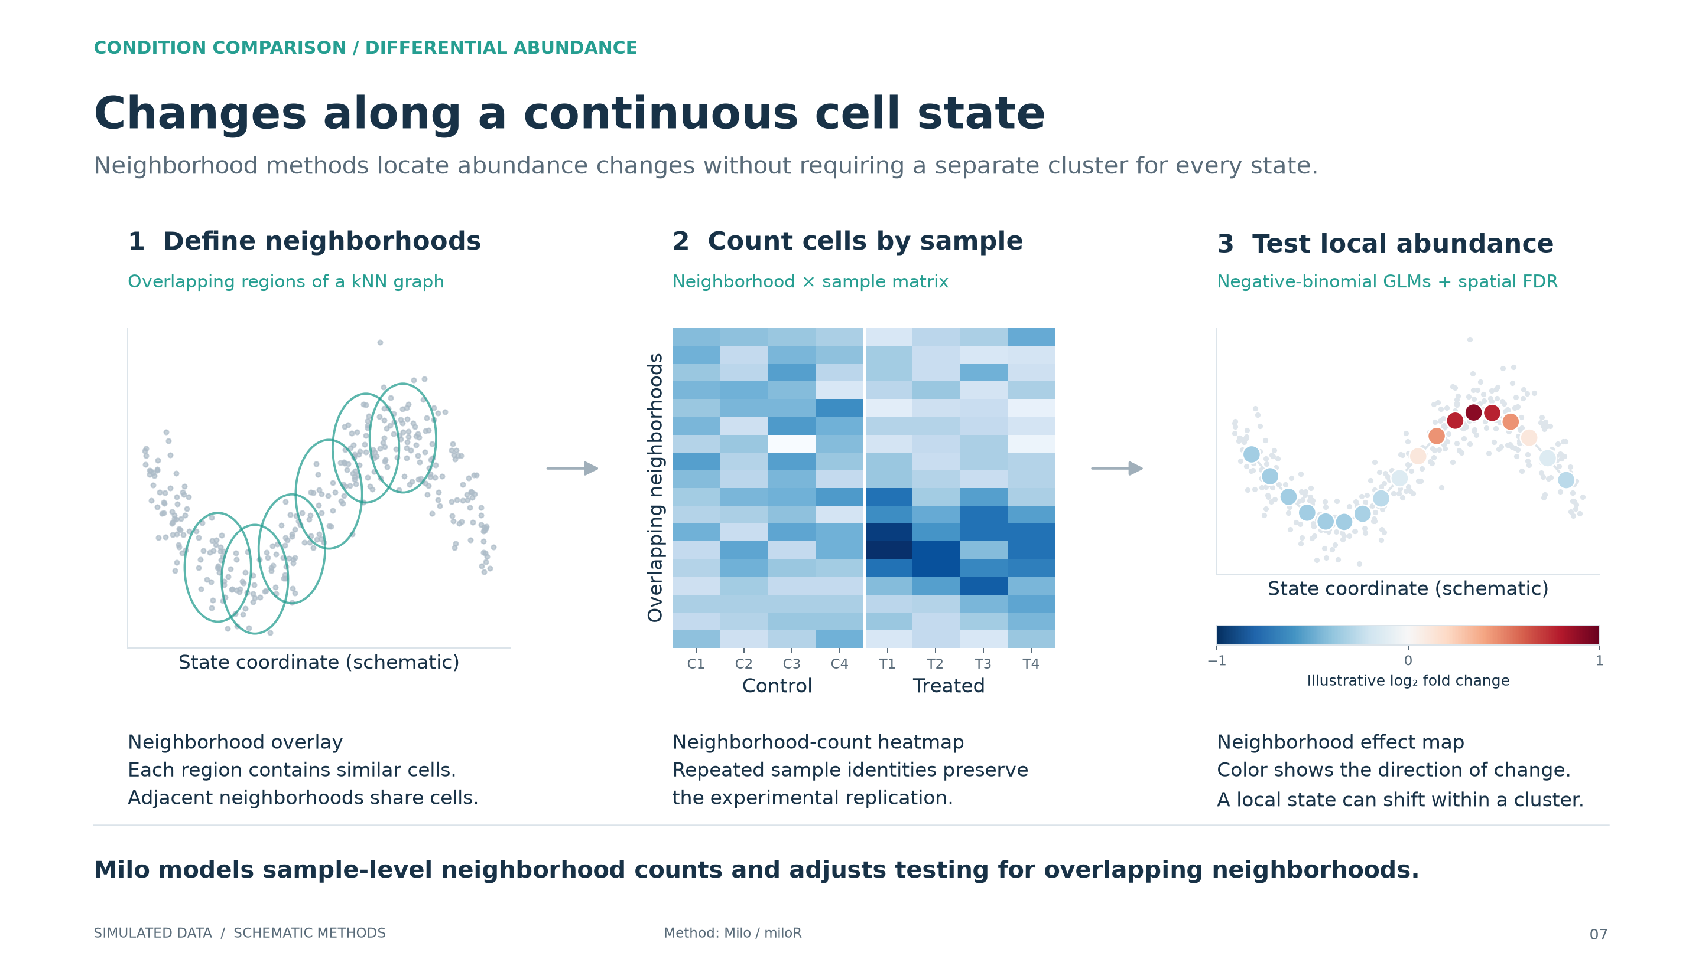
Notes:
Changes along a continuous cell state
All observations and numerical results are simulated. These figures illustrate methods rather than report biological findings. The named production packages are method examples unless explicitly stated otherwise.
Trajectory, neighborhood counts and effect map are illustrative schematics. The map displays the simulated underlying effect, not an estimated coefficient or significance result. The production Milo method uses a kNN graph, sample-level counts, negative-binomial testing, and graph-aware multiple-testing correction.
Method references:
https://www.nature.com/articles/s41587-021-01033-z

Slide 8
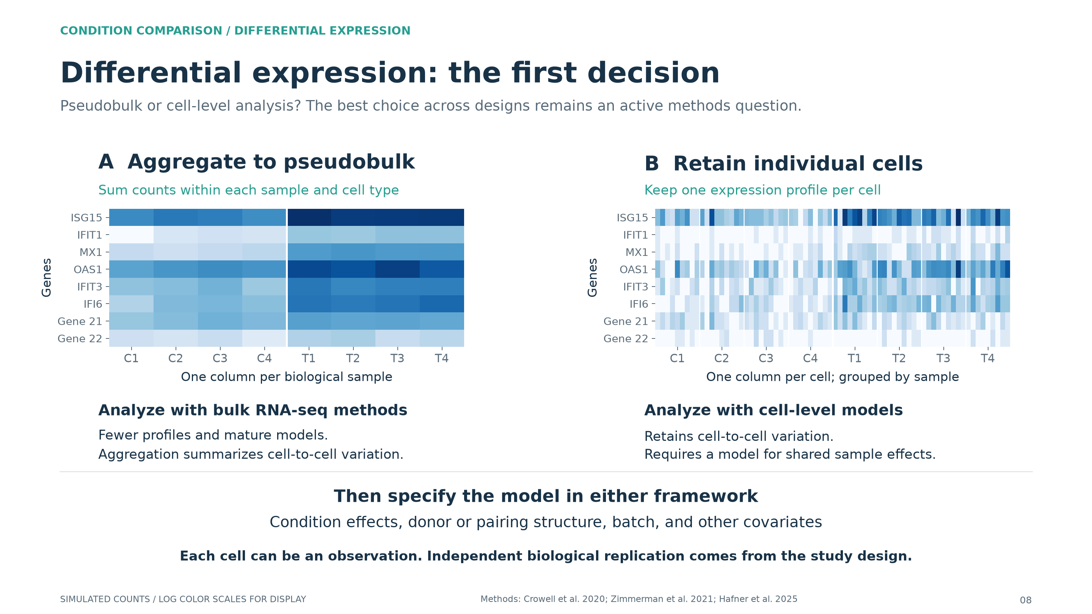
Notes:
Differential expression: the first decision
Teaching emphasis: the first major choice is the level at which expression enters the analysis. Within a corresponding cell type, either aggregate original counts within each biological sample and use a bulk RNA-seq framework, or retain each cell as an observation in a cell-level model. This is an active methodological choice across study designs, sample sizes, distributions and scientific questions, not a claim that the two approaches perform equally in every setting. Pseudobulk has strong benchmark support for many replicated mean-expression comparisons. Cell-level models can retain heterogeneity and support cell-level predictors.
After choosing the representation, both approaches require a condition contrast and appropriate handling of donor, pairing, batch and other covariates. The exact likelihood, offsets, dependence structure and available effects differ between model families; they are not interchangeable. A donor fixed effect is unidentifiable with an unpaired condition that is constant within donor. A donor random effect or aggregation can address sample dependence, with more complex repeated designs requiring additional structure.
Use the phrase "each cell is an observation" to distinguish the analysis rows from independent biological replication. Treating all cells as independent replicates is a common naive approach, but within-donor correlation and the resulting pseudoreplication problem are well established. The open methodological question is how best to use the nested data for the biological target, not whether that dependence exists.
Both heatmaps depict the same simulated monocyte population and genes. The pseudobulk matrix sums all monocytes within each of eight samples. The cell-level matrix displays nine illustrative cells per sample. Colors use log2(count+1), with separate scales; they show the difference in matrix structure, not comparable absolute color magnitudes. C1-C4 and T1-T4 are independent control and treated samples. All results are simulated.
Method references:
https://www.nature.com/articles/s41467-020-19894-4
https://www.nature.com/articles/s41467-021-21038-1
https://www.nature.com/articles/s41467-021-25960-2
https://academic.oup.com/bib/article/26/4/bbaf397/8232550

Slide 9
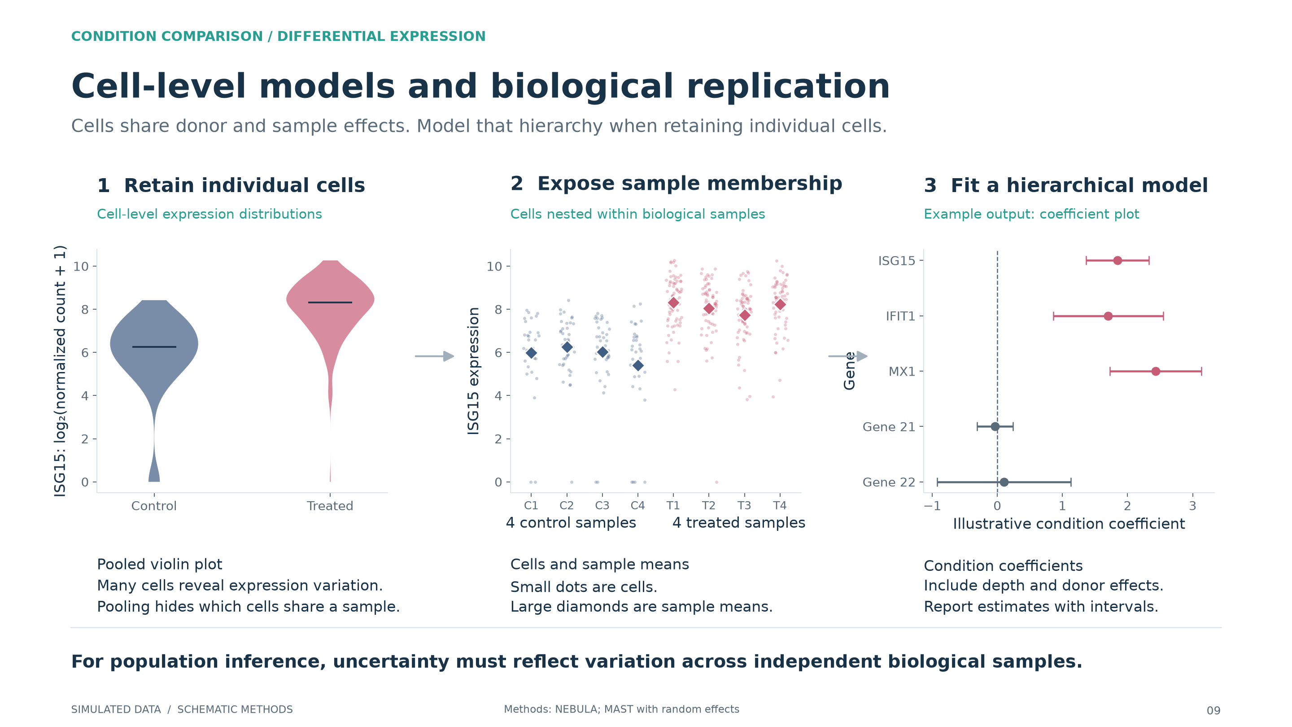
Notes:
Cell-level models and biological replication
All observations and numerical results are simulated. These figures illustrate methods rather than report biological findings. The named production packages are method examples unless explicitly stated otherwise.
The distributions show simulated ISG15 in monocytes. The coefficient plot illustrates the form of a model output using differences in sample log-CPM and simple t-based intervals, not fitted GLMM coefficients. A count GLMM includes a depth offset, condition effect and donor random effect. MAST instead uses a two-part hurdle model; random effects must be explicitly enabled. A donor random intercept suits a simple unpaired donor-level comparison; repeated treatments may require sample effects or donor-specific slopes. Adding donor as a fixed term is rank deficient when each donor belongs to one condition. Pseudobulk with mixed models, such as dreamlet, is an alternative for repeated samples.
Method references:
https://www.nature.com/articles/s42003-021-02146-6
https://www.nature.com/articles/s41467-021-21038-1
https://www.bioconductor.org/packages/release/bioc/html/dreamlet.html

Slide 10
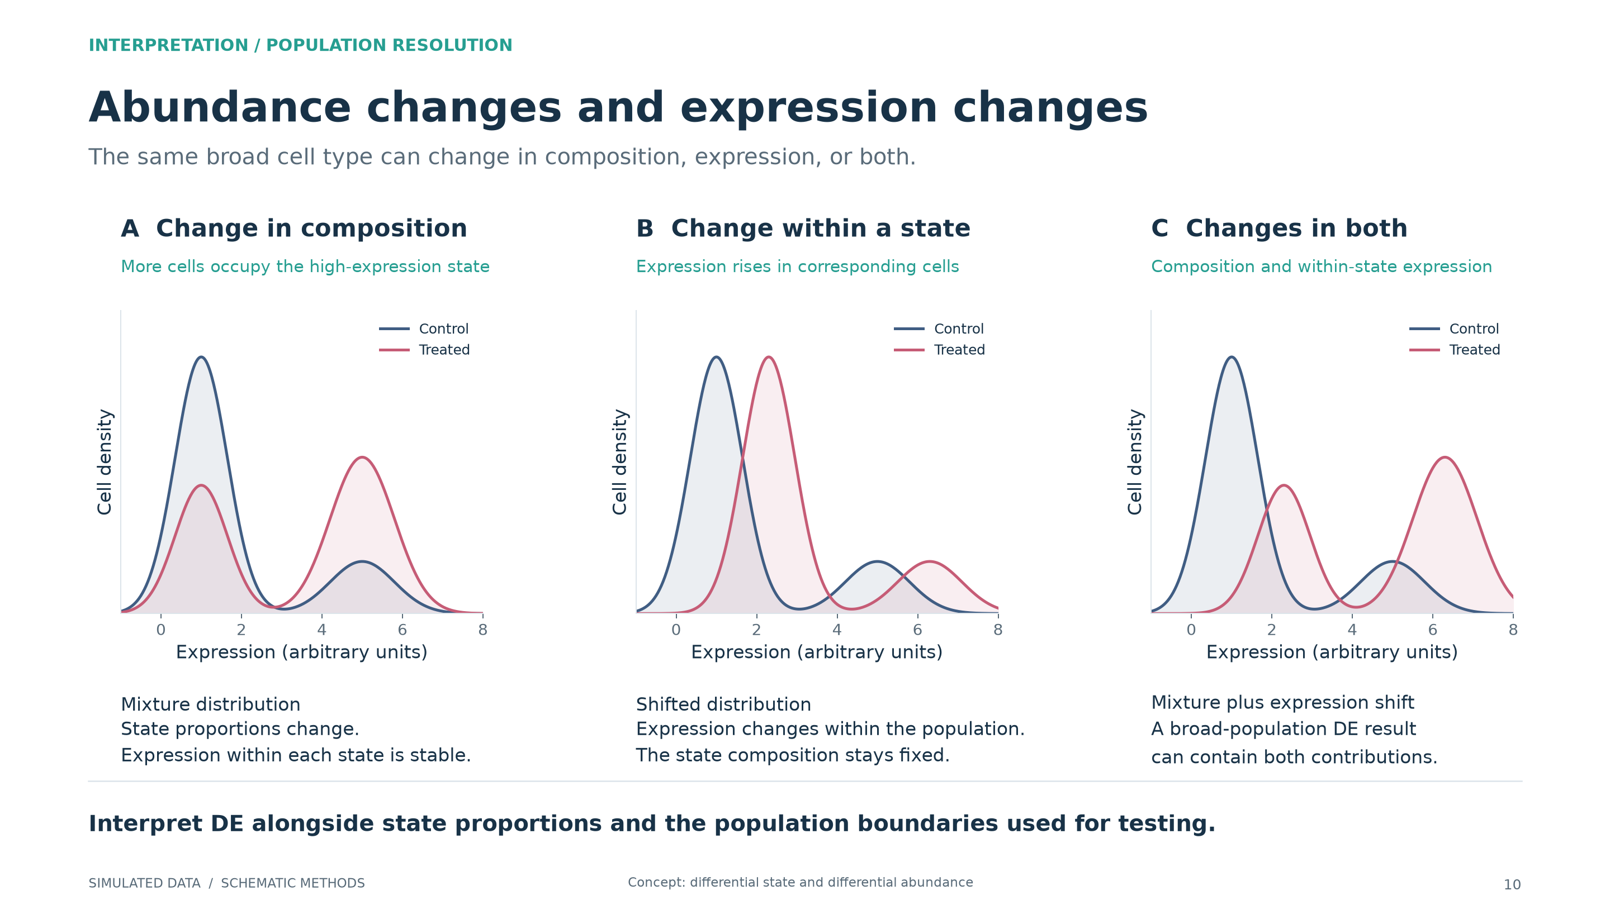
Notes:
Abundance changes and expression changes
All observations and numerical results are simulated. These figures illustrate methods rather than report biological findings. The named production packages are method examples unless explicitly stated otherwise.
These are analytic schematic mixture densities, not empirical distributions from the simulated study. Both changes in state proportions and within-state changes can alter the mean of a broad population. Resolving states can clarify mechanism, but very fine subdivisions reduce cells per sample and may condition on part of the biological response.
Method references:
https://www.nature.com/articles/s41467-020-19894-4

