Slide 1
Brief introduction to short read sequence analysis using RNA-Seq as an example

Slide 2
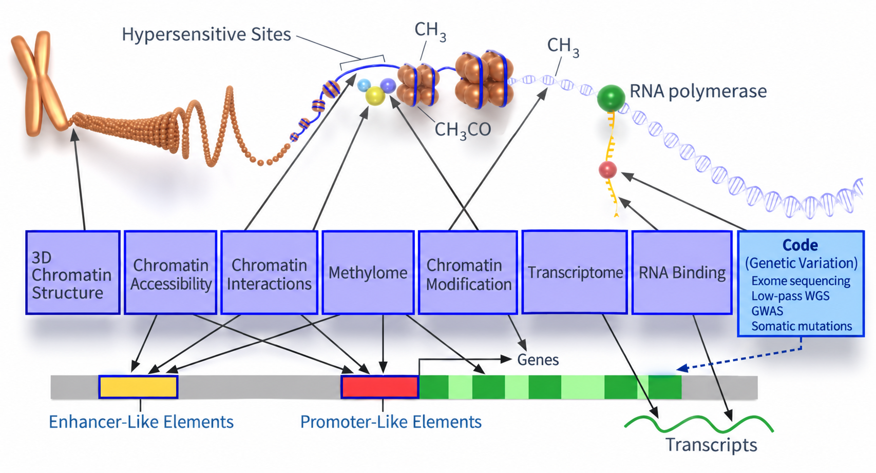
“Functional” DNA sequencing protocols
5C
ChIA-PET
Hi-C
SPRITE
Dnase-seq
ATAC-seq
ChIP-Seq
CUT&RUN
CUT&TAG
WGBS
RRBS
RNA-seq
CLIP-seq
Ribo-profiling
Genotyping
Exome seq
Low pass
Full genome
Notes:
Remake for specific types of sequencing

Slide 3
“Functional” RNA protocols
mRNA
lncRNAs
rRNAs
Small RNAs
(miRNA, tRNA, piRNA, snRNA, …)
RNA structure
RNA binding protein interactions
“CLIP-seq”
Translating RNA (ribosome-associated)
“Ribo-seq”
Notes:
Remake for specific types of sequencing

Slide 4
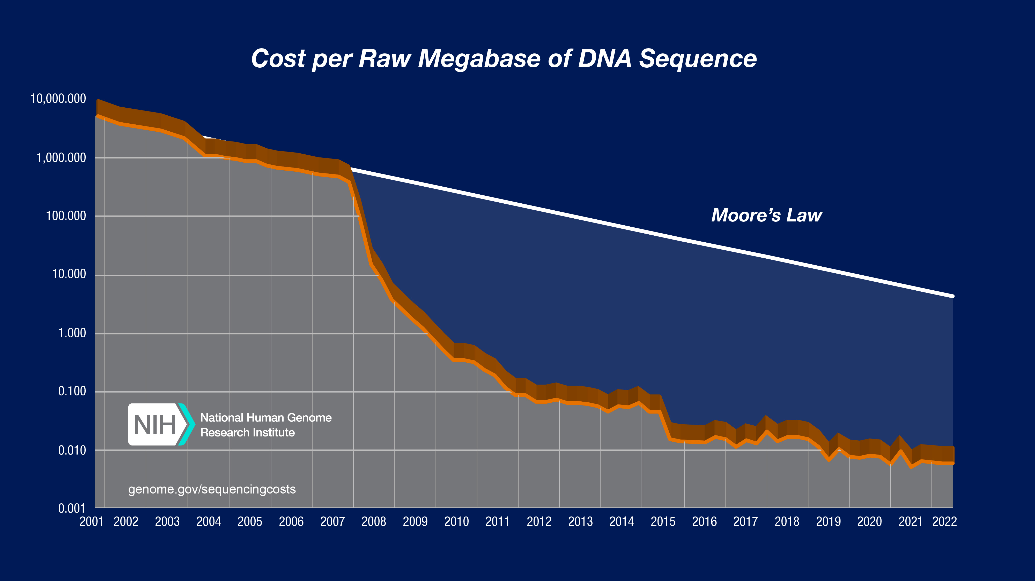
Sequencing analysis has not changed much
454 sequencer
Solexa sequencer
Sanger genome
finishing
ChIP-seq
RNA-seq
Chromosome structure:
segmental duplications
Single molecule
finishing
ChIP-seq
Peak calling
RNA-seq quant
RNA-seq transcript assembly
Estimating mutation rates
This last applicitions are counting applications

Slide 5
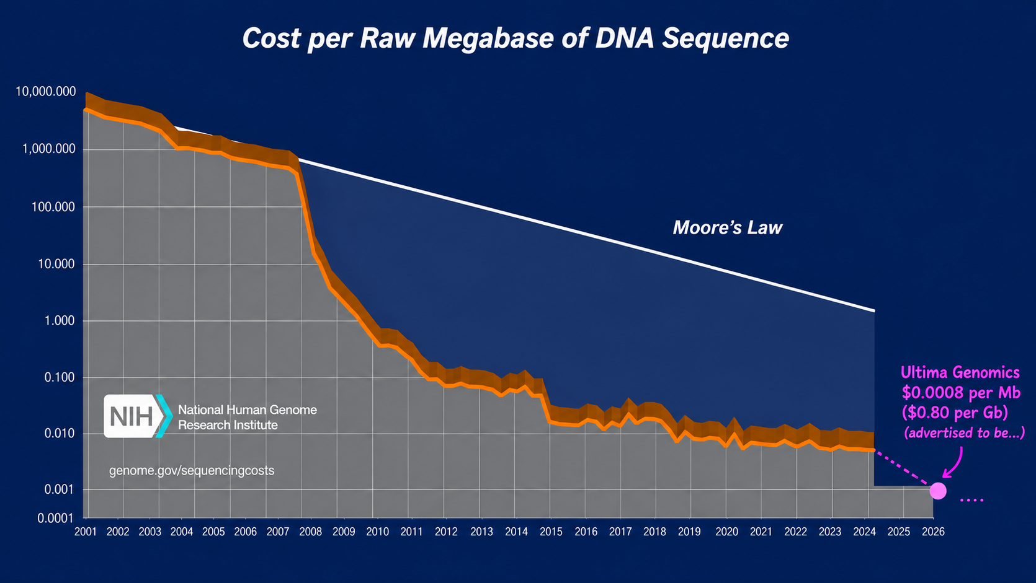
Sequencing analysis has not changed much
454 sequencer
Solexa sequencer
Sanger genome
finishing
ChIP-seq
RNA-seq

Slide 6
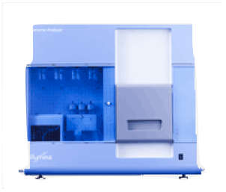


Measuring gene expression by sequencing
sequencer
Sequenced reads
cells
(c)DNA
Alignment
read coverage
genome

Slide 7
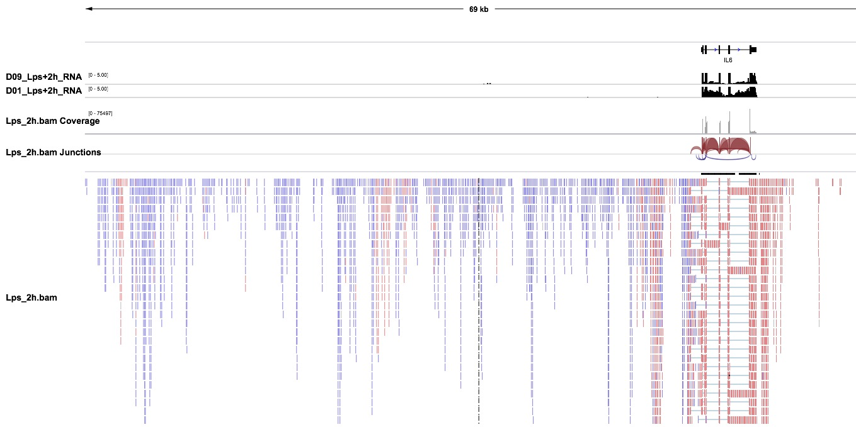
And (RNA) sequence data looks like this

Slide 8
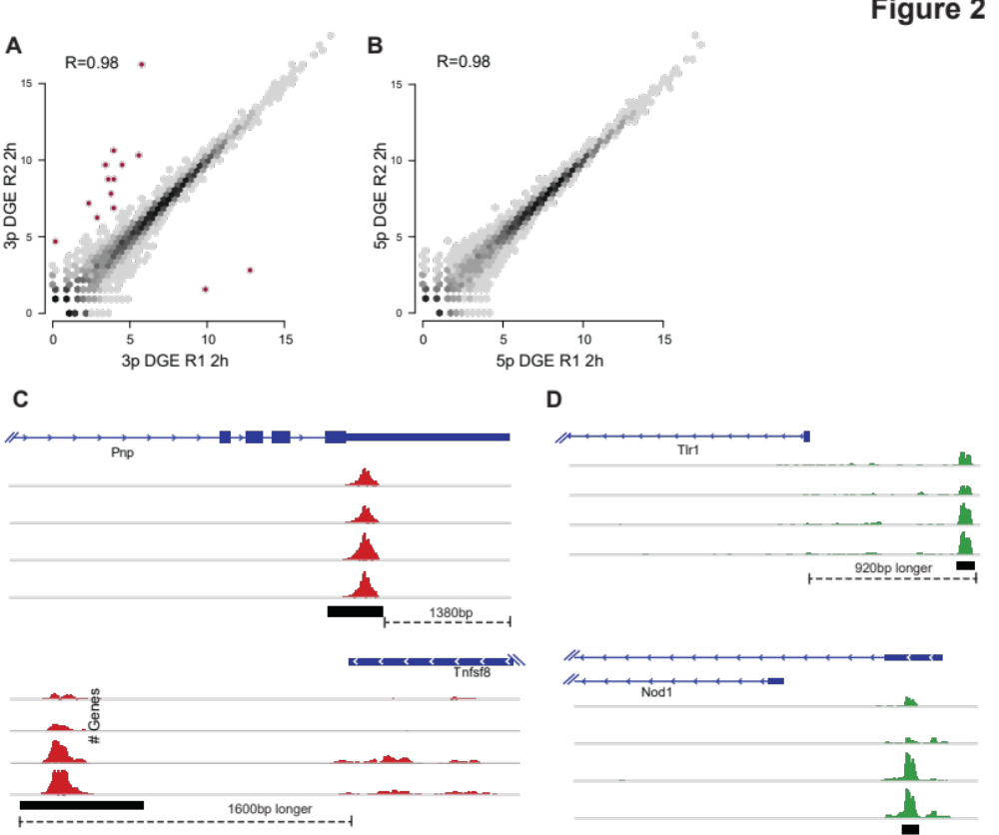
… or like this
Notes:
Remember … Kendal Tau =[ (# concordant pairs) – (# non concordant)]/n(n-1)/2
Recall: Use R for the example.

Slide 9
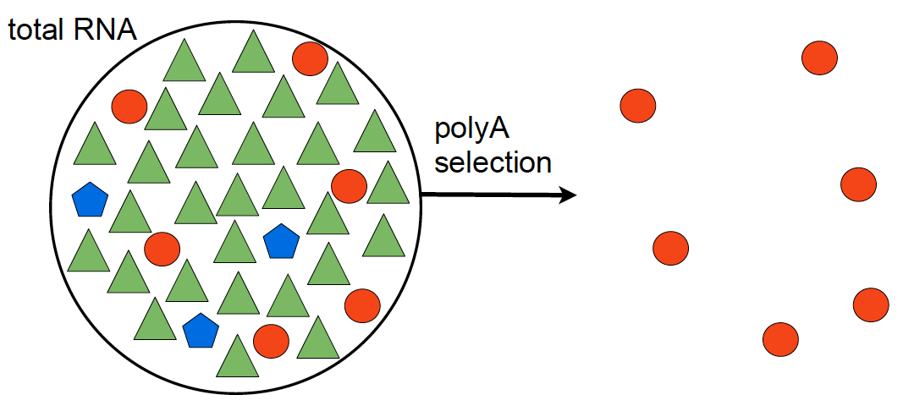
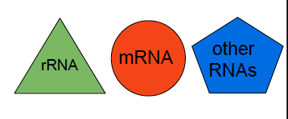
Many ways to get there – Library Preparation

Slide 10
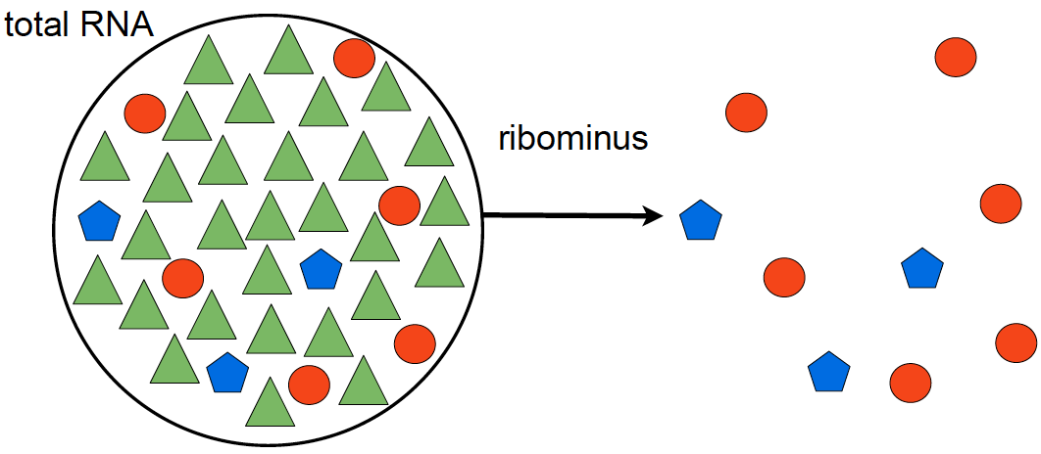
Library Preparation – removing unwanted species
polyA selection
ribominus selection
poly(A+)-transcripts:
  mRNAs
  immature microRNAs
  snoRNAs
non poly(A+)-transcripts:
  mRNAs
  histone mRNAs
  tRNAs
  other small RNAs
Notes:
snoRNAs (synthesized by RNA polymerase II).
histone mRNAs (generated by RNA polymerase II)
small RNAs generated by RNA polymerase III

Slide 11
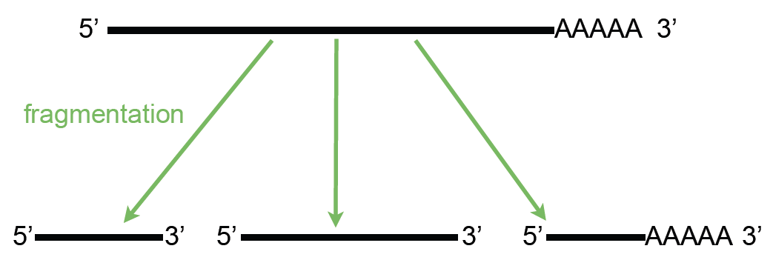
Library Preparation -- fragmentation

Slide 12
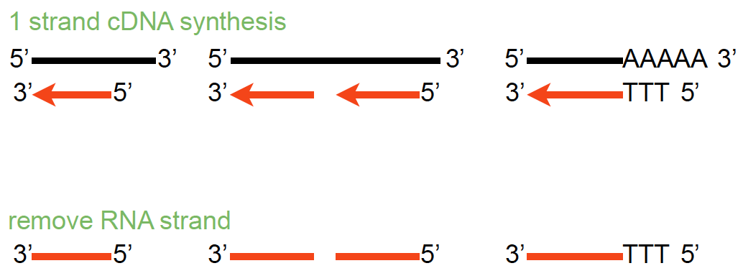
Library Preparation – Making cDNA

Slide 13
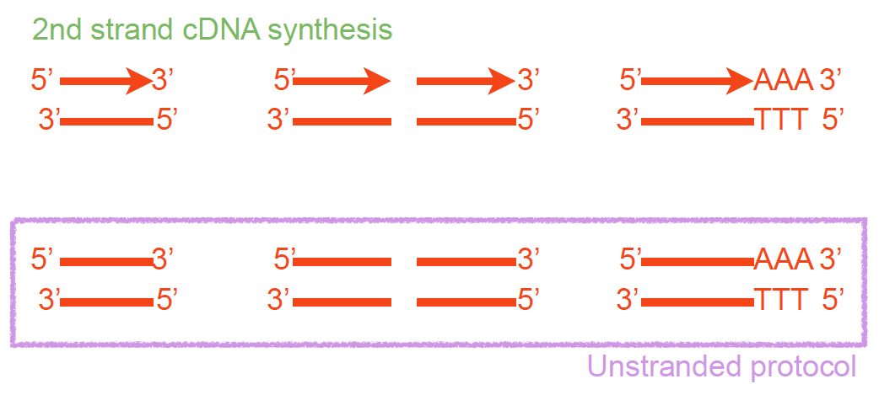
Library Preparation – Unstranded vs Stranded

Slide 14
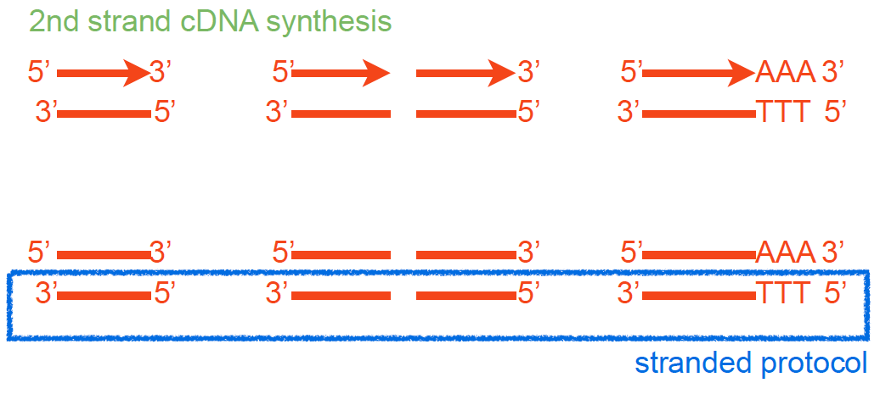
Library Preparation – Strand specific
Parkhomchuk, D., et al. (2009), Nucleic Acids Res, 37 (18), e123.

Slide 15
Library Preparation – Final steps have consequences
Fragmented cDNA
cDNA with adaptors
Size selection
PCR amplification
Notes:
Popy T magnetic beads used for polyA selection
RNA Mg and heat ; alkaline hydrolysis or nebulization) hydrojet - 200 – 500bp and cDNA fragmentation (DNase I treatment or sonication).
End repair after RT, addd A, adaptor ( contain seq compliment to the oligo in the flowcells and seq primer site)

Slide 16
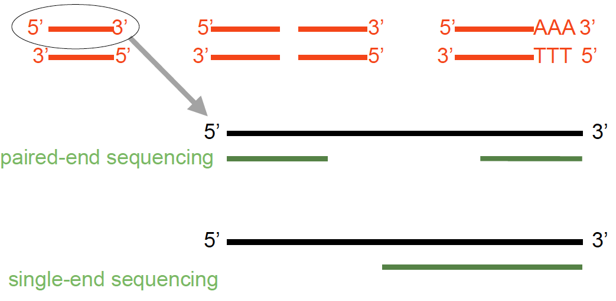
Sequencing a Library – paired vs single end

Slide 17
Single- vs paired-end sequencing
my_sequence.fastq
@HWI-BRUNOP16X_0001:1:1:1466:1018#0/1
AAGGAAGTGCTTGTCTGGCTAACACAGCNAGNCACGTGAC
+
aVfbe`^^^_TTTSSdffffdfffabbZbbfebafbbbbb
SE
my_sequence_1.fastq
@HWI-BRUNOP16X_0001:1:1:1278:989#0/1
NAAATTTCGAATTTCTGTGAAGTAAGCATCTTCTTTGTCAT
+
BJJGGKIINN^^^^^QQNTUQOOTTTRTOTY^^Y^\\^^^\
PE
my_sequence_2.fastq
@HWI-BRUNOP16X_0001:1:1:1278:989#0/2
AACCCACACAGGAGAGCAGCCTTACAGATGCAAATACTGTG
+
]K___fffffggghgeggggggdgggggfgggggegggghh
Notes:
Now it’s important to distinguish between SE and PE data
SE data is generated just as we described
The main difference with PE is that here we are using two different adaptors
And we are sequencing the molecule from both ends (and we know which end is)
This has the main advatage that we can obtain more information without having to sequence longer reads
For RNA-seq though PE data provides more information: splicing events
Also, for DNA-seq, SVs
In terms of output, different fastq files
Read names
Although the pipeline is the same, we’ll probably have to hange some options in the software we execute, as we’ll see

Slide 18
Having enough data (reads)
COVERAGE: How many reads do we need?
The coverage is defined as C = ( R_{length} x R_{num} ) / A_{length}
R_{length} = length in nucleotides of the reads
R_{num} = number of sequenced reads
A_{length} = number of nucleotides of sequenced subject (genome, transcriptome, exome)
The amount of sequencing needed for a given sample is determined by the goals of the experiment and the nature of the RNA sample.
Sims et al. Nature Reviews Genetics 15, 121–132 (2014)

Slide 19
From reads to gene expression

Slide 20
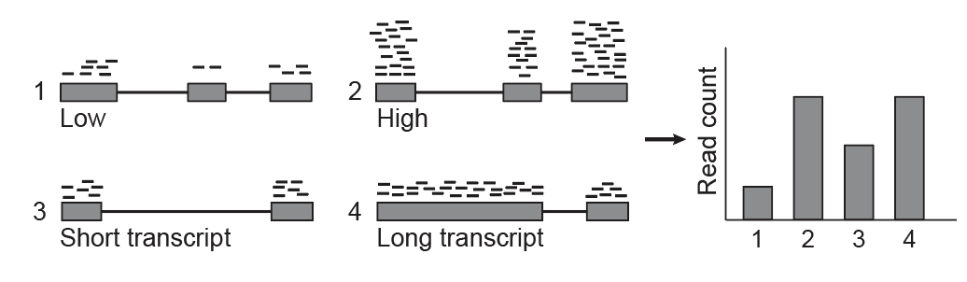
Larger transcripts generate more reads
Garber et. Al. Nat. Methods 2011

Slide 21
We need to normalize
RNA-Seq read output depends on:
Transcript expression level in the cell/tissue
Transcript length
Depth of sequencing
Can’t compare between genes or across samples

Slide 22
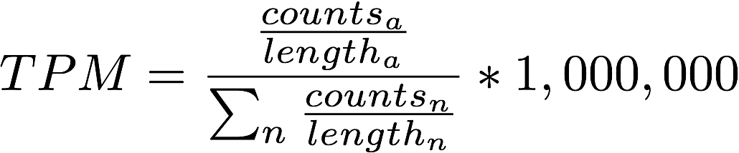
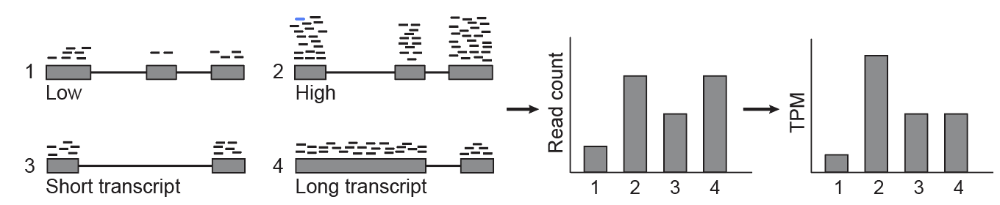
Transcripts per million (TPM) normalization
Transcripts per Million
Transcript length
Library sequencing depth
 | counts |  | TPM
sample | ctrl | exp | ctrl | exp
Fgf21 | 173 | 332 | 27097.5 | 76362.5

Slide 23
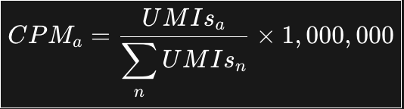
Properties of TPM
The sum of all TPMs is the same for all samples
Accounts for differences in sample sequencing depth
Accounts for gene length differences.
  if TPM_{g1} > TPM_{g2} then g₁ is more highly expressed than g₂
For 3’ end libraries such as single cell, the equivalent for TPM is

Slide 24
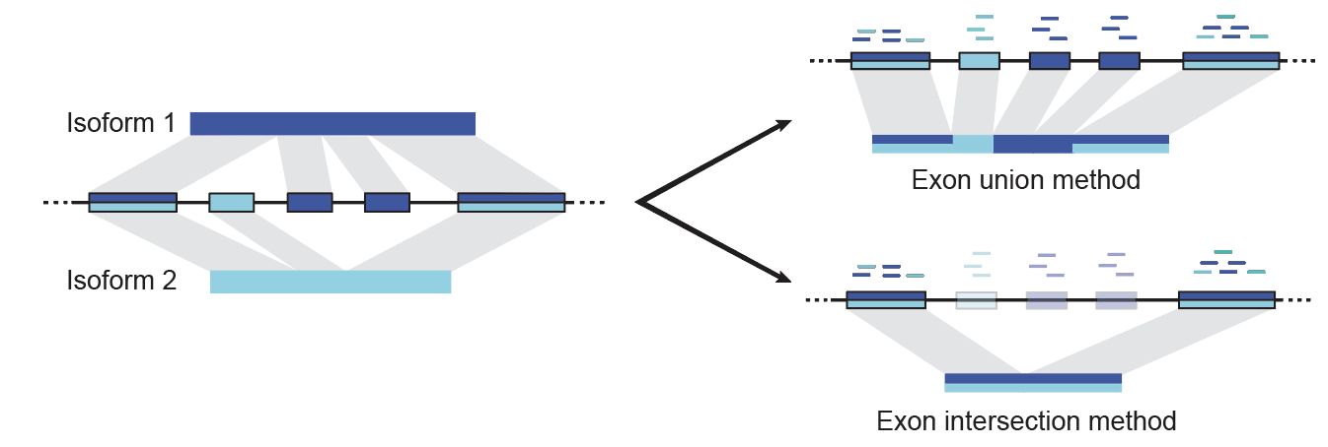
What counts?, What Length?
How do we define the length of a gene?
Can we estimate the expression of each isoform?
Solution: Estimate the expression of each isoform and use an effective gene length that weighs the length contribution of each isoform
Garber et. Al. Nat. Methods 2011

Slide 25
Wait! – Isoforms share exons!
Problem: Multimapping reads
Since isoforms share exons, many reads map to more than one isoform
Genes with close paralogs generate reads that may not map uniquely
Solution: Probabilistic read assignment
Use unique reads to estimate a prior of isoform proportions and assign reads proportionally
In general: Use any available feature to assign reads uniquely!

Slide 26
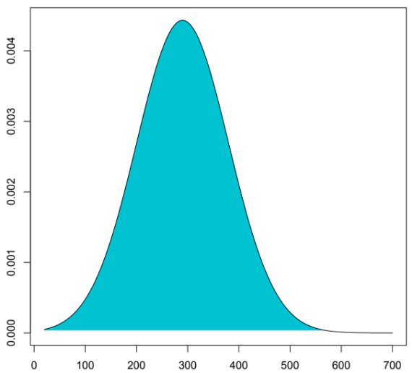
Example: Use fragment sizes in paired libraries
P₁
P₂
Get all single isoform reconstructions
Splice and compute insert distance
d₁
d₂
Estimate insert size empirical distribution

Slide 27
The gene expression table
Genes are quantified. Each gene or isoform has:
  A TPM value
  A (expected) fragment count vaue
All samples were quantified in the same fashion and arranged into a table of genes (22,000) x samples (24).
  Row i gives the expression of the gene i across all samples
  Row j gives the expression of genes in sample j.
gene | L^{Δ1,2}.rep1 | L^{Δ1,2}.rep2 | L^{Δ1,2}.rep3 | L^{Δ1.}rep1 | L^{Δ1}.rep2 | L^{Δ1}.rep3 | L^{Δ2}.rep1 | L^{Δ2}.rep2 | L^{Δ2}.rep3
Mir301 | 0 | 0 | 0 | 0 | 0 | 0 | 0 | 0 | 0
Cpne2 | 157 | 158.98 | 88.04 | 69 | 111.99 | 114.33 | 93 | 208 | 140
Capn5 | 36 | 65 | 46 | 46 | 69 | 42 | 33 | 58 | 59.01
Lage3 | 313.06 | 241.23 | 276.23 | 218.9 | 285.19 | 359.65 | 269.7 | 359.04 | 417.47
Brd7 | 379 | 358.58 | 390 | 336 | 357.26 | 368.08 | 264 | 564.07 | 476
Dimt1 | 77 | 68 | 58 | 54 | 62 | 60 | 54 | 76 | 97.03
AK017068 | 0 | 0 | 0 | 0 | 0 | 0 | 0 | 0 | 0

Slide 28
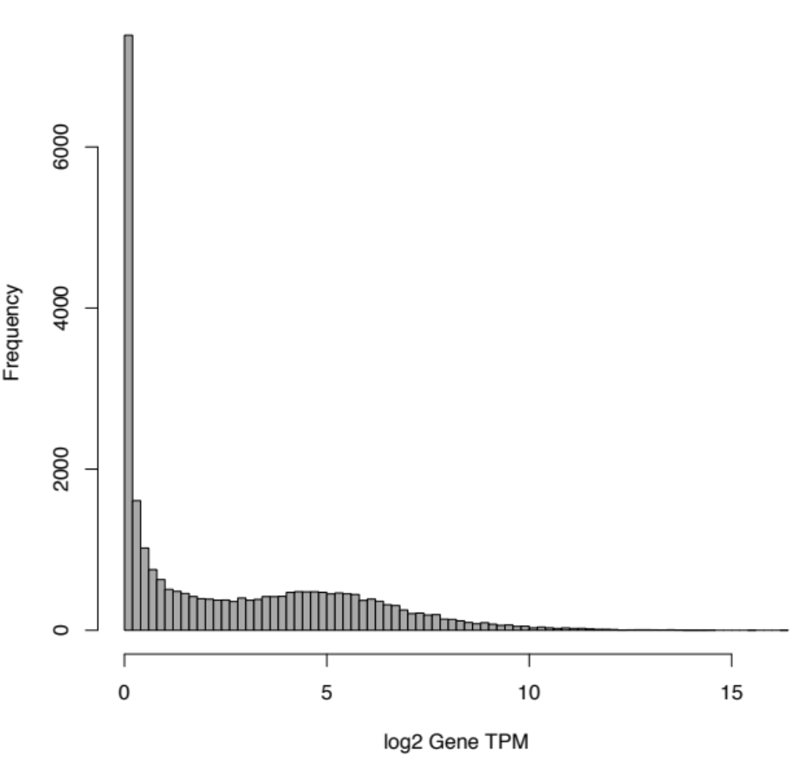
Q1: Who is expressed?

Slide 29
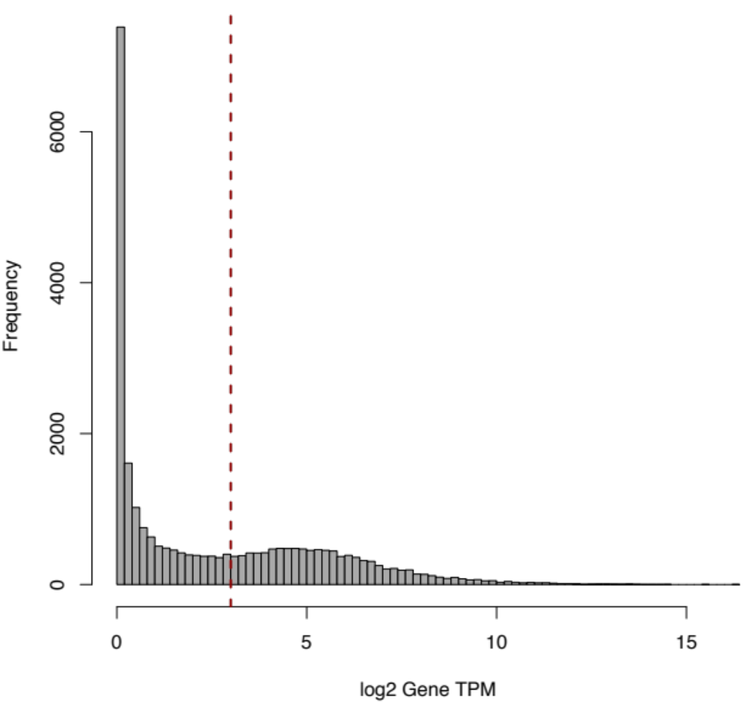
Q1: Who is expressed?
~10,000 genes

Slide 30
Exploratory analysis – Clustering and PCA
Matrices are too large, takes too much compute power:
  Initial 25,000 x 24 = 500,000 entries
  Filtering reduces by half: 250,000 entries
We can focus on interesting genes. Which ones?
  Genes that vary most are most informative, how do we find them?
    Variance or standard deviation
    Coefficient of variance: sd/mean!

Slide 31
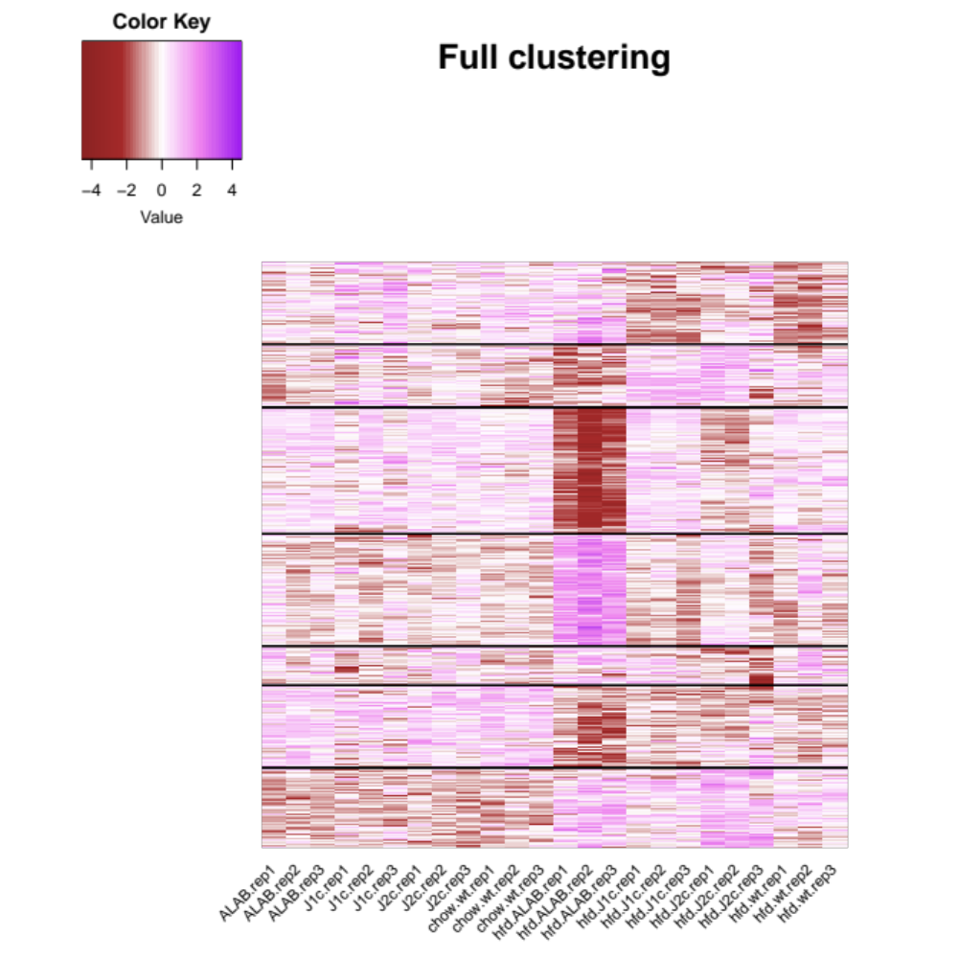






Task 3: How can I look at ALL my data at once?
Sort by CV plot top variable genes, but also “log-scale” and “k-cluster” values
Normal diet
High Fat diet

Slide 32
Sample composition impacts transcript relative abundance
Cell type I
Cell type II
Normalizing by total reads does not work well for samples with very different RNA composition, every gene will look different!

Slide 33
Sample composition impacts transcript relative abundance
Cell type I
Cell type II
Gene | Cell Type I TPM | Cell Type II TPM
 | 4/9 | 4/18

Slide 34
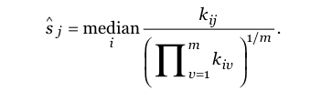
Example normalization techniques
Counts for gene i in experiment j
Geometric mean for that gene
over ALL experiments
i runs through all n genes
j through all m samples
k_{ij} is the observed counts for gene i in sample j
s_{j} Is the normalization constant
Alders and Huber, 2010

Slide 35
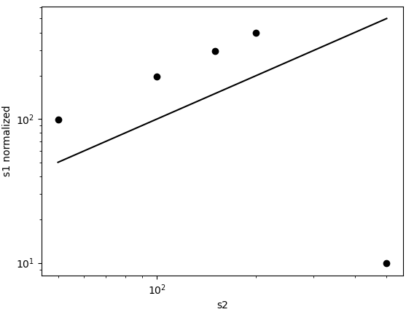
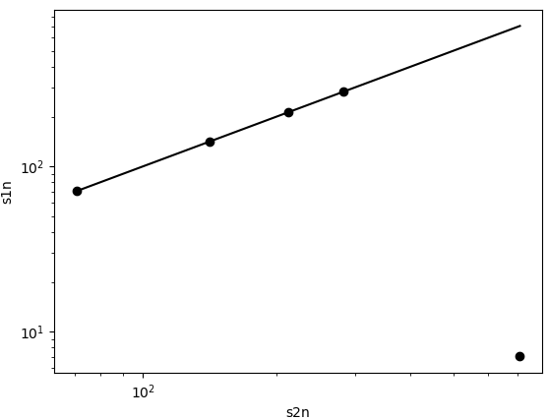
Lets do an experiment
import numpy as np
import matplotlib.pyplot as plt
# Define the sequences
s1 = np.array([100, 200, 300, 400, 10])
s2 = np.array([50, 100, 150, 200, 500])
# Calculate the normalization factor
norm = sum(s2) / sum(s1)
# Plot s2 vs. s1 normalized, on a log-log scale
plt.figure()
plt.loglog(s2, s1 * norm, 'o') # 'o' specifies that the markers are dots
plt.xlabel('s2')
plt.ylabel('s1 normalized')
plt.plot([min(s2), max(s2)], [min(s2), max(s2)], 'k-') # 'k-' specifies a black line
# Calculate the geometric mean
g = np.sqrt(s1 * s2)
# Normalize s1 and s2 by the median of their respective ratios to g
s1n = s1 / np.median(s1 / g)
s2n = s2 / np.median(s2 / g)
# Plot s2n vs. s1n, on a log-log scale
plt.figure()
plt.loglog(s2n, s1n, 'o') # 'o' specifies that the markers are dots
plt.xlabel('s2n')
plt.ylabel('s1n')
plt.plot([min(s2n), max(s2n)], [min(s2n), max(s2n)], 'k-') # 'k-' specifies a black line
plt.show()
Similar read number,
one transcript many fold changed
Size normalization results in 2-fold changes in all transcripts

Slide 36
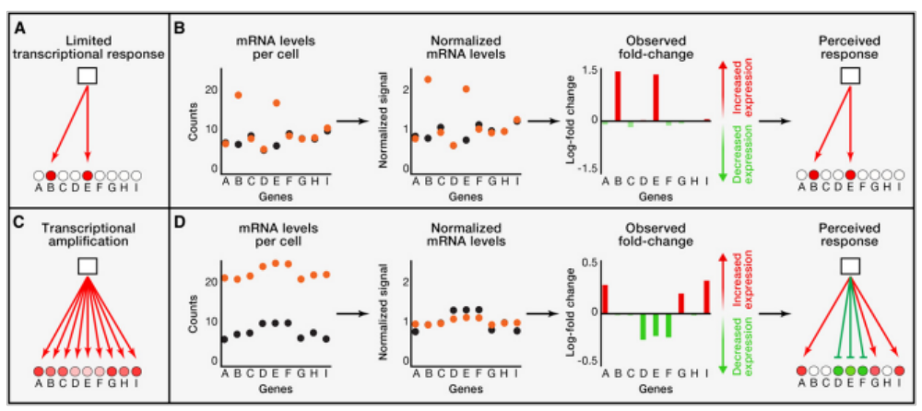
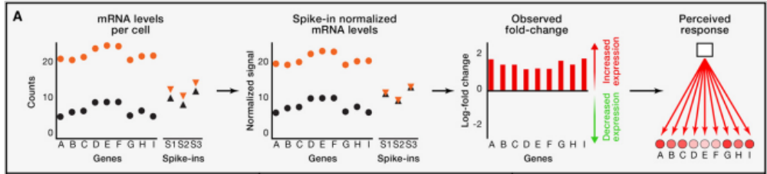
When everything changes: Spike-ins
Lovén et al, Cell 2012

Slide 37
References and thanks to
Slides: Elisa Donnard, Athma Pai, Aaron Quinlan / Cartoons: BioRender, EMBL-EBI
https://michelebusby.tumblr.com/post/26913184737/thinking-about-designing-rna-seq-experiments-to ← Designing RNA-Seq experiments
RNA-seq workflow: gene-level exploratory analysis and differential expression https://bioconductor.org/packages/release/workflows/vignettes/rnaseqGene/inst/doc/rnaseqGene.html ← Tutorial with examples
Anders S, Huber W. Differential expression analysis for sequence count data. Genome Biol. 2010;11(10):R106. https://doi:10.1186/gb-2010-11-10-r106 ← DESeq
https://www.bioconductor.org/packages/release/bioc/vignettes/edgeR/inst/doc/edgeRUsersGuide.pdf ← edgeR user guide
Bo Li, Victor Ruotti, Ron M. Stewart, James A. Thomson, Colin N. Dewey, RNA-Seq gene expression estimation with read mapping uncertainty, Bioinformatics, Volume 26, Issue 4, 15 February 2010, Pages 493–500, https://doi.org/10.1093/bioinformatics/btp692

Slide 38
Intro to live session

Slide 39
Can finish without a comment on AI
Are these models “text completion” tools?
  No, while pre-training relies on text completion strategies, the emergent behavior is much more complex than “completion”
  Post-training methods that result in “reasoning” are well beyong what pre-trained models can do.
  Bill Gates put it best. ““Biological minds, you know, it's amazing how general purpose they are in that the optimization was staying alive, breeding, socializing with each other for survival”. So, in AI terms
    Objective function: Maximize reproductive fitness, broadly speaking.
    Substrate: A biological neural network constrained by energy consumption, anatomy, developmental processes, and evolutionary history.
    Optimization: Natural selection operating over millions of generations.
    Emergent capabilities: Abstract mathematics, theoretical physics, music, philosophy, and the ability to construct artificial intelligence.
  I encourage any user of these models to follow the impact of this technology:
    https://youtu.be/A_156w0aYtU?si=_PZVQYEIJaphvYTl (bill gates interview)
    https://youtu.be/HjurAWAr_nY?si=6dbE1qaGTvKbcwxo (Jensen Huang)

