Slide 1

RNA-Seq primer

Slide 2

Sequencing: applications
Counting applications
Profiling
microRNAs
Immunogenomics
Transcriptomics
Epigenomics
Map histone modifications
Map DNA methylation
3D genome conformation
Nucleic acid Interactions
Polymorphism/mutation discovery
Bacteria
Genome dynamics
Exon (and other target) sequencing
Disease gene sequencing
Variation and association studies
Genetics and gene discovery
Cancer genomics
Map translocations, CNVs, structural changes
Profile somatic mutations
Genome assembly
Ancient DNA (Neanderthal)
Pathogen discovery
Metagenomics
Notes:
This can all be done on a scale that was impossible before

Slide 3
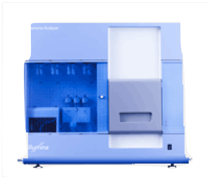


Counting applications
sequencer
Sequenced reads
cells
cDNA
ChIP
Alignment
read coverage
genome

Slide 4
Sequencing libraries to probe the genome
RNA-Seq
Transcriptional output
Annotation
miRNA
Ribosomal profiling
ChIP-Seq
Nucleosome positioning
Open/closed chromatin
Transcription factor binding
CLIP-Seq
Protein-RNA interactions
Hi-C
3D genome conformation

Slide 5
RNA-Seq libraries I: “Standard” full-length
“Source: intact, high qual. RNA (polyA selected or ribosomal depleted)
RNA → cDNA → sequence
Uses:
Annotation. Requires high depth, paired-end sequencing. ~50 mill
Gene expression. Requires low depth, single end sequence, ~ 5-10 mill
Differential Gene expression. Requires ~ 5-10 mill, at least 3 replicates, single end

Slide 6
RNA-Seq libraries II: End-sequence libraries
Target the start or end of transcripts.
Source: End-enriched RNA
Fragmented then selected
Fragmented then enzymatically purified
Uses:
Annotation of transcriptional start sites
Annotation of 3’ UTRs
Quantification and gene expression
Depth required 3-8 mill reads
Low quality RNA samples

Slide 7
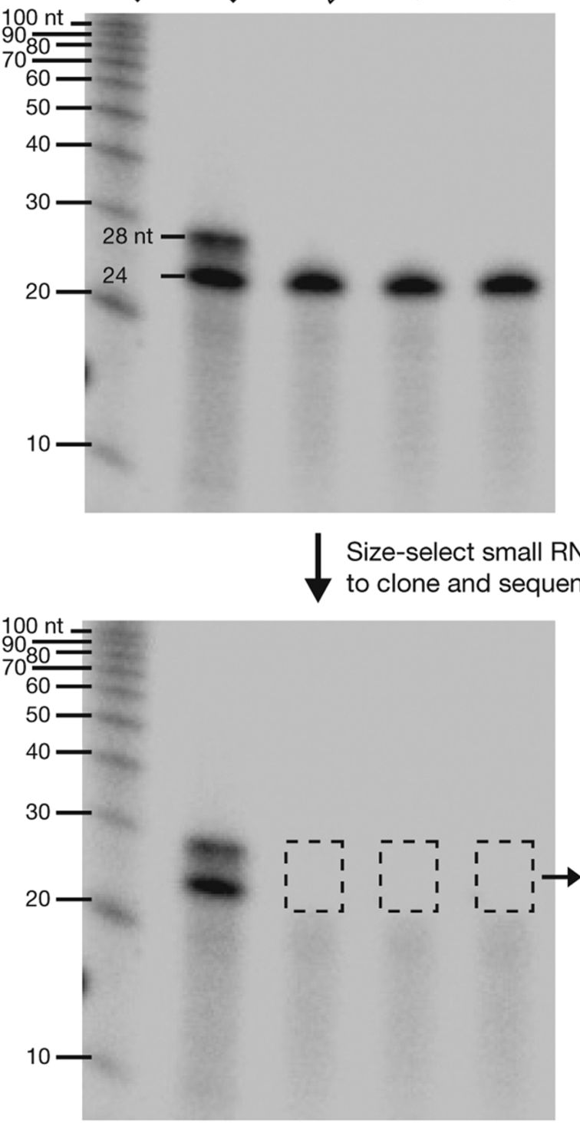
RNA-Seq libraries III: Small RNA libraries
Source: size selected RNA
Uses: miRNA, piRNA annotation and quantification
Short single end 30-50 bp reads
Require “clipping”
Depth: 5-10 mill reads
Malonne et al. CSHL protocols, 2011

Slide 8
When you need both annotation and quantification
Attempt three replicates per condition
Pool libraries to obtain ~15 mill reads per replicate
Sequence using paired ends
Analysis:
Merge replicate alignments for annotation
Split alignments for differential expression analysis

Slide 9
Our typical RNA quantification pipeline
Upload your
sequence data (fastq)
Make report of quality metrics
Output ribosomal contamination metrics report
Align to the ribosome (Bowtie)
Produce RNA-Seq report
% aligned, % intergenic, % exonic, % UTR
Align remaining reads to genome (TopHat) or transcriptome (RSEM)
Produce IGV/UCSC friendly files
Quantify transcriptome
Produce a table with normalized expression values
Call differentially expressed genes
(if multiple samples)
Report pairwise significant genes that are differentially expressed

Slide 10
Alignment requires pre-processing
Upload your
sequence data (fastq)
Make report of quality metrics
Output ribosomal contamination metrics report
Align to the ribosome (Bowtie)
Align remaining reads to genome (TopHat) or transcriptome (RSEM)
bowtie2-build -f mm10.fa mm10
rsem-prepare-reference \
--gtf ucsc.gtf --transcript-to-gene-map ucsc_into_genesymbol.rsem \
mm10.fa mm10.rsem

Slide 11
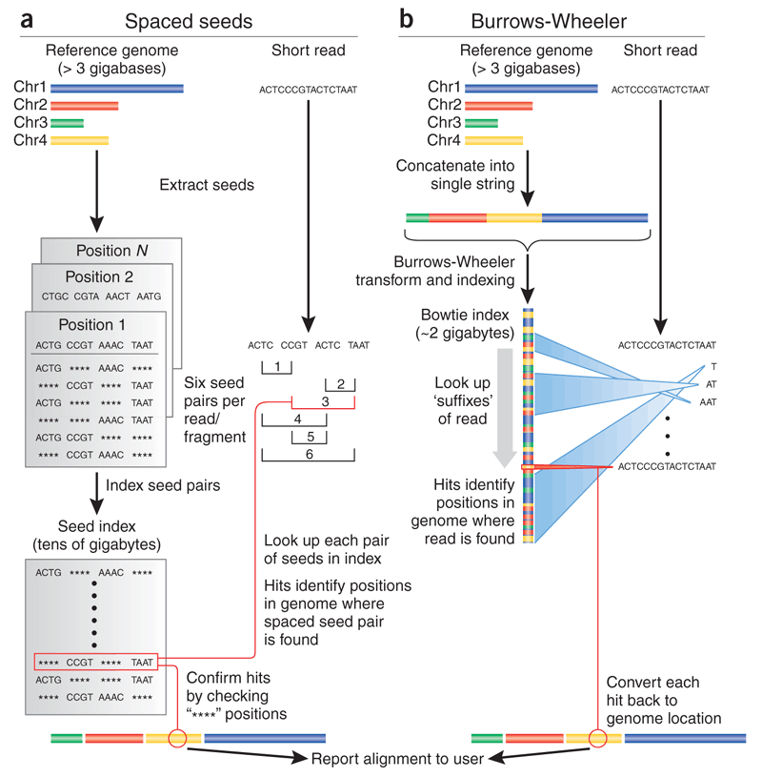
Trapnell, Salzberg, Nature Biotechnology 2009

Slide 12
Spaced seed alignment – Hashing the genome
G: accgattgactgaatggccttaaggggtcctagttgcgagacacatgctgaccgtgggattgaatg……
Store spaced seed positions
accg attg **** ****
0
0
0,45
0
0
0
accg **** actg ****
accg **** **** aatg
**** attg actg ****
**** attg **** aatg
**** **** actg aatg
ccga ttga **** ****
1
1
1
1
1
1
ccga **** ctga ****
ccga **** **** atgg
**** ttga ctga ****
**** ttga **** atgg
**** **** ctga atgg
Notes:
Of course there are on average tens of thousands of entries in each table cell.

Slide 13
Spaced seed alignment – Mapping reads
G: accgattgactgaatggccttaaggggtcctagttgcgagacacatgctgaccgtgggattgaatg……
accg attg **** ****
0
0
0,45
0
0
0
✕
q: accg atag accg aatg
accg **** actg ****
✕
accg **** **** aatg
✓
accgattgactgaatg
accgtgggattgaatg
**** attg actg ****
✕
**** attg **** aatg
✕
2 missmatches
5 missmatches
**** **** actg aatg
✕
ccga ttga **** ****
1
1
1
1
1
1
✕
Report position 0
ccga **** ctga ****
✕
ccga **** **** atgg
✕
But, how confidence are we in the placement?
**** ttga ctga ****
✕
**** ttga **** atgg
✕
**** **** ctga atgg
✕

Slide 14
Mapping quality
What does
mean?
Lets compute the probability the read originated at genome position i
q: accg atag accg aatg
q_{s} : 30 40 25 30 30 20 10 20 40 30 20 30 40 40 30 25
, the PHRED score. Equivalently:
So the probability that a read originates from a given genome position i is:
In our example

Slide 15
Mapping quality
What we want to estimate is
That is, the posterior probability, the probability that the region starting at i was sequenced given that we observed the read q:
Fortunately, there are efficient ways to approximate this probability (see Li, H genome Research 2008, for example)
Notes:
We really do not care about the probability that such read is generated by the region starting at position i, instead we want to know what is the probability that we sequenced the region at position i, given that we see the read q.

Slide 16
Considerations
Trade-off between sensitivity, speed and memory
Smaller seeds allow for greater mismatches at the cost of more tries
Smaller seeds result in a smaller tables (table size is at most 4^{k}), larger seeds increase speed (less tries, but more seeds)
Notes:
We really do not care about the probability that such read is generated by the region starting at position i, instead we want to know what is the probability that we sequenced the region at position i, given that we see the read q.

Slide 17
Short read mapping software
Seed-extend
BWT
 | Short indels | Use base qual
Maq | No | YES
RMAP | Yes | YES
SeqMap | Yes | NO
SHRiMP | Yes | NO
 | Use Base qual
BWA | YES
Bowtie | NO
Stampy* | YES
Bowtie2* | (NO)
*Stampy is a hybrid approach which first uses BWA to map reads then uses seed-extend only to reads not mapped by BWA
*Bowtie2 breaks reads into smaller pieces and maps these “seeds” using a BWT genome.
Notes:
Talk about the STAR aligner

Slide 18
RNA-Seq Read mapping
Notes:
If you have a reference genome of high quality, mapping reads leverages this information. Most eukaryote transcripts result from splicing events. RNASeq reads come from molecules that map to the genome as small exons within several KBs of genomic sequence. This makes RNA-Seq reads particularly complex to map. RNASeq reads come in three flavors: Those that map to single exons, those that map to two or more spliced exons and those that contain portions of the PolyA tail. Mapping all three classes results in optimal, coverage, connectivity and transcript end mapping.

Slide 19
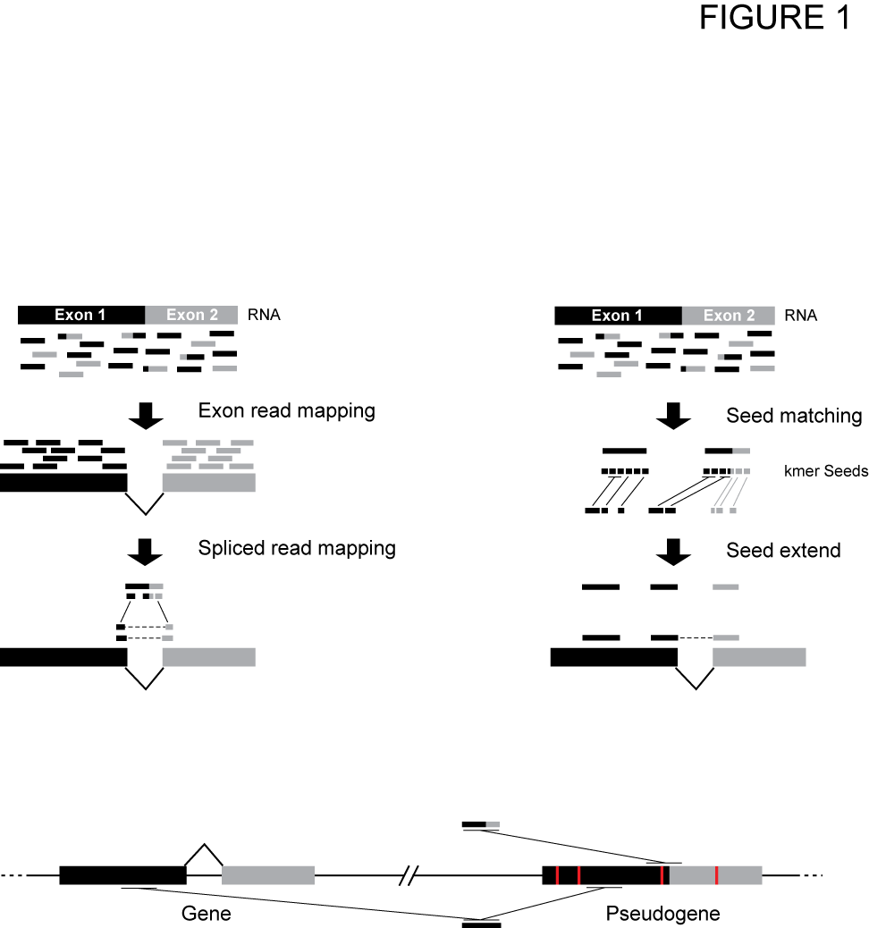
Mapping RNA-Seq reads: Seed-extend spliced alignment (e.g. GSNAP)

Slide 20
Mapping RNA-Seq reads: Exon-first spliced alignment (e.g. TopHat)

Slide 21
Short read mapping software for RNA-Seq
Seed-extend
Exon-first
 | Short indels | Use base qual
GSNAP | Yes | ?
QPALMA | Yes | NO
BLAT | Yes | NO
 | Use base qual
STAR | NO
TopHat | NO
Exon-first alignments will map contiguous first at the expense of spliced hits

Slide 22
Alignment requires pre-processing
Upload your
sequence data (fastq)
Make report of quality metrics
Output ribosomal contamination metrics report
Align to the ribosome (Bowtie)
Align remaining reads to genome (TopHat) or transcriptome (RSEM)
tophat2 --library-type fr-firststrand --segment-length 20 \
-G genome.quantification/ucsc.gtf -o tophat/th.quant.ctrl1 \
genome.quantification/mm10 fastq.quantification/control_rep1.1.fq \
fastq.quantification/control_rep1.2.fq
/project/umw_biocore/bin/igvtools.sh count -w 5 tophat/th.quant.ctrl1.bam \ tophat/th.quant.ctrl1.bam.tdf genome.quantification/mm10.fa

Slide 23
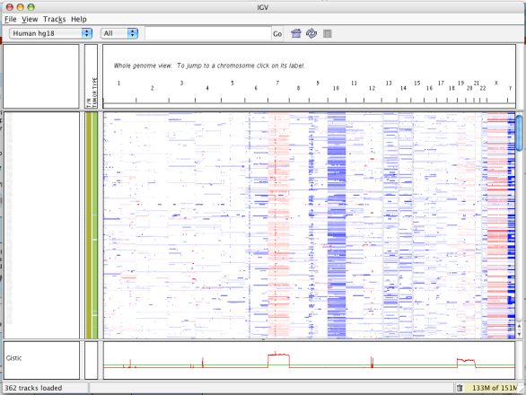
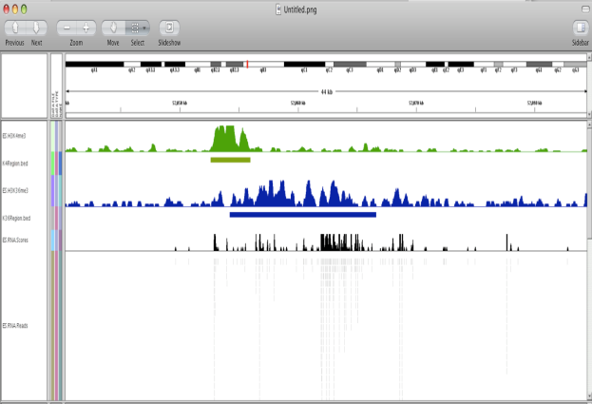
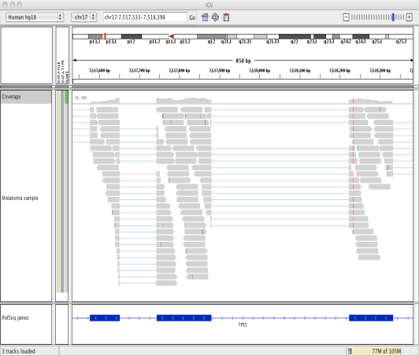
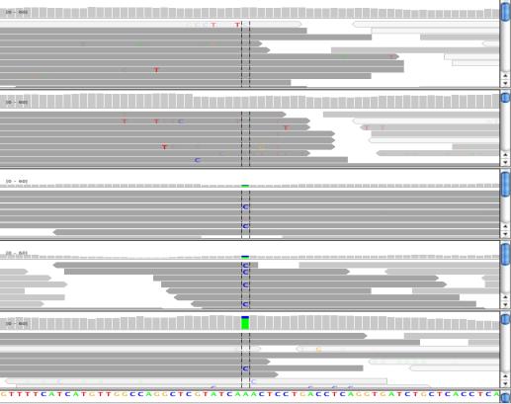
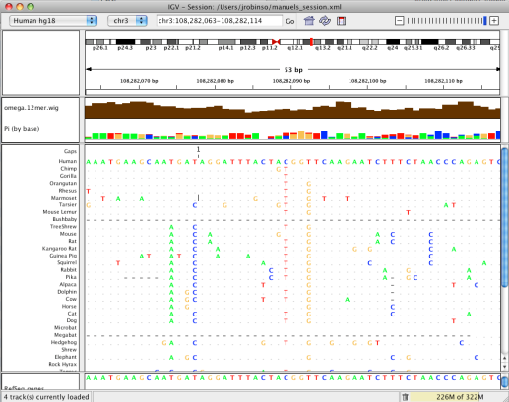
IGV: Integrative Genomics Viewer
A desktop application
for the visualization and interactive exploration
of genomic data
Microarrays
Epigenomics
RNA-Seq
NGS alignments
Comparative genomics
Notes:
Visualization of data is a key need in this field, IGV currently has all the necessary features to allow
* Desktop app – you run on your computer – not through a Web browser (like UCS genome browser)
Viewer – not computational tool
Supports any type of data that can be mapped to the genome.
Ask who works with what type of data

Slide 24
Visualizing read alignments with IGV — RNASeq
Strand specific library!
Gap between reads spanning exons

Slide 25
Visualizing read alignments with IGV — zooming out

Slide 26
How do “short” read aligners responded to read increase?
Break reads into seeds (e.g. 16nt every 10nt)
Use BWT or HashTable to find candidate positions
Prioritize candidates
Extend top candidates using classical alignment techniques.
Aligner | Technique
TopHat2 (Bowtie2) | BWT
GSNAP | Hash Table
STAR | Suffix (similar to TopHat)
Notes:
Don’t forget to mention that we are using GSNAP

Slide 27
Computing gene expression
Upload your
sequence data (fastq)
Make report of quality metrics
Output ribosomal contamination metrics report
Align to the ribosome (Bowtie)
Produce RNA-Seq report
% aligned, % intergenic, % exonic, % UTR
Align remaining reads to genome (TopHat) or transcriptome (RSEM)
Produce IGV/UCSC friendly files
Quantify transcriptome
Produce a table with normalized expression values
rsem-calculate-expression --paired-end --strand-specific -p 2 \
--output-genome-bam fastq.quantification/control_rep1.1.fq \
fastq.quantification/control_rep1.2.fq genome.quantification/mm10.rsem \
rsem/ctrl1.rsem

Slide 28
RNA-Seq quantification
Is a given gene (or isoform) expressed?
Is expression gene A > gene B?
Is expression of gene A isoform a₁ > gene A isoform a₂?
Given two samples is expression of gene A in sample 1 > gene A in sample 2?

Slide 29
Quantification: only one isoform
Reads per kilobase of exonic sequence per million mapped reads
(Mortazavi et al Nature methods 2008)
Fragmentation of transcripts results in length bias: longer transcripts have higher counts
Different experiments have different yields. Normalization is key for cross lane comparisons
Complexity increases when multiple isoforms exist

Slide 30
Normalization for comparing two different genes
To compare within a sequence run (lane), RPKM accounts for length bias.
RPKM is not optimal for cross experiment comparisons.
Different samples may have different compositions.
FPKM superseded RPKM
And later TPM = 10⁶ x Fraction of transcript

Slide 31
Normalization for comparing a gene across samples
Cell type I
Cell type II
Normalizing by total reads does not work well for samples with very different RNA composition

