Slide 1
Systematic Introduction of single cell RNASeq analysis.
Zhaorong Li

Slide 2
Introduction: Overview
Single Cell RNASeq protocols have been very popular for the recent few years.
The processing of single cell RNASeq data can sound very challenging.
However, the steps are actually very straight-forward.

Slide 3
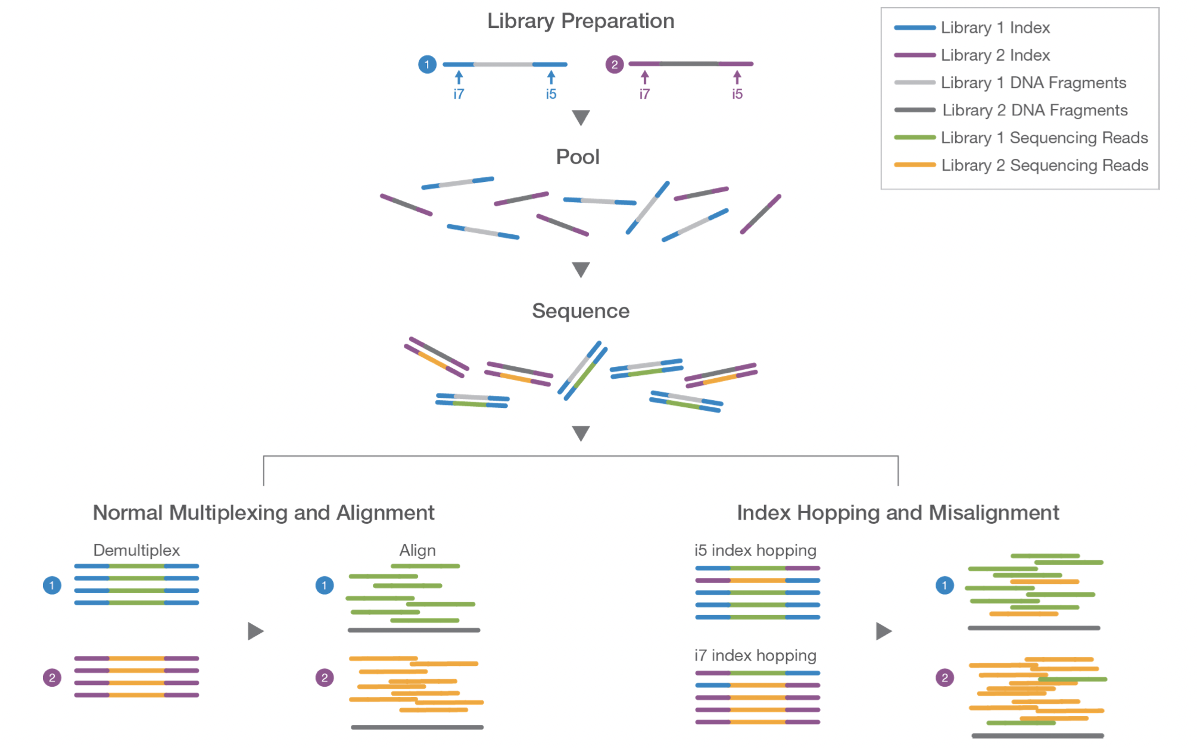
Introduction: Overview

Slide 4
Introduction: Overview
By using multiplexed library barcodes, multiple different samples can be sequenced together, depending on how many plates a researcher is willing to use during the process.

Slide 5
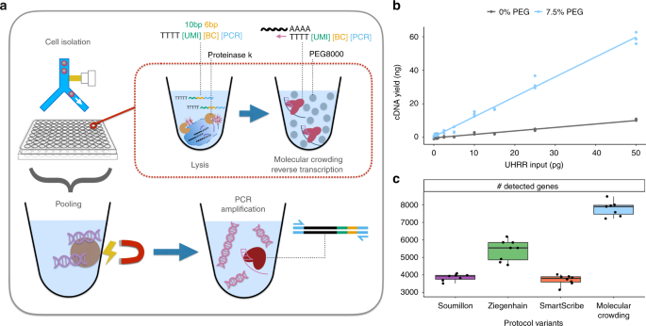
Introduction: Overview
The library multiplexing technique gives birth to the very first attempt of single cell RNASeq:
Each library contains only one cell.
Sequence hundreds of library.
Yield a single cell RNASeq sample contains hundreds of cells.

Slide 6
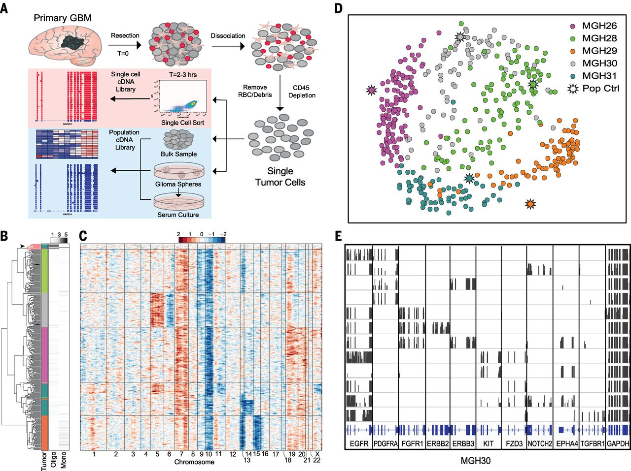
Introduction: Overview
This is called well-based single cell RNASeq protocols. Examples are:
Smart-Seq
CEL-Seq
MARS-Seq
etc

Slide 7
Introduction: Overview
Issues of well-based protocols:
Low cell number
High cost (needs a lot of plates and man-power)

Slide 8
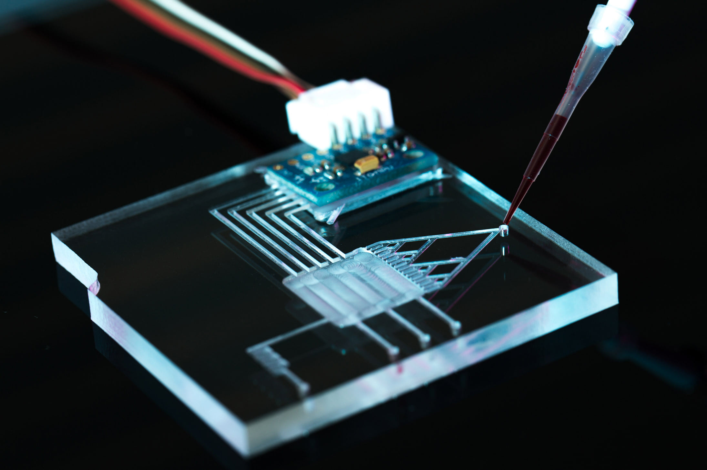
Introduction: Overview
The invention of microfluidic device changes everything.
Microfluidic device utilizes nano-scale construction of channels and fluid control technology, allowing automated and controlled flowing of fluids.

Slide 9
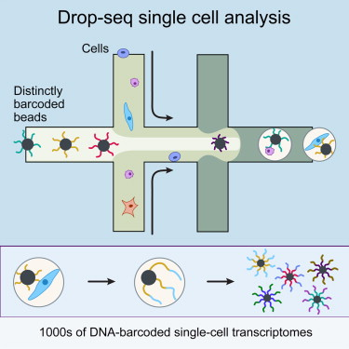
Introduction: Overview
By using microfluidic device, the experiment can flow hundreds of thousands of cells into hundreds of thousands of wells, lowering the cost of experiment and increase the number of cells profiled per experiment.
Example of this approach:
10X
inDrops
Drop-Seq
etc

Slide 10
Introduction: steps to process the data
Alignment and quantification.
Filtering empty cells, doublet cells and dying cells.
Normalization.
Dimension Reduction.
Clustering.
Annotation.

Slide 11
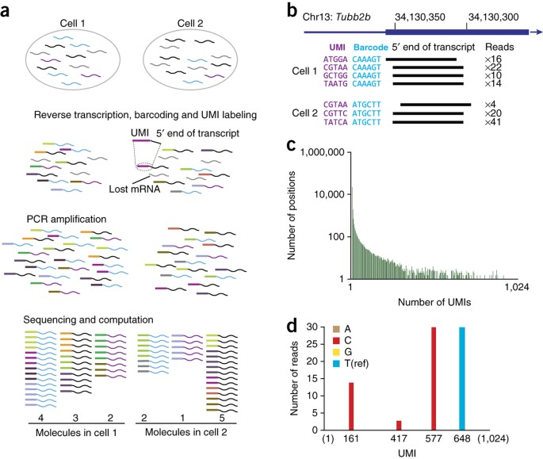
Alignment and quantification.
This step is computationally intensive for the following 2 reasons:
Each sample contains hundreds, if not thousands of cells, and each cell needs to be quantified individually.
Each read has one UMI (unique molecular identifier), this is used to remove PCR duplicates and recover the true transcriptome landscape of each cell.

Slide 12

Introduction: Filtering of cells
Like all machines created, the microfluidic device is not flawless.
Three common errors are created by the microfluidic device:
Empty cell

Slide 13

Filtering of cells
Like all machines created, the microfluidic device is not flawless.
Three common errors are created by the microfluidic device:
Empty cell
Multiplet (multiple cells tagged as one cell)

Slide 14

Filtering of cells
Like all machines created, the microfluidic device is not flawless.
Three common errors are created by the microfluidic device:
Empty cell
Multiplet (multiple cells tagged as one cell)
Dying Cell

Slide 15
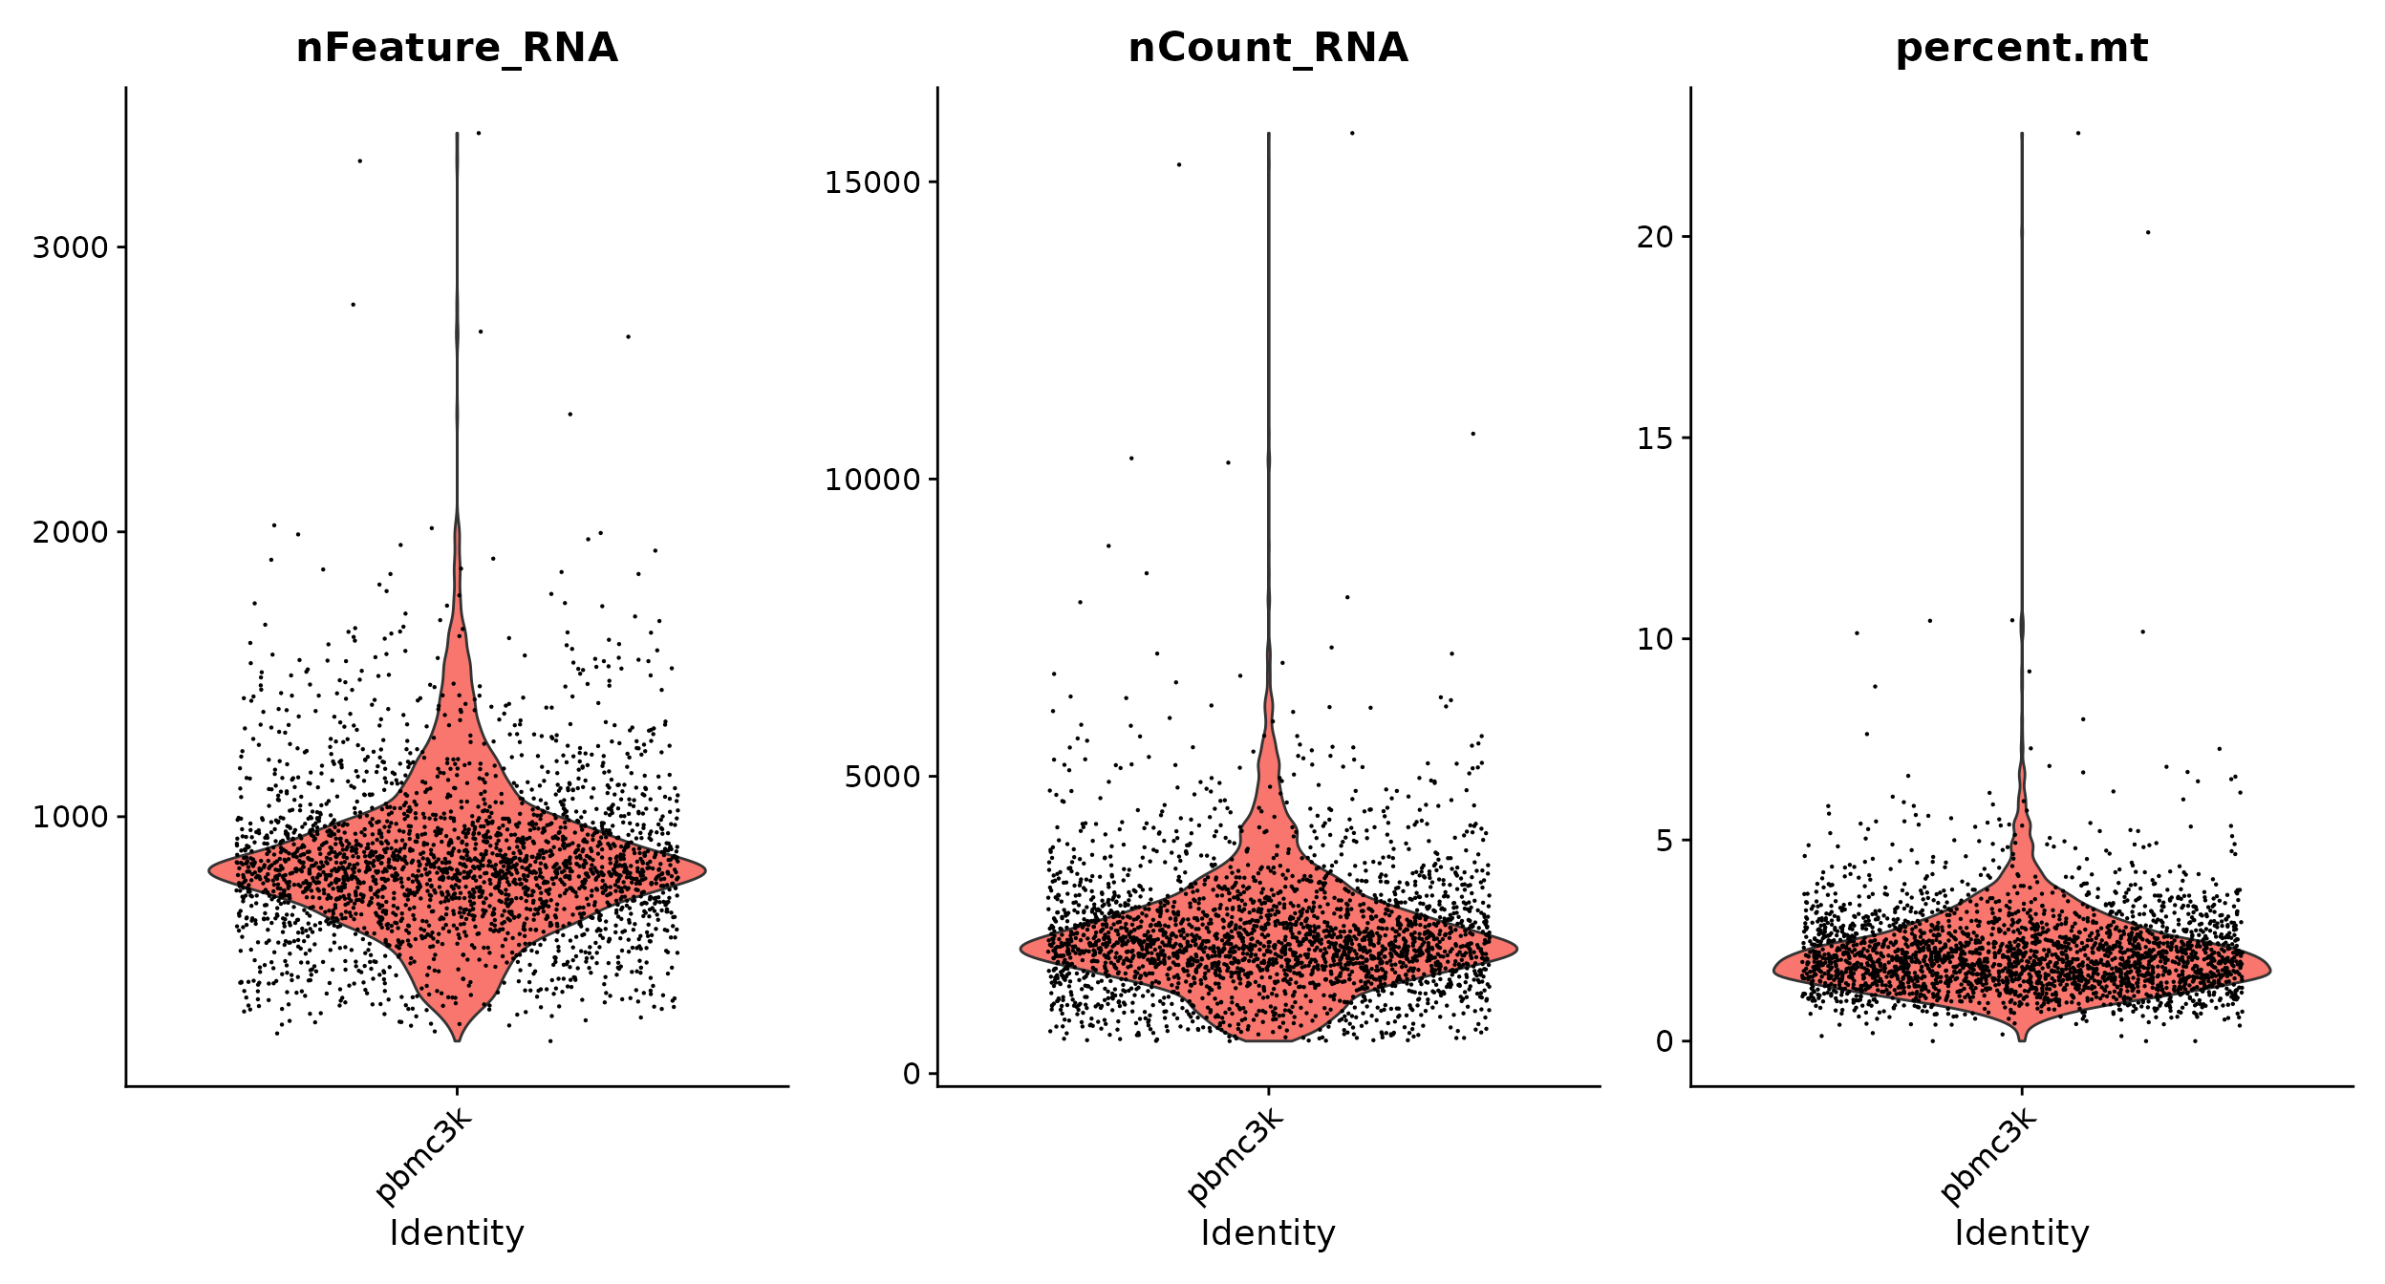




Filtering of cells
Filtering of cells are based on number of genes, number of reads and amount of mitochondrial contents.
Empty cells have very low number of genes and reads in them.
Multiplets have very high number of genes and reads in them.
Dying cells have very high mitochondrial contents in them.
Butler et al., 2018

Slide 16
Normalization
Each cell in a single cell RNA-Seq sample is like one individual RNA-Seq experiment.
That means the library size of each cell differs and can potentially impact the downstream analysis.
Normalization step normalize each gene in each cell to its library size.

Slide 17
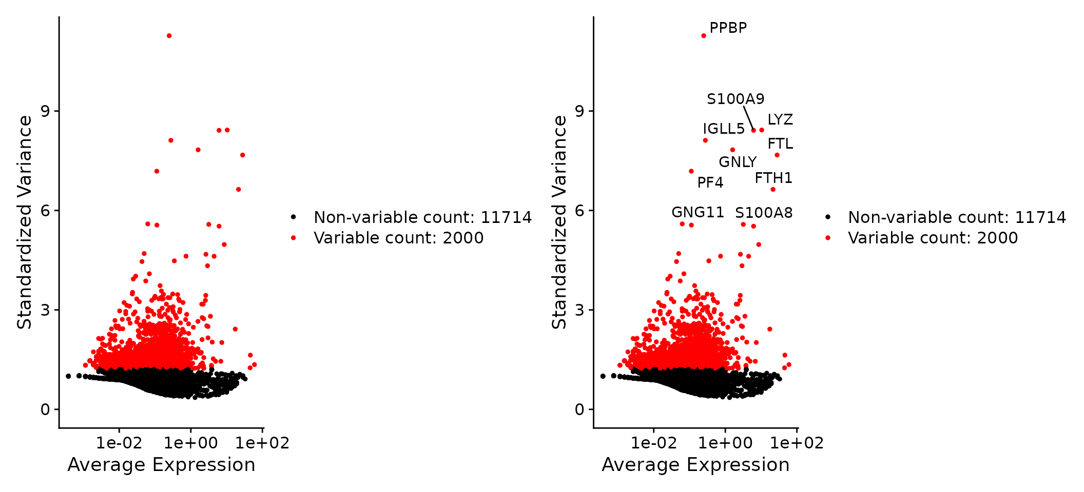
Dimension Reduction (1/2)
For each single cell RNA-Seq sample, about 10,000 genes will have non-zero reads in the samples.
And most of these genes have very low variance and count number.
To make the analysis quicker and remove noise, select the top n thousands variable genes and only use those in the following analysis.
Butler et al., 2018

Slide 18
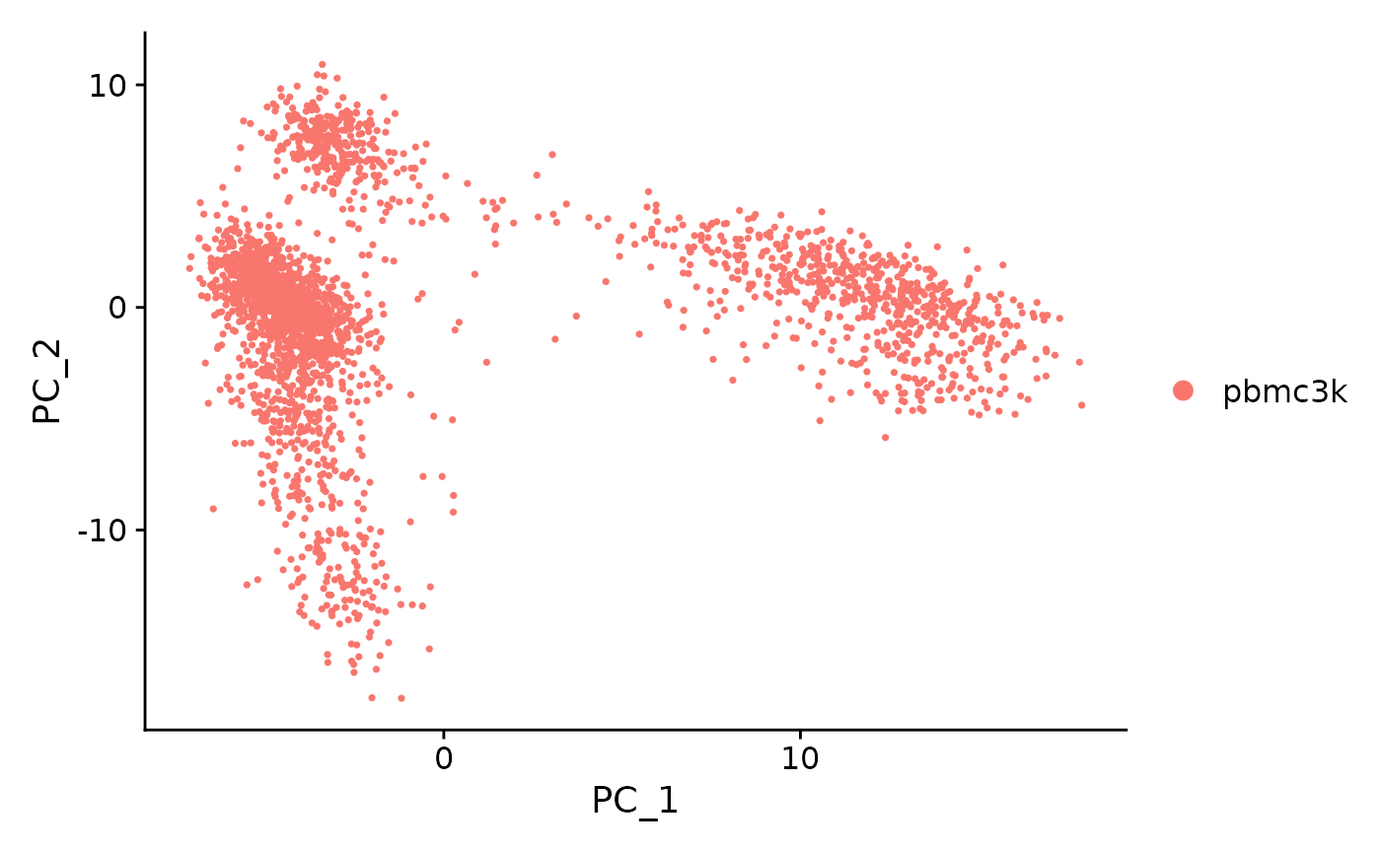
Dimension Reduction (2/2)
Use the top variable genes selected in the previous steps to conduct principle component analysis.
(Insert real life demo of PCA here)
Then only use the top n (n smaller than 100) principle components in the following analysis.
Dimension reduction:
~10,000 genes to n thousands genes
N thousands genes to less than 100 pcs.
Butler et al., 2018

Slide 19
Dimension Reduction (2/2)
Use the top variable genes selected in the previous steps to conduct principle component analysis.
(Insert real life demo of PCA here)
Then only use the top n (n smaller than 100) principle components in the following analysis.
Dimension reduction:
~10,000 genes to n thousands genes
N thousands genes to less than 100 pcs.
Butler et al., 2018

Slide 20
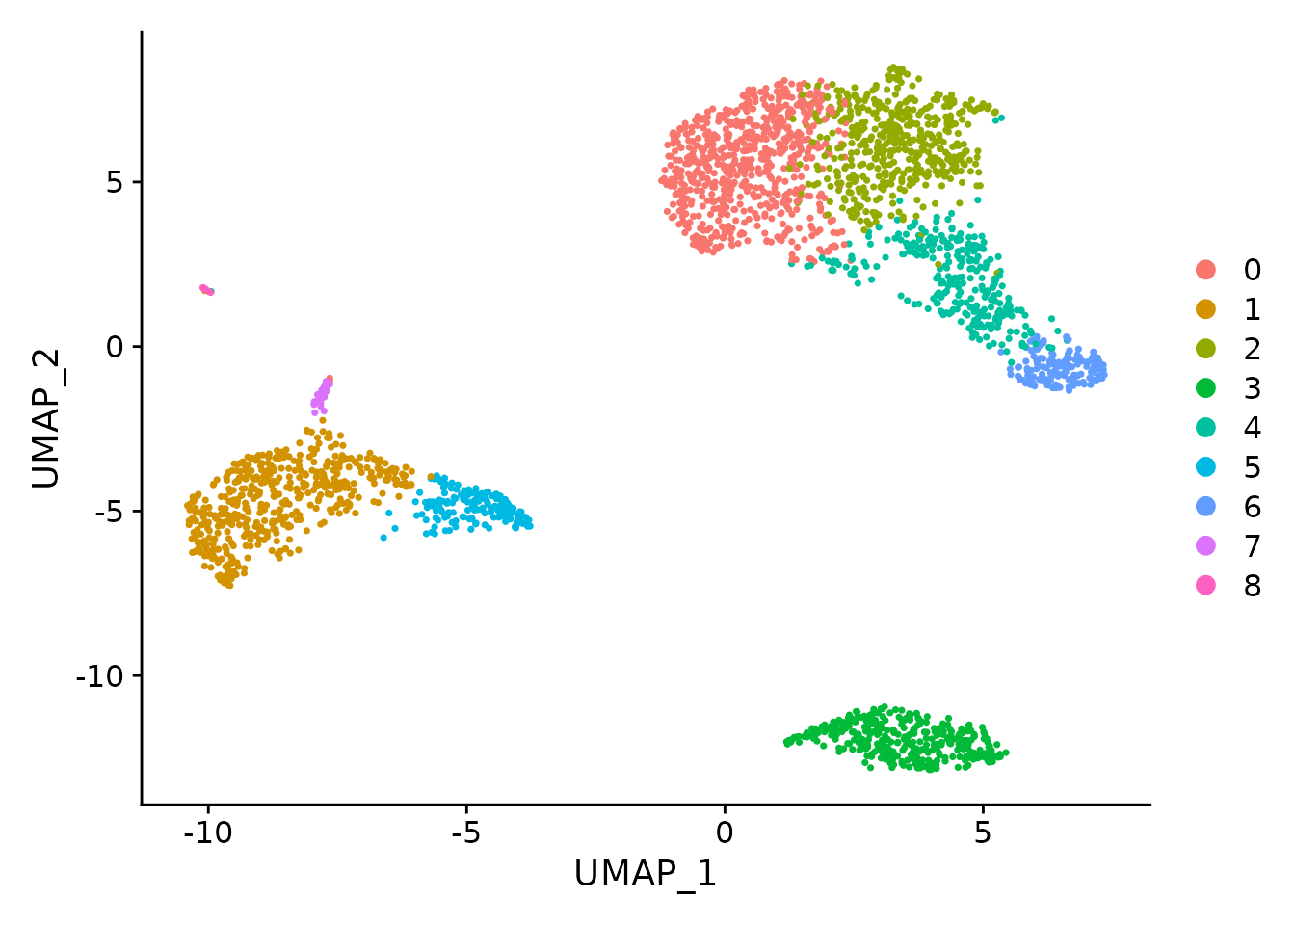
Clustering
Clustering is an un-supervised learning approach, which groups data points in an unbiased manner.
The cells are grouped together using clustering algorithm.
Butler et al., 2018

Slide 21
Annotation
After the cells are grouped into several clusters, each cluster will represent a cell population.
What are these cell populations?
Butler et al., 2018

Slide 22
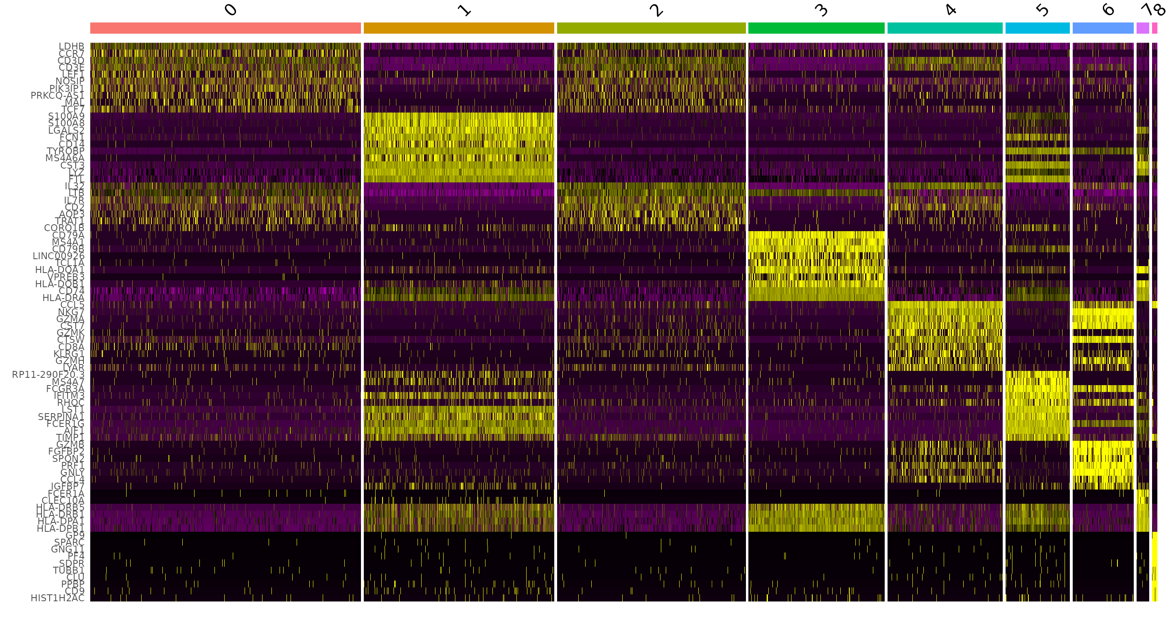
Annotation
After the cells are grouped into several clusters, each cluster will represent a cell population.
How do we determine which cell population is which cluster?
By comparing the transcriptome profile of cells in different clusters, the genes that are upregulated in each cluster can tell us which cell population is each cluster.
Butler et al., 2018

Slide 23
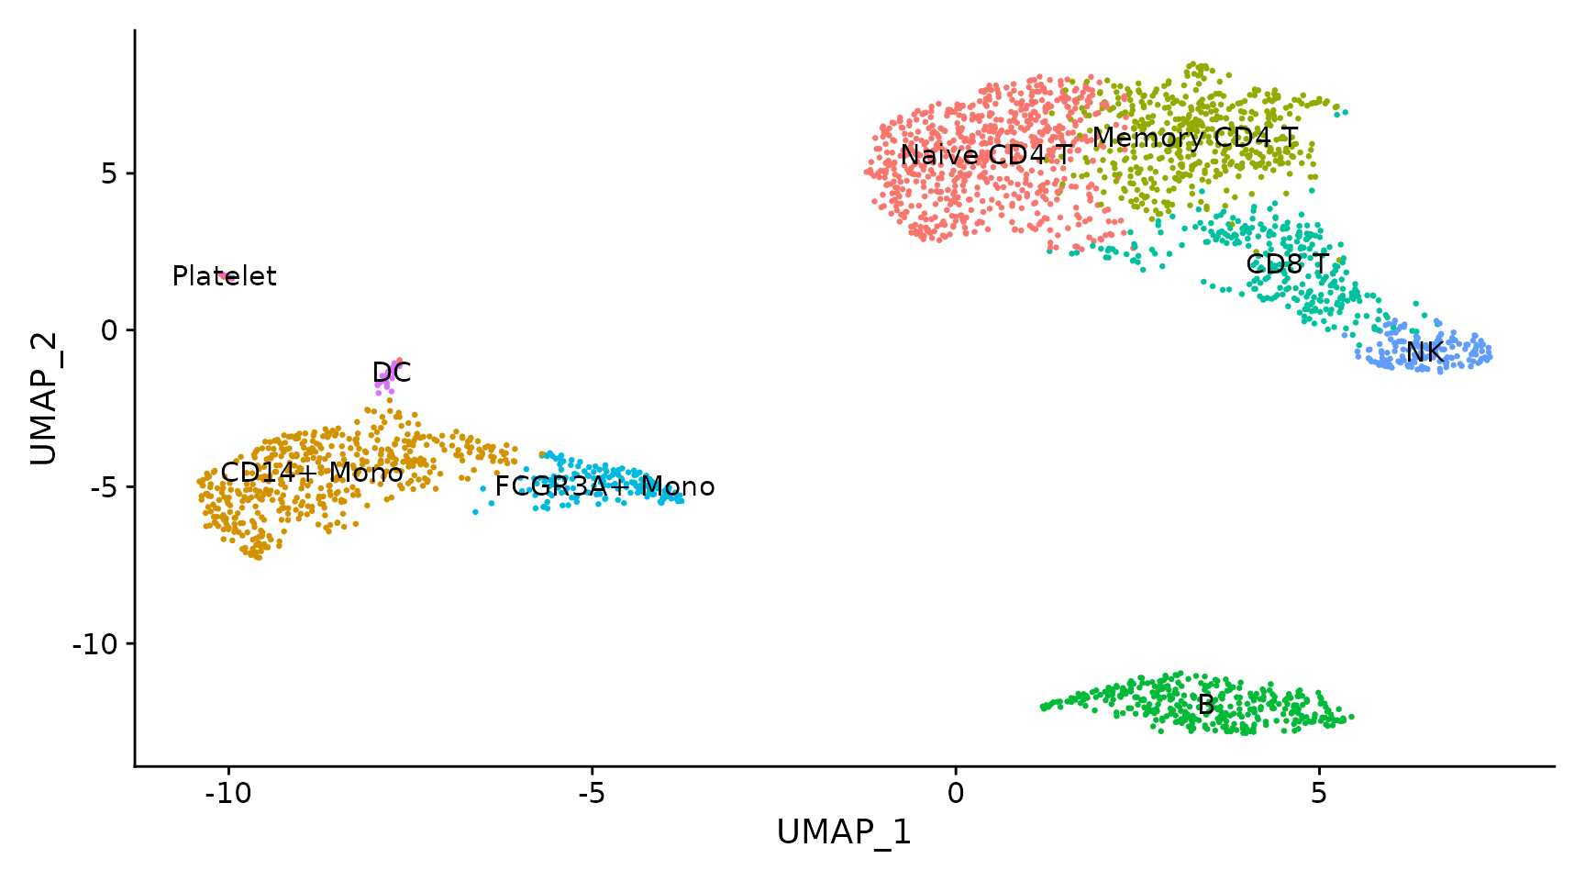
Annotation
After the cells are grouped into several clusters, each cluster will represent a cell population.
How do we determine which cell population is which cluster?
By comparing the transcriptome profile of cells in different clusters, the genes that are upregulated in each cluster can tell us which cell population is each cluster.
Butler et al., 2018

Slide 24
Where are the codes and demos of analysis pipeline?

Slide 25
Time and resource consuming of the analysis pipeline.
In average, the raw files of a single cell RNA-Seq sample will have the sizes of 10 – 20 GB.
Processing them will take:
10 CPU cores minimum.
32 GB memory minimum.
At least 3 hours of processing time.
The analysis of the count data of single cell RNA-Seq dataset will require dozens of R packages and a lot of running memory.

Slide 26

Introduction: Resources
The authors of manuscripts of single cell RNA-Seq dataset have gone through the process.
Many of these dataset are available online with well-designed website and built-in tools to conduct preliminary analysis.

Slide 27
Introduction: Resources
Broad Institute Single cell Portal:
https://singlecell.broadinstitute.org/
UCSC Cell Browser:
https://cells.ucsc.edu
CellXGene:
https://cellxgene.cziscience.com/datasets

