Slide 1
Single Cell RNA-Seq Analysis Tutorial Part 1
Zhaorong Li

Slide 2
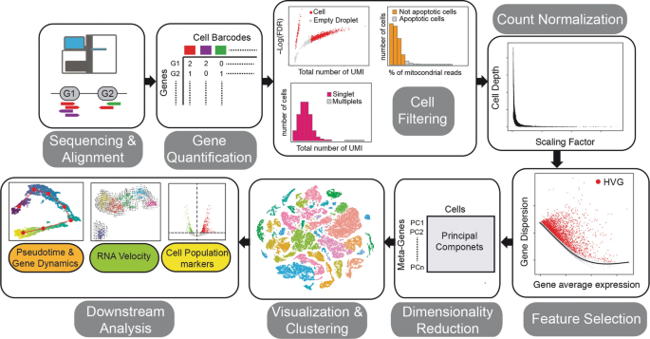
Single Cell RNA-Seq data analysis steps can be put into 4 categories
Notes:
Blue: Sequence Alignment/Quantification
Orange: Quality Filtering
Green: Normalization, Dimension Reduction and Visualization
Purple: Downstream analysis

Slide 3
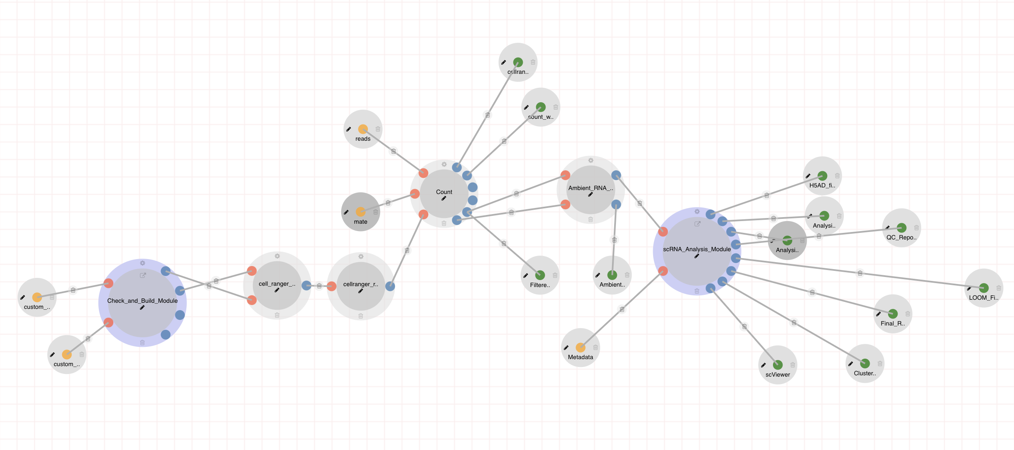
The CellRanger Pipeline and scRNA-Analysis Module handle these 4 types of steps seamlessly.
Notes:
Blue: Sequence Alignment/Quantification
Orange: Quality Filtering
Green: Normalization, Dimension Reduction and Visualization
Purple: Downstream analysis

Slide 4
Parameters related to the alignment/quantification process.
Important Parameter:
genome_build
run_mkref
add_sequences_to_reference
run_Cell_Ranger_Count
Notes:
Blue: Sequence Alignment/Quantification
Orange: Quality Filtering
Green: Normalization, Dimension Reduction and Visualization
Purple: Downstream analysis

Slide 5
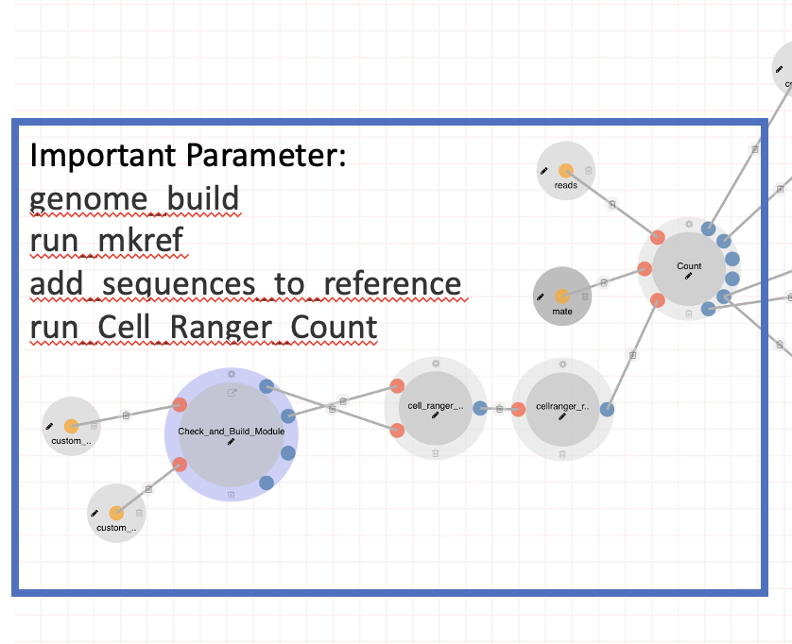
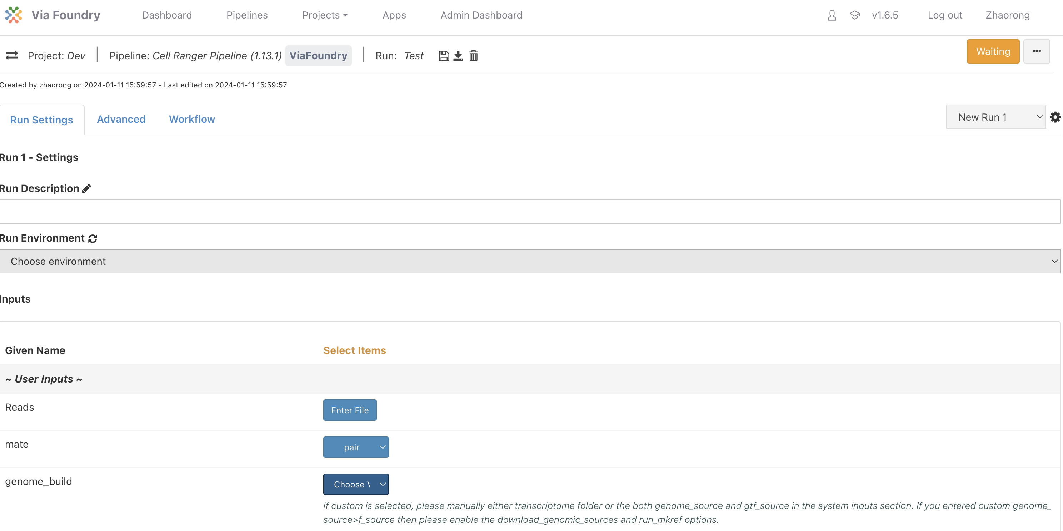
In genome_build parameter, users input the reference genome to align reads to (very important).

Slide 6
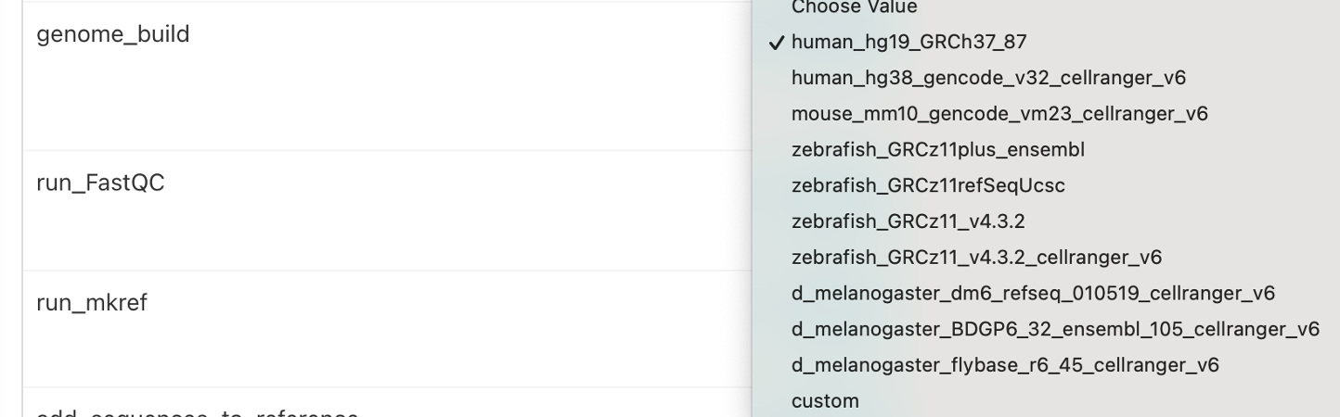
ViaFoundry have several pre-built reference genomes of commonly studied organisms.

Slide 7
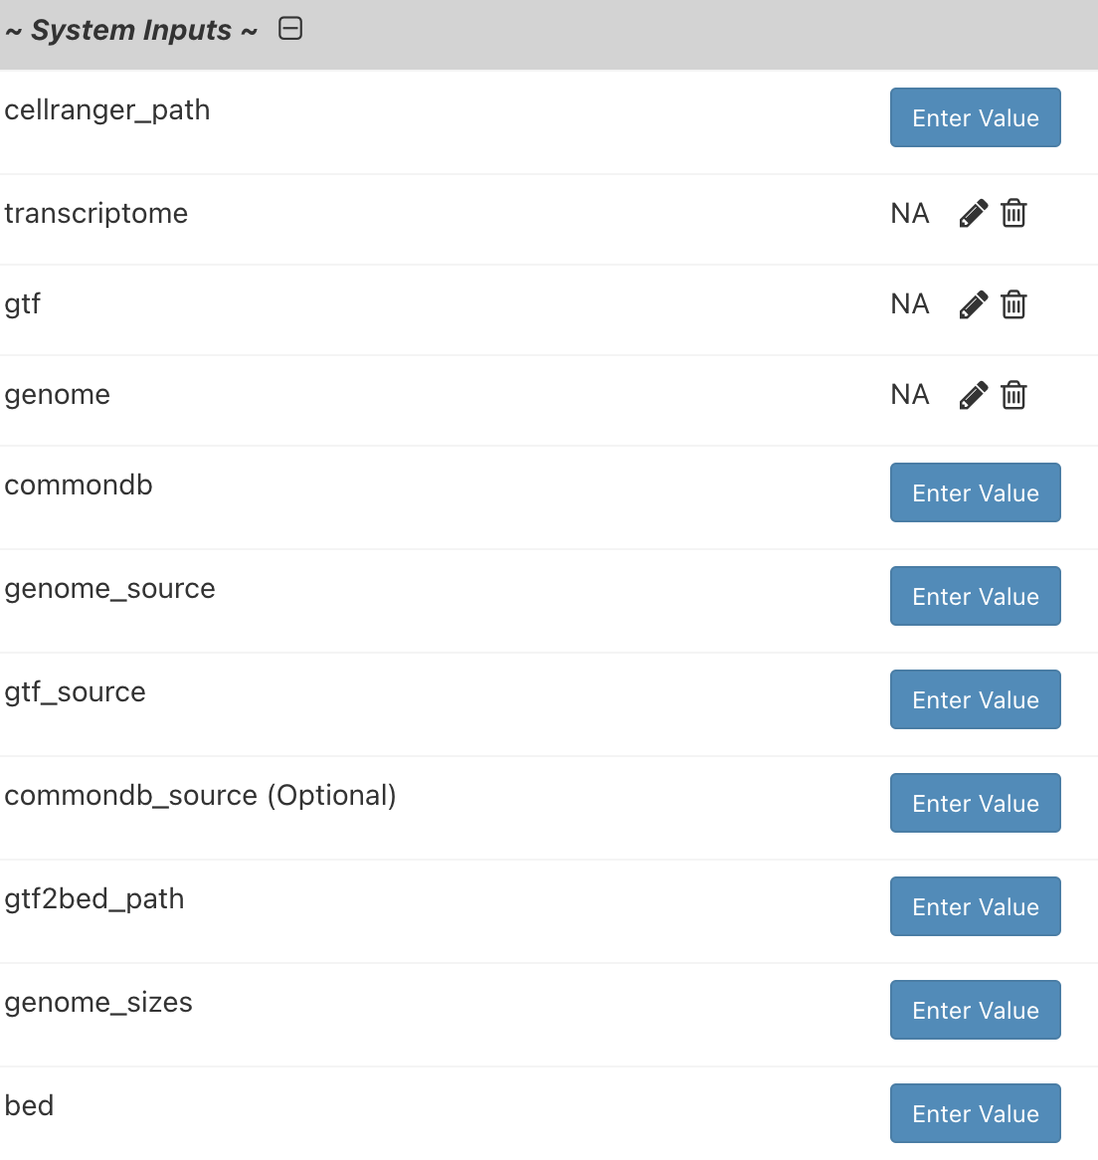
You can build new reference genome using their own genome fasta file and gtf file in the System Inputs Sections.

Slide 8
In run_mkref parameter, you can choose whether to build the reference file from scratch
Notes:
If you are using the pre-built genome, keep this parameter to FALSE.
If you want to build your own reference by setting new genome fasta and gft file, or add new sequences to reference, set this parameter to yes.

Slide 9
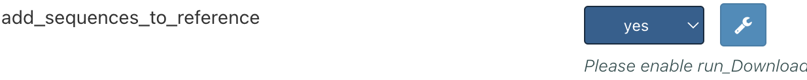
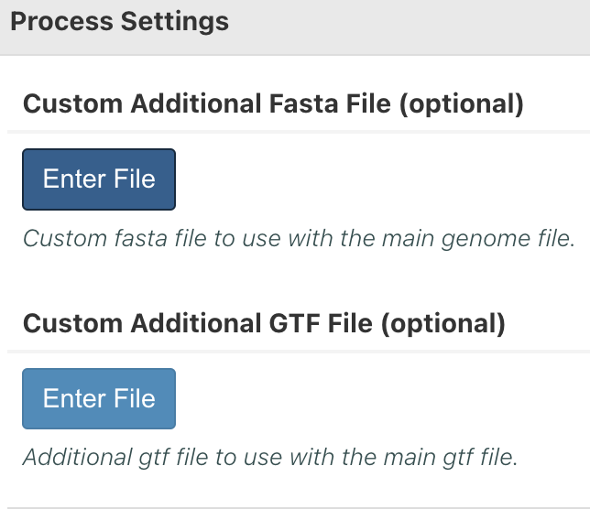
In add_sequences_to_reference parameter, you can add customize sequence to be quantified
Notes:
Sometimes people just want to add one or few sequences, such as reporters or pathogen genomes, to the reference sequence, they can just upload the fasta and gtf here.

Slide 10
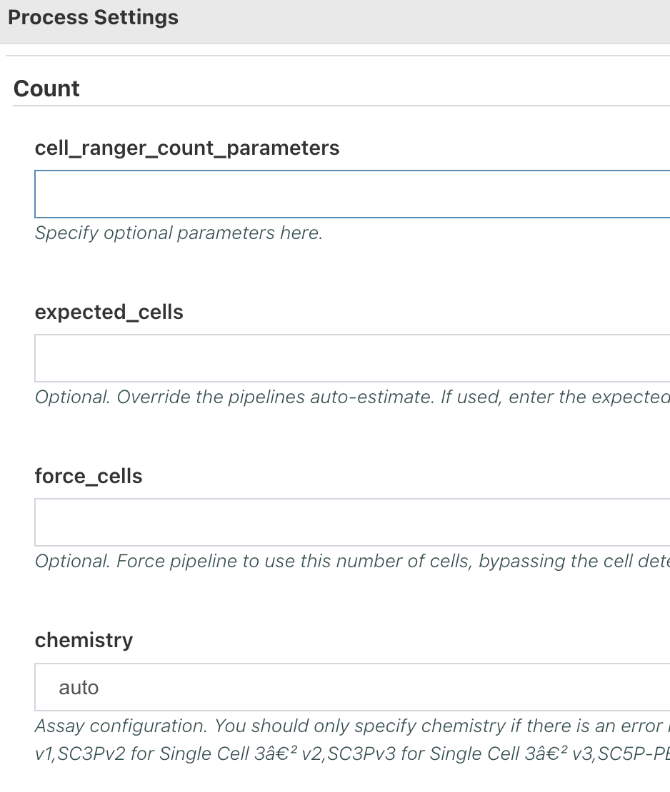
In run_Cell_Ranger_Count parameter, you can change Cell Ranger Alignment and Quantification setting
Notes:
You shouldn’t. (Easy as that)

Slide 11
Parameters that are related to the filtering of the Cells
Important Parameter:
Ambient_RNA_Removal
run_scRNA_Analysis
Notes:
Blue: Sequence Alignment/Quantification
Orange: Quality Filtering
Green: Normalization, Dimension Reduction and Visualization
Purple: Downstream analysis

Slide 12
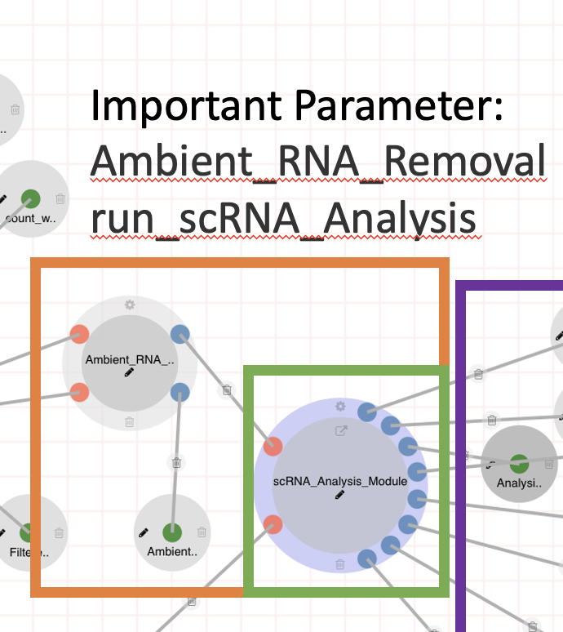
Ambient_RNA_Removal
Ambient RNA Removal is a true/false option which you can used to specify whether you want to do Ambient RNA removal step in the dataset.
An Ambient RNA contamination report will be generated from the dataset regardless of the settings.

Slide 13
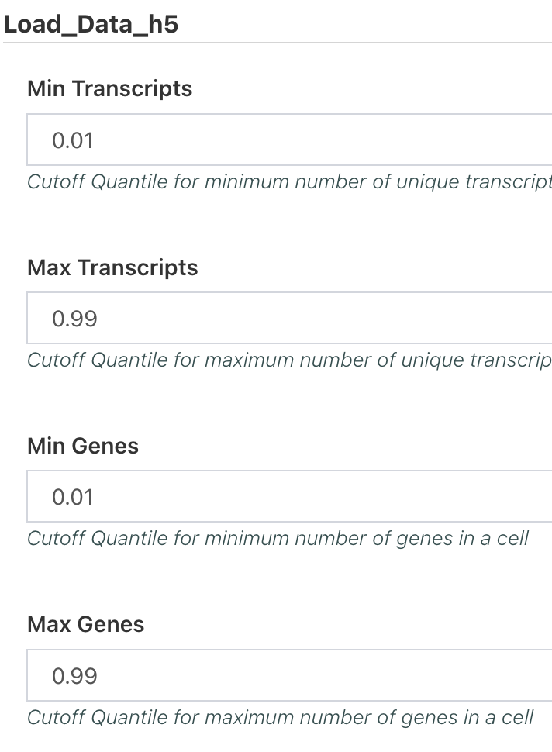
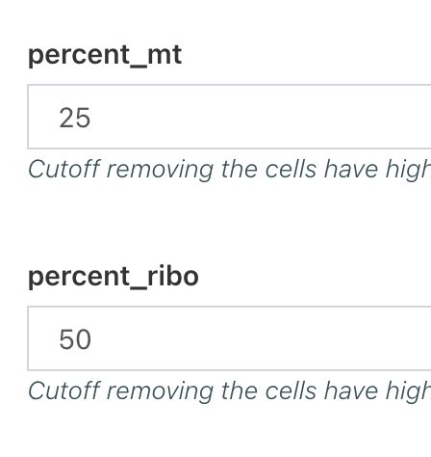
run_scRNA_Analysis
Notes:
The first 6 parameters in the run_scRNA_Analysis settings are related to cell filtering.
These parameters specify how the data is filtered.
The Min Transcripts, Max Transcripts, Min Genes and Max Genes are in quantile format. The examples shown here means that we trim out the cells that have less than 1 percentile number of UMI or higher than 99 percentile of UMI. (Same work for the genes)
For percent_mt and percent_ribo, the format is real number: these are hard threshold.

Slide 14
Parameters that are related to the Dimension Reduction and Clustering

Slide 15
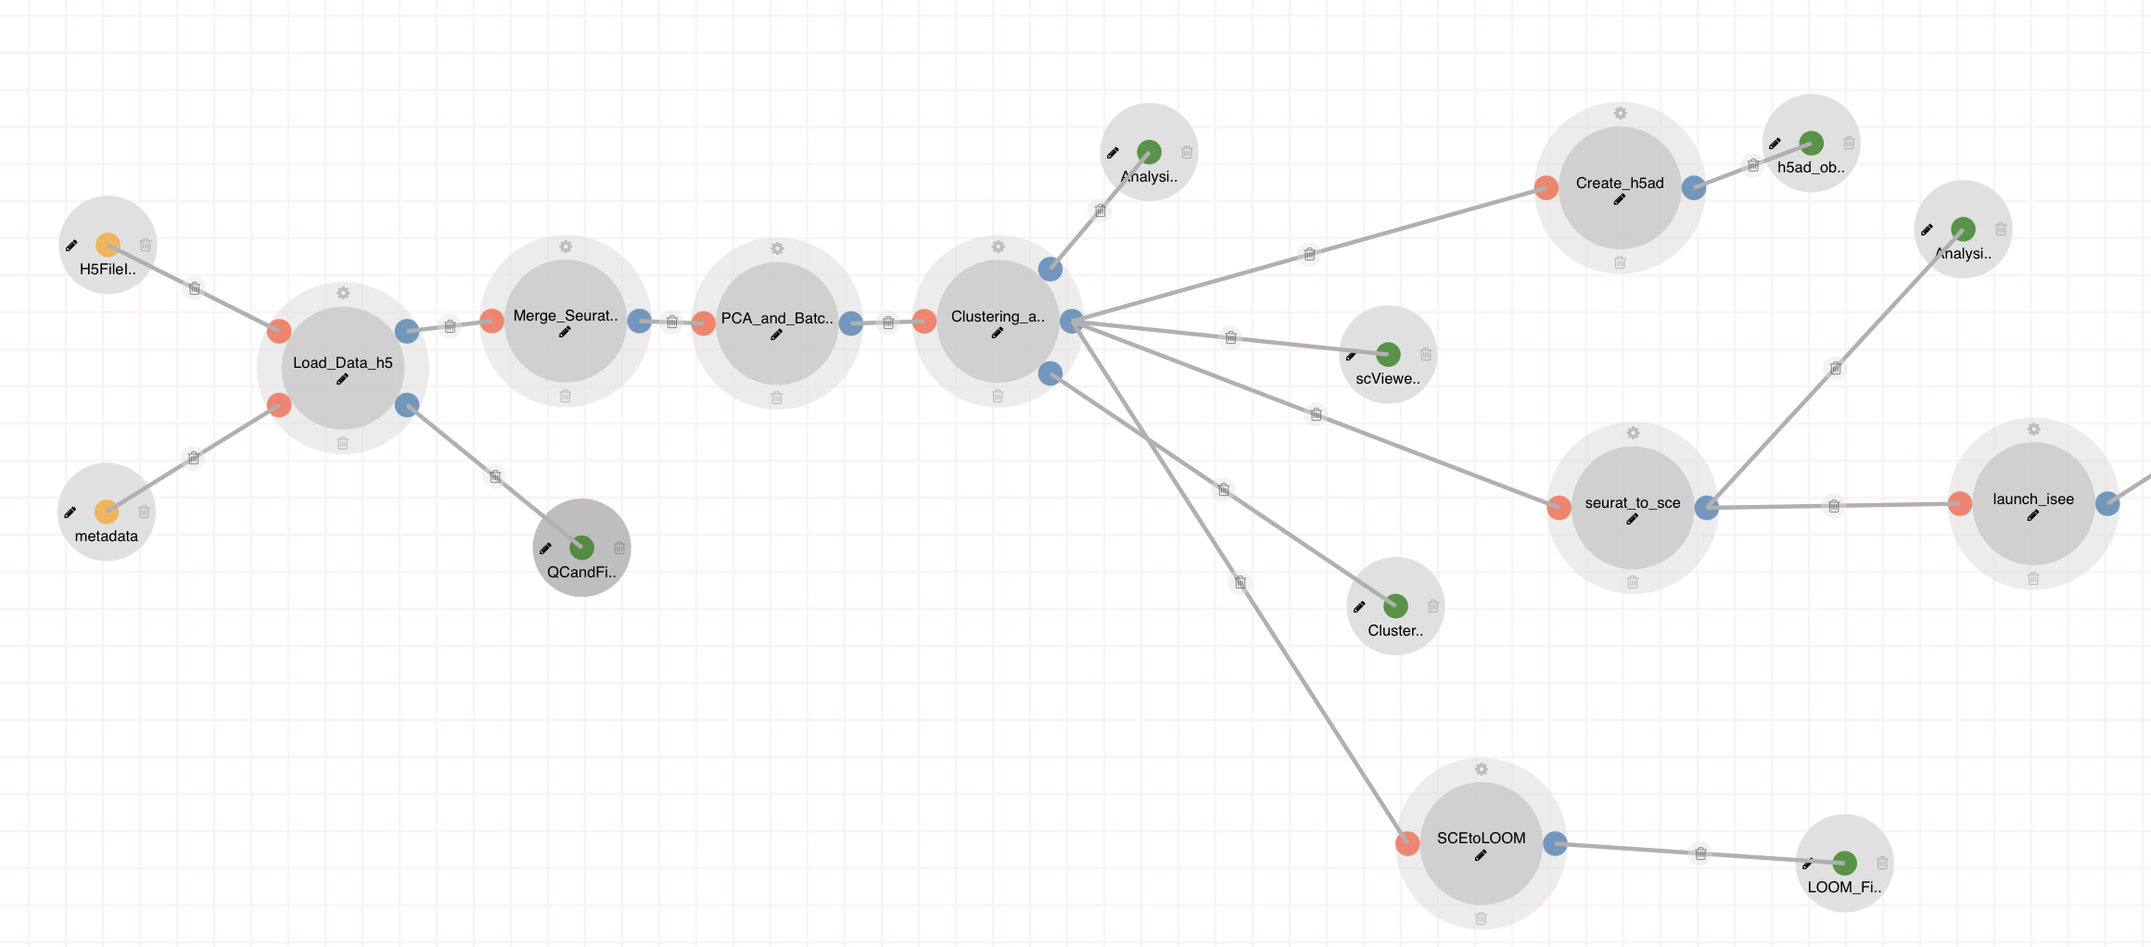
Parameters that are related to the Dimension Reduction and Clustering
# of Variable Features
Selection Method
Correct Batch Effect
Min Resolution
Max Resolution
# of Principal Components
runCellFindR
findClusterforallResolution
# of Variable Features
Normalization Method
DoubletRemoval
RemoveMitoGenes
RemoveRiboGenes

Slide 16
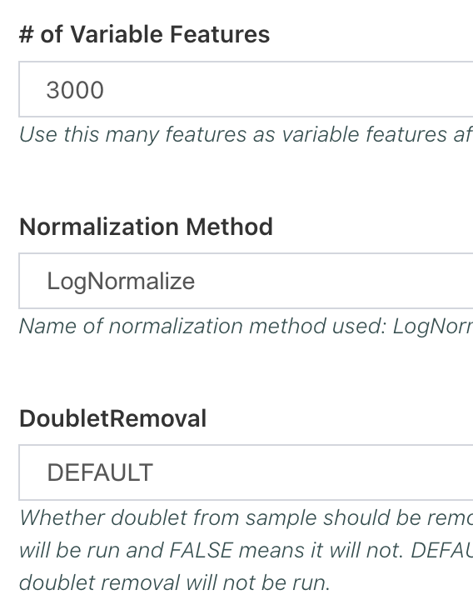
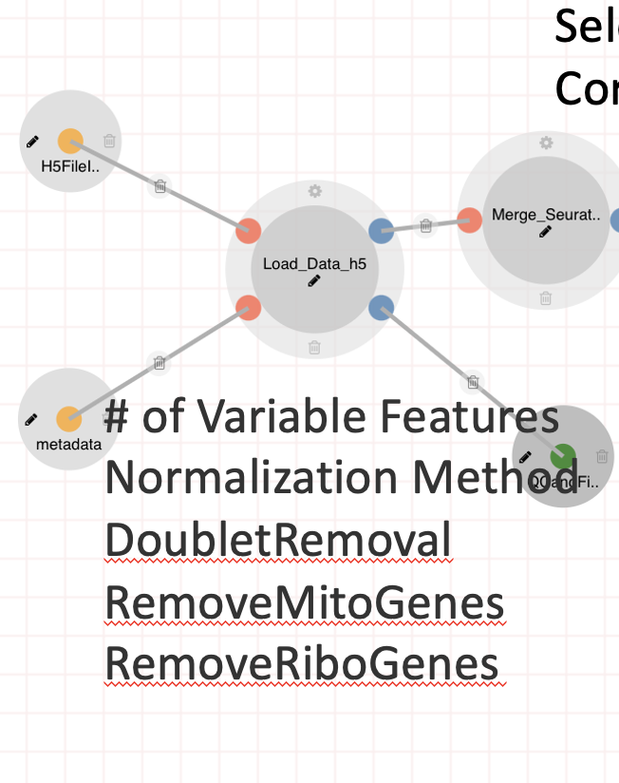
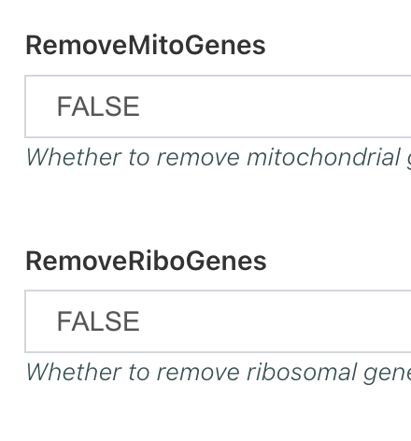
Load_Data_h5

Slide 17
Normalization Explanation: LogNormalize
LogNormalize means that the gene counts of each cell are divided by the total number of gene counts in each cell and multiplied by a million.
Then the data is natural log transformed.

Slide 18
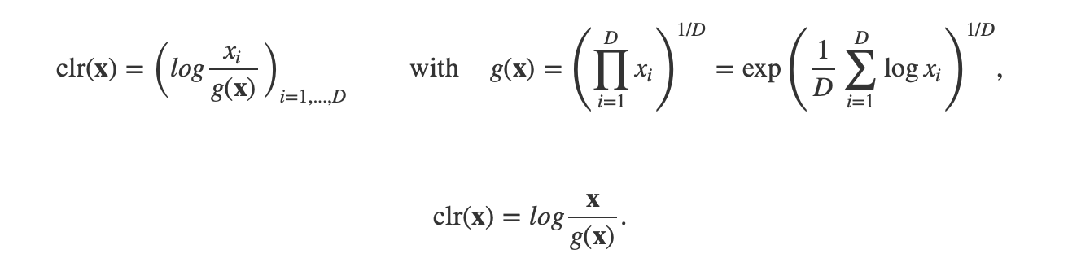
Normalization Explanation: CLR
CLR means centered log-ratio normalization.

Slide 19
Normalization Explanation: SCT
SCT is a normalization method called “regularized negative binomial regression”.
This normalization works best to enhance the biological meaningful signature in the dataset

Slide 20
Table summary
 | Common to Use | Resource taken | Biological Meaningful
LogNormalize | Very Common | Very little | Not significant
CLR | Not Very Common | Very little | Not significant
SCTransform | Not Very Common | High resource usage | Significant

Slide 21
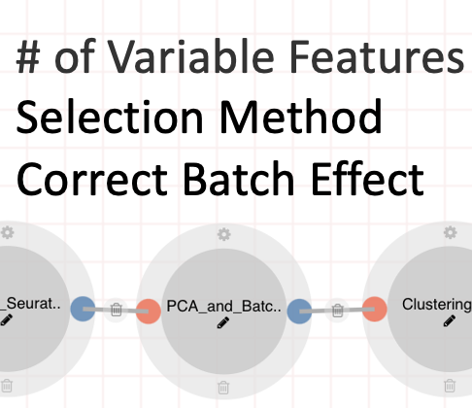
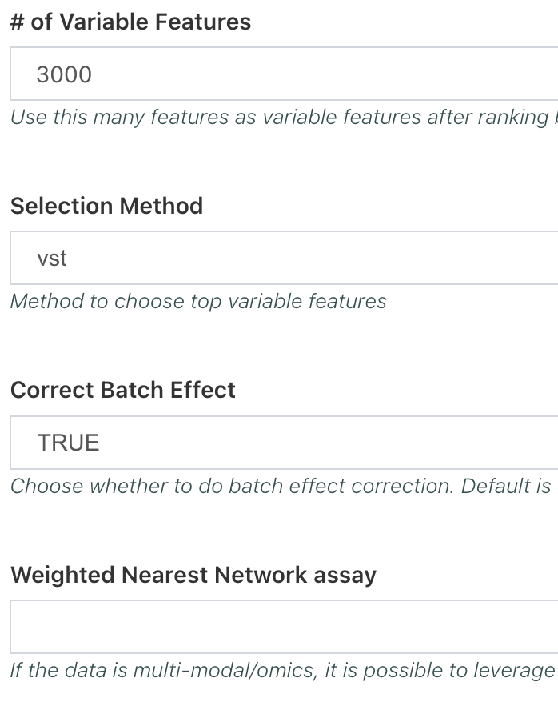
PCA_and_Batch_Effect_Correction

Slide 22
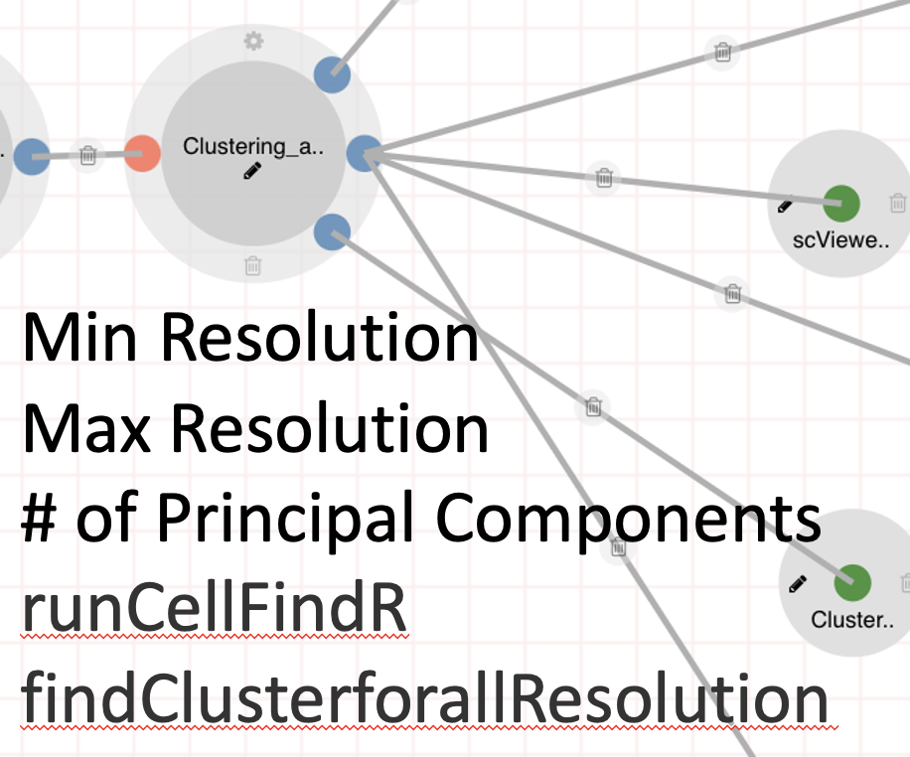
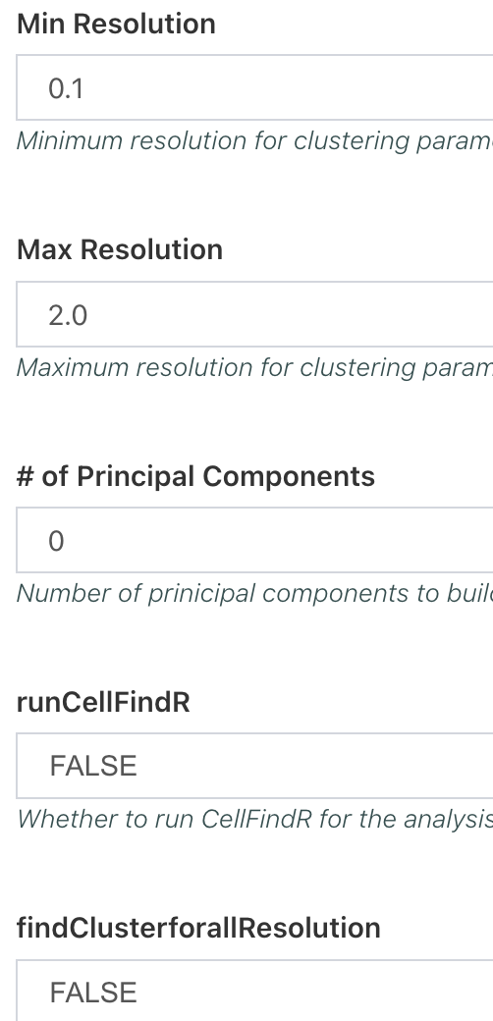
Clustering_and_Find_Markers

Slide 23
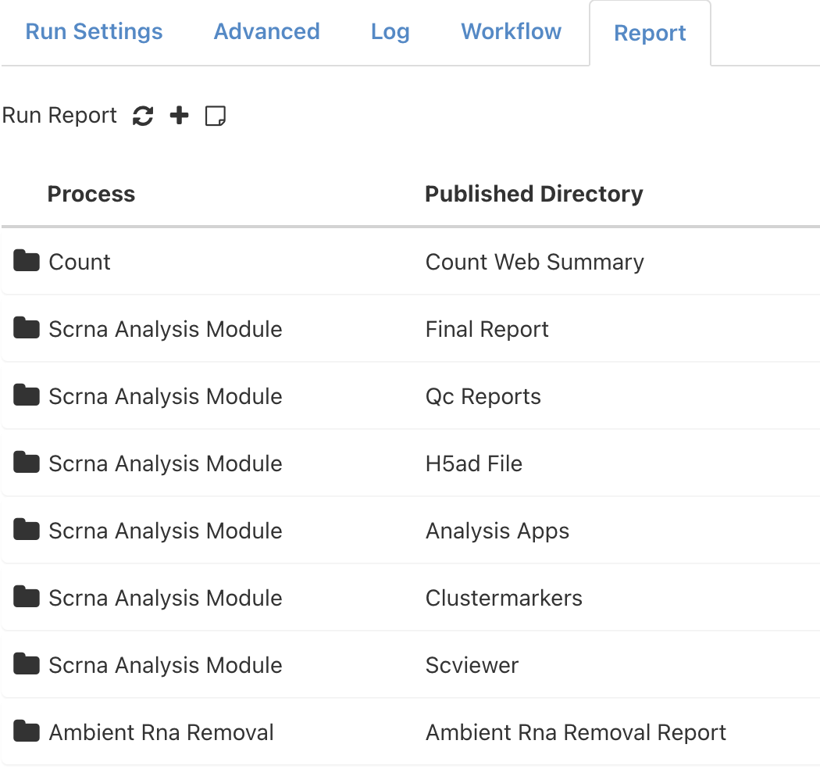
Now let’s try that on our own and view the results.

