Slide 1
Genomic alignments
Elisa Donnard, PhD
UMassMed Biocore Bootcamp

Slide 2
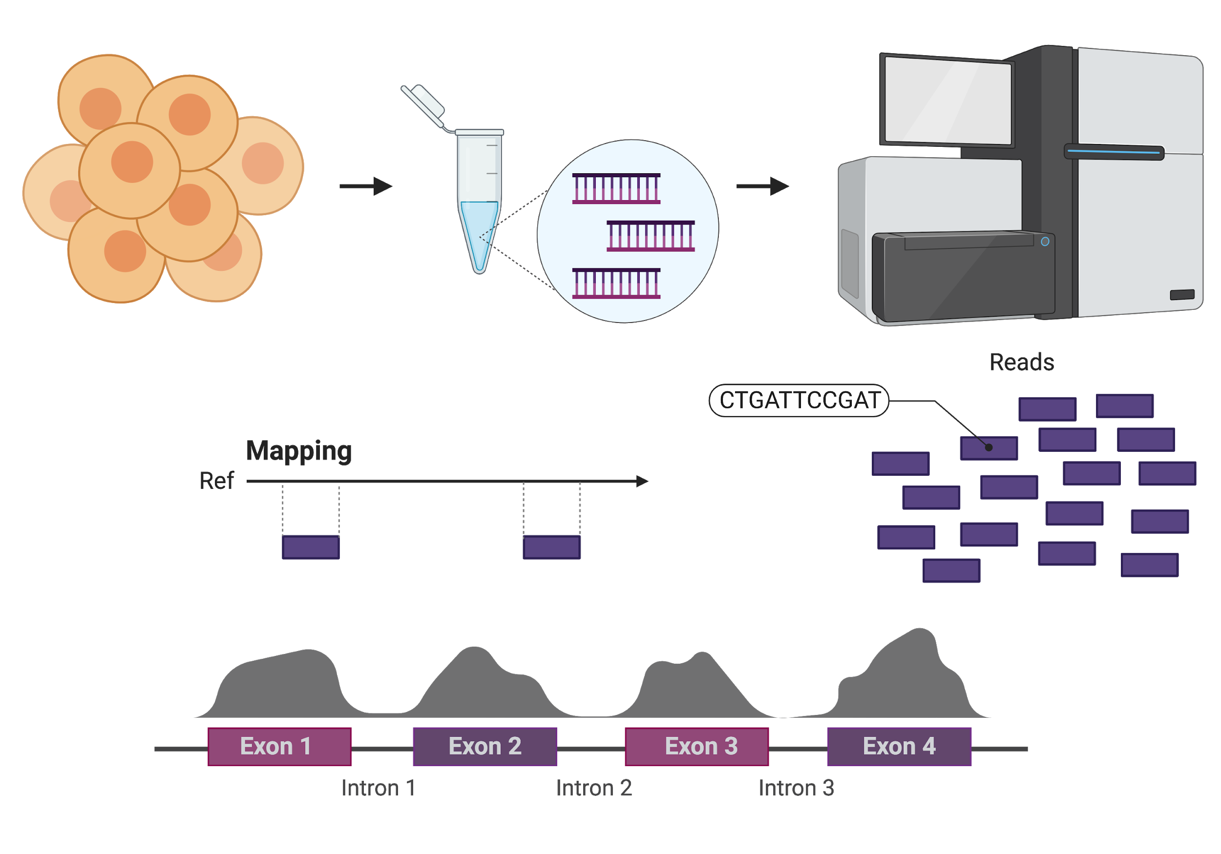
cells
DNA or cDNA
sequencing
?
FASTQ
files
FASTA
files
Read coverage
Notes:
So, let’s get back to our overview from last week:
After the sequencing run, your output are reads, which are contained in FASTQ files, and we need to figure out where in the genome they came from. After this mapping or alignment, we can generate read coverage profiles and start to interpret this information.
We will go through all these computational steps in more detail, including all of the analyses I mentioned for RNA-Seq. But the basis is the same for genomic data as well.

Slide 3
Mapping vs Alignment
Mapping: Finding the region (or regions) in a reference sequence where a read sequence can be aligned
Alignment: Detailed placement of each base, or the optimal base by base alignment of the read sequence to the reference sequence
Notes:
This means that each read will be mapped to one or more positions in the genome (stored in the SAM/BAM files) and for this position, you can examine the alignment, and observe if there are any mismatches, gaps, insertions, etc.

Slide 4
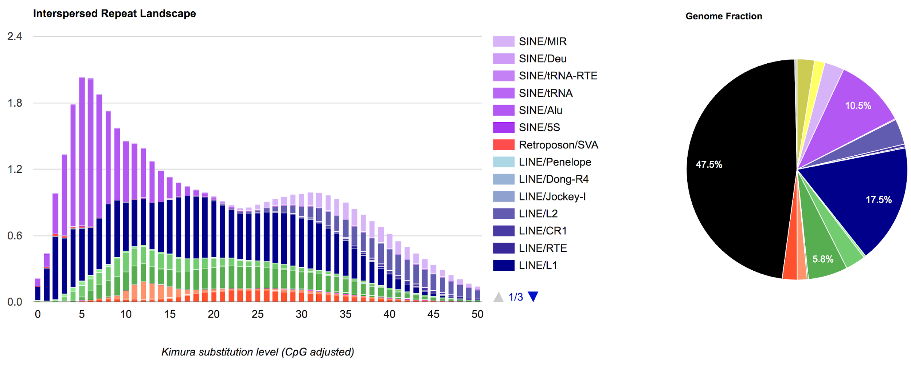
Mapping challenges
RepeatMasker for the human genome
Notes:
More than half of the genome is composed of repetitive elements

Slide 5

Mapping challenges
Notes:
The genome is large as well! How can this task be fast and efficient, given that we have to map millions of reads?

Slide 6
Hash-based mapping:
Step1: hash/index the genome
Toy genome
(16 bp)
CATGGTCATTGGTTCC
Slide from Aaron Quinlan
Notes:
The answer is to create an index, which just like the index for a book, allows you to quickly find sequences that are contained in it.

Slide 7
Hash-based mapping:
Step1: hash/index the genome
CATGGTCATTGGTTCC
k = 3
Kmer/Hash
Genome Positions
CAT
1
Slide from Aaron Quinlan

Slide 8
Hash-based mapping:
Step1: hash/index the genome
CATGGTCATTGGTTCC
k = 3
Kmer/Hash
Genome Positions
CAT
1
ATG
2
Slide from Aaron Quinlan

Slide 9
Hash-based mapping:
Step1: hash/index the genome
CATGGTCATTGGTTCC
k = 3
Kmer/Hash
Genome Positions
CAT
1
ATG
2
TGG
3
Slide from Aaron Quinlan

Slide 10
Hash-based mapping:
Step1: hash/index the genome
CATGGTCATTGGTTCC
k = 3
Kmer/Hash
Genome Positions
CAT
1
ATG
2
TGG
3
GGT
4
Slide from Aaron Quinlan

Slide 11
Hash-based mapping:
Step1: hash/index the genome
CATGGTCATTGGTTCC
k = 3
Kmer/Hash
Genome Positions
CAT
1
ATG
2
TGG
3
GGT
4
GTC
5
Slide from Aaron Quinlan

Slide 12
Hash-based mapping:
Step1: hash/index the genome
CATGGTCATTGGTTCC
k = 3
Kmer/Hash
Genome Positions
CAT
1
ATG
2
TGG
3
GGT
4
GTC
5
TCA
6
Slide from Aaron Quinlan

Slide 13
Hash-based mapping:
Step1: hash/index the genome
CATGGTCATTGGTTCC
k = 3
Kmer/Hash
Genome Positions
CAT
1,7
ATG
2
TGG
3
GGT
4
GTC
5
TCA
6
Slide from Aaron Quinlan

Slide 14
Hash-based mapping:
Step1: hash/index the genome
CATGGTCATTGGTTCC
k = 3
Kmer/Hash
Genome Positions
CAT
1,7
ATG
2
TGG
3,10
GGT
4,11
GTC
5
TCA
6
ATT
8
TTG
9
GTT
12
TTC
13
TCC
14
Complete hash/kmer index of our toy genome (forward strand only)
Slide from Aaron Quinlan

Slide 15
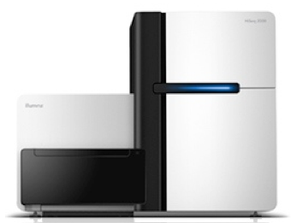
Hash-based mapping:
Step2: use the index to map (i.e., find alignment locations) reads
Toy genome
CATGGTCATTGGTTCC
Kmer/Hash
Genome Positions
CAT
1,7
ATG
2
TGG
3,10
GGT
4,11
GTC
5
TCA
6
ATT
8
TTG
9
Read
TGGTCA
GTT
12
TTC
13
TCC
14
kmer index is used to quickly find candidate alignment locations in genome.

Slide 16
Hash-based mapping:
Step2: use the index to map (i.e., find alignment locations) reads
Toy genome
CATGGTCATTGGTTCC
Kmer/Hash
Genome Positions
CAT
1,7
ATG
2
TGG
3,10
GGT
4,11
GTC
5
TCA
6
ATT
8
TTG
9
Read
TGGTCA
GTT
12
TTC
13
TCC
14
Slide from Aaron Quinlan

Slide 17
Hash-based mapping:
Step2: use the index to map (i.e., find alignment locations) reads
Toy genome
CATGGTCATTGGTTCC
Kmer/Hash
Genome Positions
CAT
1,7
ATG
2
TGG
3,10
GGT
4,11
Hash match
GTC
5
TCA
6
ATT
8
TTG
9
Read
TGGTCA
GTT
12
TTC
13
3,10
TCC
14
Hash
matches
Slide from Aaron Quinlan

Slide 18
Hash-based mapping:
Step2: use the index to map (i.e., find alignment locations) reads
Toy genome
CATGGTCATTGGTTCC
Kmer/Hash
Genome Positions
CAT
1,7
ATG
2
TGG
3,10
GGT
4,11
GTC
5
TCA
6
ATT
8
TTG
9
Read
TGGTCA
GTT
12
TTC
13
3,10,6
TCC
14
Hash
matches
Slide from Aaron Quinlan

Slide 19
Hash-based mapping:
Step2: use the index to map (i.e., find alignment locations) reads
Toy genome
CATGGTCATTGGTTCC
Kmer/Hash
Genome Positions
CAT
1,7
ATG
2
TGG
3,10
GGT
4,11
3 6
GTC
5
TCA
6
ATT
8
TTG
9
Read
TGGTCA
GTT
12
TTC
13
3,10,6
TCC
14
Hash
matches
Slide from Aaron Quinlan

Slide 20
What is a good choice of hash size?
k=10?
4¹⁰ (1,048,576)
Every one of these is present in the human genome at least once
http://bmcbioinformatics.biomedcentral.com/articles/10.1186/1471-2105-9-167

Slide 21
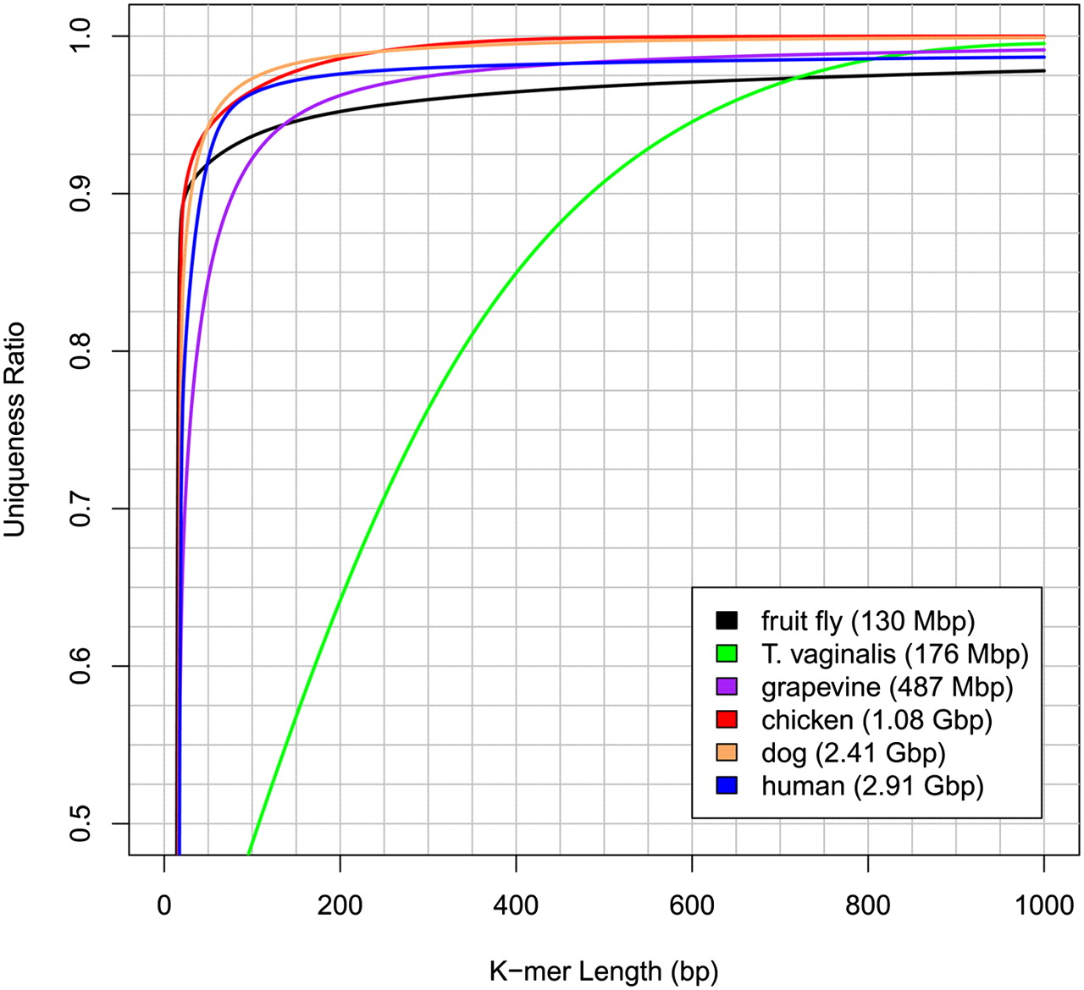
It takes a very long k-mer
to be unique in most genomes!
http://genome.cshlp.org/content/20/9/1165
Slide from Aaron Quinlan

Slide 22
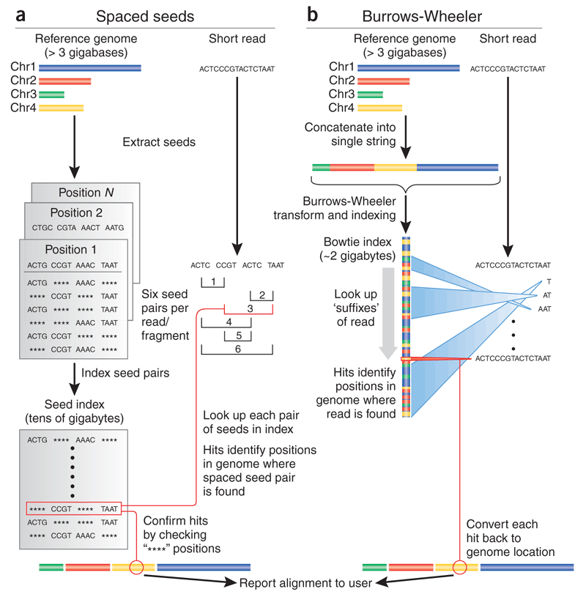
Trapnell, Salzberg, Nature Biotechnology 2009
Notes:
Other strategies for creating indices
BWT advantage: memory efficient!

Slide 23
Mapping quality (MAPQ)
What is the probability that the sequence should be mapped here and only here?
MAPQ uses the Phred (log) scale:
MAPQ = -10*log10(Pmap_loc_wrong)
(P_{map_loc_wrong})
log₁₀(P_{map_loc_wrong})
MAPQ
1
0
0
0.1
-1
10
0.01
-2
20
0.001
-3
30
0.0001
-4
40
Slide from Aaron Quinlan

Slide 24
Read alignment relies on a dictionary
Once loaded onto memory, they can process thousands of reads/second
Different aligners offer different advantages:
Sensitivity to variability (aligning to highly variable organisms)
Speed
Memory
Specificity (at some cost of sensitivity)
It is NOT a solved problem
You really do not know which region was sequenced you only know what is the best match to the reference.
There could be sequencing errors
Variability
Non unique alignments

Slide 25
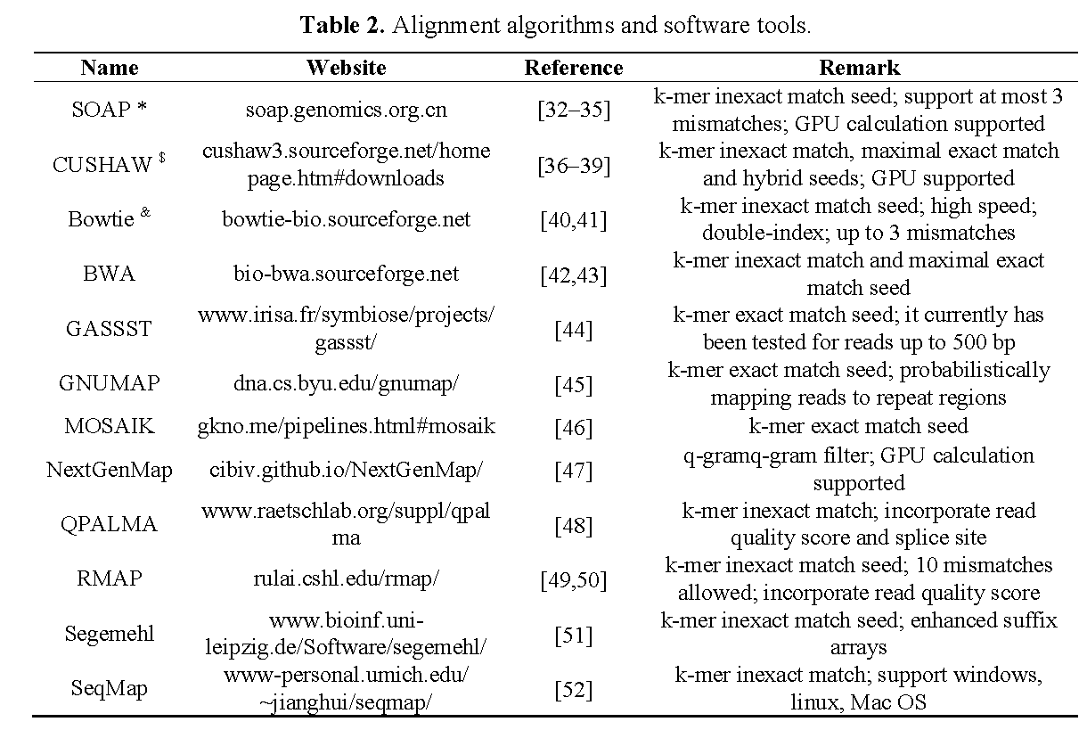
Short read aligners
Pharmaceutics 2015, 7, 523-541; doi:10.3390/pharmaceutics7040523

Slide 26
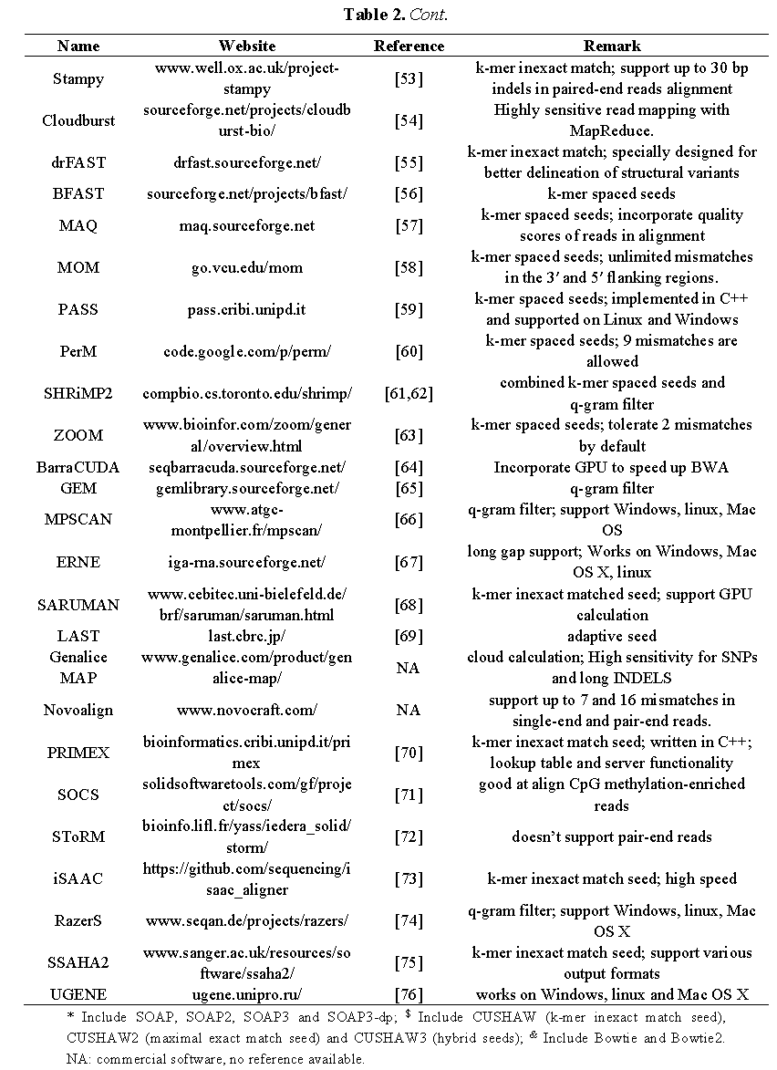
Short read aligners
Pharmaceutics 2015, 7, 523-541; doi:10.3390/pharmaceutics7040523

Slide 27
Sequence alignment software
Aligner | Approach | Applications | Availability
BWA-mem | Burrows-Wheeler | DNA, SE, PE, SV | open-source
Bowtie2 | Burrows-Wheeler | DNA, SE, PE, SV | open-source
Novoalign | hash-based | DNA, SE, PE | free for academic use
STAR | hash-based | RNA-seq | open-source
GSNAP | hash-based | RNA-seq | open-source
TopHat2 | Burrows-Wheeler | RNA-seq | open-source
HISAT2 | Burrows-Wheeler | RNA-seq | open-source
Slide from Aaron Quinlan

Slide 28
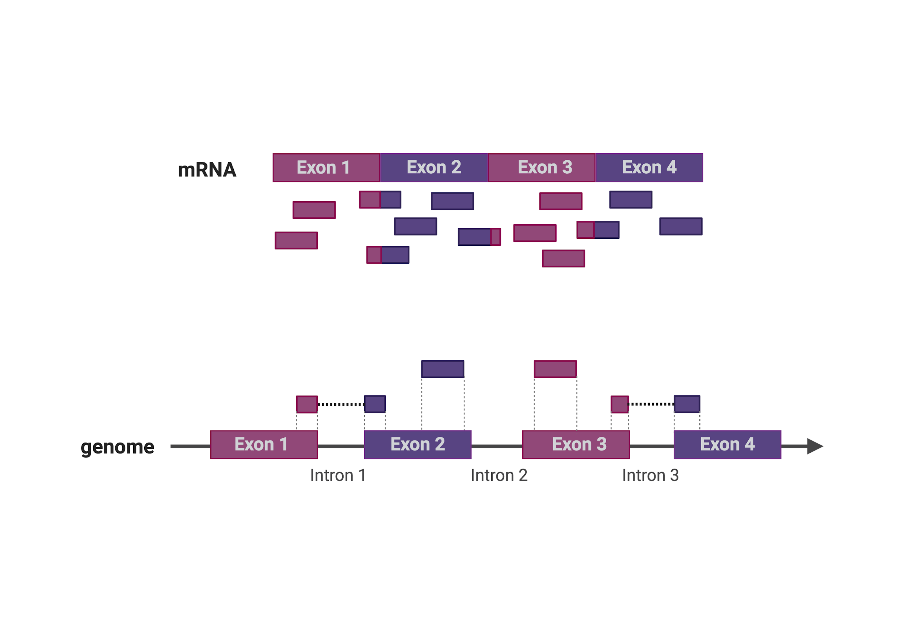
RNA-Seq mapping
Notes:
RNA-seq reads come from a large majority of mature transcripts, which means that for genomic mapping, we need to consider splicing events!, many reads will likely span more than one exon, and cannot be aligned in a single stretch to a genomic locus.
Instead of being mapped to the genome, reads can also be aligned directly to the transcriptome.
How? Using FASTA files that contain the sequence of all known transcripts.
Advantages to this are speed and continuous alignments.
The disadvantages are that it depends on having a quality transcriptome annotation available, and will not discover any potential new isoforms.

Slide 29
RNA-Seq mapping
Notes:
RNA-seq reads come from a large majority of mature transcripts, which means that for genomic mapping, we need to consider splicing events!, many reads will likely span more than one exon, and cannot be aligned in a single stretch to a genomic locus.
Instead of being mapped to the genome, reads can also be aligned directly to the transcriptome.
How? Using FASTA files that contain the sequence of all known transcripts.
Advantages to this are speed and continuous alignments.
The disadvantages are that it depends on having a quality transcriptome annotation available, and will not discover any potential new isoforms.

Slide 30
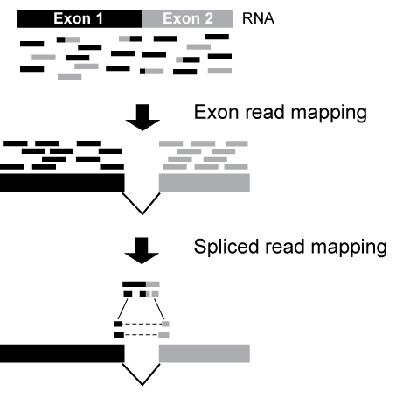
Mapping RNA-Seq reads to the genome:
Exon-first spliced alignment (TopHat)

Slide 31
References
More from Quinlan lab: https://github.com/quinlan-lab/applied-computational-genomics
Trapnell, C., Salzberg, S. How to map billions of short reads onto genomes. Nat Biotechnol 27, 455–457 (2009). https://doi.org/10.1038/nbt0509-455
RepeatMasker: http://www.repeatmasker.org/genomicDatasets/RMGenomicDatasets.html

