Slide 1
Sequencing results
FASTA and FASTQ files

Slide 2
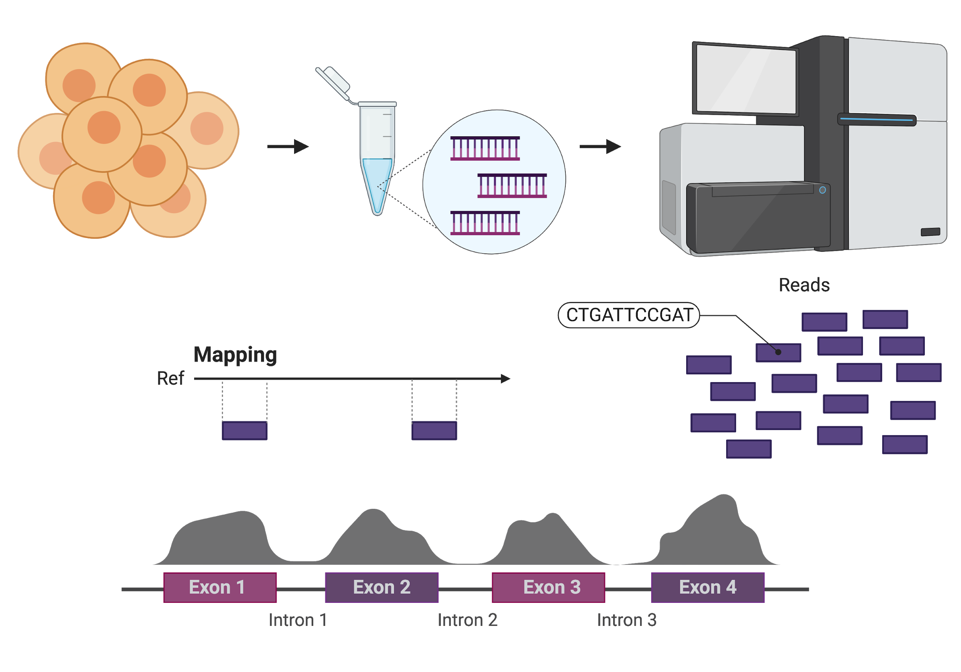
cells
DNA or cDNA
sequencing
Read coverage

Slide 3
FASTA and FASTQ files
Storing biological sequence information
Storing the metadata for a given sequence
Text-based
Different purposes
Notes:
These files have some common characteristics

Slide 4
The FASTA format
xxx.fa or xxx.fasta
Simple text format to allow for easy manipulation and store biological sequences
Reference genome files
>chr1
ATCCAACCTGGCAACTTCCACCTGCCAATAATGATTAGTCTGTCCATCCT
ACCATCTGGTCTCAGTTCTAAAGTTTTTAAACTTATCCAGGAAAAGCACT
GGGGGGAGGGGAGGAGGGGAGAAGGAGACATCTGGGTCTGTTCCATCCTT
CTAACCTTCAACATAAGAAAATAATTCAGACATGATTTAAACAAACAGGC
AAAGAACACAGAAATATGAATGCCGATTGGTATACAATAACAAAAGAGAA
AGTGAGATGATGACAAAGTGGGCATGACCTGAAATGTCTCTAAAGAAATT
AGAGGACCCAACCCCTTATCAAGAGATCTGGTAGGTCTCTTGGTACTGAT
GACTCTTGGTGTCTAGTGGATCTGCTGCAGTCTTCTGTTGTCAGTGCTAA
ATCACAGGTTTACAGATTTACTAGAGTTAAAGCAGGCTCAGACAAACATT
>chr2
GGAGGAGGGGAGAAGGAGACATCTGGGTGTATTCAGACATGATTCCATCC
CAACCCCTTATCAAGAGATCTACTTATCCAGGAAAAGCACTTCTGGTAGG
Notes:
Curiously the FASTA format exists since 1988!
Legacy from the sequence search algorithm with the same name, very similar to BLAST
It has since then become the universal standard for storing basic sequence information (protein or nucleic acid)

Slide 5
The FASTQ format
xxx.fq or xxx.fastq
Text format to allow for easy manipulation and store biological sequences + quality scores!
Sequencing read files
@NS500602:506:H2HKGBGX5:3:11401:17453:1112 2:N:0:GAGTGG
GAGATTGCGAGAGTGCTTGCTAGTGACTCCTTGCAGCATGCTCTATTTT
+
AAAAAEEEEEEEEEA/EEA<EA<A/EE66/EEEEEAEEEEEEEAEEE/<
@NS500602:506:H2HKGBGX5:3:11401:24328:1068 2:N:0:GAGTGG
TGACTAGTAACGAGTGATTGCTTGTGACGCCTTGTCCATGTCGCACTTT
+
AAAAAEEEEEEEEEEEEEEEE6EEEAE66AEEEEEEEEEEEEEEEEEAE
@NS500602:506:H2HKGBGX5:3:11401:9916:1038 2:N:0:GAGTGG
AACGGTAGCGAGTGATTGCTTCTGACGACTTAGAATAGATAATCGTTTT
+
AAAAAEEEEEEEEEAE<EAAEA/AAEA/66EAEEAEEE/E/EEEEEEAE
Notes:
Fastq was developed more recently, originally for SANGER sequencing information and base qualities.
All the information for a sequence identification is in the first line
Always starts with @ (similar to the FASTA >) followed by an identifier for the sequence
The next line is the proper sequence of the fragment that was read and decoded by the instrument.
Same as the FASTA format but usually in high throughput methods the reads are short, they commonly range from as little as 20nt to 150bp or even 300bp (illumina) and much longer for other platforms such as pacbio or nanopore which we will not go into.
3rd line is a separator, to signal the end of the sequence, it always starts with a + sign and is usually left empty or repeats the information in the 1st line (read name), but this is not used currently because in big files it will make the file even bigger and you would waste precious storage space.
Finally, the 4th line contains a string that tells you the quality of each base that was read. This is the main difference from the FASTA.
So the 4th line will have the same length as the second line (sequence), and each of these characters encodes a quality score
Like a FASTA file, a FASTQ file can contain information on one or multiple sequences, with the same structure maintained
***caution note, technically the sequence and quality information can span more than one line, so you should not assume any fastq in the world will have 4 lines per sequence, but this is the more common use from modern sequencing software.

Slide 6
Read names
@NS500602:506:H2HKGBGX5:3:11401:17453:1112 2:N:0:GAGTGG
GAGATTGCGAGAGTGCTTGCTAGTGACTCCTTGCAGCATGCTCTATTTT
+
AAAAAEEEEEEEEEA/EEA<EA<A/EE66/EEEEEAEEEEEEEAEEE/<
NS500602 | unique instrument ID
506 | run ID in your system
H2HKGBGX5 | flowcell ID
3 | flowcell lane number
11401 | tile number within the flowcell lane
17453 | x'-coordinate of the cluster within the tile
1112 | y'-coordinate of the cluster within the tile
2 | read is member of a pair, 1 or 2 (paired reads only)
N | Y if the read is filtered, N otherwise
0 | not used currently, will always be 0
GAGTGG | index sequence
Notes:
The read name identifier is composed of a series of strings separated by colons. (Illumina standard described here)
They each give an information about:
the sequencing instrument used,
the run number,
the serial number of the flowcell,
and the coordinates of the read location in the flowcell.
Additional information may or may not be present after a space, this can include if the read is the first or second in a pair, and the barcode used for this sequenced sample.
This is the barcode that you used to label all fragments of DNA or cDNA from a single sample with, to be able to pool multiple libraries in a single sequencing run.
Reasons this may be useful: quality control, or detective work!
Were all these reads sequenced at the same time? Same library? Is there a problem with a flowcell? With an area of a flowcell? You are not expected to do these technical things on your own but when you have a failed run and contact illumina they may use the information to determine if there was a problem in the system!
Otherwise, you will more commonly use it to know if samples have batch effects, or which reads came from a given barcode…

Slide 7

Phred quality scores
@NS500602:506:H2HKGBGX5:3:11401:17453:1112 2:N:0:GAGTGG
GAGATTGCGAGAGTGCTTGCTAGTGACTCCTTGCAGCATGCTCTATTTT
+
AAAAAEEEEEEEEEA/EEA<EA<A/EE66/EEEEEAEEEEEEEAEEE/<
ASCII encoded
A = 32
E = 36
…
Phred Quality Score | Probability of incorrect base call | Base call accuracy
10 | 1 in 10 | 90%
20 | 1 in 100 | 99%
30 | 1 in 1000 | 99.9%
40 | 1 in 10,000 | 99.99%
50 | 1 in 100,000 | 99.999%
60 | 1 in 1,000,000 | 99.9999%
Notes:
To generate the sequence, the software makes a “call” for which base was read at each position.
The quality score reflects how confident you can be in that call.
Why should you care???
Used for assessment of sequence quality
Or for identifying and removing low-quality sequence (trimming)

Slide 8
References
Cock PJ, Fields CJ, Goto N, Heuer ML, Rice PM. The Sanger FASTQ file format for sequences with quality scores, and the Solexa/Illumina FASTQ variants. Nucleic Acids Res. 2010;38(6):1767–1771. doi:10.1093/nar/gkp1137
Illumina: bcl2fastq2 Conversion Software v2.20 Software Guide
Illumina BaseSpace Online Help: Quality Score Encoding
Miscellaneous smart people: J. Miguel Ortega, Pedro Galante, Konrad Rudolph

