Slide 1
Genomic data analysis
What a typical pipeline looks like

Slide 2
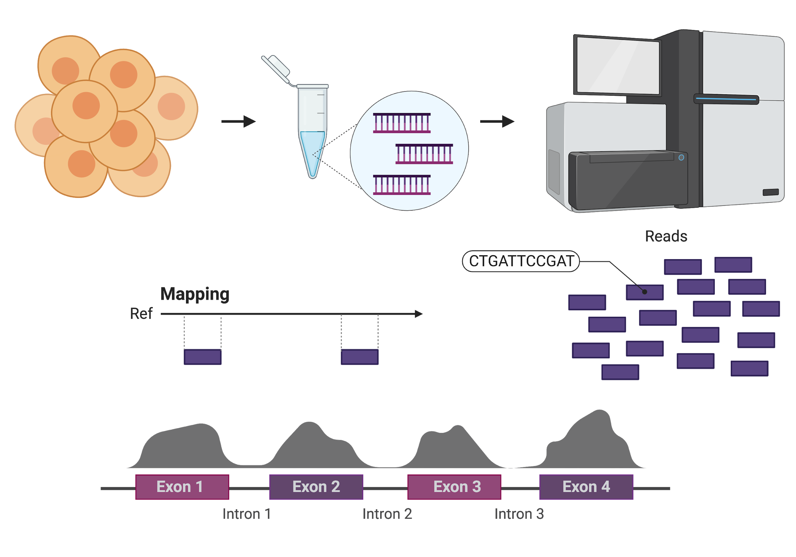
cells
DNA or cDNA
sequencing
Read coverage

Slide 3
What are we doing?
Goal: quantifying nucleic acid species in a sample
Collected nucleic acids – all mixed up
Sheared it into roughly equally large fragments – all mixed up
Added adapters so that we can read the pieces in the sequencer
We sequence a small fraction (30-70 bases) of the fragments
Objective: Given a sequence of 50 bases read from each piece, can we determine:
What nucleic acids sequenced were there to begin with?
In what proportion?
Strategy: Try to find the place were each 50 base read originated by finding the best place were it matches the genome
Difficulties:
The genome is large!
The genome is complicated – lots of repetitive sequence

Slide 4
A typical RNA-Seq pipeline
Make report of quality metrics
Upload your
sequence data (fastq)
Output ribosomal contamination metrics report
Produce RNA-Seq report
% aligned, % intergenic, % exonic, % UTR
Align to ribosomal RNA genes
Align remaining reads to genome (STAR) or transcriptome (Bowtie)
Produce IGV/UCSC friendly files
Produce a table with normalized expression values
Quantify transcriptome (RSEM)
Call differentially expressed genes
(if multiple samples/conditions)
Report pairwise significant genes that are differentially expressed

Slide 5
The SAM/BAM format
xxx.sam or xxx.bam
Text format to allow for easy manipulation and store biological sequences, their quality scores, as well as the information of their genomic/transcriptomic alignment (where/how)
Alignment result files
BAM is what you will usually encounter, it is the compressed binary form of a SAM file
Efficient storage and searching of records
NS500602:540:HKW73BGX5:3:13502:26352:17950:GTCTGGAAAATCGAAG:CTTTATGA 16 chr1 3121186 50 58M * 0 0
CTTTTCTAAATATTGGGTGTTATTAGCACCATGATAACTGTATATTAATTTGCACCGA AEEEEAEEEEE/EE<EE//EE/EEEEEEEEEEEEE/EEEEEEEEEEEEEEEEEAAAAA
AS:i:-8 XN:i:0 XM:i:2 XO:i:0 XG:i:0 NM:i:2 MD:Z:18T36T2 YT:Z:UU NH:i:1
Notes:
SAM = Sequence Alignment/Map
One line per record/sequence and 11 mandatory fields, tab delimited.
SAM files can also have a header, which contains information about the reference used for mapping, and the command that was used to create the file. All lines that are part of the header start with @.

Slide 6
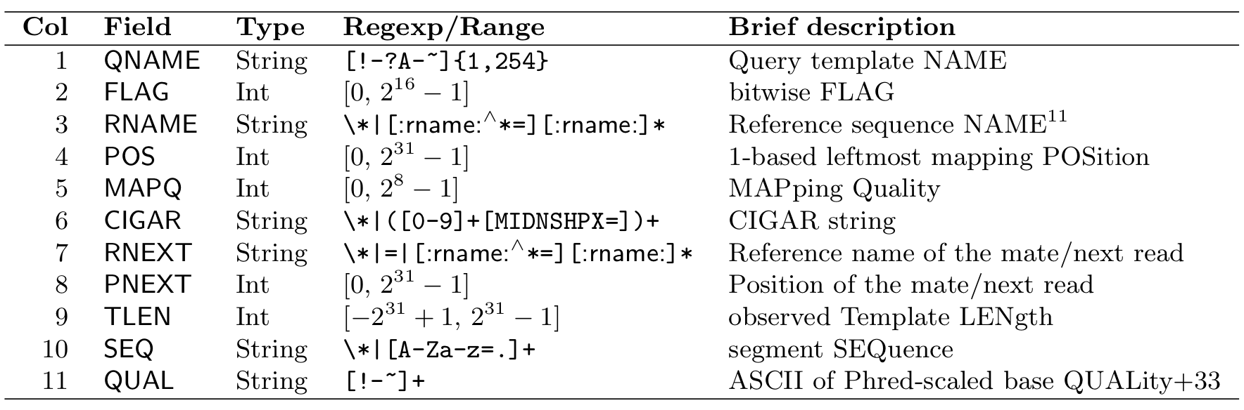
The SAM/BAM format
read1 0 chr1 100200 30 15M * 0 0 CTAAATATTGGGTGT AEEEEAEEEEE/EEE
Notes:
reads with flag 0 are unpaired (because the first flag, 0x1, is not set), successfully mapped to the reference (because 0x4 is not set) and mapped to the forward strand (because 0x10 is not set)
CIGAR stands for Concise Idiosyncratic Gapped Alignment Report

Slide 7
The SAM/BAM format
NS500602:540:HKW73BGX5:3:13502:26352:17950:GTCTGGAAAATCGAAG:CTTTATGA 16 chr1 3121186 50 58M * 0 0
CTTTTCTAAATATTGGGTGTTATTAGCACCATGATAACTGTATATTAATTTGCACCGA AEEEEAEEEEE/EE<EE//EE/EEEEEEEEEEEEE/EEEEEEEEEEEEEEEEEAAAAA
AS:i:-8 XN:i:0 XM:i:2 XO:i:0 XG:i:0 NM:i:2 MD:Z:18T36T2 YT:Z:UU NH:i:1
Notes:
SAM = Sequence Alignment/Map
One line per record/sequence and 11 mandatory fields, tab delimited.
SAM files can also have a header, which contains information about the reference used for mapping, and the command that was used to create the file. All lines that are part of the header start with @.

Slide 8
References
https://samtools.github.io/hts-specs/SAMv1.pdf
https://broadinstitute.github.io/picard/explain-flags.html
http://www.htslib.org/doc/samtools.html
Miscellaneous smart people: Alper Kucukural, Manuel Garber, Pedro Galante
Full SAM format information
This is great!
SAMTools commands

