Slide 1
Cantera in OpenFOAM

Slide 2
Installation and settings
Installation in MSI
Refer to the folder “OpenFOAM_cantera” in the shared COMMON folder

Slide 3
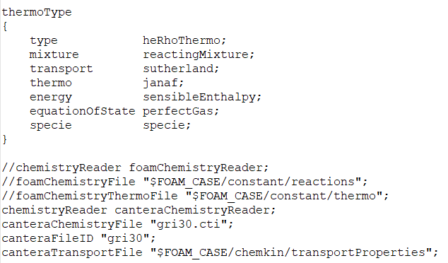
Cantera chemistry reader in OpenFOAM
constant/thermophysicalProperties settings
Specify chemistryReader and the Cantera mechanism files

Slide 4

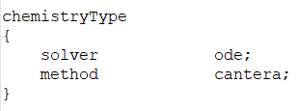
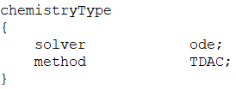
Cantera chemistry models in OpenFOAM
In constant/chemistryProperties file
Default: standard chemistry model
Specify chemistry model: cantera
Specify chemistry model: TDAC
Note:
canteraChemistryModel and standardChemistryModel
are inherited classes from basicChemistryModel.
TDAC is inherited from standardChemistryModel.
Future work is to replace all the functions in TDAC inherited from standardChemistryModel by the functions in canteraChemistryModel and develop a TDAC_cantera class.

Slide 5
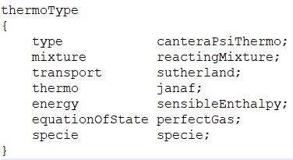
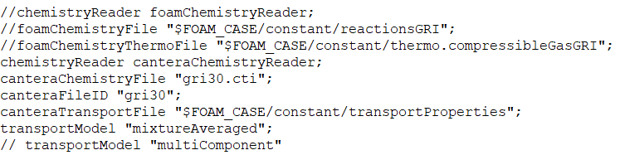
Transport models
constant/thermophysicalProperties
Still Sutherland here,
but the viscosity and thermal diffusion is calculated
in canteraPsiThermo.C
Specify which transport model you want to use.

Slide 6
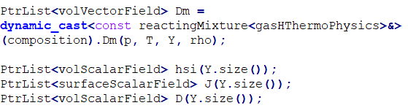
Transport models
Modification needed in solver (use reactingFoam as an example)
In YEqn.H
Dm: diffusion velocity, its is calculated
in reactingMixtureI.H
Definition of sensible enthalpy,
diffusion flux
and mass diffusion coefficient

Slide 7
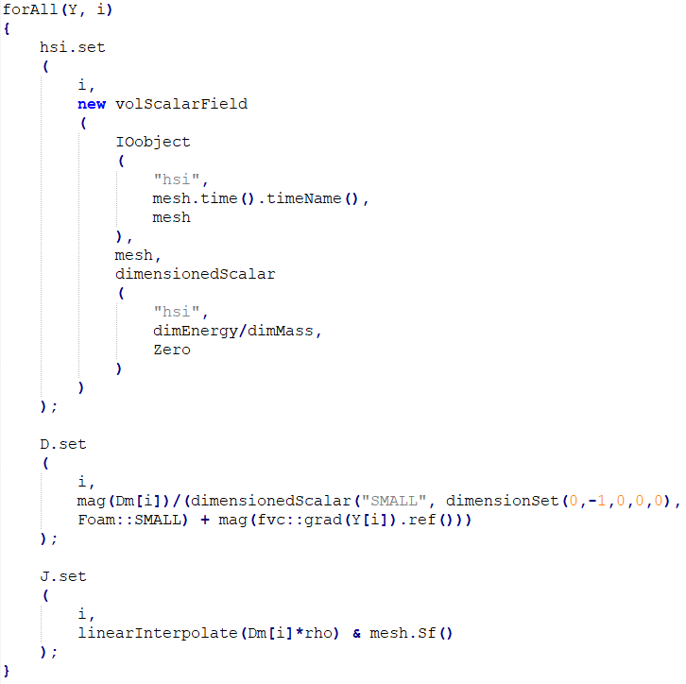
Transport models
Initialize hsi to zero
Calculate mass diffusion coefficient
Calculate mass flux

Slide 8
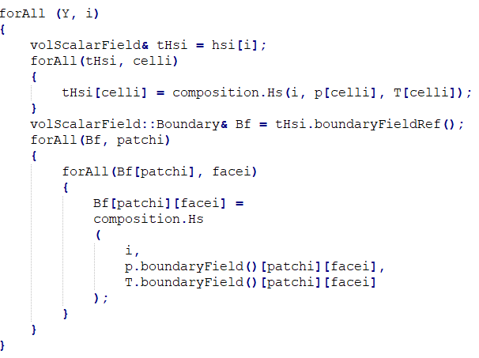
Transport models
Calculate hsi in the field

Slide 9
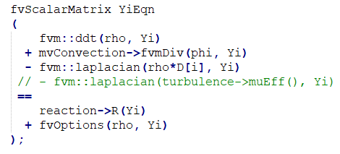
Transport models
Updated diffusion term, D is either calculated by mixture averaged model or multi-component model
OpenFOAM original diffusion term.
With this term, Schmidt number is assumed to be unity

Slide 10
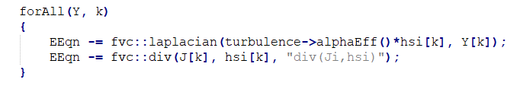
Transport model
In EEqn.H, add the heat flux terms caused by mass flux and mass gradient
Remember modify the species equation (YEqn) and energy equation (EEqn) accordingly when using mixture averaged or multicomponent transport model

Slide 11
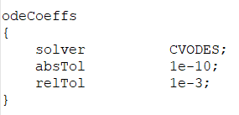
CVODES
Seulex is the traditional stiff ODE solver in OpenFOAM and it is found to fail to solve the chemistry source terms for fuels with NTC. Additionally, it is also found to be unstable reported in lieteratures.
CVODES from the sundials library is widely used in the combustion community (e.g Cantera, NGA).
Hence, CVODES was also coupled into OpenFOAM.
In chemistryProperties file, specify the ODE solver.

Slide 12
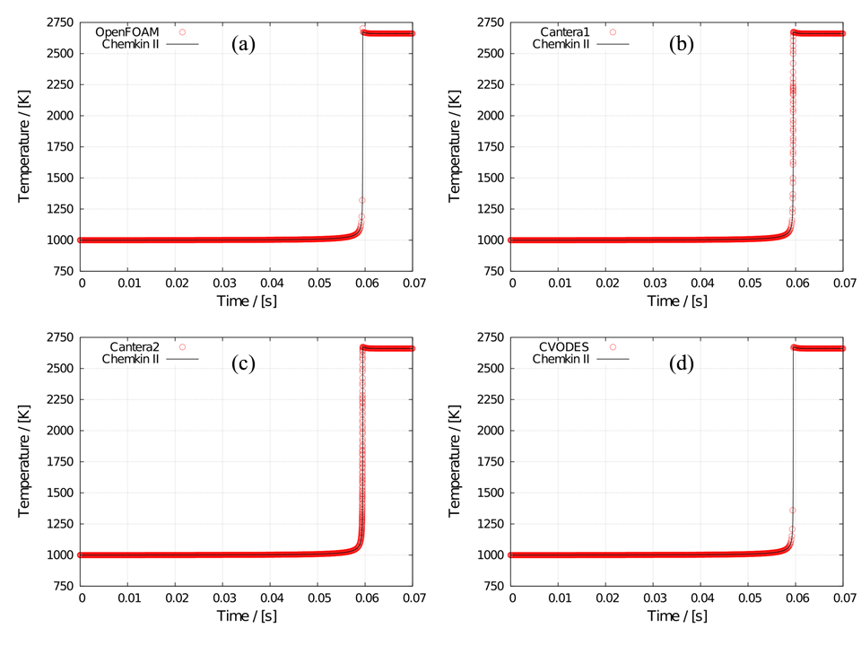
Preliminary validation results
GRI3.0 methane autoignition (T₀ = 1000K, P₀ = 1bar, ER = 1.0)
Comparisons of temperature profiles between Chemkin-II and
Foam chemistry reader + OpenFOAM standard chemistry model
Cantera chemistry reader + OpenFOAM standard chemistry model
Cantera chemistry reader + Cantera chemistry model
(d) Cantera chemistry reader + Cantera chemistry model with CVODES

Slide 13
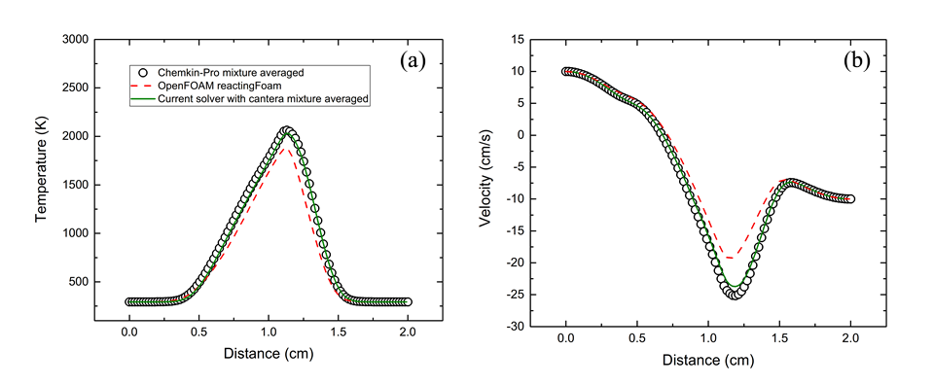
Preliminary validation results
GRI3.0 2D counter flow diffusion flame
Comparisons of (a) temperature as a function of distance and
(b) axial velocity as a function of distance among Chemkin-Pro,
original OpenFOAM reactingFoam solver and the current solver.
The results of Chemkin-Pro and current solver are calculated with mixture averaged transport model.

