Slide 1
Virtual Patient Simulation
Curtis K. Johnston & Shen Cheng
11/20/2026

Slide 2
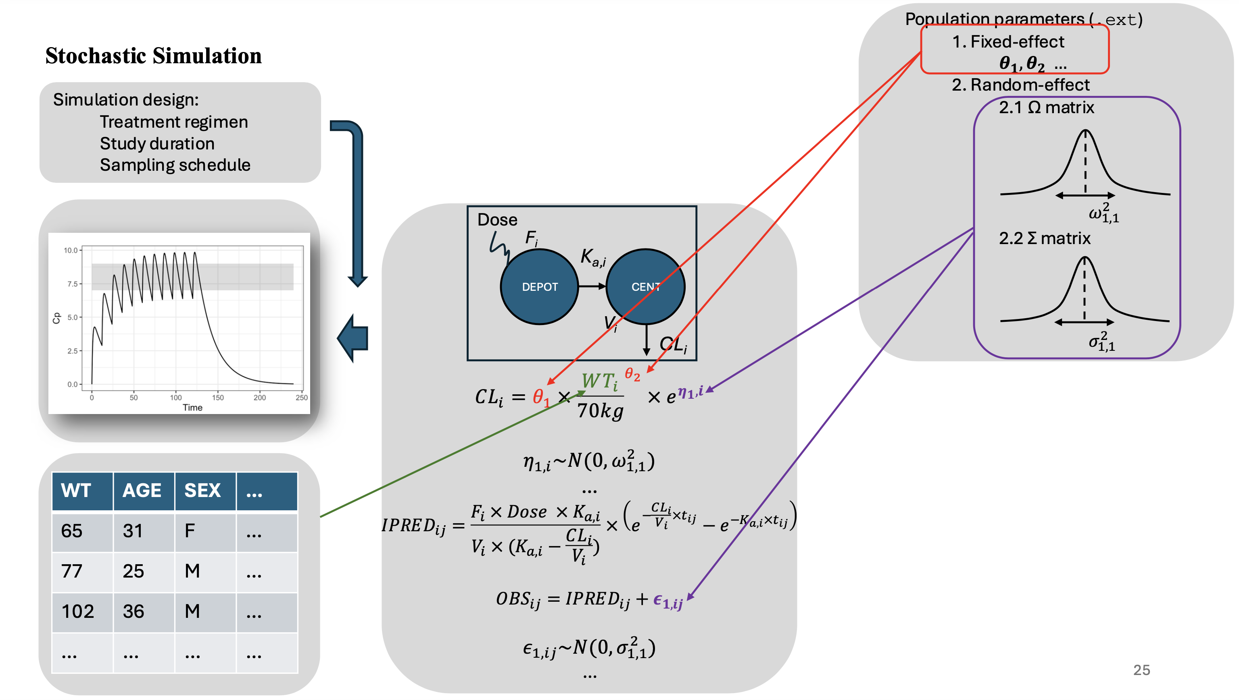

Slide 3
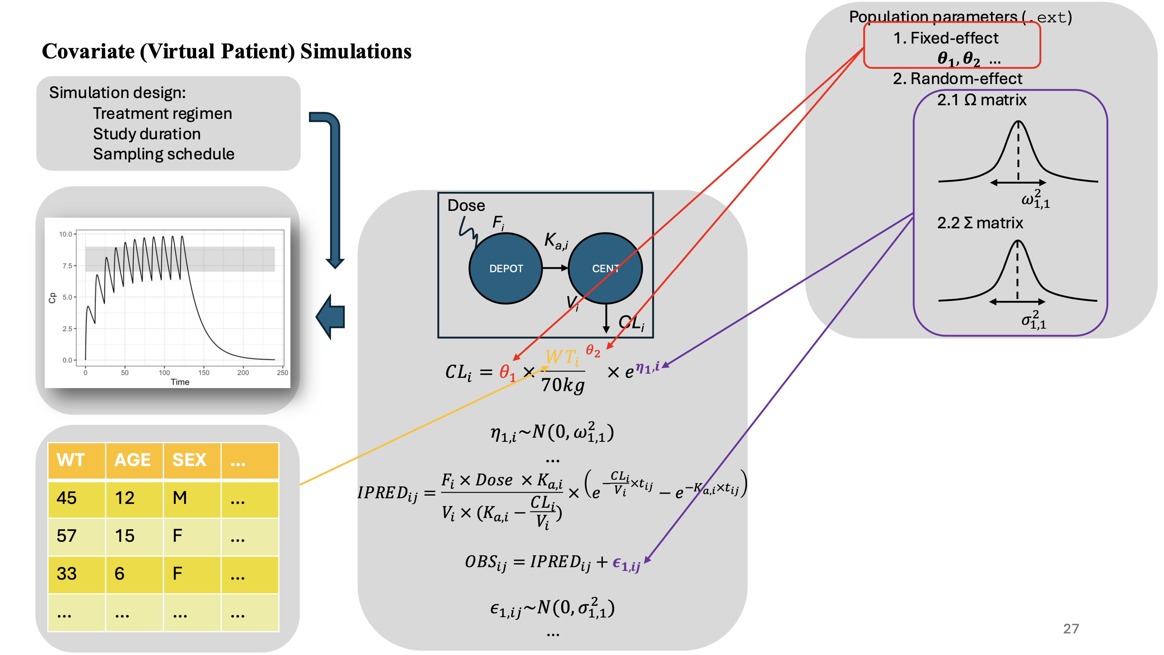

Slide 4
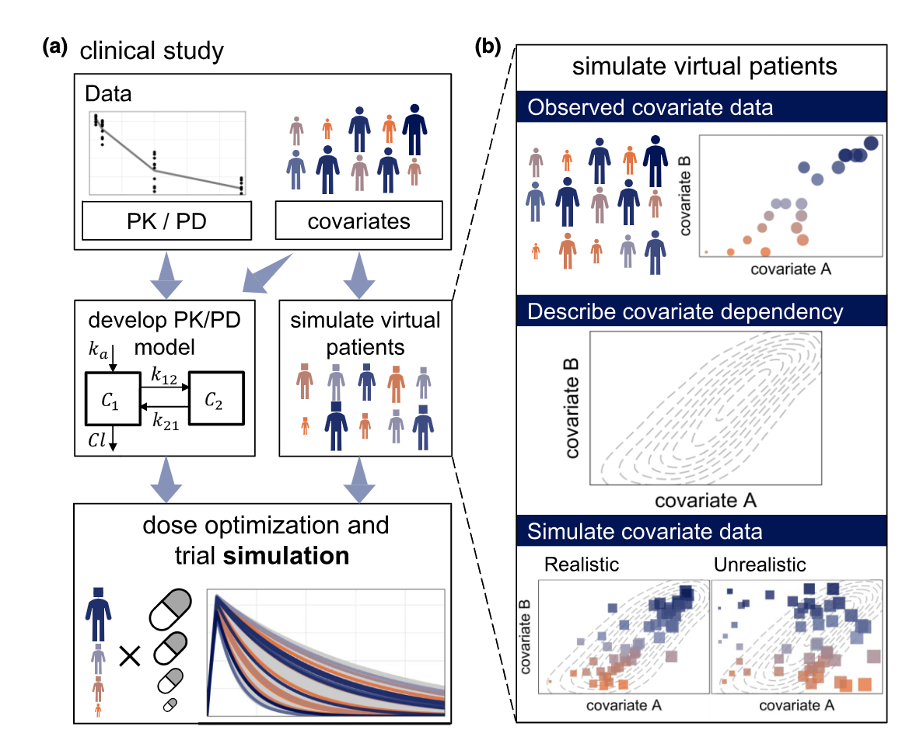
“Realistic” Virtual Population
Difficulties in simulating realistic virtual population:
Different covariates exhibit different distributions (i.e., marginal distributions)
Intricate dependency structure (i.e., correlation)
Unrealistic virtual patient example:
A patient of 95 years old, with a high body weight and a very good kidney.
Failing to consider such correlations inflate the variability of covariates, in other words, unrealistic virtual patients.
Zwep LB et al., Clin Pharmacol Ther. 2023

Slide 5
Methods of Virtual Patient Simulations
Data (Resample)-based methods
  Bootstrap
  Conditional distributions
    Also known as Multiple Imputation by Chained Equations (MICE)
Distribution-based methods
  Marginal distributions
  Multivariate normal distributions (MVND)
  Copula modeling
Population Data
Direct
Virtual population
Indirect
Population Data
Population distribution
Virtual population

Slide 6
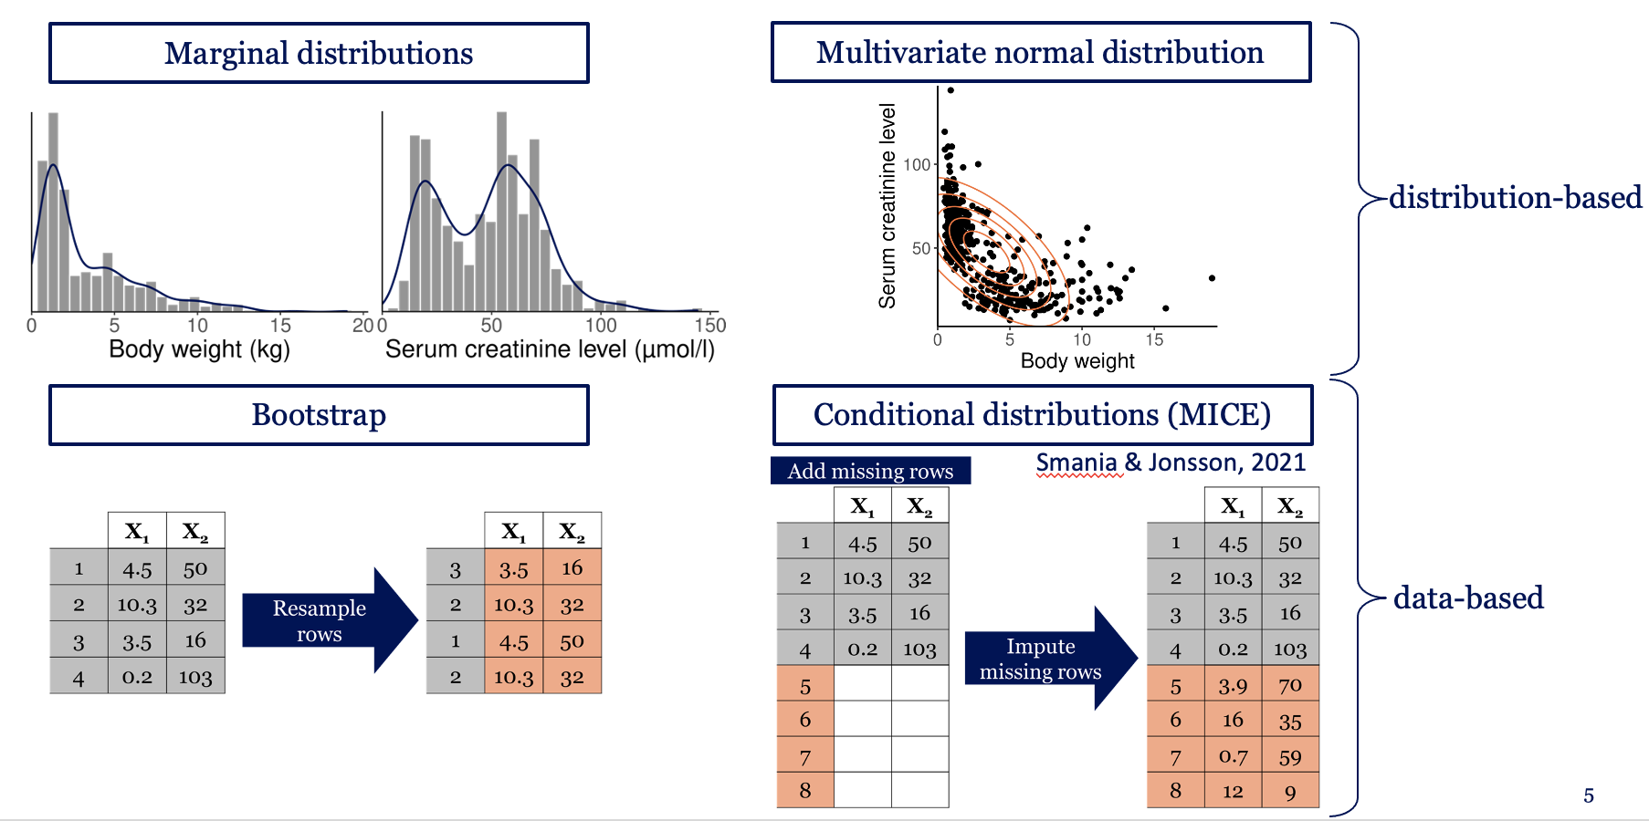
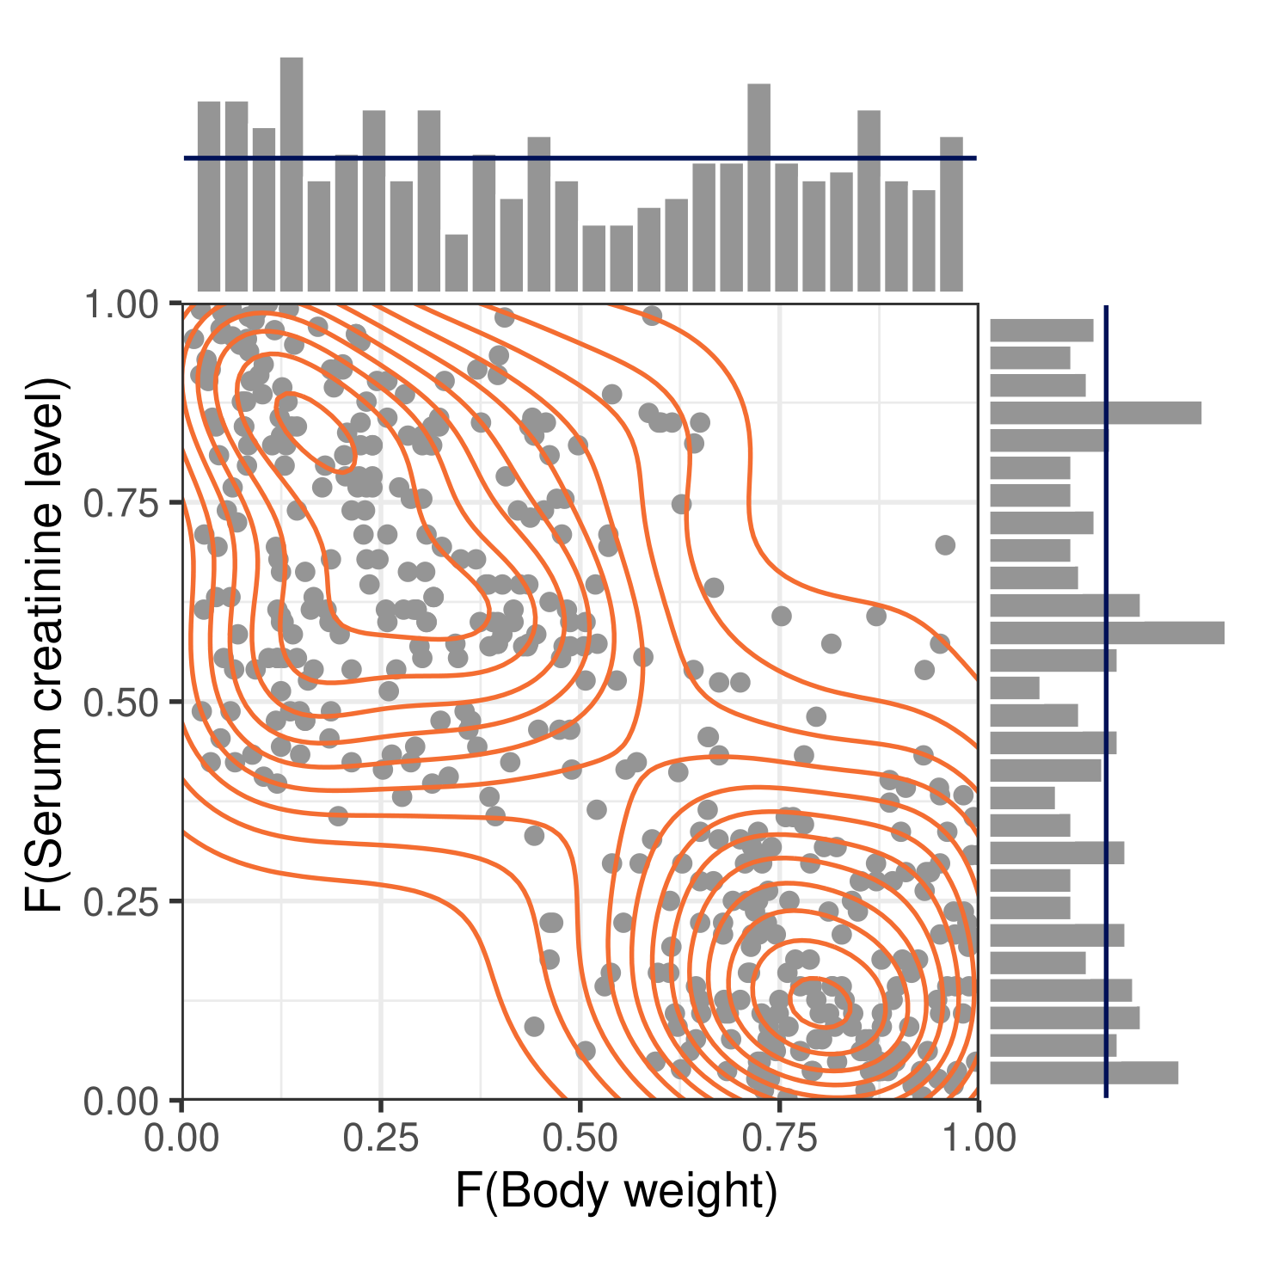
Methods of Virtual Patient Simulations
Need actual data
Cannot extrapolate
Need actual data (indirectly)
Copula modeling
Ignore correlations
Distributional assumptions
Zwep LB et al., PAGE. 2022

Slide 7
Distribution-Based Methods
Marginal distributions
Multivariate normal distributions (MVND)
Copula modeling

Slide 8
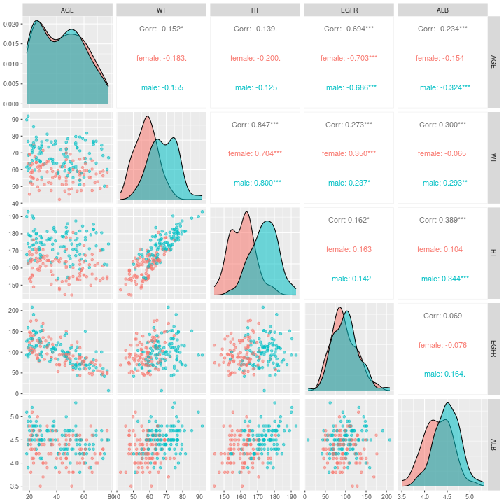
Population Data
./wk11/data/pop.csv
Seven covariates:
Continuous:
  AGE: age in years
  WT: body weight in kg
  HT: height in cm
  EGFR: estimated glomerular filtration rate in mL/min
  ALB: albumin concentration in g/dL
Categorical:
  SEX: gender (male vs female)

Slide 9
Experiments
Separate the population data based on SEX (male vs female)
Derive two distributions, one for male, one for female, using different method:
  Marginal distributions
  Multivariate normal distributions
  Copula modeling
Simulate from the derived distributions 100 times for simulation method evaluation.
Final simulation from the derived distributions(n=1)
Compare the simulated data with the population data, determine which method simulate the most “realistic” data (i.e., most similar to population data).

Slide 10
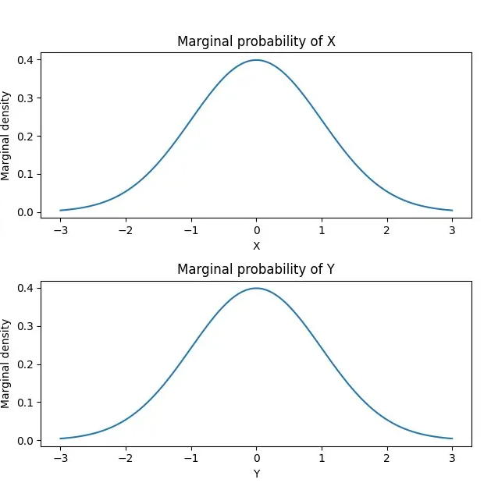
Marginal Distributions
Derive the means and standard deviations (SDs) of each variable in the population dataset.
Sample from a (truncated) normal distribution (or other distributions) with the same mean and SD of each variable.
Meccanismo Complesso. Marginal probability. 12/11/2023

Slide 11
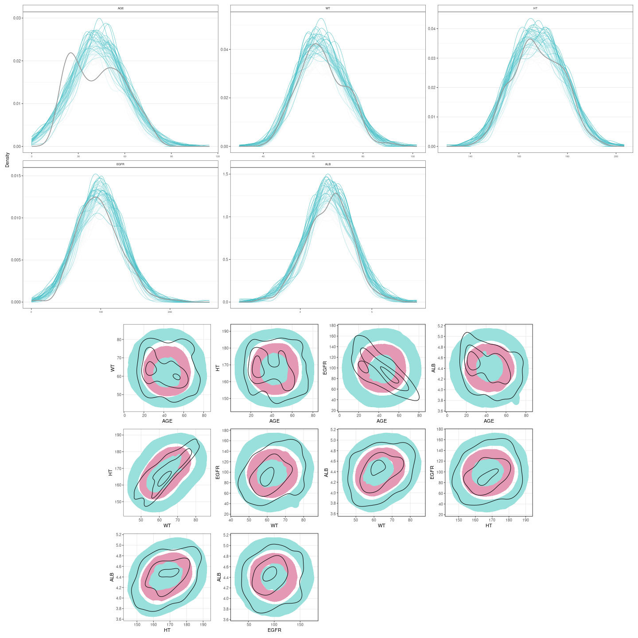
Marginal Distributions Simulation Method Evaluation
(Simulation replicates: n=100)

Slide 12
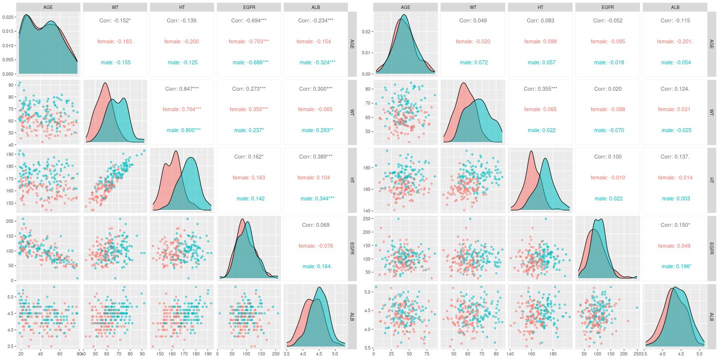
Marginal Distributions (Final simulation n=1)

Slide 13
Summary-Marginal Distributions
Simulation ignoring correlations (i.e., joint distribution)
Unrealistic simulation
  Unrealistic combination of covariates
    Low weight + high height
    High age + high eGFR
Easy to implement
Not appropriate to use most of the time.

Slide 14
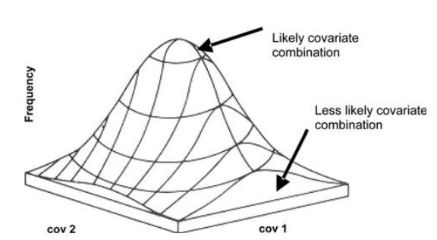
Multivariate Normal Distributions
Derive the means and the covariance matrix of the population dataset.
Sample from the multivariate normal distribution defined by the means and the covariance matrix .
Tannenbaum et al. 2006. Journal of Pharmacokinetics and Pharmacodynamics

Slide 15
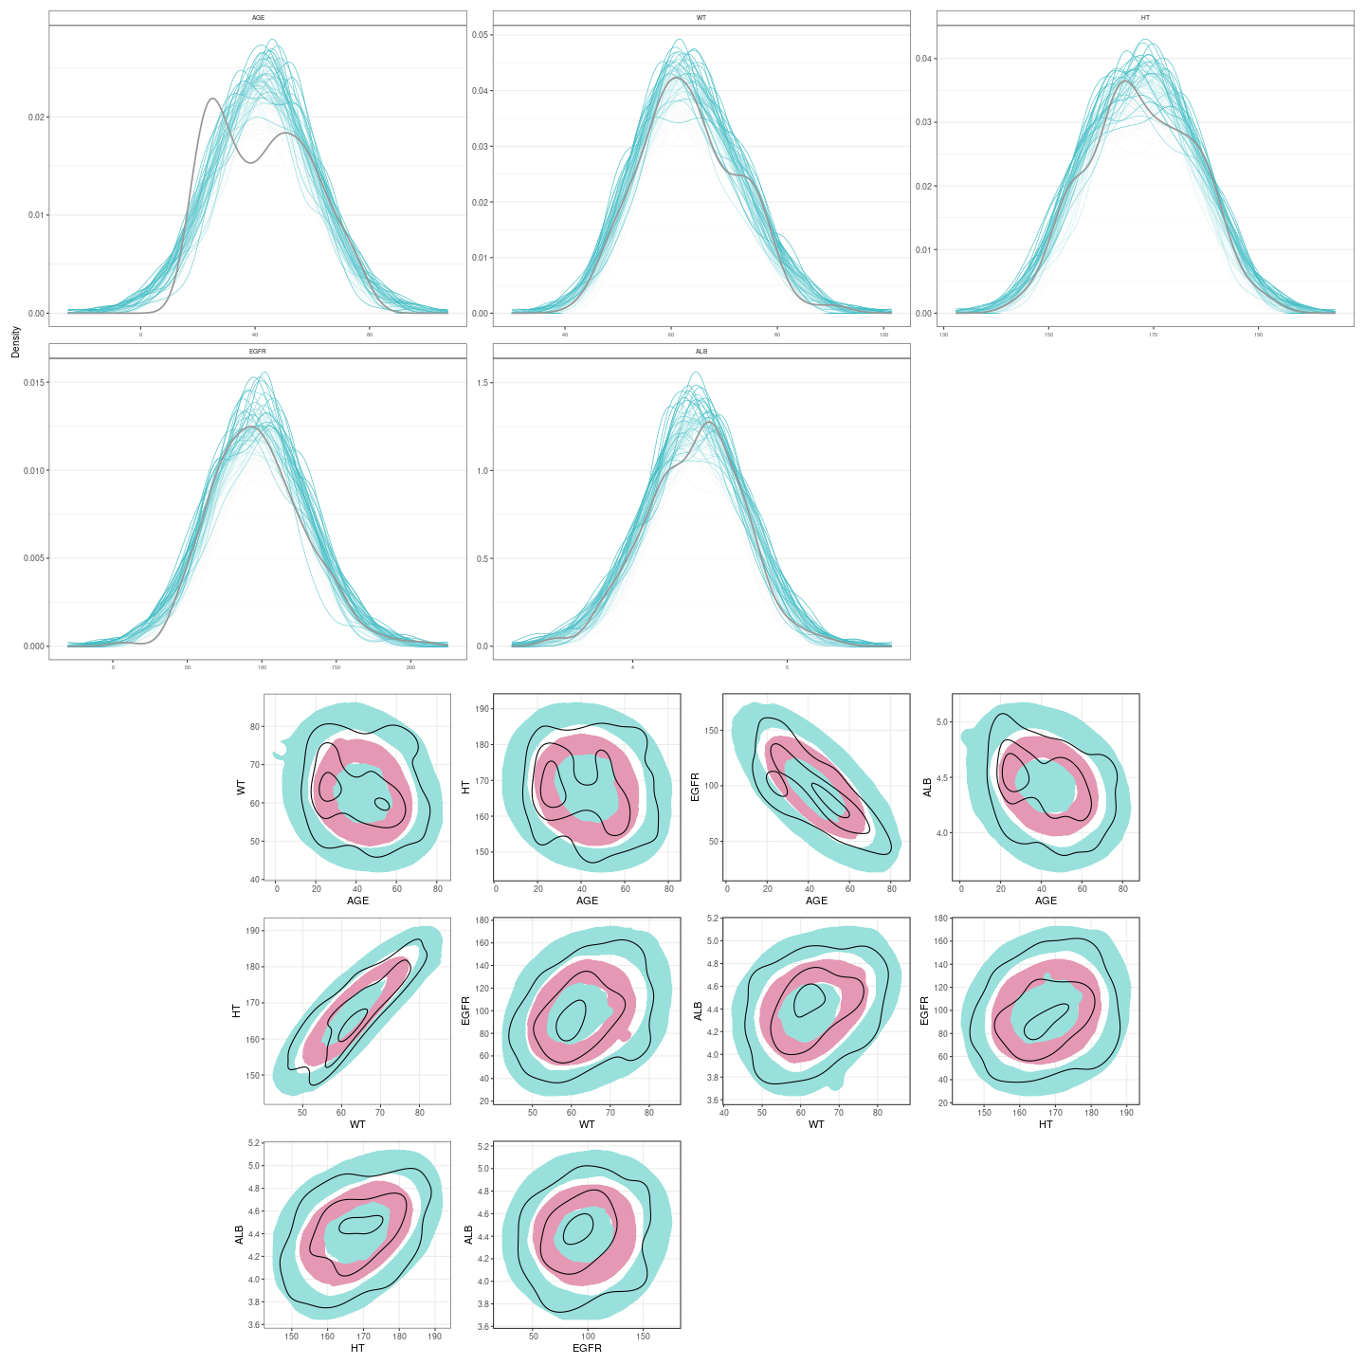
Multivariate Normal Distributions Simulation Method Evaluation
(Simulation replicates: n=100)

Slide 16
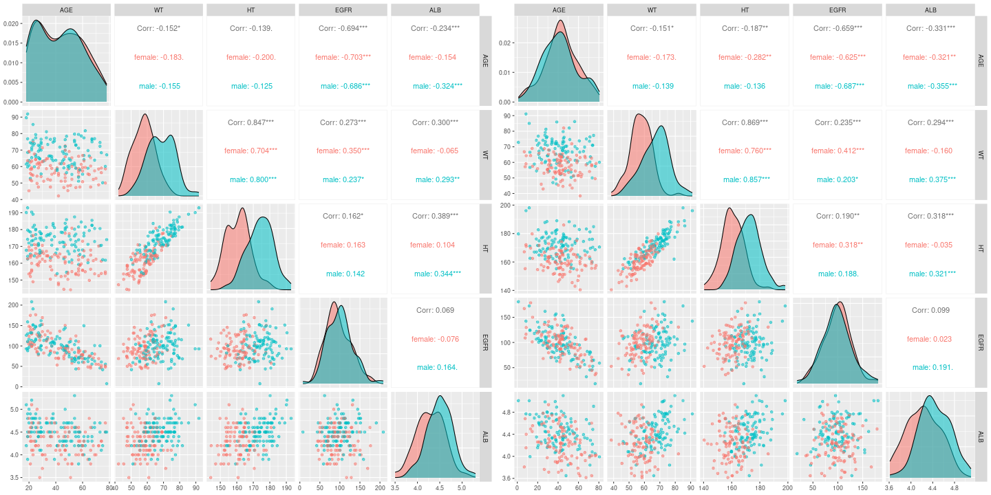
Multivariate Normal Distributions (Final simulation n=1)

Slide 17
Summary-Multivariate Normal Distributions
Simulation considering both marginal and joint distribution
More realistic simulation
  Realistic combination of covariates
Strong distributional assumptions
  Normal marginal distribution
  Linear correlation

Slide 18
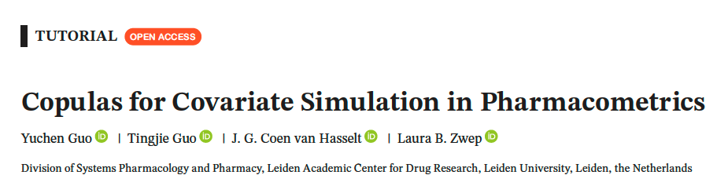
Copula-Based Virtual Patient Simulation
Zwep L.B. “Virtual patient simulation: a copula approach.” PAGE (2022).
Zwep, L. B., et al. “Virtual patient simulation using copula modeling.” CPT (2022).
Guo, Y., et al. “Generation of realistic virtual adult populations using a model-based copula approach.” JPKPD (2024).
Guo, Y., et al. “Copulas for Covariate Simulation in Pharmacometrics” CPT:PSP (2026)
  R package (pmxcopula): https://github.com/vanhasseltlab/pmxcopula
  Installation: devtools::install_github("vanhasseltlab/pmxcopula", build_vignettes = TRUE, force = TRUE)

Slide 19







Sklar’s Theorem
$$f\left(x,y\right)=C\left(U,V\right) ̇f_{X}\left(X\right) ̇f_{Y}(Y)$$
$$U=F_{X}\left(X\right)$$
$$U\sim U(0,1)$$
$$V=F_{Y}\left(Y\right)$$
$$V\sim U(0,1)$$
$$X=F_{X}^{−1}\left(U\right)$$
$$Y=F_{Y}^{−1}\left(V\right)$$
f (x, y) | Joint density function
Fx(X), FY (Y) | Marginal distribution
C (U, V) | Copula describing the dependence structure
F_{X}⁻¹(X), F_{Y}⁻¹(Y) | Inverse marginal cumulative density function
Guo, Y., et al. CPT:PSP (2026)

Slide 20
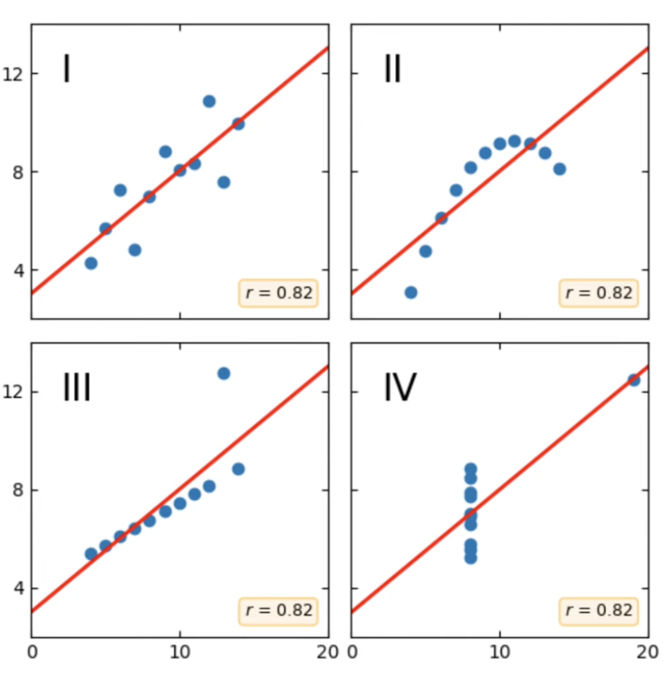
Why Copulas? Correlation Is Not Enough
Same Pearson correlation ≠ Same joint distribution
Datasets can have
The same correlation coefficient
But differ substantially in their dependence patterns.
Matching a correlation matrix alone does not guarantee realistic combinations of patient covariates.
Kiran Karra. Copula Short Course. Youtube

Slide 21
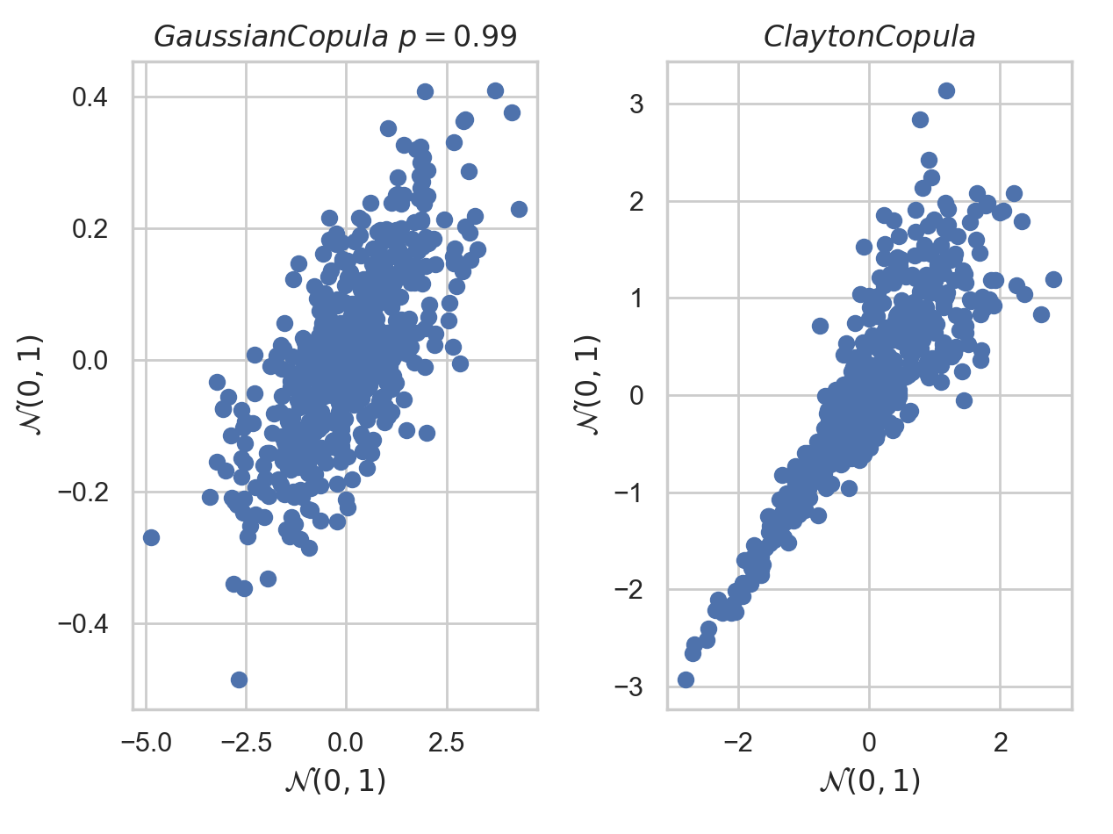
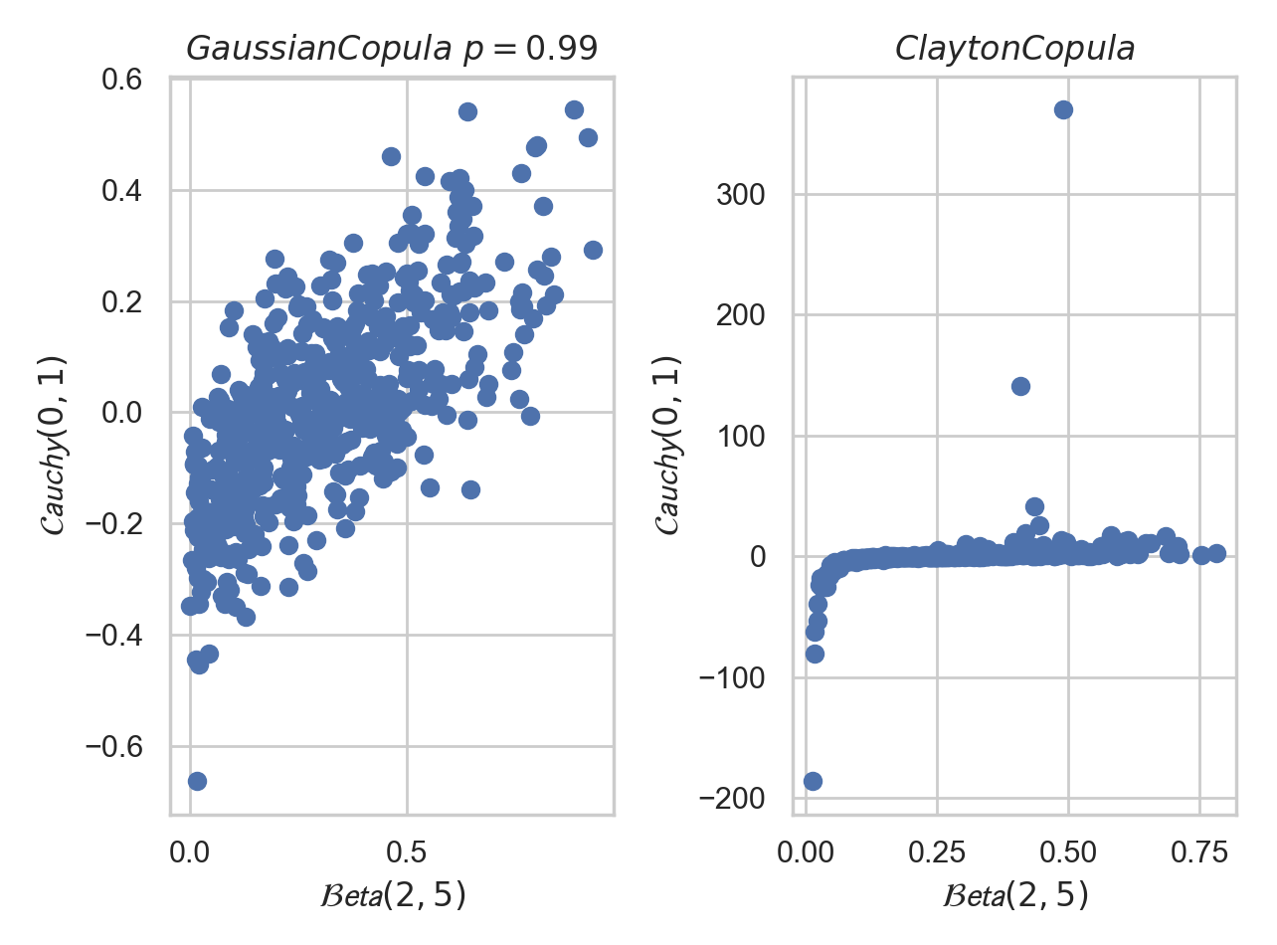
Why copula? Dependence Beyond Correlation
Gaussian copula | Clayton copula
Symmetric dependence structure | Asymmetric dependence structure
No tail dependence | Lower tail dependence
Kiran Karra. Copula Short Course. Youtube

Slide 22
Copula-Based Simulation Workflow
f(x,y) = C(U_{i}, U_{j}) x F_{i}(X_{i}) x F_{j}(X_{j})
1. Characterize observed covariates
Estimate marginal distribution of covariates (e.g., AGE, WT, EGFR, etc)
2. Transform covariates to uniform distributions
U_{j}=F_{j}(X_{j})
3. Fit a copula model
Model dependence (C(U_{i}, U_{j})) between uniformly distributed covariates
e.g., using vine copula guided by AIC
4. Simulate uniformly distributed covariates based on the fitted copula model
U_{j}*
5. Transform back to clinical covariate values
X_{j}*=F_{j}⁻¹(U_{j}*)
Notes:
Transform marginal distributions into uniform distributions
Develop copula model
Vine copula: rvinecopulib
Copula selection using AIC
Simulations
Transform the simulated uniform distributions into the original marginal distributions
A vine copula is a flexible way to model multivariate dependence by decompose multivariate distribution into a series of bivariate distribution.
It's not the only copula modeling approach.

Slide 23
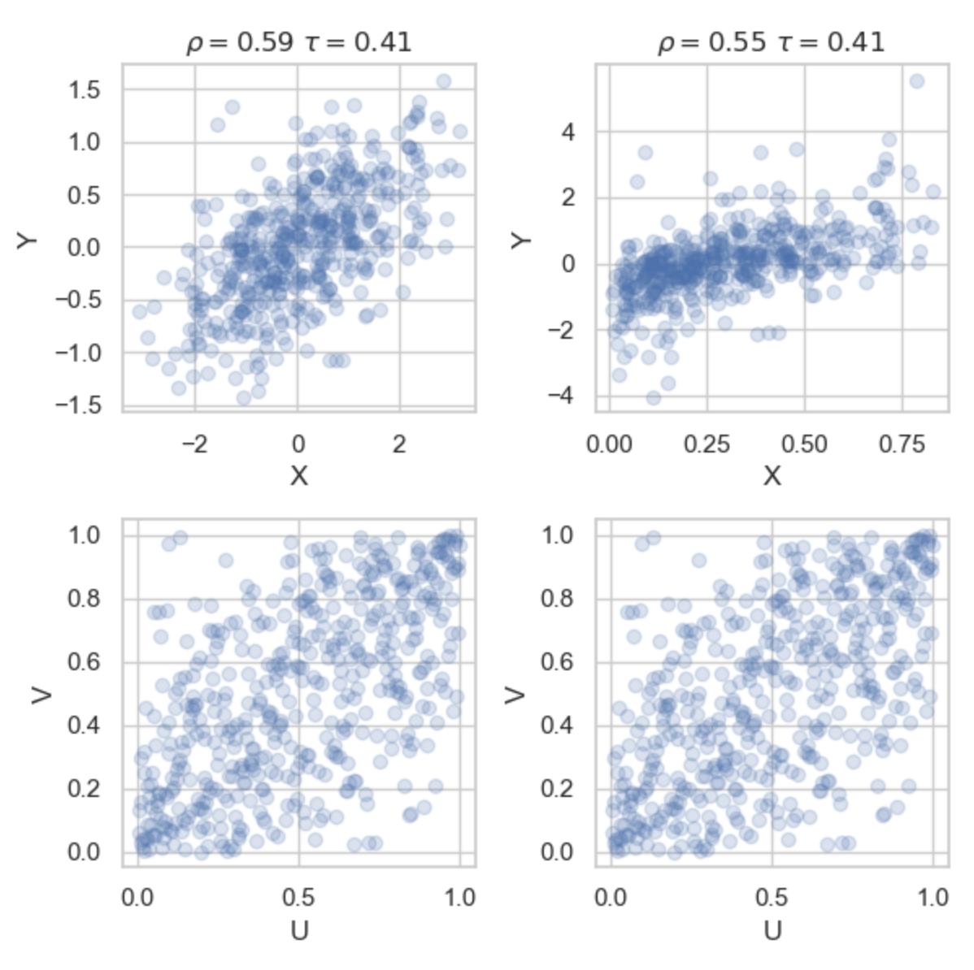
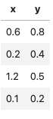
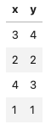
Uniform Marginals Isolate the Dependence Structure
Why use uniform marginal distributions?
Separate marginal distributions from dependence.
  Model dependence regardless of the original covariate scales.
  Preserve rank-based association.
Generate new covariate combinations using different marginal distributions while retaining the fitted copula.
Original observations
Rank observations
Kiran Karra. Copula Short Course. Youtube
Key takeaway: Copulas allow us to model how patient covariates depend on one another, independently of how each covariate is distributed.

Slide 24
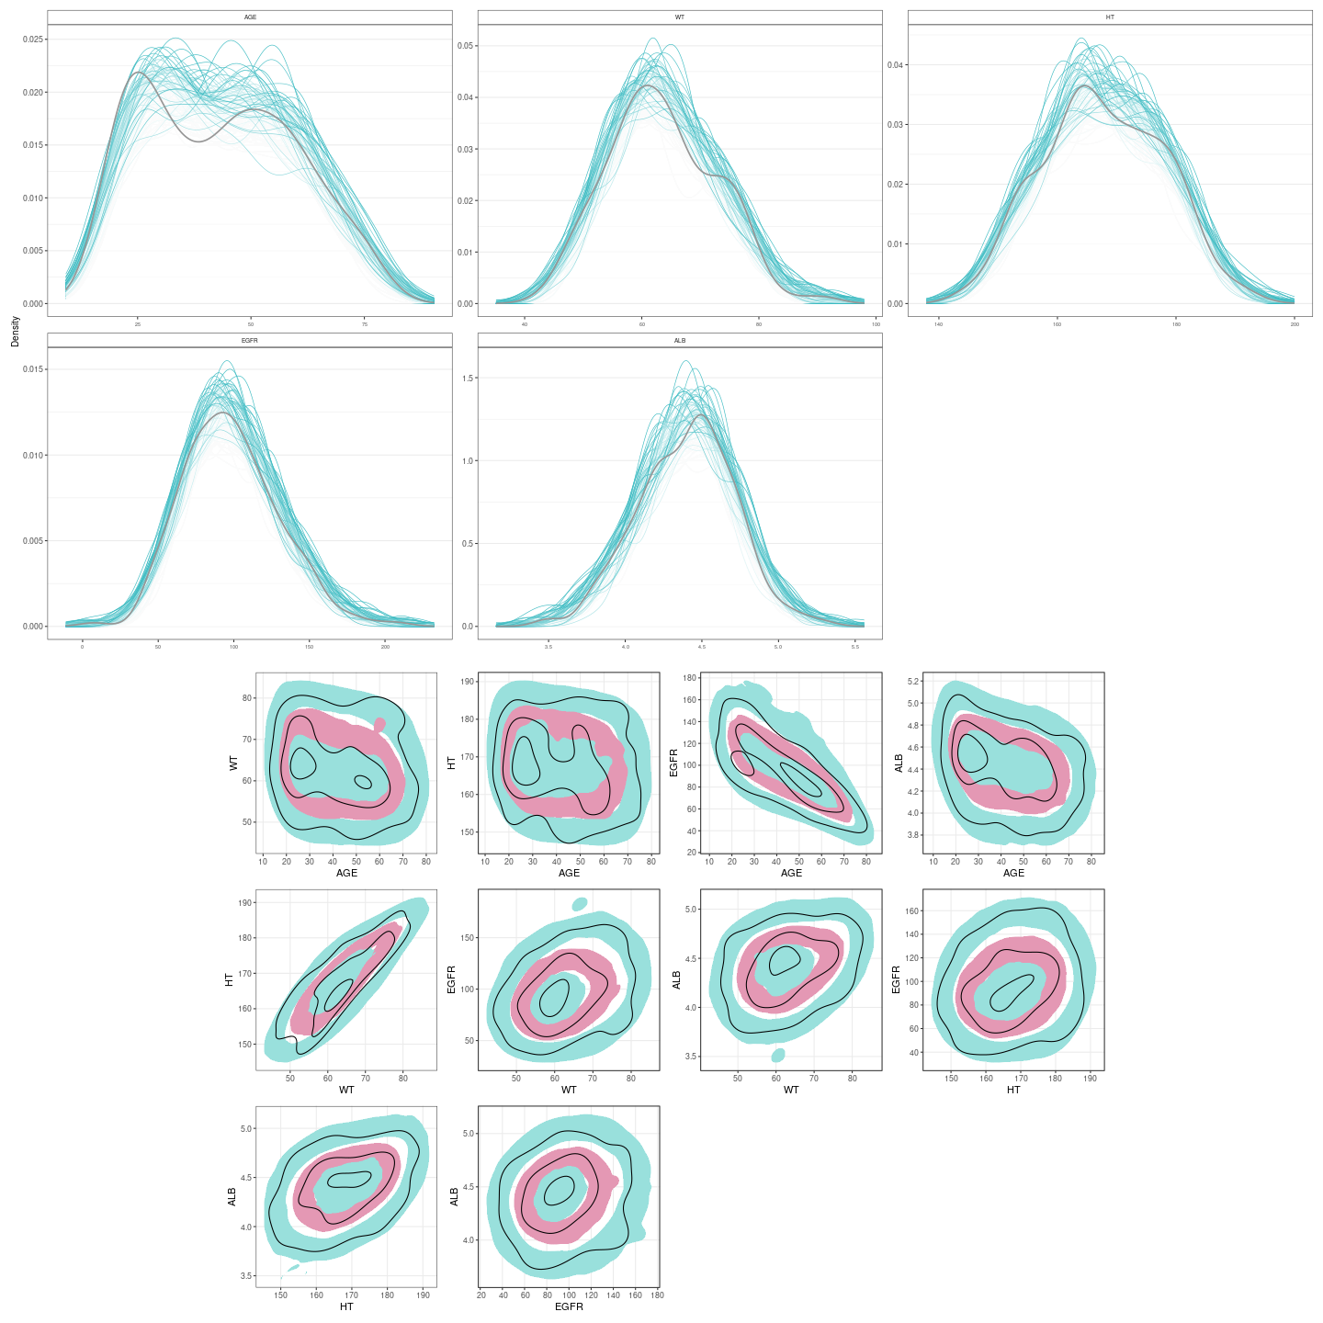
Copula Modeling Simulation Method Evaluation
(Simulation replicates: n=100)

Slide 25
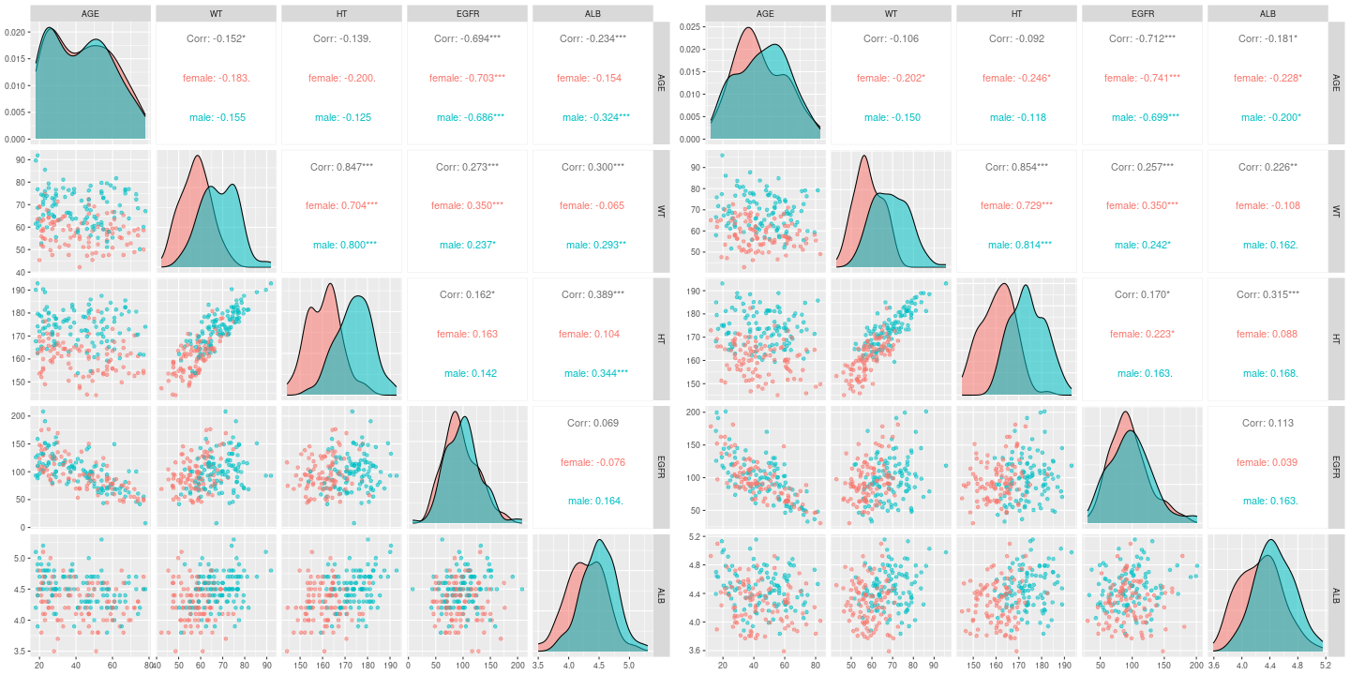
Copula Modeling (Final simulation n=1)

Slide 26
Copula resources
Laura B. Zwep, Tingjie Guo, Jacqueline J. Meulman, J.G. Coen van Hasselt. Copula modeling for realistic virtual patient covariate simulation. PAGE 2022
Zwep, L.B., Guo, T., Nagler, T., Knibbe, C.A.J., Meulman, J.J. and van Hasselt, J.G.C. (2024), Virtual Patient Simulation Using Copula Modeling. Clin Pharmacol Ther, 115: 795-804. https://doi.org/10.1002/cpt.3099
  Github: https://github.com/vanhasseltlab/copula_vps
Guo, Y., Guo, T., Knibbe, C.A.J. et al. Generation of realistic virtual adult populations using a model-based copula approach. J Pharmacokinet Pharmacodyn (2024). https://doi.org/10.1007/s10928-024-09929-4
  Github: https://github.com/vanhasseltlab/NHANES_copula
  ShinyAPP: https://cocosim.lacdr.leidenuniv.nl/
Kiran Karra. Copula Short Course. Youtube

Slide 27
Homework
Deterministic, stochastic, and virtual population simulations to support exposure-response analysis, exposure matching and dose recommendations.
  Details: `./wk11/homework/homework-wk11.pdf`
  All required documents are in `./wk11/homework/` directory
Make a copy of `./wk11/ homework-wk11.qmd` with appropriate rename. Perform all analysis based on this qmd file. Knit into a pdf file for submission.
Deadline: Dec. 11, 2026 before class (3-week)
This assignment will account for 20% of the final grade.

Slide 28
The End

