Slide 1
GDC git primer

Slide 2
First some vocabulary
Version control- the practice of tracking and managing changes to software code
Git - a version control system used for tracking changes in files.
Github- a cloud-based Git repository that helps developers store, manage, and track changes to their projects

Slide 3


Slide 4
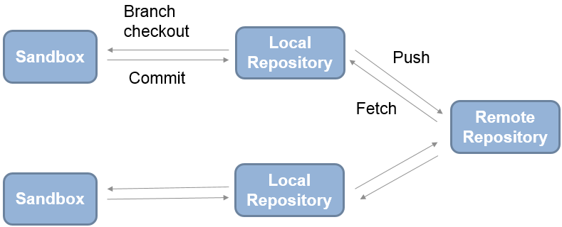

Slide 5
Feature branch workflow
Want to make new feature?
  Make a new branch
Ensures that won’t break project for everyone else

