Slide 1
GDC Genomics QC design

Slide 2
Bash scripts for each process (plink cleaning, ancestry predict, etc)
Argparse built into each bash script
Python wrapper for each process
Call processes from python script

Slide 3
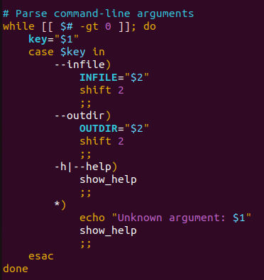
Bash scripts
- Add an argument parse to each bash script (this will allow us to call it as a function)
- Argument parser should be at the top of file
- Then we can call the script like this

Slide 4
Scripts needed
Genetics QC for homogeneous population
Missingness, heterozygosity, Linkage Disequilibrium, MAF
Applied to full sample and individual ancestries
Predict ancestry (fraposa workflow)
Pcrelate to select singeltons (also use gcta)

Slide 5
Structure
Red = Bash
Blue = Python
Yellow = Quarto
Repeat for each Chrom
Projection plots
Project onto PC space
Data
Merge Chrom’s
QC
(convert to bed, missing, het, LD, MAF)
# removed
Knn or probabilistic clustering
Repeat for each Chrom
PCRelate and GRM select unrelated
Output
QC
(convert to bed, missing, het, LD, MAF)
Report
cluster labels
cluster labels

