Slide 1

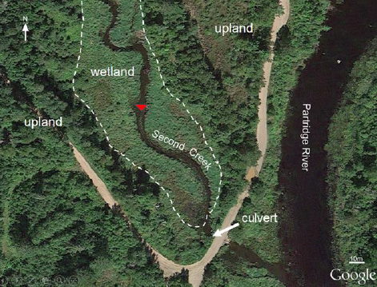
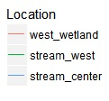
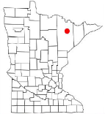
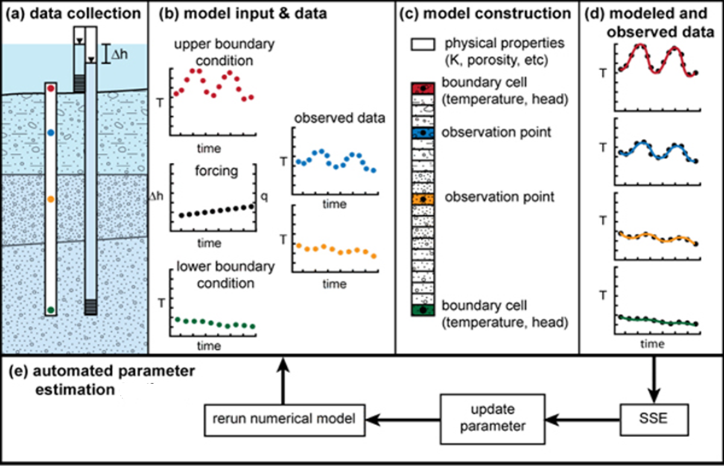
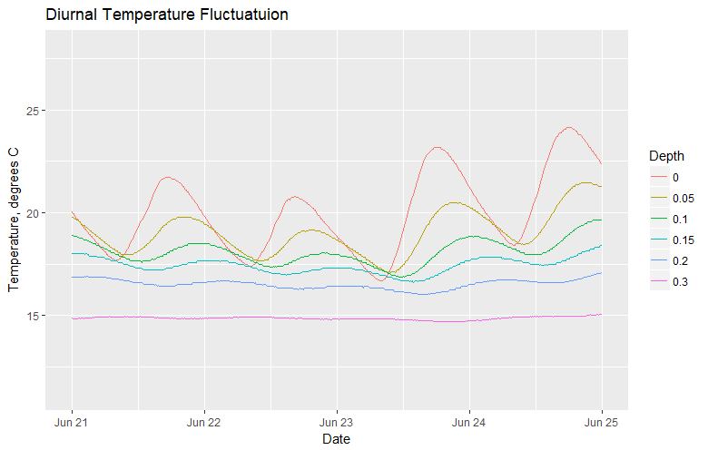

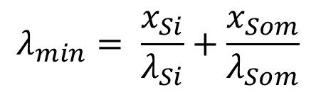
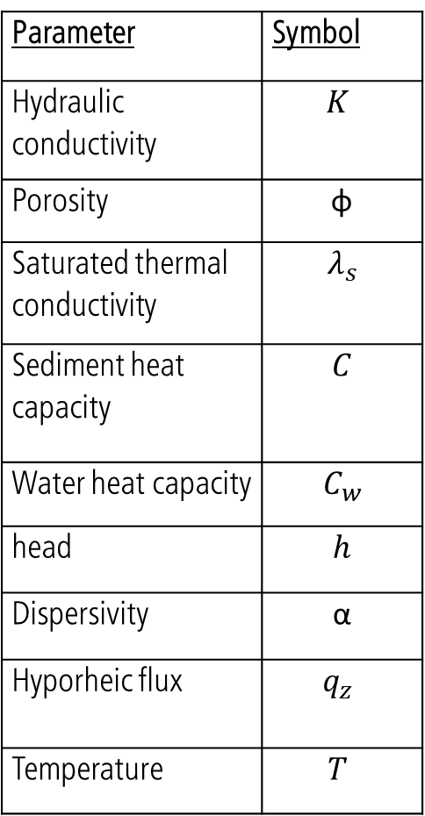


Quantifying Surface Water-Groundwater Exchange Using Temperature Profile Inverse modeling in a Riparian Wetland
number
Jack Lange, G.-H. Crystal Ng, Amanda R. Yourd, Chad Sandell , Andrew D Wickert
Dept. of Earth Sciences, University of Minnesota Twin-Cities
Introduction
Sediment characterization
Model fit and sensitivity analysis
Motivation: understand how mining derived sulfate affects biogeochemical cycling in first order streams on the iron range
Hyporheic flux controls the sediment geochemical gradient [Hayashi & Rosenberry 2002; Kurtz et al. 2007.]
Wetland
Stream
Channel
Stream
channel
The influence of dispersity is proportional to flux magnitude. At high dispersivity, low flux magnitude (K) is required to match the observations. At low dispersivity, higher K is required.
As sediment conductivity increases, energy from the warm surface water is transferred downwards more easily, so higher hyporheic flux (K) is required to maintain the observed temperature profile
Saturated heat capacity is relatively insensitive, it is dominated by the heat capacity of water due to the sediment’s high porosity (0.51)
[Yourd, 2017]
[Yourd, 2017]
Goal: quantify hyporheic flux at a sulfate impacted stream site
Site: Second Creek is a riparian wetland located in Minnesota’s Iron Range
Sediment is characterized by high organic content, low dry bulk density, high porosity [Mybro, 2013.]
Measured dry bulk density from [Mybro, 2013.] used to estimate the fraction silicate and SOM
80-90% SOM, 10-20% silicate
Thermal conductivity and sediment heat capacity constrained by computing upper and lower bounds based on [Farouki,1961]
Dispersivity estimated from the range provided by Zheng & Bennet, 1995
Methods
Forward model governing equation
To do:
Increase font and line size on all R plots for readability
Give context to the X axis values on sensitivity analysis plots
Show a metric of goodness of fit for each point in the sensitivity analysis plots
Hydraulic conductivity is estimated by reducing the residual between a modeled temperature profile and the observed profile
$${(λ}_{s}+q_{z}αC_{w})\frac{∂^{2}T}{∂t^{2}}−q_{z}C_{w}\frac{∂T}{∂z}=\frac{∂T}{∂t}(φC_{w}+(1−φ)C_{s})$$
$$λ_{min}= \frac{x_{Si}}{λ_{Si}}+\frac{x_{Som}}{λ_{Som}}$$
$$λ_{max}=x_{Si}λ_{Si} + x_{Som}λ_{Som}$$
$$q_{z}= −K\frac{dh}{dz}$$
Conclusions
Estimating K by fitting model to observations using 1DTempPro
[Healy, R.W., and A.D. Ronan. 1996]
Flux in the hyporheic zone is consistently upwards throughout the summer
The lowest magnitude of flux occurs in the west stream channel
Flux in the west stream channel has smaller fluctuations than the stream center or west wetland
One brief flux reversal occurred following a major storm event in late August
Parameter | Symbol
Hydraulic conductivity | $$K$$
Porosity | φ
Saturated thermal conductivity | $$λ_{s}$$
Sediment heat capacity | $$C$$
Water heat capacity | $$C_{w}$$
head | $$h$$
Dispersivity | α
Hyporheic flux | $$q_{z}$$
Temperature | $$T$$
Results
Do you think the smoothed version or the unsmoothed version would be more informative?
Future work
0.18 m/d
Similar data with higher spatial resolution, and longer field time (may – October) was collected in 2017
2017 long term flux reversal, heterogeneity resolution
2018 field campaign: unique parameterization based on sediment collected at each probe location
[Modified, Koch et al. 2015]
Data collection
Three temperature probes were collocated with piezometers across the site
Pressure and temperature was measured at 15 minute intervals to capture diurnal variability over the summer
Rainfall data supplied by the nearby Embarrass, MN weather station
Waiting on blurb/image from ANDY
References
Location | Hydraulic conductivity, m/d
West wetland | 0.07
Stream west | 0.04
Stream center | 0.18
Farouki, O., 1961. Thermal properties of soils. United States Army Corps of Engineers Cold Regions Research and Engineering Laboratory.; Hayashi, M. & Rosenberry, D.O., 2002. Effects of Groundwater Exchange on the Hydrology and Ecology on Surface Water. Groundwater.; Healy, R.W., and A.D. Ronan. 1996. Documentation of computer program VS2DH for simulation of energy transport in variably saturated porous media – modification of the U.S. Geological Survey’s computer program VS2DT. U.S. Geological Survey Water-Resources Investigations Report.; Koch et al. 2015., 1DTempPro V2: New Features for Inferring Groundwater/Surface-Water Exchange, Groundwater.; Kurtz, A.M. et al., 2007. The importance of subsurface geology for water source and vegetation communities in Cherokee Marsh, Wisconsin. Wetlands.; Mybro, A., 2013. Wild Rice Sulfate Standard Field Surveys 2011, 2012, 2013: Final Report. University of Minnesota.; Yourd, A., 2017. Using reactive transport modeling to link hydrologic flux and root zone geochemistry at Second Creek, a sulfate enriched wild rice stream in northeastern Minnesota, Masters Thesis, University of Minnesota.; Zheng, C. & Bennett, G., 1995. Applied Contaminant Transport Modeling . John Wiley & Sons.

