Slide 1
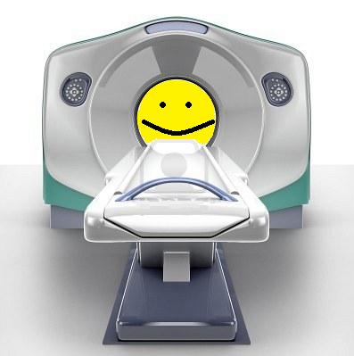
Methods Core
Preprocessing Documentation

Slide 2
Requirements
SPM8 with VBM8 toolbox
FSL 4.1.9 or higher
Bash
4D NIFTI images (.nii)
Standard directory structure

Slide 3
Expected Directory Structure
Experiment_Name
Subject_#
Subject_#
Subject_01
anatomy
func
[topDir]/func
t1spgr.nii
t1overlay.nii
run_01
run_02
run_##
run_01
run_##
run_01.nii
run_02.nii
run_01.nii
Note: All example commands will use this directory structure and are executed while at the directory Experiment_Name in a Unix shell.

Slide 4
Command Features
Minimize user script writing
Extensive logging for all processing
Allows quality control between commands
Allows for large scale data throughput
Built-in help (just type command name at shell)
Launches to background
Email/text message notification
Optimized performance

Slide 5
Processing Stream
sliceTime8
Slice timing correction
Realignment
Coregistration
Warping
Smoothing
Apply Warp
realignfMRI
coregOverlay
coregHiRes
vbm8HiRes
vbm8Check
warpfMRI
vbm8Check
smoothfMRI

Slide 6

sliceTime8
This script uses SPM8 to perform slice time corrrection.
TYPE THIS COMMAND BY ITSELF:
sliceTime8
View information & available options. All commands have this feature.

Slide 7
sliceTime8
sliceTime8 –v run –M ./ <Subjects>
-U youremail@umich.edu
sliceTime8 Options
-B run in the foreground
-D enable super debug flag
-d enable debug flag
-F set the TR for volume acquisition
-f [directory] functional directory e.g. connect/func
-G set the value for the reference slice
-M [directory] master subject directory
-n [name] name prepend
-O slice acquisition order
-t test flag
-U [unique] user email name/txt msg address
-v [name] volume name (name of functional file)

Slide 8
sliceTime8
If you typed everything correctly, you will get an email when sliceTime8 is complete.
List the contents of Subject_01’s run_01 directory:
You should now see a slice timed corrected run – arun_01.nii

Slide 9
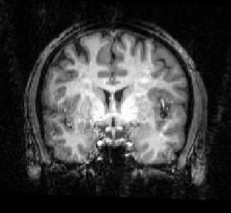
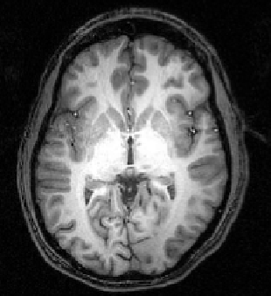
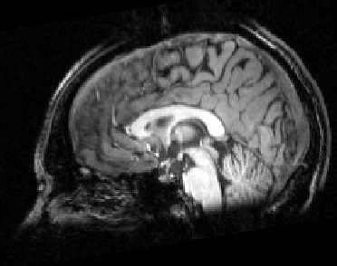
Realignment
Remember: This step is to align each volume of the brain to a target volume using six parameters: three translations and three rotations
pitch
roll
yaw
z translation
y translation
x translation
Under the Hood
Builds shell script that calls FSL’s mcflirt
Default mcflirt options: “-cost normcorr -stats -plots”

Slide 10
Realignment
realignfMRI –v arun –i 1-2 –M ./ <Subjects>
-U youremail@umich.edu
realignfMRI Options
-A all runs present
-B run in the foreground
-D enable super debug flag
-d enable debug flag
-f [directory] functional directory e.g. connect/func
-i [#-#] inclusive run list
-M [directory] master subject directory
-m [“options”] mcflirt options
-O name to give realignRefVolume
-n [name] name prepend
-S [#] standard volume number for mcflirt
-t test flag
-U [unique] user email name/txt msg address
-v [name] volume name wild card
-# [run number] include this run number

Slide 11
Realignment
Launching Script into Background = YAY!
Another email
List the contents of the run directories again
Output
rarun_##.nii
mcflirt_realign_arun.dat - transformation parameters
r_mcflirt_arun_meanvol.nii - mean image after realign
r_mcflirt_arun_sigma.nii - std over time
r_mcflrit_arun_variance.nii - variance over time

Slide 12
Pause – A look at what you have so far
Subject_01
anatomy
func
t1spgr.nii
t1overlay.nii
run_01
run_02
run_01.nii
arun_01.nii
rarun_01.nii
mcflirt_realign_arun_01.dat
r_mcflirt_arun_01_meanvol.nii
r_mcflirt_arun_01_sigma.nii
r_mcflirt_arun_01_variance.nii
run_02.nii
arun_02.nii
rarun_02.nii
mcflirt_realign_arun_02.dat
r_mcflirt_arun_02_meanvol.nii
r_mcflirt_arun_02_sigma.nii
r_mcflirt_arun_02_variance.nii

Slide 13
coregOverlay
coregOverlay –o t1overlay –v rarun –M ./
<Subjects> -U your_email@umich.edu
-a [directory] set path for anatomy directory
-B run in the foreground
-D enable super debug flag
-d enable debug flag
-f [directory] functional directory e.g. connect/func
-M [directory] master subject directory
-n [name] name to add to output file name
-O name of other files to process
-o [name] name of overlay file
-r set reslice flag
-s [directory] set sub-directory under ‘run_##’
-t test flag
-U [unique] user email name/txt msg address
-v [name] name of functional image
-w [directory] set output path

Slide 14
coregOverlay
Subject_01
anatomy
func
t1spgr.nii
t1overlay.nii
run_01
run_02
coReg
The coregOverlay command copies the original t1overlay from “anatomy” into a new directory “coReg” located under “func”
The copied t1overlay is the one that is coregistered
t1overlay.nii

Slide 15
coregHiRes
coregHiRes –h t1spgr –o t1overlay –M ./
<Subjects> -U your_email@umich.edu
-a [directory] set path for anatomy directory
-B run in the foreground
-D enable super debug flag
-d enable debug flag
-f [directory] functional directory e.g. connect/func
-h [name] name of high resolution anatomical (t1spgr)
-M [directory] master subject directory
-n [name] name to add to output file name
-O name of other files to process
-o [name] name of overlay file
-r set reslice flag
-t test flag
-U [unique] user email name/txt msg address
-w [directory] set output path

Slide 16
coregHiRes
Subject_01
anatomy
func
t1spgr.nii
t1overlay.nii
run_01
run_02
coReg
The coregHiRes command copies the original t1spgr from “anatomy” into a new directory “coReg” located under “func”
The copied t1spgr is the one that is coregistered to the t1overlay in coReg (the one that is already in functional space)
t1overlay.nii
t1spgr.nii

Slide 17
DARTEL Warping – vbm8HiRes
vbm8HiRes –h t1spgr –a func/coReg
–w func/coReg/VBM8 –I r3mm_avg152T1_BET –n w3mm_
–M ./ <Subjects> -U your_email@umich.edu
-a [directory] set path for anatomy directory
-B run in the foreground
-D enable super debug flag
-E set the erosion iteration numbers
-d enable debug flag
-H calculate bias field corrected image
-h [name] name of high resolution anatomical (t1spgr)
-I [Ref name] set the reference image to use for VBM8
-L erosion flag
-M [directory] master subject directory
-m fsl options
-n [name] name to add to output file name
-O name of other files to process
-t test flag
-U [unique] user email name/txt msg address
-w [directory] set output path
-z set the voxel size for resampling

Slide 18
Directory Structure – After DARTEL
Subject_01
anatomy
func
t1spgr.nii
t1overlay.nii
run_01
run_02
run_##
coReg
run_02.nii
(rarun_02.nii or raprun_02.nii)
arun_02.nii
rarun_02.nii
t1spgr.nii
t1overlay.nii
VBM8
w3mm_t1spgr.nii
y_rt1spgr.nii
(other DARTEL output)

Slide 19
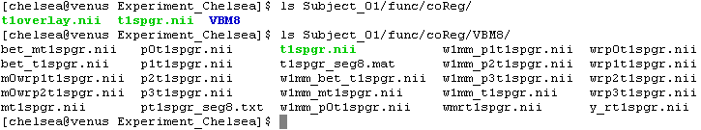
DARTEL Warping – vbm8HiRes
List the contents of func/coReg to see new VBM8 directory. List the contents of the VBM8 directory to see DARTEL output

Slide 20
Quality Checks
A quality check too with FSL:
vbm8Check – 3 steps
0. check skull stripping
check registration between spgr & template
(later)

Slide 21
Quality Checks
0. skull stripping of spgr
TYPE:
vbm8Check -a func/coReg/VBM8 –h t1spgr –M ./ <Subjects>

Slide 22
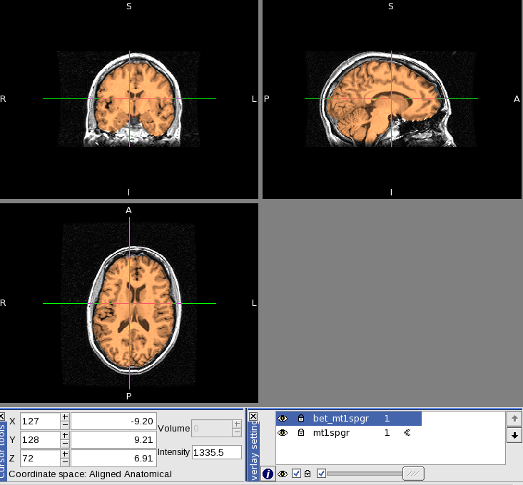
Quality Checks

Slide 23
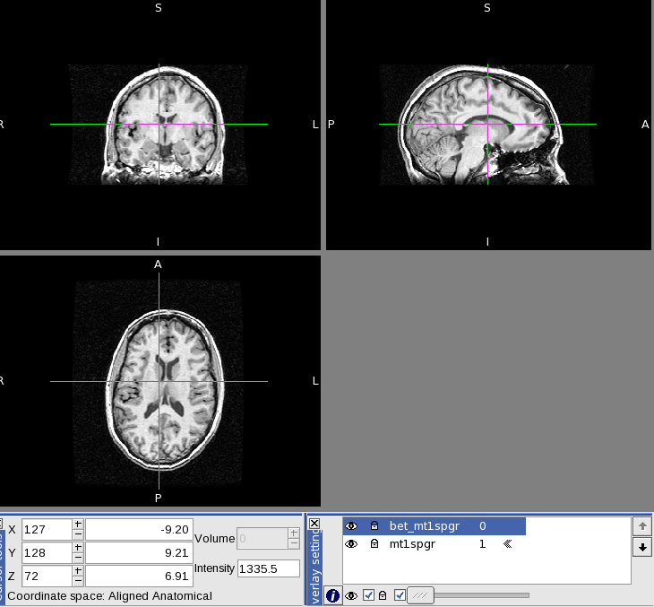
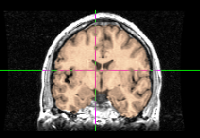
Quality Checks
Scroll this button back and forth to fade between spgr and skull-stripped spgr. Click around the brain and look at different views. Close FSL

Slide 24
Quality Checks
1. Registration between spgr & template
TYPE:
vbm8Check -a func/coReg/VBM8
–h w3mm_mt1spgr -1
–I r3mm_avg152T1_BET
–M ./ <Subjects>

Slide 25
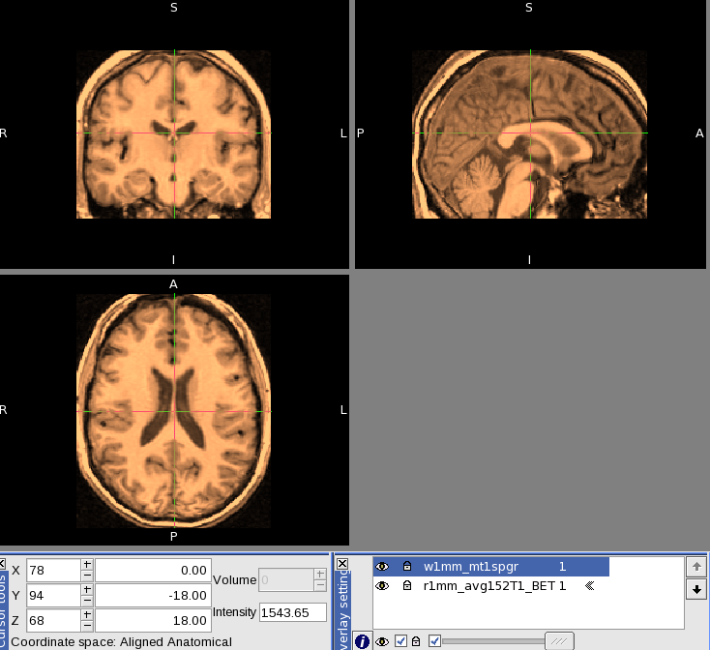
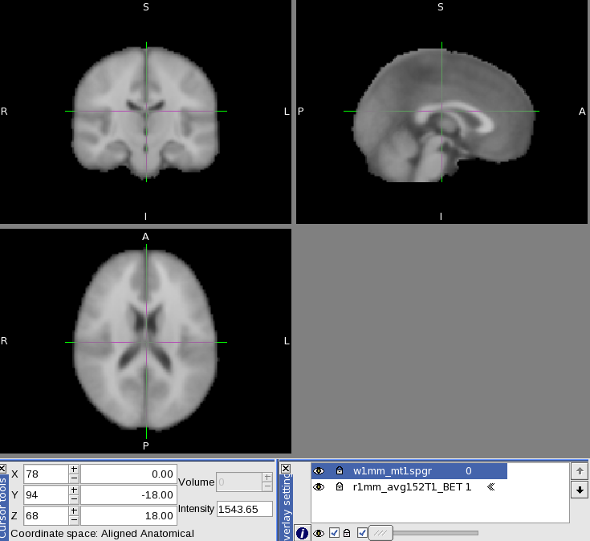
Quality Checks
Use the little button again to fade back and forth between the spgr and the template checking that they match up. Close FSL

Slide 26
Apply Warp – warpfMRI
warpfMRI –h t1spgr –w coReg/VBM8
–I r3mm_avg152T1_BET –n w3mm_ -v rarun –W –M ./
<Subjects> -U your_email@umich.edu
-B run in the foreground
-f [directory] set path to functional directory
-h [name] name of high resolution anatomical (t1spgr)
-I [Ref name] set the reference image to use for VBM8
-M [directory] master subject directory
-n [name] name to add to output file name
-t test flag
-U [unique] user email name/txt msg address
-v [name] name of functional volume
-W Enable VBM8 (DARTEL) warping for fMRI
-w [directory] set output path
-z set the voxel size for resampling

Slide 27
Quality Checks
vbm8Check
2. Registration between spgr & functionals
TYPE:
vbm8Check -a func/coReg/VBM8
–h w3mm_mt1spgr -2 –v w3mm_rarun
–M ./ <Subjects>

Slide 28
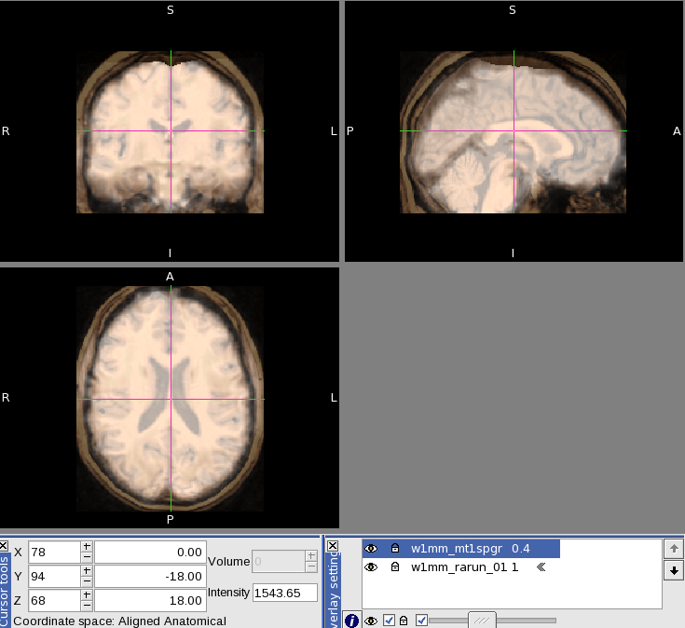
Quality Checks

Slide 29
Smoothing - smoothfMRI
smoothfMRI 5 5 5 –v w3mm_ -M ./ < <Subjects> -U your_email@umich.edu
-B run in the foreground
-D enable super debug flag
-d enable debug flag
-e set file extension for smoothfMRI
-f [directory] set path to functional directory
-M [directory] master subject directory
-n [name] name to add to output file name
-t test flag
-U [unique] user email name/txt msg address
-v [name] name of functional volume

Slide 30
Directory Structure – After Processing
Experiment_Name
Subject_ID
Subject_ID
matlabScripts
anatomy
func
t1spgr.nii
t1overlay.nii
run_01
run_02
run_##
coReg
run_02.nii
(rarun_02.nii or raprun_02.nii)
arun_02.nii
rarun_02.nii
w1mm_rarun_02.nii
sw1mm_rarun_02.nii
t1spgr.nii
t1overlay.nii
VBM8
w3mm_t1spgr.nii
y_rt1spgr.nii
(other DARTEL output)

Slide 31
Logging
When a process is run, the command will automatically configure a “job” by writing a shellscript file and as needed a matlab script file. These files will be created in a directory specified by the name for the command being issued and then further segregated by the year and month. The “job” files have names that are based on the command issued, the date,/time, the user and the computer node. Once the command completes building the process it will launch into the background for execution, releasing the interactive terminal.
Example:
matlabScripts
spm8Batch
coregOverlay
2012_07
coregOverlay_120722_09_37_18_heffjos.sh
coregOverlay_120722_09_37_18_heffjos.m
coregOverlay_120722_09_37_18_heffjos.log

