Slide 1


UNIVERSAL MEDICAL RECORDS™
Presentation
September 5, 2015

Slide 2
Data Exchange Dilemma
All healthcare providers desire improvement in the exchange and function of all collected data.
Current state-of-the art exchanges do not solve the internal needs to share all data nor allow providers an efficient means to view this data.
www.universalmedicalrecord.com © 2010 - 2015

Slide 3


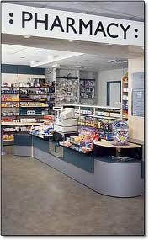

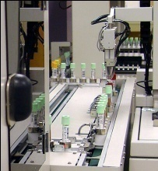

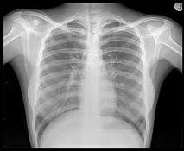





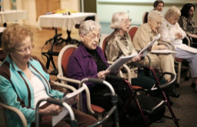
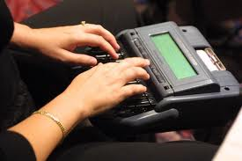
Healthcare Partners Now
Patient
Health Care Insurer
Laboratory
Access
Consent
Assisted
Living
?
Radiology
SHARED
DASHBOARD
Providers
Tele-health
Services
Scanned Documents
Transcription
Home care
Nursing home
www.universalmedicalrecord.com © 2010 - 2015

Slide 4
Universal Medical Records’Solution
Integrate all of the healthcare providers via a web based HIPAA compliant UMR portal.
This portal maintains all standards of CCD, C-CDA and HL7 communication protocols.
Give all healthcare providers a unique and clinically focused Dashboard for review of all data generated by its partners.
Provide tools to manage shared risk/savings, like ACOs, Health Homes, future business arrangements .
Allows all healthcare providers to become an exchange within its own.
www.universalmedicalrecord.com © 2010 - 2015

Slide 5
UMR Dashboard View
Review all patient-centric data compiled into medical disciplines, ‘billing codes, medications, study results’ to formulate collaborative patient-centric treatment plans.
  achieve quality outcomes
  improve patient safety
  reduce costs
  eliminate duplication
www.universalmedicalrecord.com © 2010 - 2015

Slide 6

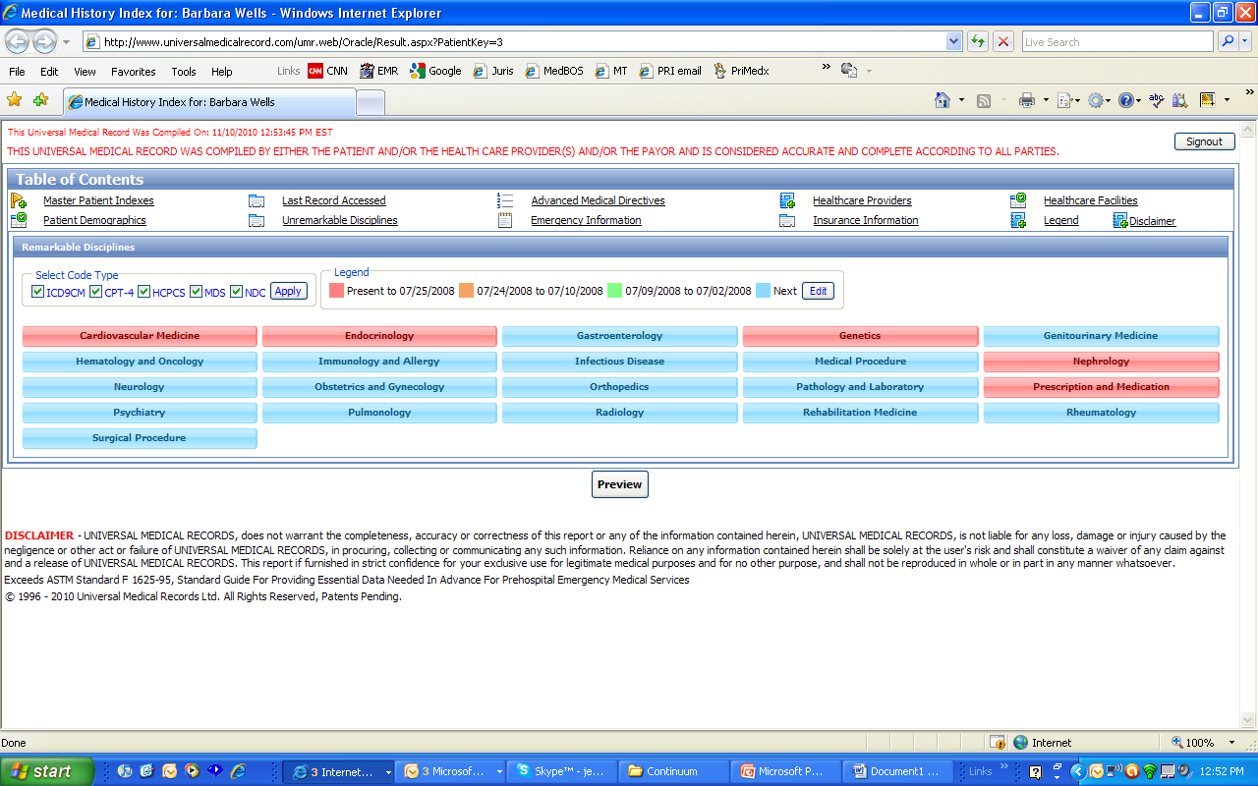


Healthcare Partners
Patient
Health Care Insurer
Laboratory
Radiology
Access
Consent
Assisted
Living
SHARED UMR
DASHBOARD
UMR Dashboard
World
USA
Providers
Scanned Documents
Transcription
Home care
Nursing home
Tele-health
Services
www.universalmedicalrecord.com © 2010 - 2015

Slide 7
The UMR view by Disciplines
Orthopedics
Medical Content Index
The next slide will demonstrate the unique organization by frequency and dates of all orthopedic codes
www.universalmedicalrecord.com © 2010 - 2015

Slide 8
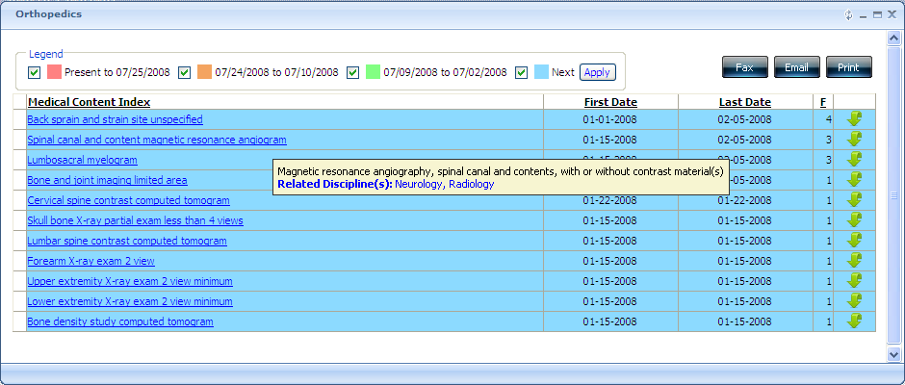
The UMR view by Disciplines
Orthopedics
Enhances collaboration between disciplines
Genealogy
www.universalmedicalrecord.com © 2010 - 2015

Slide 9
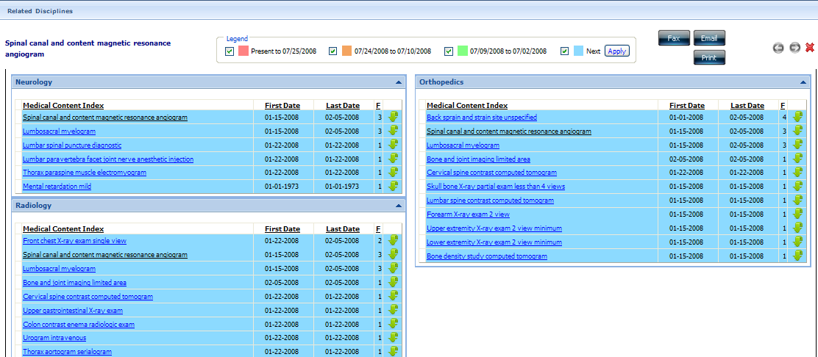
The UMR view by Disciplines Orthopedics
Communication Details
Provider ID
Healthcare Facility ID
The next slide demonstrates communications and demographics locator
www.universalmedicalrecord.com © 2010 - 2015

Slide 10
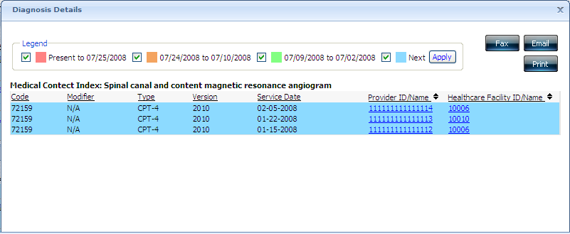
The UMR view by Disciplines Orthopedics
Communications and Demographics locator
www.universalmedicalrecord.com © 2010 - 2015

Slide 11
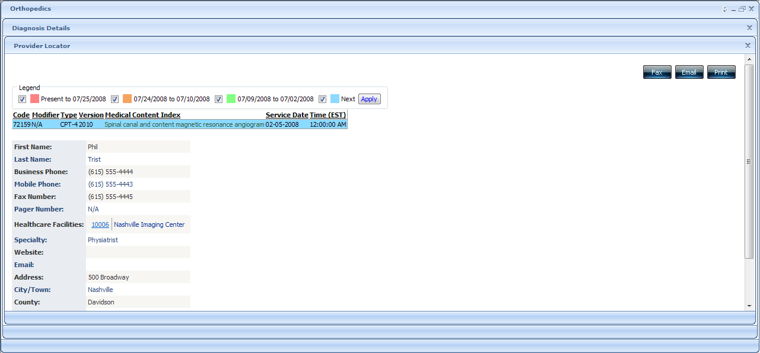
Breaking Down the Disciplines
Provider Locator
www.universalmedicalrecord.com © 2010 - 2015

Slide 12
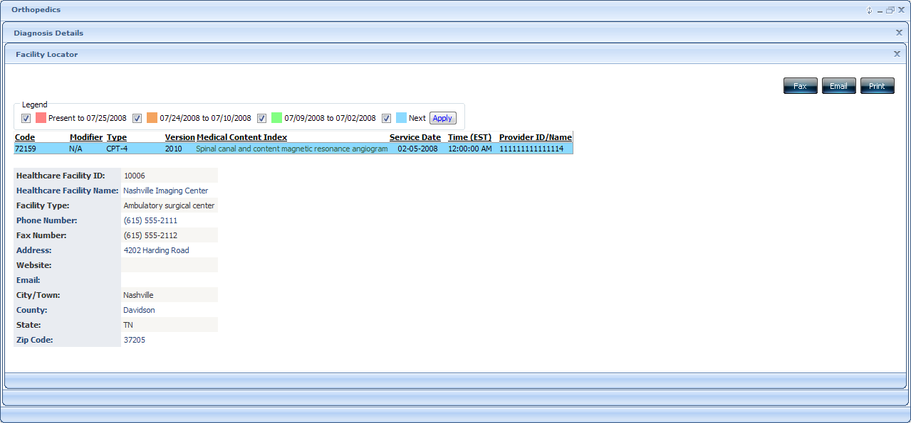
Breaking Down the Disciplines
Facility Locator
www.universalmedicalrecord.com © 2010 - 2015

Slide 13
Universal Medical Records’ Solution
Integrates all data to provide better management for the:
  Provider – Time saving from data mining; manages performance standards.
  Patient – Safety from comprehensive decision making through shared data.
  Payor – Improves quality and reduces errors/redundancy/costs/fraud and abuse.
Provides infrastructure to comprehensive patient management.
www.universalmedicalrecord.com © 2010 - 2015

Slide 14
Who is Universal Medical Record
Universal Medical Records (UMR) has been engaged in research and development efforts involving automated data records and medical/health care since 1996. Its primary focus has been the implementation of an integrated computerized patient medical record and the services associated with it for offering immediate and cost-effective on-line worldwide storage, access and retrieval.
Steven C. Cohn, M.D. CEO/President
Wayne O. Wells, M.D. Chief Medical Officer
Reza Bin Raquib – Chief Technology Officer
www.universalmedicalrecord.com © 2010 - 2015

Slide 15
Return On Investment
Triage Center
Minimizes Duplication
Maximizes disease management outcomes
HEDIS Criteria, Paid for Performance/Quality
Improves specificity coding
Predictive Modeling – future allocation of resources
www.universalmedicalrecord.com © 2010 - 2015

Slide 16
Return On Investment
Data Mining
  Securing Grants
  Research Opportunities
  Analytic/Metric management
Corporate Compliance
www.universalmedicalrecord.com © 2010 - 2015

