Slide 1
UMRS Demo Day
Unified Multimodal Retrieval System
Text RAG, SAM3.1 segmentation, and HMAE reconstruction
Validated against rccs-cloud profile on 2026-07-20
UMRS Demo Day | rccs-cloud validation

Slide 2
What UMRS Does
Receives multimodal data through isolated bucket aliases.
Coordinates durable jobs, workflows, model access, and result storage.
Runs HPC workloads through Slurm and controlled container runtimes.
Keeps client, storage, database, and GPU ownership separate.
UMRS Demo Day | rccs-cloud validation

Slide 3
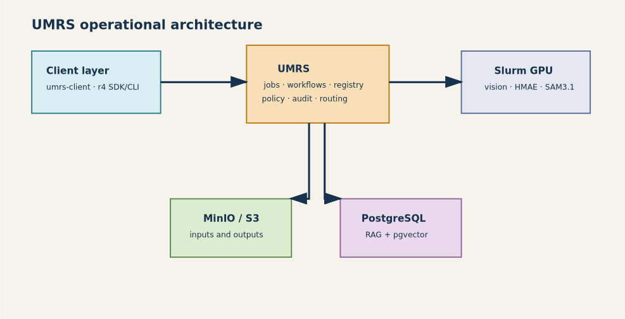
Architecture
umrs-client and r4 are user-facing clients.
UMRS owns durable workflow and job semantics.
MinIO/S3 carries inputs and generated outputs.
PostgreSQL/pgvector stores RAG state; Slurm hosts GPU execution.
UMRS Demo Day | rccs-cloud validation

Slide 4
Live Environment Evidence
rccs-cloud server reachable: data0.ai.r-ccs.riken.jp:50090.
35 system model registrations, including hmae and sam3.1.
Experience add followed by reload created six synchronized aliases.
Text bucket and all private aliases are isolated by modality and task.
UMRS Demo Day | rccs-cloud validation

Slide 5
Demo 1: Text RAG
Use mnagaso3-text for document ingestion and embeddings.
Upload a directory of text files, then inspect data list and status.
RAG pipeline creation requires a valid JSON pipeline file for r4.
Narrative: object storage input -> embedding/indexing -> retrieval-ready corpus.
UMRS Demo Day | rccs-cloud validation

Slide 6
Demo 2: SAM3.1 Segmentation
Use demo-defect, provisioned as image / segmentation.
Live upload of Cat_1.jpg completed with status=ok.
Model registration is facebook/sam2-hiera-small through the SAM3 adapter.
Download target is the paired output bucket, not the input bucket.
UMRS Demo Day | rccs-cloud validation

Slide 7
Demo 3: HMAE Reconstruction
Use demo-hmae for reconstruction; companion aliases support MAE and features.
Live upload of Cat_1.jpg completed with status=ok.
HMAE ViT-B is registered as a vision model in the experience.
Show output only after server-side execution creates artifacts in the output bucket.
UMRS Demo Day | rccs-cloud validation

Slide 8
Private Experience Provisioning
Normal flow: experience add <experience.json> --update, then reload.
Verified aliases: demo-defect, demo-hmae, demo-hmae-mae, demo-hmae-features, demo-opossum.
Provisioning succeeded; no text-bucket fallback is used for vision workloads.
HMAE experience definitions merge by xp_name; full pipeline aliases are present after reload.
UMRS Demo Day | rccs-cloud validation

Slide 9
Runbook Reality Check
Result directories must exist before data download.
Current upload checks prove S3 ingestion, not completed GPU inference.
After test uploads, status all showed server idle and no generated outputs were observed.
Opossum is provisioned but lacks a repository MP4 fixture for end-to-end execution.
UMRS Demo Day | rccs-cloud validation

Slide 10
Demo Sequence
1. umrs-client --profile rccs-cloud ping
2. umrs-client --profile rccs-cloud bucket list
3. Text upload to mnagaso3-text and RAG inspection.
4. SAM3 upload to demo-defect, then monitor and download output when job appears.
5. HMAE upload to demo-hmae, then monitor and download output when job appears.
6. Show doctor report and explain operational follow-up for idle processing.
UMRS Demo Day | rccs-cloud validation

