Slide 1
Who needs figma when you’ve got powerpoint
View the slides in presentation mode to see animations
Map expand on mouse hover (slide transition)
UMG logo sway in main menu (looping textbox animation)

Slide 2
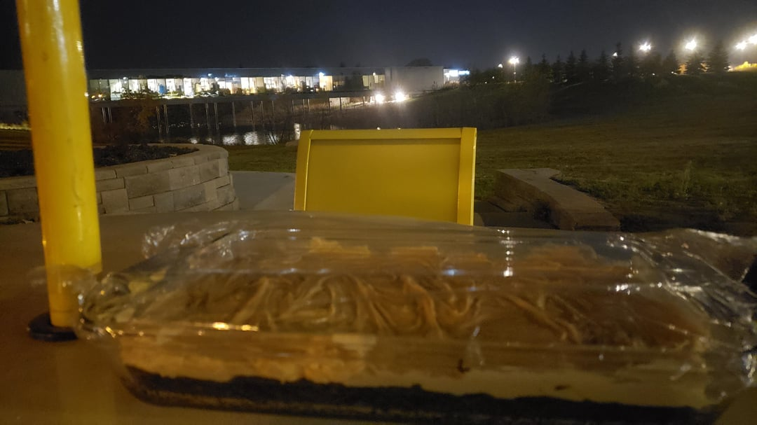
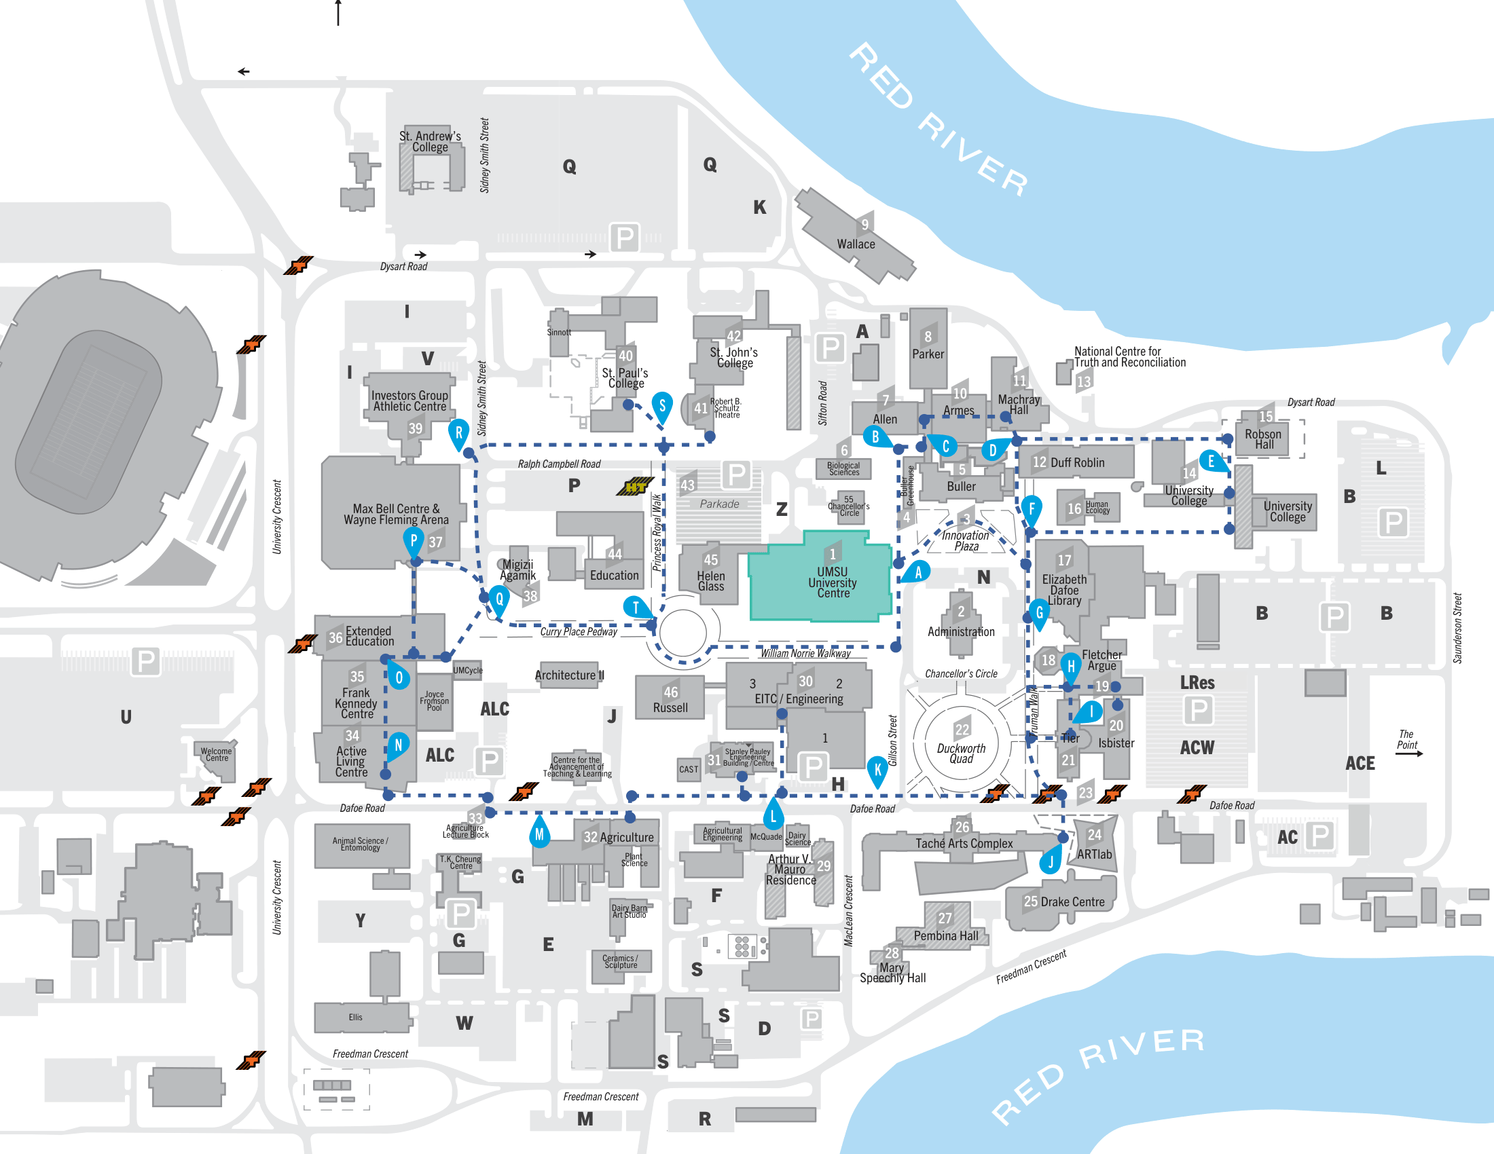
Round
3/5
Countdown
00:24
Score
12345

Slide 3
Round
3/5
Countdown
00:24
Score
12345

Slide 4
UMG!
Round
3/5
Countdown
00:24
Score
12345

Slide 5
UMG!
Round
3/5
Countdown
00:24
Score
12345

Slide 6
UMG!
Countdown
00:24
Round
3/5
Score
12345

Slide 7
UMG!
Countdown
00:24
Round
3/5
Score
12345

Slide 8
Less polished but full game flow

Slide 9
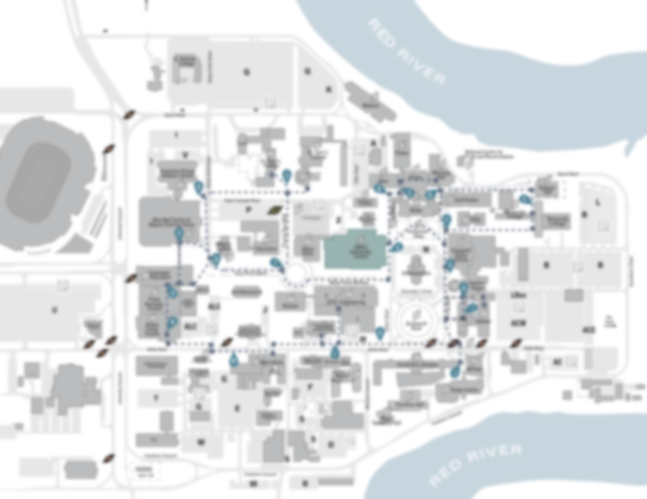
UMG!
UManitobaGuessr
Rounds
5
10
15
Countdown
OFF
1
min
5
min
PLAY

Slide 10
Loading…

Slide 11
EXIT
Score
12345
Round
3/5
CONFIRM GUESS

Slide 12
EXIT
Score
12345
Round
3/5
CONFIRM GUESS

Slide 13
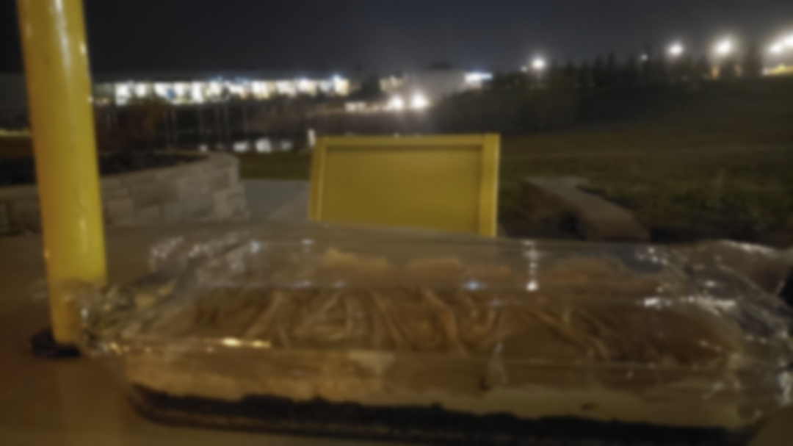
Loading…

Slide 14

Exit
Score
12345
Round
3/5
Score
+999
NEXT ROUND

Slide 15
Loading…

Slide 16
Exit
Round
5/5
Score
54321

Slide 17
UMG!
UManitobaGuessr
Rounds
5
10
15
Countdown
OFF
1
min
5
min
PLAY

