Slide 1

Notes:
This template can be used as a starter file for presenting training materials in a group setting.
Sections
Right-click on a slide to add sections. Sections can help to organize your slides or facilitate collaboration between multiple authors.
Notes
Use the Notes section for delivery notes or to provide additional details for the audience. View these notes in Presentation View during your presentation.
Keep in mind the font size (important for accessibility, visibility, videotaping, and online production)
Coordinated colors
Pay particular attention to the graphs, charts, and text boxes.
Consider that attendees will print in black and white or grayscale. Run a test print to make sure your colors work when printed in pure black and white and grayscale.
Graphics, tables, and graphs
Keep it simple: If possible, use consistent, non-distracting styles and colors.
Label all graphs and tables.

Slide 2
ABOUT THE PROJECT: The online job portal project is designed to facilitate the process of job search and recruitment. It utilizes a database schema consisting of several tables, including user accounts, user types, seeker profiles, employer profiles, companies, business streams, and seeker skills. The system allows users to create accounts as either seekers or employers, providing personal information and relevant details. Seekers can showcase their skills and desired salary, while employers can create company profiles and specify the business stream they operate in. The platform enables seekers to search for job opportunities based on their skills, view company profiles, and apply for positions. Employers can post job listings, review seeker profiles, and contact potential candidates. The database schema ensures efficient storage and retrieval of user information, job details, and skill sets, facilitating seamless interaction between job seekers and employers in the dynamic online job market.
Notes:
Give a brief overview of the presentation. Describe the major focus of the presentation and why it is important.
Introduce each of the major topics.
To provide a road map for the audience, you can repeat this Overview slide throughout the presentation, highlighting the particular topic you will discuss next.

Slide 3
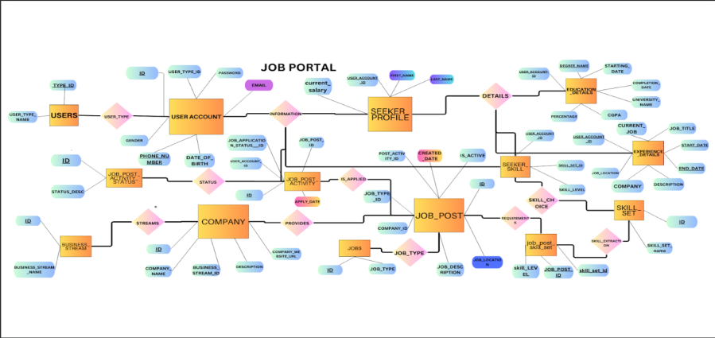
ENTITY RELATIONAL MODEL :
Notes:
This is another option for an Overview slide.

Slide 4
ANY FURTHER SPLITTING ?? In all the tables that are present in the er diagram, it is only the primary key(even if composite) that defines all the other attributes. There can be no other functional dependencies found other than that. Hence all the tables are already in bcnf and no further decomposition is required.
Notes:
Use a section header for each of the topics, so there is a clear transition to the audience.

Slide 5
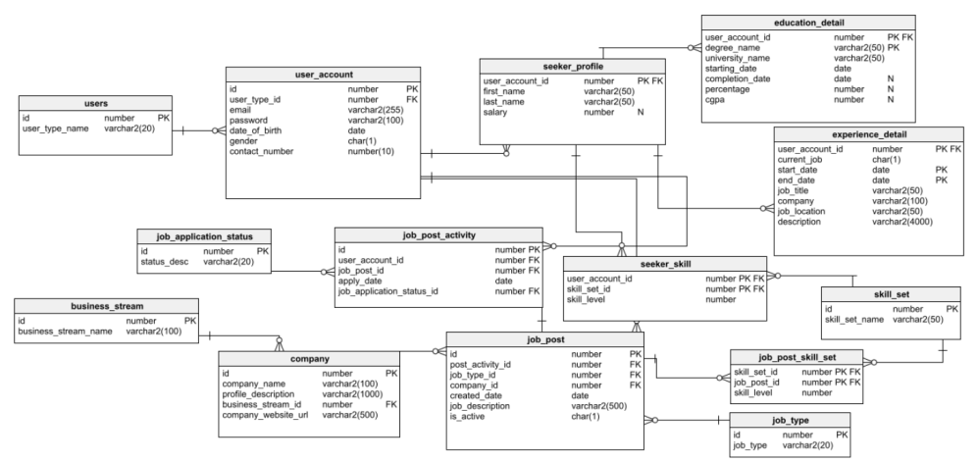
RELATIONAL SCHEMA :

Slide 6
CREATING TABLES AND INSERTING DATA

Slide 7
USERS :
PURPOSE :
This table is used to identify the type of user accessing the data.
CREATION :
CREATE TABLE users (
ids NUMBER PRIMARY KEY,
user_type_name VARCHAR2(20)
);
DATA INSERTION :
INSERT INTO users VALUES(1, 'seeker');
INSERT INTO users VALUES(2, 'employer');

Slide 8
USER_ACCOUNT :
PURPOSE :
To store all the information related to the user who is registered in our portal. This is includes email , password and general informaton like date of birth , gender etc.
CREATION :
CREATE TABLE user_account (
ids NUMBER PRIMARY KEY,
user_type_id NUMBER,
email VARCHAR2(255),
passwords VARCHAR2(100),
date_of_birth DATE,
gender CHAR(1),
contact_number NUMBER(10),
FOREIGN KEY (user_type_id) REFERENCES users(ids)
);
DATA INSERTION :
INSERT INTO user_account VALUES (1, 1, 'email1@example.com', 'password1', TO_DATE('1990-01-01', 'YYYY-MM-DD'), 'M', 1234567890);

Slide 9
INSERT INTO user_account VALUES(2, 2, 'email2@example.com', 'password2', TO_DATE('1991-02-02', 'YYYY-MM-DD'), 'F', 2345678901);
INSERT INTO user_account VALUES(3, 1, 'email3@example.com', 'password3', TO_DATE('1992-03-03', 'YYYY-MM-DD'), 'M', 3456789012);
INSERT INTO user_account VALUES(4, 2, 'email4@example.com', 'password4', TO_DATE('1993-04-04', 'YYYY-MM-DD'), 'F', 4567890123);
INSERT INTO user_account VALUES(5, 1, 'email5@example.com', 'password5', TO_DATE('1994-05-05', 'YYYY-MM-DD'), 'M', 5678901234);
INSERT INTO user_account VALUES(6, 2, 'email6@example.com', 'password6', TO_DATE('1995-06-06', 'YYYY-MM-DD'), 'F', 6789012345);
INSERT INTO user_account VALUES(7, 1, 'email7@example.com', 'password7', TO_DATE('1996-07-07', 'YYYY-MM-DD'), 'M', 7890123456);
INSERT INTO user_account VALUES(8, 2, 'email8@example.com', 'password8', TO_DATE('1997-08-08', 'YYYY-MM-DD'), 'F', 8901234567);
INSERT INTO user_account VALUES(9, 1, 'email9@example.com', 'password9', TO_DATE('1998-09-09', 'YYYY-MM-DD'), 'M', 9012345678);

Slide 10
INSERT INTO user_account VALUES(10, 2, 'email10@example.com', 'password10', TO_DATE('1999-10-10', 'YYYY-MM-DD'), 'F', 1234567890);

Slide 11
SEEKER_PROFILE :
PURPOSE :
It stores the names and expected salaries of the job seekers registered in the portal.
CREATION :
CREATE TABLE seeker_profile (
user_account_id NUMBER,
user_type_id NUMBER ;
first_name VARCHAR2(50),
last_name VARCHAR2(50),
salary NUMBER
primary key(user_account_id,user_type_id) ;
foreign key(user_type_id) references users(ids);
foreign key(user_account_id) references user_account(ids)
);
DATA INSERTION :
INSERT INTO seeker_profile VALUES(1, 1,'John', 'Doe', 50000);
INSERT INTO seeker_profile VALUES(2, 2,'Jane', 'Smith', 60000);
INSERT INTO seeker_profile VALUES(3, 1,'Michael', 'Johnson', 70000);

Slide 12
INSERT INTO seeker_profile VALUES(4,2, 'Emily', 'Brown', 55000);
INSERT INTO seeker_profile VALUES(5, 1,'William', 'Davis', 65000);
INSERT INTO seeker_profile VALUES(6,2, 'Olivia', 'Miller', 75000);
INSERT INTO seeker_profile VALUES(7,1,'James', 'Wilson', 52000);
INSERT INTO seeker_profile VALUES(8,2,'Sophia', 'Jones', 62000);
INSERT INTO seeker_profile VALUES(9,1,'Benjamin', 'Taylor', 72000);
INSERT INTO seeker_profile VALUES(10,2,'Isabella', 'Anderson', 54000);

Slide 13
EDUCATIONAL_DETAIL :
PURPOSE :
It stores all the information related to education of the job seekers. It includes degree name, university name and his/her performance in that degree.
CREATION :
CREATE TABLE education_detail (
user_account_id NUMBER,
degree_name VARCHAR2(50),
university_name VARCHAR2(50),
starting_date DATE,
completion_date DATE,
percentage NUMBER,
cgpa NUMBER,
PRIMARY KEY (user_account_id, degree_name),
FOREIGN KEY (user_account_id) REFERENCES user_account(ids)
);

Slide 14
DATA INSERTION :
INSERT INTO education_detail VALUES(1,'Bachelor of Science', 'ABC University', TO_DATE('2010-09-01', 'YYYY-MM-DD'), TO_DATE('2014-05-31', 'YYYY-MM-DD'), 80.5, 3.6);
INSERT INTO education_detail VALUES(2, 'Bachelor of Arts', 'XYZ University', TO_DATE('2011-08-01', 'YYYY-MM-DD'), TO_DATE('2015-06-30', 'YYYY-MM-DD'), 85.2, 3.8);
INSERT INTO education_detail VALUES(3, 'Bachelor of Engineering', 'DEF University', TO_DATE('2012-07-01', 'YYYY-MM-DD'), TO_DATE('2016-07-15', 'YYYY-MM-DD'), 75.0, 3.4);
INSERT INTO education_detail VALUES(4, 'Bachelor of Commerce', 'PQR University', TO_DATE('2013-09-01', 'YYYY-MM-DD'), TO_DATE('2017-04-30', 'YYYY-MM-DD'), 78.9, 3.5);
INSERT INTO education_detail VALUES(5, 'Bachelor of Technology', 'MNO University', TO_DATE('2014-07-01', 'YYYY-MM-DD'), TO_DATE('2018-05-31', 'YYYY-MM-DD'), 82.3, 3.7);

Slide 15
INSERT INTO education_detail VALUES(6, 'Bachelor of Science', 'ABC University', TO_DATE('2015-08-01', 'YYYY-MM-DD'), TO_DATE('2019-06-30', 'YYYY-MM-DD'), 87.6, 3.9);
INSERT INTO education_detail VALUES(7, 'Bachelor of Arts', 'XYZ University', TO_DATE('2016-09-01', 'YYYY-MM-DD'), TO_DATE('2020-05-31', 'YYYY-MM-DD'), 79.8, 3.6);
INSERT INTO education_detail VALUES(8, 'Bachelor of Engineering', 'DEF University', TO_DATE('2017-08-01', 'YYYY-MM-DD'), TO_DATE('2021-06-30', 'YYYY-MM-DD'), 83.2, 3.8);
INSERT INTO education_detail VALUES(9, 'Bachelor of Commerce', 'PQR University', TO_DATE('2018-07-01', 'YYYY-MM-DD'), TO_DATE('2022-07-15', 'YYYY-MM-DD'), 76.5, 3.3);
INSERT INTO education_detail VALUES(10, 'Bachelor of Technology', 'MNO University', TO_DATE('2019-09-01', 'YYYY-MM-DD'), TO_DATE('2023-04-30', 'YYYY-MM-DD'), 81.7, 3.6);

Slide 16
EXPERIENCE_DETAIL:
PURPOSE :
It stores all the prior experience details of the job seekers registered on the portal.
CREATION :
CREATE TABLE experience_detail (
user_account_id NUMBER,
current_job CHAR(1),
start_date DATE,
end_date DATE,
job_title VARCHAR2(50),
company VARCHAR2(100),
job_location VARCHAR2(50),
descriptions VARCHAR2(4000),
PRIMARY KEY (user_account_id, start_date, end_date),
FOREIGN KEY (user_account_id) REFERENCES user_account(ids)
);
DATA INSERTION :

Slide 17
INSERT INTO experience_detail VALUES(1, 'Y', TO_DATE('2014-06-01', 'YYYY-MM-DD'), TO_DATE('2023-05-13', 'YYYY-MM-DD'), 'Software Engineer', 'ABC Company', 'City A', 'Responsible for developing and maintaining software applications.');
INSERT INTO experience_detail VALUES(2, 'N', TO_DATE('2015-07-01', 'YYYY-MM-DD'), TO_DATE('2022-12-31', 'YYYY-MM-DD'), 'Marketing Manager', 'XYZ Corporation', 'City B', 'Led marketing campaigns and managed a team of marketing professionals.');
INSERT INTO experience_detail VALUES(3, 'N', TO_DATE('2016-08-01', 'YYYY-MM-DD'), TO_DATE('2023-05-13', 'YYYY-MM-DD'), 'Electrical Engineer', 'DEF Industries', 'City C', 'Designed electrical systems and performed troubleshooting and maintenance tasks.');
INSERT INTO experience_detail VALUES(4, 'Y', TO_DATE('2017-09-01', 'YYYY-MM-DD'), TO_DATE('2023-05-13', 'YYYY-MM-DD'), 'Financial Analyst', 'PQR Bank', 'City D', 'Conducted financial analysis and prepared reports for decision-making.');
INSERT INTO experience_detail VALUES(5, 'N', TO_DATE('2018-10-01', 'YYYY-MM-DD'), TO_DATE('2022-06-30', 'YYYY-MM-DD'), 'Product Manager', 'MNO Tech', 'City E', 'Managed product lifecycle and collaborated with cross-functional teams.');
INSERT INTO experience_detail VALUES(6, 'Y', TO_DATE('2019-11-01', 'YYYY-MM-DD'), TO_DATE('2023-05-13', 'YYYY-MM-DD'), 'Research Scientist', 'ABC Labs', 'City A', 'Conducted research experiments and analyzed data for scientific discoveries.');

Slide 18
INSERT INTO experience_detail VALUES(7, 'N', TO_DATE('2020-12-01', 'YYYY-MM-DD'), TO_DATE('2021-12-31', 'YYYY-MM-DD'), 'Graphic Designer', 'XYZ Agency', 'City B', 'Created visually appealing designs for various marketing materials.');
INSERT INTO experience_detail VALUES(8, 'N', TO_DATE('2021-01-01', 'YYYY-MM-DD'), TO_DATE('2023-05-13', 'YYYY-MM-DD'), 'Mechanical Engineer', 'DEF Manufacturing', 'City C', 'Developed mechanical designs and oversaw manufacturing processes.');
INSERT INTO experience_detail VALUES(9, 'Y', TO_DATE('2022-02-01', 'YYYY-MM-DD'), TO_DATE('2023-05-13', 'YYYY-MM-DD'), 'Accountant', 'PQR Company', 'City D', 'Managed financial records and performed tax-related tasks.');
INSERT INTO experience_detail VALUES(10, 'N', TO_DATE('2023-03-01', 'YYYY-MM-DD'), TO_DATE('2023-05-13', 'YYYY-MM-DD'), 'Software Developer', 'MNO Tech', 'City E', 'Implemented software solutions and participated in code reviews.');

Slide 19
SKILL_SET :
PURPOSE :
Lists out all the skills that are required for various jobs and positions.
CREATION :
CREATE TABLE skill_set (
ids NUMBER PRIMARY KEY,
skill_set_name VARCHAR2(50)
);
DATA INSERTION :
INSERT INTO skill_set VALUES(1, 'Java');
INSERT INTO skill_set VALUES(2, 'Python');
INSERT INTO skill_set VALUES(3, 'C++');
INSERT INTO skill_set VALUES(4, 'JavaScript');
INSERT INTO skill_set VALUES(5, 'HTML');
INSERT INTO skill_set VALUES(6, 'CSS');
INSERT INTO skill_set VALUES(7, 'Database Management');
INSERT INTO skill_set VALUES(8, 'Project Management');
INSERT INTO skill_set VALUES(9, 'Data Analysis');
INSERT INTO skill_set VALUES(10, 'Communication Skills');

Slide 20
SEEKER_SKILL :
PURPOSE :
Stores the skills of each job seeker along with skill level of each skill possessed.
CREATION :
CREATE TABLE seeker_skill (
user_account_id NUMBER,
skill_set_id NUMBER,
skill_level NUMBER,
PRIMARY KEY (user_account_id, skill_set_id),
FOREIGN KEY (user_account_id) REFERENCES user_account(ids),
FOREIGN KEY (skill_set_id) REFERENCES skill_set(ids)
);
DATA INSERTION :
INSERT INTO seeker_skill VALUES(1, 1, 8);
INSERT INTO seeker_skill VALUES(1, 2, 7);
INSERT INTO seeker_skill VALUES(2, 3, 6);
INSERT INTO seeker_skill VALUES(2, 4, 9);
INSERT INTO seeker_skill VALUES(3, 5, 7);

Slide 21
INSERT INTO seeker_skill VALUES(3, 6, 8);
INSERT INTO seeker_skill VALUES(4, 7, 9);
INSERT INTO seeker_skill VALUES(4, 8, 6);
INSERT INTO seeker_skill VALUES(5, 9, 7);
INSERT INTO seeker_skill VALUES(5, 10, 9);

Slide 22
BUSINESS_STREAM :
PURPOSE :
To store various number the streams( the field which a particular job belongs to) that currently exist in the market.
CREATION :
CREATE TABLE business_stream (
ids NUMBER PRIMARY KEY,
business_stream_name VARCHAR2(100)
);
DATA INSERTION :
INSERT INTO business_stream VALUES(1, 'Technology');
INSERT INTO business_stream VALUES(2, 'Finance');
INSERT INTO business_stream VALUES(3, 'Healthcare');
INSERT INTO business_stream VALUES(4, 'Marketing');
INSERT INTO business_stream VALUES(5, 'Education');
INSERT INTO business_stream VALUES(6, 'Hospitality');
INSERT INTO business_stream VALUES(7, 'Retail');
INSERT INTO business_stream VALUES(8, 'Manufacturing');
INSERT INTO business_stream VALUES(9, 'Consulting');
INSERT INTO business_stream VALUES(10, 'Transportation');

Slide 23
COMPANY :
PURPOSE :
List of all the companies that are offering jobs to the job seekers along with the business stream in which the job is being offered. It also stores other mandatory/standard information of the companies like their website url.
CREATION :
CREATE TABLE company (
ids NUMBER PRIMARY KEY,
company_name VARCHAR2(100),
profile_description VARCHAR2(1000),
business_stream_id NUMBER,
company_website_url VARCHAR2(500),
FOREIGN KEY (business_stream_id) REFERENCES business_stream(ids)
);
DATA INSERTION :
INSERT INTO company VALUES(1, 'ABC Tech', 'Leading technology solutions provider.', 1, 'http://www.abctech.com');
INSERT INTO company VALUES(2, 'XYZ Financial', 'Offering comprehensive financial services.', 2, 'http://www.xyzfinancial.com');

Slide 24
INSERT INTO company VALUES(3, 'DEF Healthcare', 'Providing healthcare solutions for better living.', 3, 'http://www.defhealthcare.com');
INSERT INTO company VALUES(4, 'PQR Marketing', 'Delivering innovative marketing strategies.', 4, 'http://www.pqrmarketing.com');
INSERT INTO company VALUES(5, 'MNO Education', 'Empowering minds through quality education.', 5, 'http://www.mnoeducation.com');
INSERT INTO company VALUES(6, 'GHI Hotels', 'Creating memorable hospitality experiences.', 6, 'http://www.ghihotels.com');
INSERT INTO company VALUES(7, 'UVW Retail', 'Offering a wide range of retail products.', 7, 'http://www.uvwretail.com');
INSERT INTO company VALUES(8, 'JKL Manufacturing', 'Providing high-quality manufacturing solutions.', 8, 'http://www.jklmanufacturing.com');
INSERT INTO company VALUES(9, 'RST Consulting', 'Offering expert consulting services.', 9, 'http://www.rstconsulting.com');
INSERT INTO company VALUES(10, 'EFG Transportation', 'Delivering efficient transportation solutions.', 10, 'http://www.efgtransportation.com');

Slide 25
JOB_TYPE :
PURPOSE :
Gives the job type which can be internship , freelance etc offered by various companies.
CREATION :
CREATE TABLE job_type (
ids NUMBER PRIMARY KEY,
job_type VARCHAR2(20)
);
DATA INSERTION :
INSERT INTO job_type VALUES(1, 'Full-time');
INSERT INTO job_type VALUES(2, 'Part-time');
INSERT INTO job_type VALUES(3, 'Contract');
INSERT INTO job_type VALUES(4, 'Freelance');
INSERT INTO job_type VALUES(5, 'Temporary');
INSERT INTO job_type VALUES(6, 'Internship');
INSERT INTO job_type VALUES(7, 'Remote');
INSERT INTO job_type VALUES(8, 'Volunteer');
INSERT INTO job_type VALUES(9, 'Commission');
INSERT INTO job_type VALUES(10, 'Seasonal');

Slide 26
JOB_APPLICATION_STATUS :
PURPOSE :
There are various steps the companies follow before selecting the candidates in the vacant positions. Interview, shortlisting, reviewing etc are some of them. This table gives the information about all the possible stages the companies have in their recruitement
process.
CREATION :
CREATE TABLE job_application_status (
ids NUMBER PRIMARY KEY,
status_desc VARCHAR2(20)
);
DATA INSERTION :
INSERT INTO job_application_status VALUES(1, 'Pending');
INSERT INTO job_application_status VALUES(2, 'Reviewed');
INSERT INTO job_application_status VALUES(3, 'Shortlisted');

Slide 27
INSERT INTO job_application_status VALUES(4, 'Interview Scheduled');
INSERT INTO job_application_status VALUES(5, 'Offer Extended');
INSERT INTO job_application_status VALUES(6, 'Offer Accepted');
INSERT INTO job_application_status VALUES(7, 'Offer Declined');
INSERT INTO job_application_status VALUES(8, 'Hired');
INSERT INTO job_application_status VALUES(9, 'Not Selected');
INSERT INTO job_application_status VALUES(10, 'Withdrawn');

Slide 28
JOB_POST :
PURPOSE :
Stores the information of all the jobs that are available from each company. Complete data about the job i.e the company which is offering the job, the type of job , availability and some other attributes are contained in it.
CREATION :
CREATE TABLE job_post (
ids NUMBER PRIMARY KEY,
job_type_id NUMBER,
company_id NUMBER,
created_date DATE,
job_description VARCHAR2(500),
is_active CHAR(1),
FOREIGN KEY (job_type_id) REFERENCES job_type(ids),
FOREIGN KEY (company_id) REFERENCES company(ids)
);
DATA INSERTION :

Slide 29
INSERT INTO job_post VALUES(1,1, 1, TO_DATE('2023-05-13', 'YYYY-MM-DD'), 'Seeking a Java Developer with 3+ years of experience.', 'Y');
INSERT INTO job_post VALUES(2, 3, 2, TO_DATE('2023-05-13', 'YYYY-MM-DD'), 'Looking for a Contract Data Analyst proficient in Python.', 'Y');
INSERT INTO job_post VALUES(3, 2, 3, TO_DATE('2023-05-13', 'YYYY-MM-DD'), 'Hiring a Full-time Financial Analyst with expertise in Excel.', 'Y');
INSERT INTO job_post VALUES(4, 4, 4, TO_DATE('2023-05-13', 'YYYY-MM-DD'), 'Freelance Graphic Designer needed for creative projects.', 'Y');
INSERT INTO job_post VALUES(5, 1, 5, TO_DATE('2023-05-13', 'YYYY-MM-DD'), 'Seeking a Part-time Java Developer for a flexible schedule.', 'Y');
INSERT INTO job_post VALUES(6, 6, 6, TO_DATE('2023-05-13', 'YYYY-MM-DD'), 'Internship opportunity for a Software Engineering student.', 'Y');
INSERT INTO job_post VALUES(7, 1, 7, TO_DATE('2023-05-13', 'YYYY-MM-DD'), 'Remote Full-time Front-end Developer position available.', 'Y');
INSERT INTO job_post VALUES(8, 8, 8, TO_DATE('2023-05-13', 'YYYY-MM-DD'), 'Volunteer opportunity for a Project Manager in the non-profit sector.', 'Y');

Slide 30
INSERT INTO job_post VALUES(9, 5, 9, TO_DATE('2023-05-13', 'YYYY-MM-DD'),'Temporary Teaching Assistant position for the upcoming semester.', 'Y');
INSERT INTO job_post VALUES(10, 2, 10, TO_DATE('2023-05-13', 'YYYY-MM-DD'), 'Seasonal Delivery Driver needed for busy holiday season.', 'Y');

Slide 31
JOB_POST_ACTIVITY :
PURPOSE :
Stores the information of which user has applied for what job among all the jobs available. Its also shows the status of the application.
CREATION :
CREATE TABLE job_post_activity (
ids NUMBER PRIMARY KEY,
user_account_id NUMBER,
job_post_id NUMBER,
apply_date DATE,
job_application_status_id NUMBER,
FOREIGN KEY (user_account_id) REFERENCES user_account(ids),
FOREIGN KEY (job_post_id) REFERENCES job_post(ids),
FOREIGN KEY (job_application_status_id) REFERENCES job_application_status(ids)
);
DATA INSERTION :
INSERT INTO job_post_activity VALUES(1, 1, 1, TO_DATE('2023-05-13', 'YYYY-MM-DD'),1);

Slide 32
INSERT INTO job_post_activity
VALUES(2, 2, 2, TO_DATE('2023-05-13', 'YYYY-MM-DD'), 3);
INSERT INTO job_post_activity
VALUES(3, 3, 3, TO_DATE('2023-05-13', 'YYYY-MM-DD'), 2);
INSERT INTO job_post_activity
VALUES(4, 4, 4, TO_DATE('2023-05-13', 'YYYY-MM-DD'), 1);
INSERT INTO job_post_activity
VALUES(5, 5, 5, TO_DATE('2023-05-13', 'YYYY-MM-DD'), 4);
INSERT INTO job_post_activity
VALUES(6, 1, 6, TO_DATE('2023-05-13', 'YYYY-MM-DD'), 2);
INSERT INTO job_post_activity
VALUES(7, 2, 7, TO_DATE('2023-05-13', 'YYYY-MM-DD'), 3);
INSERT INTO job_post_activity
VALUES(8, 3, 8, TO_DATE('2023-05-13', 'YYYY-MM-DD'), 5);
INSERT INTO job_post_activity
VALUES(9, 4, 9, TO_DATE('2023-05-13', 'YYYY-MM-DD'), 4);
INSERT INTO job_post_activity
VALUES(10, 5, 10, TO_DATE('2023-05-13', 'YYYY-MM-DD'), 1);

Slide 33
JOB_POST_SKILL_SET:
PURPOSE :
It stores all the information regarding the skills required along with the level of each skill for all the jobs that are available.
CREATION :
CREATE TABLE job_post_skill_set (
skill_level number,
job_post_id number ,
skill_set_id number ,
FOREIGN KEY (job_post_id) REFERENCES job_post(ids),
FOREIGN KEY (skill_set_id) REFERENCES skill_set(ids),
PRIMARY KEY (job_post_id, skill_set_id)
);
DATA INSERTION :
INSERT INTO job_post_skill_set VALUES(3, 1, 1);
INSERT INTO job_post_skill_set VALUES(4, 1, 5);

Slide 34
INSERT INTO job_post_skill_set VALUES(2, 2, 2);
INSERT INTO job_post_skill_set VALUES(3, 2, 9);
INSERT INTO job_post_skill_set VALUES(4, 3, 8);
INSERT INTO job_post_skill_set VALUES(2, 3, 7);
INSERT INTO job_post_skill_set VALUES(3, 4, 6);
INSERT INTO job_post_skill_set VALUES(4, 5, 1);
INSERT INTO job_post_skill_set VALUES(2, 5, 4);
INSERT INTO job_post_skill_set VALUES(3, 6, 1);

Slide 35
Executing sample queries

Slide 36

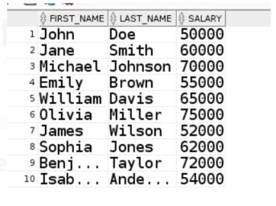
QUERY-1 :
Select the first name , last name and salary of all the job seekers enrolled.
SQL QUERY :
OUTPUT :

Slide 37
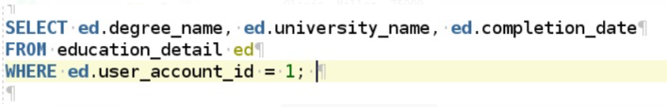

QUERY-2 :
Give the degree name , university name and completion date of the user with id =1.
SQL QUERY :
OUTPUT :

Slide 38

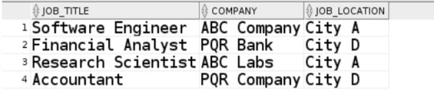
QUERY-3 :
Give the job title , company name and job location of the job seeker with current job ‘Y’
SQL QUERY :
OUTPUT :

Slide 39
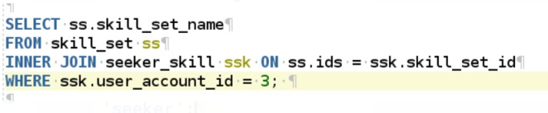

QUERY-4 :
Give the skill set names of the skills possessed by the job seeker with id=3
SQL QUERY :
OUTPUT :

Slide 40
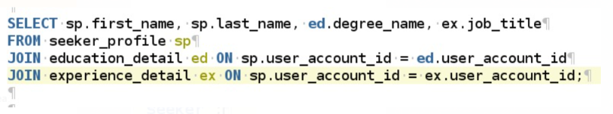
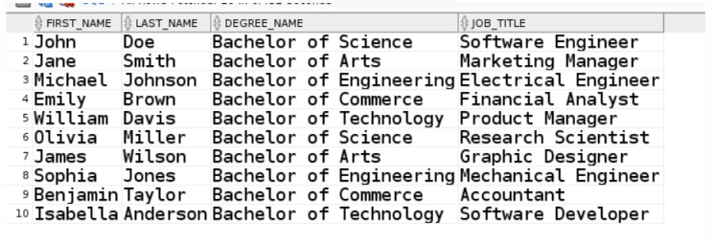
QUERY-5 :
Give the names , degree name and job title of all the seekers enrolled in the portal.
SQL QUERY :
OUTPUT :

Slide 41
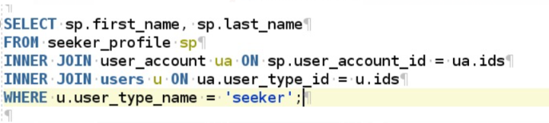
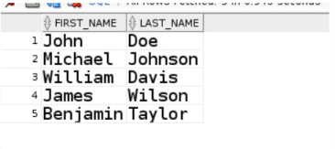
QUERY-6 :
Give the names of all the seekers enrolled in the portal
SQL QUERY :
OUTPUT :

Slide 42
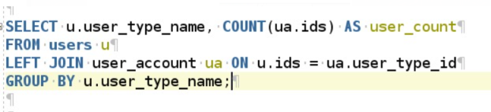
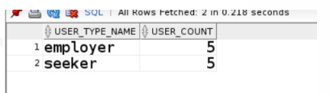
QUERY-7 :
Give the number of seekers and employers enrolled in the portal
SQL QUERY :
OUTPUT :

Slide 43
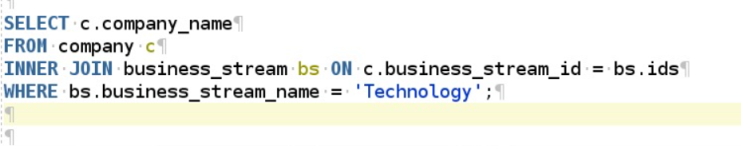

QUERY-8 :
Give the names of all the companies that offer a job in the business field
‘Technology’.
SQL QUERY :
OUTPUT :

Slide 44
Summary :
We have first presented the idea of our project.
We then have proceeded for the Entity-relational model construction from our idea.
Since we have found out that there are no other functional dependencies that exist in each table other than the primary key defining other attributes, we have concluded that all the tables are already in BCNF and, there is no need to decompose any table further.
We than have created the tables and inserted certain data into each table using sql devoloper.
Finally to test our project, we have executed some sample sql queries on our data and have rightly got the outputs for all the queries.
Notes:
Summarize presentation content by restating the important points from the lessons.
What do you want the audience to remember when they leave your presentation?
Save your presentation to a video for easy distribution (To create a video, click the File tab, and then click Share. Under File Types, click Create a Video.)

Slide 45
Resources :
<The drive link to access the ER diagram and the relational schema of the data base> :
<https://drive.google.com/drive/folders/1qIXl2R9LSi2jaUQgOjR9jEKScDhSj7PB?usp=sharing>

Slide 46
PRESENTERS :
1) U.MANOJ HARSHA (21CSB0A62)
2) AD SACHIN
(21CSB0A54)
CONTACT INFORMATION :
EMAIL IDS :
1)
um21csb0a62@student.nitw.ac.in
2)
ss21csb0a54@student.nitw.ac.in

Slide 47
THANK YOU
Notes:
Is your presentation as crisp as possible? Consider moving extra content to the appendix.
Use appendix slides to store content that you might want to refer to during the Question slide or that may be useful for attendees to investigate deeper in the future.

