Slide 1
Text Detection from images
Varun Sharma

Slide 2
Progress So Far
1 image -> folder of images
Perform named-entity-recognition on the text found
Group common entities together
Removed padding parameter (brute force)
Documented code

Slide 3

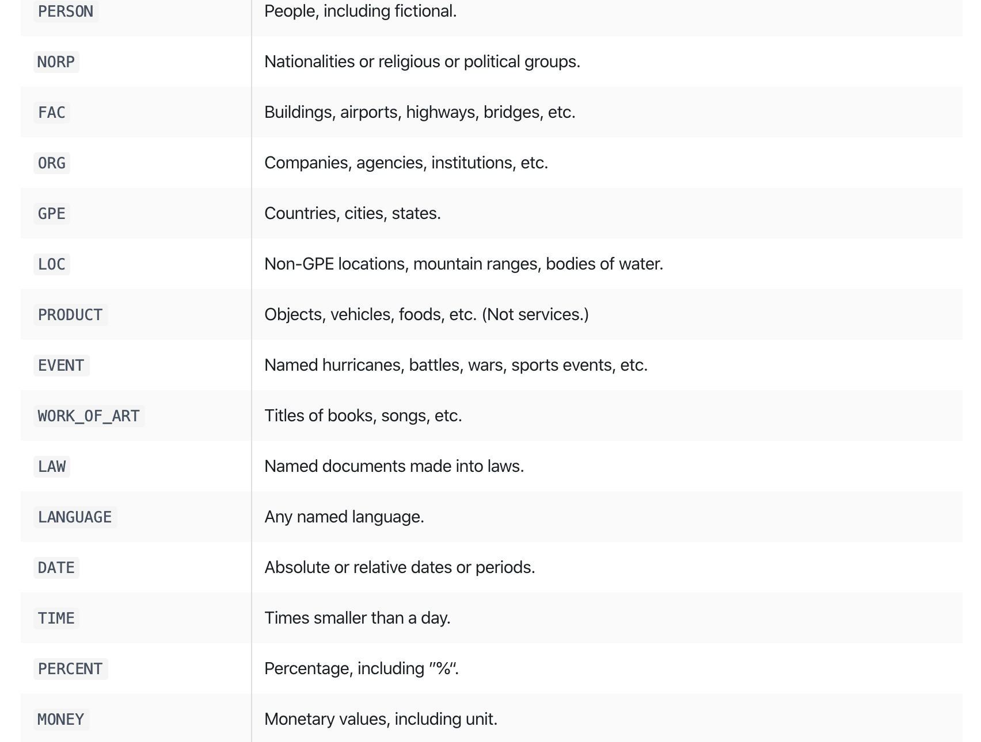
Ner with Spacy

Slide 4
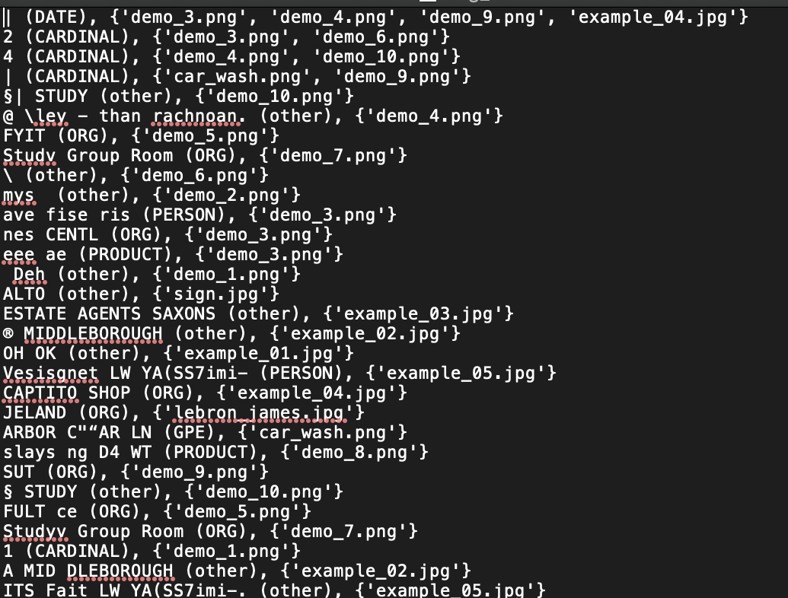
Entity (Type) , {img}

Slide 5
Steps for next week
Readme + requirements.txt
Ready to be handed over
Chat logs?

