Slide 1
Scene Detection Using ResNet
Vivek Bhave

Slide 2
Problem Statement
This project aims to identify the possible setting in which an image is clicked. (setting = scene category)
The scene category is predicted from the scene attributes (also predicted by the model I am using)
The scene category is used to make a binary classifier of indoor and outdoor images.
Notes:
What did you try to do? Articulate your objectives using absolutely no jargon. Pretend we know nothing about your project at all

Slide 3
Usefulness of the Model
This model can be used as a preprocessing step to many other downstream computer vision tasks.
This model has already been used to improve performance of image similarity and can be used in various other tasks like CSAM Image classifier, image filtering based on scene attributes.
The indoor/outdoor image classifier can be used to discard millions of outdoor images for our use case.
Notes:
Who cares? If you are successful, what difference will it make? (Hint: the answer is Dan!), 2nd point analysis of only particular categories important to our use case like child’s room.

Slide 4
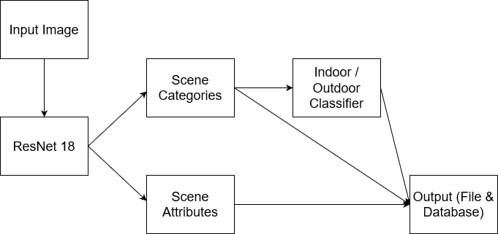
Approach
The input to the model is an input image of any size.
A ResNet-18 model is used to find the confidence scores of the scene categories and the presence or absence of over 200 scene attributes.
As per the scene category with highest confidence, each image can be labelled to be in an indoor or outdoor environment.
Notes:
What approach did you take? High level overview of the method. I’m expecting something like “My inputs were a set of bunnies who needed glasses. I used the Foobar library to feed them carrots. The output was bunnies with improved vision.

Slide 5
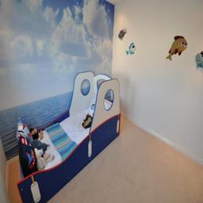
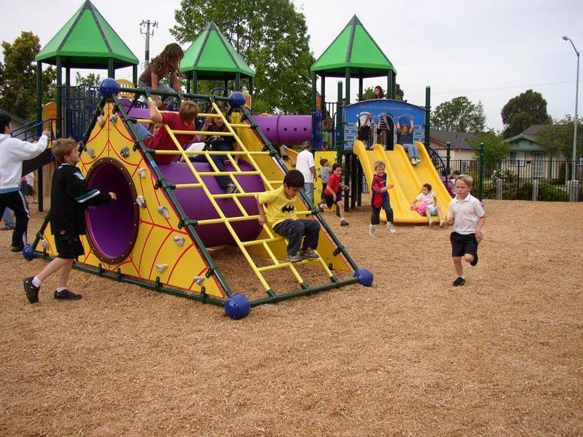
Demo
Notes:
Demo. Ideally live, but feel free to cook the books with prior results.

Slide 6
Benchmarking
The code has been tested by Jagath on Dan’s machine on a few sample images.
Without using GPU the model takes 0.24 seconds/image to find the scene categories, and 1.98 seconds/image to find both the scene categories and attributes.
With GPU the speed has improved a lot and can compute close to 8 million images per day.
Notes:
What are your performance results? Speed (1 second per bunny) and Accuracy (some bunnies still needed glasses in the end). I’m joking about bunnies, here I really want specific units. 1 photo / second. 55% recall. Please talk about your testing regime and whether it’s local or from Dan’s machine

Slide 7
Results
Tested the model on the validation set of Places365 dataset Challenge
Highest Confidence Score Accuracy – 50%
Top 5 predicted scenes accuracy – 80%
Overall Average F1 Score – 0.47
Indoor Classes Average F1 Score 0.48

Slide 8
Results
Interesting Scene Categories – Child’s room, Nursery, Kindergarten Classroom, Playground, Playroom
All these categories have above average precision, recall, f1 score
Top 5 scene categories - Basketball court, boxing ring, Cockpit, Ballpit, Car Interior, Gymnasium
All top categories have f1 scores, precision and recall around 0.9.

Slide 9
Other Accomplishments
Used a pretrained model to perform Speech Diarization given input the number of speakers in the audio file.
Improved the accuracy of scene detection on grayscale images using an image colorization model.

Slide 10
Future Work
Firstly, making the code compatible to both CPU and GPU as per resources available
Trying out any more models – ResNet101, ResNet 152 (if enough computation resources available)
Retrain with interesting classes vs rest, or binary classifier for each interesting class.
Notes:
Optional: Give us some commentary. Anything you want. Tell us what was hard, or what didn’t work, or what you would do next

