Slide 1
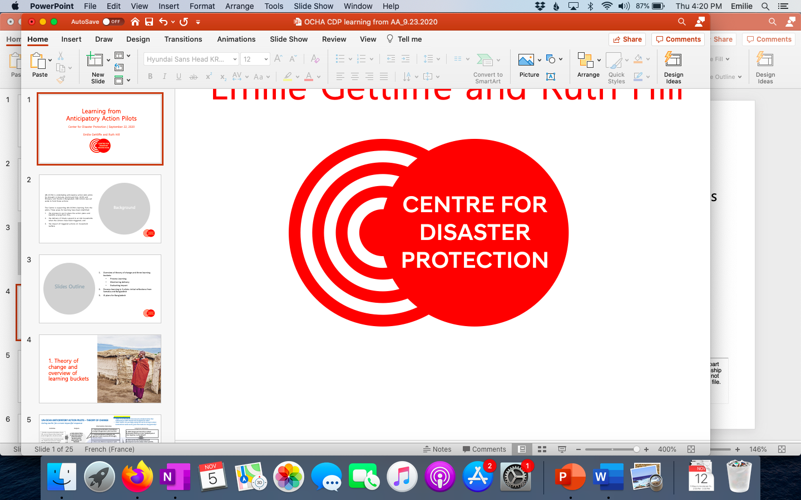
Action Learning Discussion
Bangladesh Anticipatory Action (AA) Pilot
Emilie Gettliffe 6.26.2020

Slide 2
Framing the conversation
Purpose:
Understand and capture views on the effectiveness of the Ethiopia AA plan development process so far
Foster constructive and actionable exchange and real-time learning on AA.
Context: OCHA is committed to integrating and sharing learning from the AA pilots. Trying something new and soliciting and giving honest feedback takes courage and commitment! So, THANK YOU in advance for sharing your time and perspectives to support this learning!
“Learning is more effective when it is an active rather than a passive process.”
- Kurt Lewin

Slide 3
Discussion on key Hypotheses

Slide 4
Questions:
Hypothesis #1:
The roll-out team has sufficiently engaged key HQ and in-country stakeholders to develop a well-contextualized and locally-owned AA plan by the target deadline.
To what extent does the hypothesis currently hold true?
What has facilitated the hypothesis holding true?
What have been barriers to it holding true?
What are possible ways to address the barriers identified?

Slide 5
Questions:
To what extent does the hypothesis currently hold true?
What has facilitated the hypothesis holding true?
What have been barriers to it holding true?
What are possible ways to address the barriers identified?
Hypothesis #2:
Models, indicators and triggers are deemed legitimate enough by partners and collaborators for agreement on a final plan.

Slide 6
Questions:
Hypothesis #3:
Operationally possible activities are selected that will be impactful in mitigating the impacts of flooding for vulnerable people.
To what extent does the hypothesis currently hold true?
What has facilitated the hypothesis holding true?
What have been barriers to it holding true?
What are possible ways to address the barriers identified?

Slide 7
Questions:
Hypothesis #4:
The process undertaken supports 1) building on existing in-country systems and expertise (including colleagues allocating the needed time), and 2) learning from the pilot to enhance future anticipatory action in Bangladesh and elsewhere.
To what extent does the hypothesis currently hold true?
What has facilitated the hypothesis holding true?
What have been barriers to it holding true?
What are possible ways to address the barriers identified?

Slide 8
Are there other hypotheses crucial to articulate and discuss at this point in time?
Anything else to add?

Slide 9
Thank you

