Slide 1




XIII Meeting of the
INSARAG Americas Regional Group
The IEC/R 2014-2015 Update
Lima, Peru
15-17 October 2014
www.insarag.org

Slide 2


Agenda:
1. 10 Activities in 2014
2. Main Findings from IEC/R
3. 2015 Workplan (and beyond)
4. Identification of possible candidates for IEC in the Americas

Slide 3

IEC & IER 2014 Progress Report 2014:
 | Month | Date | Event | Country | Team Name | Classification
1 | March | 24 – 30 | IEC | France | Unité d'Instruction et d'Intervention de la Sécurité Civile n. 1 | Heavy
2 |  |  | IEC | France | Unité d'Instruction et d'Intervention de la Sécurité Civile n. 7 | Heavy
3 | April | 7 – 11 | IER | Poland | USAR Poland | Heavy
4 | May | 26 - 30 | IEC | Romania | Romanian SAR | Medium
5 | June (MODEX) | 11 - 14 | IER | Iceland | Icelandic International USAR Team | Medium

Slide 4
IEC & IER 2014 Progress Report 2014:
 | Month | Date | Event | Country | Team Name | Classification
6 | June - July | 30 – 4 | IEC | Ukraine | Mobile Rescue Centre | Heavy
7 | August | 26-28 | IER | China | China International Search and Rescue | Heavy
8 | October | 27 – 30 | IER | Switzerland | Swiss Rescue | Heavy
9 |  |  | IEC | Morocco | Unité Mobile Nationale d'Intervention | Heavy
10 | March | 1 - 9 | ToT and Mentor | UAE | IEC/R Mentors & Team Leaders Training
*Note: the UK IER & the Qatar IEC were postponed from 2014 to 2015

Slide 5

Main Findings: IEC/IER 2014
From the IEC/R Advisory Notes:
BoO: Management and Health &Safety concerns;
Safety - Skills & equipment, reliability, quality issues;
Staffing - Redundancy Staffing Challenges
International Coordination - OSOCC/RDC processes need strengthening

Slide 6
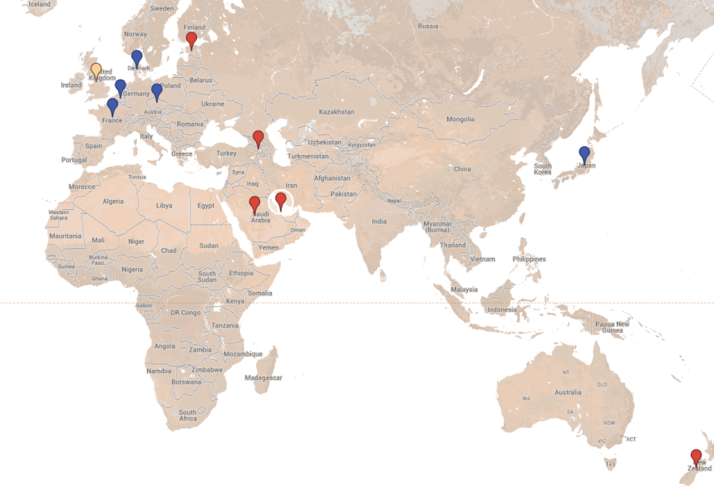
IEC/IER 2015 Work Plan – 5 IECs, 6 IERs
 | Month | Event | Country | Classification
1 | March | IER | Japan | Heavy
2 | March | IEC | New Zealand | Heavy
3 | April | IEC | Saudi Arabia | Heavy
4 | May | IER | UK | Heavy
5 | June | IER | France | Medium
6 | June | IER | Czech Republic | Heavy
7 | September | IER | Denmark | Heavy
8 | September | IER | Belgium | Heavy
9 | October | IEC | Estonia | Medium
10 | November | IEC | Armenia | Medium
11 | November | IEC | Qatar | Medium
In 2016-17: another two dozen teams planned or preparing for IEC/R

Slide 7
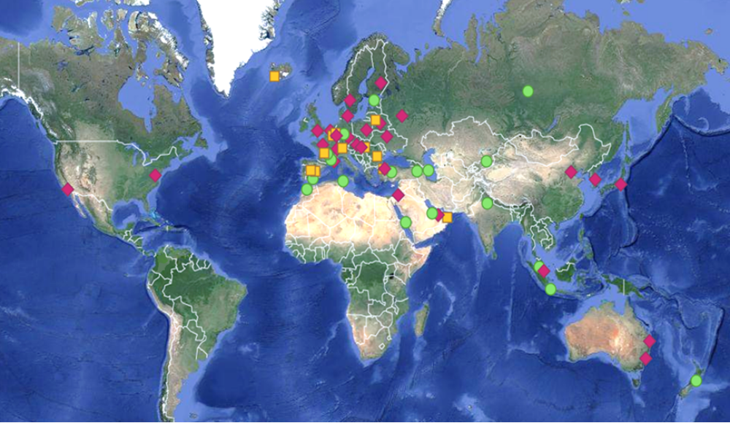
Current IEC/IER Global Overview
Planned Teams 2015-’17=18
Heavy Teams=27
Medium Teams=12

Slide 8

Classifier Contributors
YEAR OF 2014
YEAR OF 2015
9 IEC/IER
2 Postponed
77
CLASSIFIERS NEEDED
11
IEC/
IER
74 CLASSIFIERS NEEDED
ALL POSITIONS FILLED
30 TEAMS CONTRIBUTED
17 TEAMS ON THE IEC/R RESERVE ROSTER
ALL TEAMS NOMINATED CLASSIFIERS
Many Thanks to all Donor Countries and organizations for your support!

Slide 9
Current status of preparations for IECs in the Americas?

