Slide 1
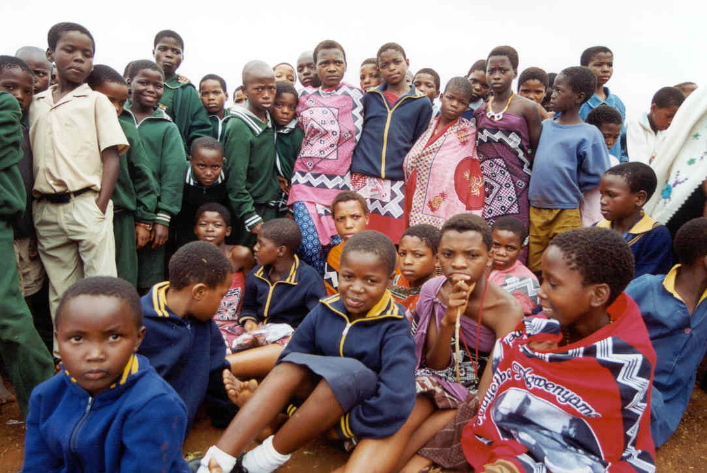
Welcome to the Trainers’ Training
On Protecting Vulnerable Groups from Sexual Exploitation and Abuse in Humanitarian Context
Nairobi 9-11 October 2007

Slide 2

Introduction and Objectives

Slide 3
Main Aims of Training
Create awareness of sexual exploitation and abuse in WFP working context.
To build capacity of staff to carry out training.

Slide 4
Specific Objectives
Explain the various types and contexts of sexual exploitation and abuse of vulnerable groups in emergencies.
Explain and rationalise the core principles for standards of conduct and the obligations these core principles create.
Describe the short and long term effects of sexual exploitation of children and women and highlight prevention strategies.

Slide 5
Identify possible points of exploitation and abuse within the supply and distribution cycle (how they happen, at what point within programme implementation, supply and distribution chain) and identify potential prevention methods.
Explain and apply mechanisms and procedures for reporting and investigating sexual exploitation and abuse.

Slide 6
Highlight steps for preventive and response mechanisms.
Discuss and compile a needs analysis and tentative training proposal for WFP Kenya Country office.

Slide 7

Defining Sexual Abuse and Exploitation

Slide 8
OVERVIEW OF WEST AFRICA REPORT
Carried out by UNHCR and Save the Children
Due to growing concerns about sexual violence and exploitation

Slide 9
GENERAL FINDINGS
Where it occurs:
Within family setting.
Within camp and surrounding areas.
Within local towns and centers.

Slide 10
Who was implicated
UN peacekeeping forces
Local government personnel
National UN & NGO staff
International NGO staff
Local security forces
Teachers
Businessmen
…… 99% of these people are MEN!

Slide 11
Key Findings
Exchange of sex for money or gifts widespread.
Majority girls between 13 and 18 years.
Children with out parents most vulnerable.
Perpetrators are usually men in positions of power.

Slide 12
Inter-agency Standing Committee
In March 2002, an(IASC) established a task force on protection from sexual exploitation and abuse in humanitarian crisis.
Sexual exploitation and abuse in humanitarian crisis is not confined to West Africa, but is a global problem.
The task force has produced an action plan to prevent and respond to sexual abuse and has developed 6 core principles governing behavior.

Slide 13
All IASC members implement core concepts and principles through awareness creation, reporting and investigating mechanisms.

Slide 14
GLOBAL OVERVIEW OF GBV
“Gender-based violence (GBV)” is defined as violence that is committed as a result of gender-based power imbalances. Because of their subordinate status, women and girls are the primary victims. GBV may be physical, sexual, psychological, economic or socio-cultural.

Slide 15
GLOBAL OVERVIEW (cont)
“Violence against women is one of the crucial mechanisms by which women are forced into a subordinate position compared to men” UN General Assembly Declaration on the Elimination of Violence against Women

Slide 16
Global Overview (cont)
Sexual exploitation and abuse exists everywhere.
The root cause is power imbalance and gender inequality.
Sexual abuse and exploitation is prevalent and often increases in crisis situations

Slide 17
EXAMPLES
One in three women worldwide will be beaten or raped in her lifetime. UNFPA
In Addis Ababa, Ethiopia, half of the 100,000 prostitutes are under 18 years of age. (Save the Children)
In the United States, one in 4 girls and one in 9 boys will be sexually abused.

Slide 18
SEXUAL EXPLOITATION AND ABUSE
AS DEFINED BY IASC
SEXUAL ABUSE:
Actual or threatened physical intrusion of a sexual nature, including inappropriate touching, by force or under unequal or coercive conditions.

Slide 19
EXPLOITATION:
Any attempted or actual abuse of a position of vulnerability, differential power, or trust for sexual purpose; this includes profiting monetarily, socially or politically from sexual exploitation of another.

Slide 20
HUMANITARIAN WORKER:
Include all workers engaged by humanitarian agencies, whether internationally or nationally recruited, or formally or informally retained from the beneficiary community, to conduct the activities of that agency.

Slide 21

APPLICATION OF CODE OF CONDUCT

Slide 22
SIX PRINCIPLES
1.Sexual exploitation and abuse by humanitarian workers constitute acts of gross misconduct and are therefore grounds for termination of employment.
2. Sexual activity with children (persons under the age of 18) is prohibited regardless of the age of majority or age of consent locally. Mistaken belief in the age of a child is not a defense.

Slide 23
3.Exchange of money, employment, goods or services for sex, including sexual favours or other forms of humiliating, degrading or exploitative behavior is prohibited. This includes exchange of assistance that is due to beneficiaries.
4.Sexual relationship between humanitarian workers and beneficiaries are strongly discouraged since they are based on inherently unequal power dynamics. Such relationships undermine the credibility and integrity of humanitarian aid work.

Slide 24
5.Where humanitarian worker develops concerns or suspicions regarding sexual abuse or exploitation by a fellow worker, whether in the same agency or not, s/he must report such concerns via established agency reporting mechanisms.
6.Humanitarian workers are obliged to create and maintain an environment which prevents sexual exploitation and abuse and promotes the implementation of their code of conduct. Managers at all levels have particular responsibility to support and develop systems which maintain this environment.

Slide 25

Recap of the first day’s discussions

Slide 26

Possible Points of Abuse and Exploitation within Supply Chain Distribution

Slide 27
DISTRIBUTION CYCLE
Emergency
Assessment
Delivery
Procurement
Recruitment
Post-distribution
Monitoring
Warehousing
Actual Distribution
    Pre-Distribution
    Preparations

Slide 28
Key Steps to Prevent Abuse
Awareness creation among key audiences.
Policy to be included in contracts of staff, partners & vendors.
Procedures for various activities to be clear.
Supervision, record keeping and monitoring of activities to be a priority.

Slide 29

Reporting Mechanism and Investigative
Protocols

Slide 30
REPORTING MECHANISMS AND INVESTIGATIVE PROTOCOLS
All organizations must have reporting and investigative mechanisms in place.
All mechanisms must be age and gender sensitive.
Communities must be empowered and their capacity developed to monitor and report on the behavior of humanitarian workers and commercial service providers.
Perpetrators must be held accountable and victims must be protected.

Slide 31
Confidentiality -The protection of witnesses is the primary concern.
Transparency-Clear reporting guidelines should be in place.
Accessibility-All beneficiaries and staff need to have access to individuals who can help them if they have a complaint.
Safety-Witnesses protection and investigators.

Slide 32

Training Theory and Methodology

Slide 33
Key Factors for Communicating Effectively
Know and understand your audience.
Know your objectives and subject matter.
Use the most appropriate medium.
Listen and observe feedback from your audience.

Slide 34
Principles of Adult Learning
EXPERIENCE: concrete or direct - process through use of activities such as case studies, problem solving, role-play, games, group tasks etc..
PROCESS: observation and refection –sort out information from 1st phase by reflection in groups
GENERALIZATION: theory and concept- allowing participants to interpret and express lessons learned

Slide 35
Principles of Adult Learning cont’
APPLICATION: applying and testing – applying lessons learned through practicing of new skills, planning for action, field visits and discussion.
McCaffery, James A. The Experiential Approach to Training, Training Resources Group, INC., 20

Slide 36

Delivery

Slide 37
Principles of Facilitation
Trust in other people and their capacities.
Honesty.
Patience.
Humility.
Confidence without arrogance.
Respect for others’ opinions and ways of doing things.

Slide 38
Effective Presentation
Successful presentations come from skill in two key areas:
Preparation
Delivery

Slide 39


Slide 40
2. Understanding your expected audience
How many are you expecting.
What expectations will they come with to the presentation.
3. Research your topic.

Slide 41
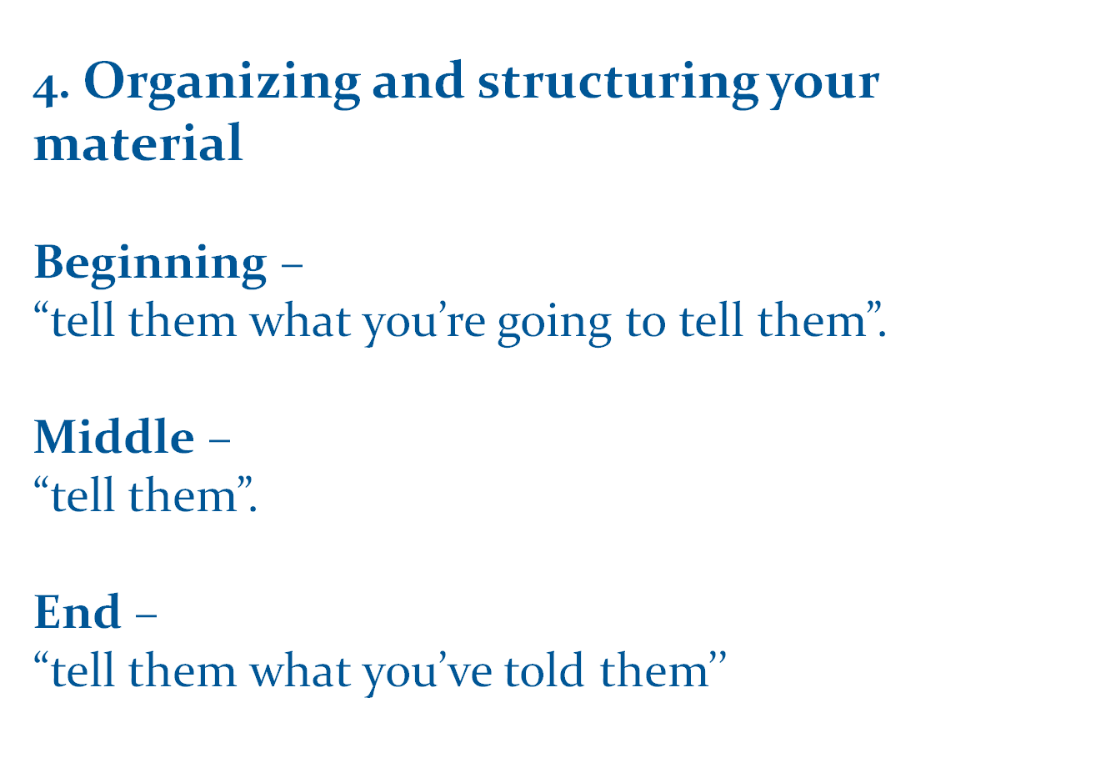

Slide 42
Planning How You Will Present
Rehears!
Rehears!
Rehears!

Slide 43
Delivery
Looking confident.
Looking and feeling confident.
Establishing rapport.
Introduce yourself firmly and relevantly.
Explain your purpose for being there.
Register any necessary appreciation of individuals or groups.

Slide 44
Positive body language
Face- smile and relax your face!
Use eye contact as this demands your audience’s attention, and show confidence.

Slide 45
Voice Projection
Be audible
Emphasize certain words that you want the audience to take notice of.
Do not speak too fast for the audience to follow your ideas clearly.
Pause to allow digestion.

Slide 46
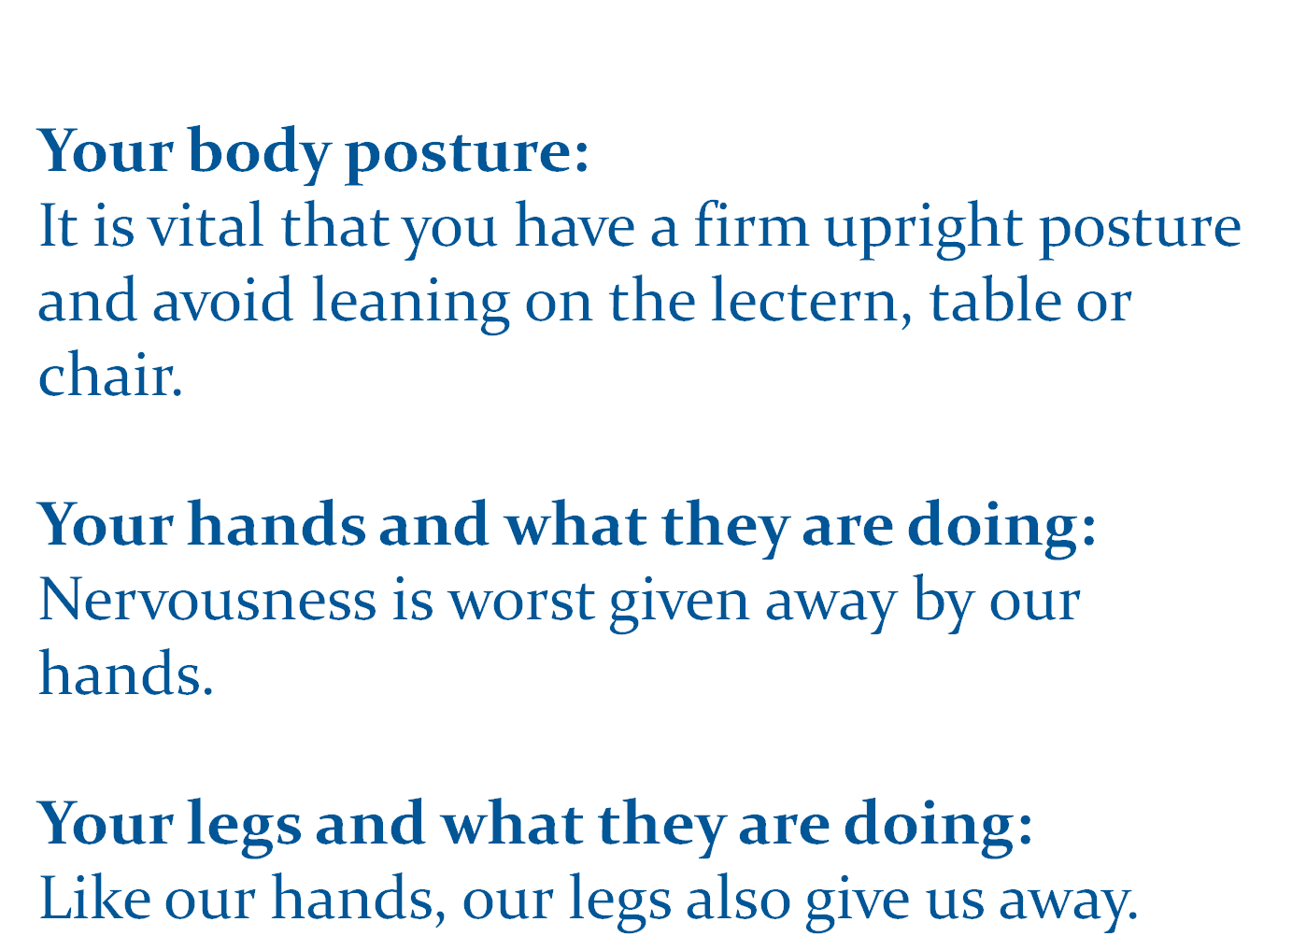

Slide 47
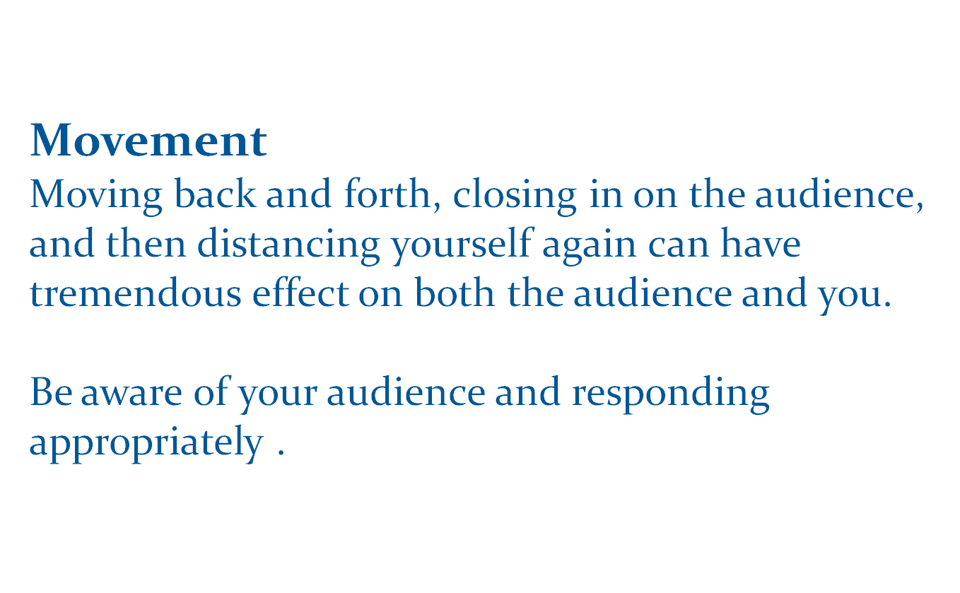

Slide 48
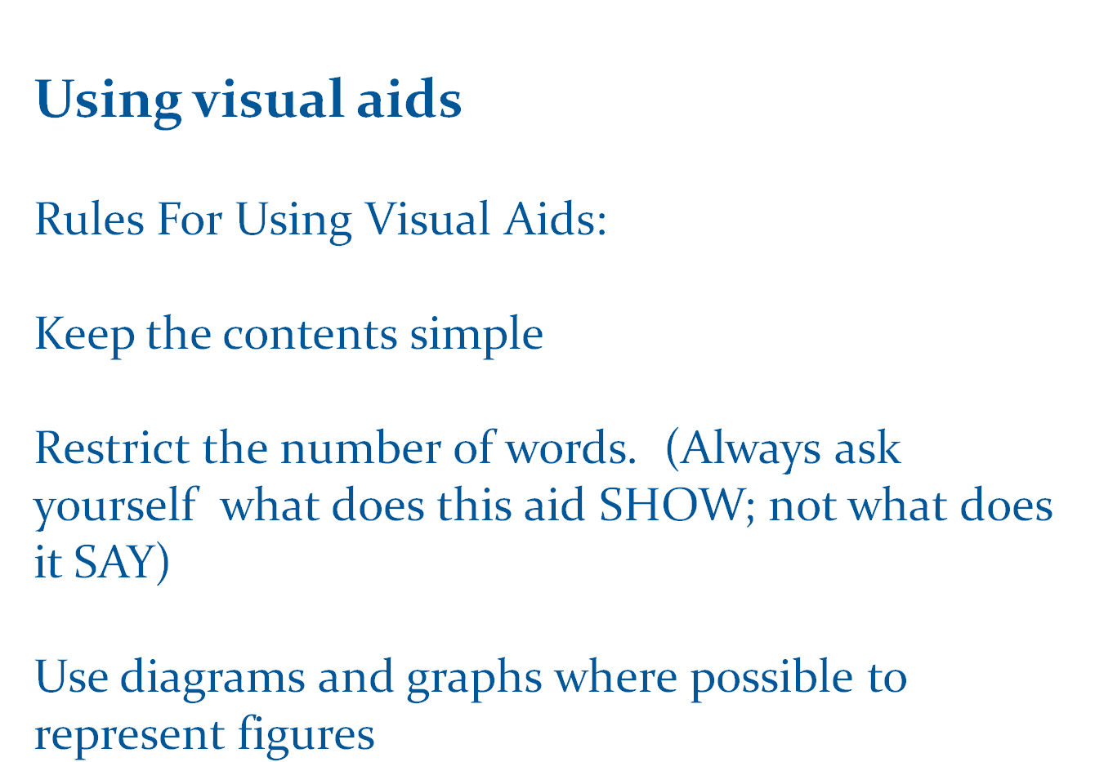

Slide 49
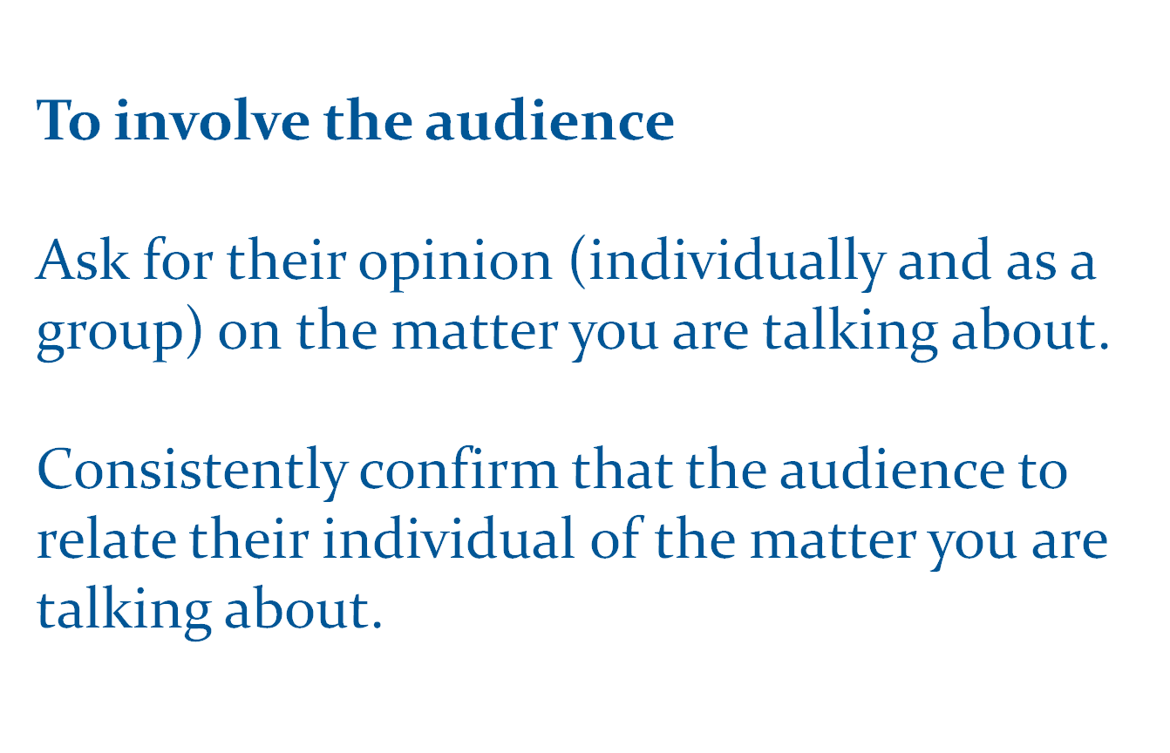

Slide 50

Training Techniques

Slide 51
Training Techniques
We Learn
1% through taste
2% through touch
3% through smell
11% through hearing
83% through sight
We Remember
10% of what we read
20% of what we hear
30% of what we see
50% of what we see and hear
80% of what we say
90% of what we say and do
(Source: VIPP Manual, 1993)

Slide 52

Planning an Event

Slide 53
Priority Target Audiences
WFP Staff
New staff
Locally recruited staff/beneficiary staff in camps/EMOP stations
Enumerators (data collectors from Nairobi and locally recruited
Security guards contracted by WFP

Slide 54
VV
Contractors/ Vendors
Transporters –owners, managers & drivers
Warehousing facilities- warehousing companies, labour providing companies (managers and loaders)
Security companies working in WFP compounds/WFP leased warehouses.
SGS (fumigators) and National Cereals Produce Board working within WFP warehousing system.

Slide 55
Partners (with a focus on EMOP & Development)
Lead agencies- CARE, World Vision, Red Cross national NGOs etc...(focus on Busia, Eldoret and Nairobi slums)
Village elders and Relief/Advisory/ Management Committees (EMOP)
School Management Committees (targeted school feeding schools)
Teachers
Government partners
Girls in low cost boarding schools/children in schools supported by WFP.

Slide 56
WFP Contract Clause
The United Nations and WFP are committed to the protection of vulnerable populations in humanitarian crisis, including form sexual exploitation or abuse. By entering into an agreement with WFP, the Contractor undertakes to adhere to the standard of conduct to the highest standards of moral and ethical conduct. Any failure by the Contractor to take preventive measures against sexual exploitation or abuse, to investigate allegations thereof or to take corrective action, shall constitute grounds for termination of the contract.

