Slide 1



Prevention of Sexual Exploitation
and Sexual Abuse in UN Missions
Rapid Public Information Response
DPKO 23-28 May 2005

Slide 2
Learning Outcomes
Describe what constitutes sexual exploitation and abuse
Outline the UN policies on standards of conduct concerning sexual exploitation and abuse
Describe what is prohibited behaviour
Explain the impact of misconduct on peacekeeping operations and host population

Slide 3
Learning Outcomes
List the consequences for individuals and the mission if mission personnel are directly or indirectly involved in engaging in this form of misconduct
List the main responsibilities of personnel and managers /staff officers to prevent and respond to sexual exploitation and abuse
Outline complaints mechanisms for sexual exploitation and abuse

Slide 4
Learning Outcomes
Identify who is the peacekeeping operation’s Focal Point (and alternate) on sexual exploitation and abuse
List measures UN / Mission is taking to respond to and prevent sexual exploitation and abuse
Identify tactics that PI can use to communicate key messages and support these measures

Slide 5
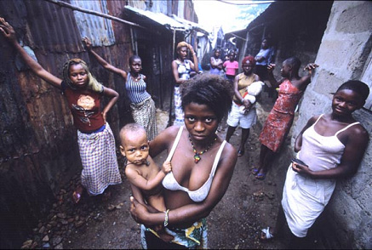
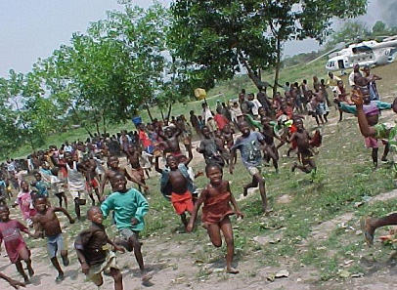
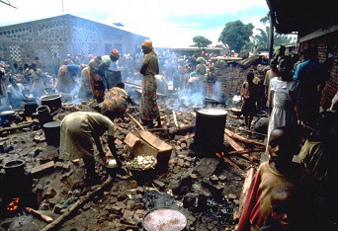
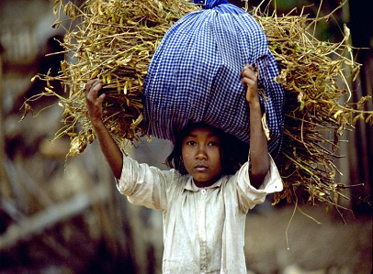
* PI Briefing Note 6 May 05
* PI Guidance – dealing with allegations of misconduct 10 Feb 05
* PI Guidelines – photos and sexual exploitation & abuse 10Feb
* PI Information note on sexual exploitation and abuse 10 Feb 05

Slide 6
What is sexual exploitation and abuse?
Sexual exploitation
Any actual or attempted abuse of a position of vulnerability, differential power or trust for sexual purposes, including but not limited to, profiting monetarily, socially or politically from the sexual exploitation of another.
(ST/SGB/2003/13)

Slide 7
Sexual abuse
Actual or threatened physical intrusion of a sexual nature, whether by force or under unequal or coercive conditions.
(ST/SGB/2003/13)

Slide 8
Standards of Conduct
Sexual activity with children (persons under the age of 18) is prohibited
Exchange of money, employment, goods, assistance or services for sex, e.g. Sex with prostitutes, is prohibited
Sexual relationships with beneficiaries of assistance are strongly discouraged

Slide 9
Secretary-General’s Bulletin
Consider the “abuse” element required for sexual exploitation:
Actual or attempted abuse of:
  Position of vulnerability
  Differential power
  Trust …….for sexual purposes

Slide 10
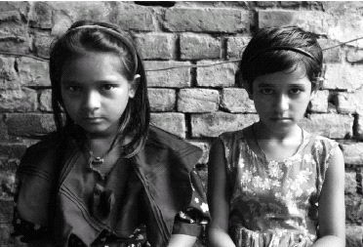
What is human trafficking?
Trafficking is the recruitment, transportation, transfer, harbouring or receipt of persons, by the threat or use of force or other means, for the purpose of exploitation.
(Art 3 UN Trafficking Protocol)

Slide 11
Zero tolerance
Means that the culture of impunity and complacency toward sexual exploitation and abuse will no longer be tolerated.
Zero-tolerance for impunity means that active measures are being introduced to prevent sexual exploitation and abuse and appropriate disciplinary action will be taken against all persons who are found to have violated the UN standards of conduct.

Slide 12
Approach taken with media
Proactive and transparent
Need to follow due process and respect confidentiality
Senior officials have talked at all levels
Need to combat gossip with facts (where available) and UN approach
Encourage accurate reporting by media and not to “exploit” victims in the press

Slide 13
Consequences of Sexual Misconduct
Sexual exploitation and abuse is serious misconduct and subject to disciplinary action
Possible summary dismissal, termination of UN contract and no further UN service
For criminal offences, all except military members of national contingents can be tried in the host country
Military members of national contingents subject to their own national military justice, including court martial

Slide 14
Guidance for PI
Know policies and procedures
Know and follow due process and respect confidentiality
Dos and Don’ts
(refer to 10 Feb 04 PI Guidelines – Allegations of misconduct pg, 3-4)

Slide 15
UN personnel Responsibilities
Be informed
Be a role model
Report suspicions, rumours and allegations
Cooperate fully with investigations
Inform local population on reporting mechanisms

Slide 16
How do UN personnel report a rumour, suspicion, or allegation of sexual exploitation?
Chain of Command
Mission Focal Point (or other agency focal point) for Sexual Exploitation and Abuse
Personnel Conduct Officer
The Office of Internal Oversight Services (OIOS)

Slide 17
How do the public report a rumour of sexual exploitation?
Relevant UN Focal Point (Mission or other agency) for Sexual Exploitation and Abuse

Slide 18
What are the duties of managers and officers to prevent and respond to sexual exploitation and abuse?
Be a role model
Create an environment that discourages sexual exploitation and abuse
Provide information to and raise awareness of PKO personnel
Provide information to local populations on the UN standards of conduct and complaints mechanisms available

Slide 19
UN Measures
C34, Zeid Report, DPKO Taskforce, Interagency Taskforce
DPKO Directive and SOPs being developed to implement C-34 decisions and ST/SGB/2003/13

Slide 20
DPKO Directive
(i) Prevention
- Awareness raising,
- Mandatory training
  all staff, managers, senior leadership;
- Recreational and welfare facilities
* One UN, one standard – different disciplinary consequences and mechanisms and criminal authorities

Slide 21
(ii) Enforcement
Complaints mechanisms
Compliance mechanisms
Investigations
Monitoring, reporting and follow up,
Victim assistance
PI and communication
Disciplinary procedures (As per Disciplinary directives)

Slide 22
What measures are being taken on your Mission?
EXAMPLES:
* Training, Induction courses
* Codes of conduct
* Procedures
* Off limit areas
* Curfews
* No fraternization policies
* Personnel Conduct Units, Reporting networks

Slide 23
Focal Point (and alternate) for Sexual Exploitation and Abuse
Name
Office
Extension
Mobile

Slide 24
Key Messages for Peacekeeping Personnel
Remember
  Sex with anyone under 18 years of age is prohibited
  Exchanging money, goods, food or employment for sex, e.g. prostitution, is prohibited
  Sexual relations with beneficiaries of assistance are strongly discouraged
Prevent sexual exploitation and abuse
Report any suspicions, rumours or allegations
Set an example

Slide 25
Post -workshop test
10 minutes to complete
All results confidential
Upon completion, please hand test and pre-session test to facilitator
Complete evaluation form and hand in to facilitator

