Slide 1

Standard Training Module 3: Combating Sexual Exploitation and Abuse
Role of Senior Mission Leadership
Conduct and Discipline Unit
Department of Field Support
UN Headquarters
2 UN Plaza, New York, NY 10017
Notes:
This presentation is intended to provide senior managers with an overview of DPKO’s policy and programmatic strategy to prevent and combat sexual exploitation and abuse in mission areas with a particular emphasis on their management responsibilities.
General Background note for the module:
“We have tens of thousands of extremely competent, honest and courageous personnel in the field. We cannot allow acts of serious misconduct by some to betray their good work and tarnish the reputation of the United Nations peacekeeping. It is an indispensable instrument, it is effective, and it is helping to maintain peace for tens of millions of people around the world.”
Jean-Marie Guehenno presentation to Security Council - Feb 2006
“UN peacekeepers are present in a host country to help promote peace and stability and often, more specifically, to support the re-establishment of a functioning government and the rule of law. Their personal behaviour must therefore mirror this goal. It is essential that all personnel serving in a UN peacekeeping operation, whether military, civilian police or civilian personnel, have an understanding of the UN standards of conduct with regard to sexual exploitation and abuse. They should be aware of the UN zero-tolerance policy against any involvement, direct or indirect, in such acts and of the administrative and disciplinary measures that may be taken against any individual found responsible for such conduct.
In particular, senior leadership must understand their roles and responsibilities in preventing and responding effectively to sexual exploitation and abuse of the local population.” Source: Zeid Report

Slide 2
Contents of Module
Learning Outcomes
Sexual Exploitation and Abuse: A Brief History
Standards of Conduct
Misconduct
Definitions of Sexual Exploitation and Abuse (SEA)
Specific Managerial Responsibilities
Environment in Post-conflict Societies and Impact on Host Population
Observances by UN Forces of International Humanitarian Law
Impact of Misconduct on Mission Mandate
Command Considerations
Three-pronged Approach
Leadership Best Practices
Leadership Challenge and Response
Unequivocal Message by Senior Leadership
Video and Case Study

Slide 3
Learning Outcomes
Provide mission leaders with an understanding of the problem related to sexual exploitation and abuse;
Inform mission leaders of their responsibilities and accountability with respect to addressing serious misconduct;
Provide examples of best practice in the field.

Slide 4
Sexual Exploitation and Abuse: A Brief History
Allegations in Cambodia & Balkans – 1990s
Allegations in West Africa (Sierra Leone, Liberia) 2001-02 (A/57/465)
SG’s Bulletin - SGB 2003/13, 2003
Similar allegations in DRC 2004 (A/59/661)
Prince Zeid appointed adviser – 2004
Zeid Report submitted to C-34 – 2005 (A/59/710)
SG’s Report endorsed by GA – 2005 (A/Res/59/300)
Bunia II (A/61/841)

Slide 5
Standards of Conduct
Highest standards of efficiency, competence and integrity
The UN has a zero-tolerance policy on sexual exploitation and abuse
The UN holds accountable those throughout the chain of command who fail to act decisively in enforcing this standard
Managers, commanders and all other leaders are accountable and responsible to their staff

Slide 6
Misconduct
Staff Rule 110.1 defines misconduct as:
“Failure by a staff member to comply with his or her obligations under the Charter of the United Nations, the Staff Regulations and Staff Rules or other relevant administration issuances, or to observe the standards of conduct expected of an international civil servant…”

Slide 7
Guidelines and Prohibitions on SEA as per ST/SGB/2003/13
Sexual activity with children (persons under the age of 18) is prohibited.
Exchange of money, employment, goods, assistance or services for sex, e.g. sex with prostitutes, is prohibited.
Sexual relationships with beneficiaries of assistance are strongly discouraged.

Slide 8
Sexual Exploitation
Any actual or attempted abuse of a position of vulnerability, differential power or trust for sexual purposes, including but not limited to, profiting monetarily, socially or politically from the sexual exploitation of another.
(ST/SGB/2003/13)

Slide 9
Sexual Abuse
Actual or threatened physical intrusion of a sexual nature, whether by force or under unequal or coercive conditions.
(ST/SGB/2003/13)

Slide 10
Specific Managerial Responsibilities
ST/SGB/2003/13
Create and maintain an environment that prevents SEA, and shall take appropriate measures for this purpose.
Inform staff of the contents of the SGB and ascertain that staff receive a copy.
Take appropriate action in cases where there is reason to believe that any of the standards have been violated.
Inform the Department of Management of its investigations into cases of SEA, and the actions it has taken as a result of such investigations.
Ensure all serious misconduct is reported to OIOS.

Slide 11
Environment in
Post-conflict Societies
Women and children most vulnerable
Sexual violence as strategy in armed conflict
Increase of organized crime
Increased poverty
Loss of social services
Loss of access to rights; fear of retaliation and lack of access to justice

Slide 12
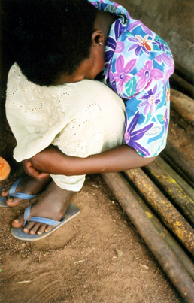
Impact of SEA on
Host Population
Further victimization of vulnerable persons
Increased risks of sexually transmitted infections
Violates victims’ human rights
Notes:
Anecdotally, mission colleagues report an atmosphere crossed between the “Love Boat” and “Animal House.” This indicates how low our command climate has dropped.
Our efforts to address SEA are rooted in the basis of our purpose and pride, and are not rooted in interrogation, fear and audit.
With great authority comes great responsibility.
Leaders must address their fiduciary, social and personal responsibilities and be aware of how their staff watch and evaluate their leadership. Standards of behaviour must be maintained at the highest level with particular attention to your own lifestyle as an important tool to trade upon as you place increasing demands on the staff and personnel under your leadership.
Zeid Report:
Accountability cannot be thought of in negative terms; it is an integral part of management and command. Managers who make a good-faith effort to deal with the issue of sexual exploitation and abuse must be rewarded by appropriate notations in the performance appraisal mechanisms used to assess their suitability for higher office. But good managerial performance in addressing sexual exploitation and abuse cannot be linked to the number of allegations reported. The institution of some of the reporting and outreach mechanisms that I advocate above may lead, in the short run, to a larger number of reports of abuse as victims realize that they can securely come forward and complain.

Slide 13
Observance by UN Forces of International Humanitarian Law
ST/SGB/1999/13
The SGB applies to UN forces in situations of armed conflict or in peacekeeping operations where force is permitted in self-defence.
Military personnel are subject to prosecution in their national courts.
Attacks against the civilian population are prohibited
Women shall be protected against any attack, in particular against rape, enforced prostitution.
Children shall also be protected against any form of indecent assault.

Slide 14

Impact of Misconduct on
Mission Mandate
Misconduct contrary to UN Principles
Violates Integrity and impartiality
Reduces credibility and image of UN
Threatens UN security
Undermines rule of law & fosters crime
Notes:
Sexual exploitation and abuse damages the image and credibility of a peacekeeping operation and damages its impartiality in the eyes of the local population, which in turn may well impede the implementation of its mandate.
The ill discipline engendered by sexual exploitation and abuse also degrades the effectiveness of the peacekeeping operation, especially in times of crisis. Moreover, instances of sexual exploitation and abuse may constitute violations of international humanitarian law, international human rights law or both.
Indeed, a peacekeeping operation cannot legitimately advise the Government on adherence to international human rights standards and legal and judicial reform if its own peacekeeping personnel are engaging in acts of sexual exploitation and abuse, including such crimes as rape. Sexual misconduct by peacekeeping personnel can also expose both them and the mission to blackmail and violent retaliation, especially during times of breakdown in law and order in the country.
Moreover, such misconduct increases the incidence of medical problems, including the risk of contracting or transmitting sexually transmitted diseases and HIV/AIDS. Victims frequently suffer from psychological trauma as a result of their experiences. Victims and abandoned peacekeeper babies may face stigmatization by their families and communities, which deprive them of all support (economic, social, emotional, etc.). This in turn may push victims into further exploitative relationships with peacekeeping personnel and others in order for them and their children to survive.
Source: Zeid Report

Slide 15
Command Considerations
Sexual exploitation & abuse does not occur in a vacuum
Abuse & other misconduct prevail in environments of ineffective leadership
Leaders are accountable for their own failures and of those they lead

Slide 16
DPKO’s Three-pronged Approach
The comprehensive strategy is a three-pronged approach based on the recommendations of the Special Committee on Peacekeeping Operations (A/59/19/Rev.1) adopted in General Assembly resolution 59/300.
  Prevention
  Enforcement
  Remedial action

Slide 17
Three-pronged Approach: Prevention
Uniform Standards
Training
Public outreach information/outreach
Welfare & Recreation

Slide 18
Three-pronged Approach: Enforcement
Complaint mechanisms/reporting
Investigations
Data management

Slide 19
Three-pronged Approach: Remedial Action
Victim Assistance
Reputation Repair

Slide 20
Leadership Best Practices
Continuous training for all levels of personnel
Periodic misconduct risk assessments
Address potential or actual violations
Thorough investigation & vigorous enforcement
Public outreach/awareness of UN measures
Establish and maintain reporting mechanisms
Implement welfare and recreation measures
Create and maintain an environment free from sexual exploitation and abuse
Raise awareness of prohibited conduct

Slide 21
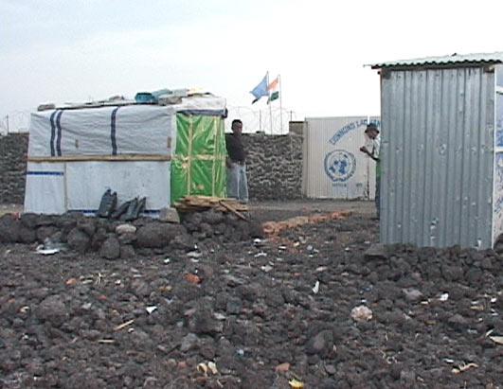
Leadership Challenge and Response
Challenge: UN Proximity to local living areas
Responses:
Move barracks away from densely populated areas
Improve lighting around barracks & entry/exit controls
Check for holes in fence
Co-operate with local police,
UN security to minimise access
to barracks by local population
Organise hearts and minds projects
e.g. school rehabilitation that allow structured and supervised contact with the public.
Notes:
U.N. Aid Workers Accused of Sex Crimes in Congo
In violation of the U.N. Curfew and Code of Conduct that prohibits any contact with prostitutes, ABC News caught a U.N. van being loaded with prostitutes from a cafe in Bunia.
Source: ABC News: U.N. Sex Abuse Scandal: Feb 18, 2005

Slide 22
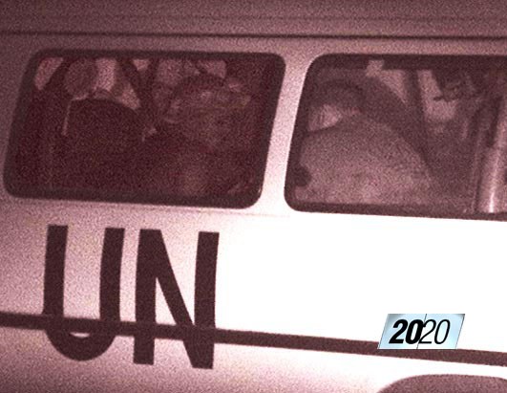
Leadership Challenge and Response
Challenge: Fraternization or inappropriate contact with local population
Responses:
Non-fraternization for contingent
members
Curfews & patrols to monitor personnel
Off-Limits premises/locations
Wearing of uniform when in public
Enforce Disciplinary Directives
Welfare & recreation facilities
Enforce Commanders accountability
Notes:
Additional measures include:
Use of performance appraisal of managers and commanders
Repatriation of commanders for failure to prevent SEA

Slide 23
Unequivocal Message by Senior Leadership
Maintain standards of conduct
Commitment to SG’s zero-tolerance policy
Emphasize command responsibilities
Set the tone – be a role model
Report misconduct
Notes:
It is, of course, to be expected that from time to time individuals will violate the prohibitions against sexual exploitation and abuse. This does not dishonour a contingent that is trying to deal with the problem and that takes action against alleged perpetrators.
But what is inexcusable is a contingent commander who does not cooperate with a Department of Peacekeeping Operations investigation or, worse, seeks to hinder that investigation by failing to properly cooperate with it.
It is recommended that the Secretary-General:
direct heads of mission to recommend the immediate repatriation of any contingent commander who fails to cooperate with a Department of Peacekeeping Operations investigation or otherwise fails to discharge his or her responsibility to help the mission eliminate sexual exploitation and abuse.
write to the Head of State of the troop-contributing country to explain why he was forced to take such action. These obligations on contingent commanders should be specifically set out in the model memorandum of understanding, in which the troop-contributing country should be obligated to take disciplinary action against contingent commanders who are so removed.
It is also recommended that the model memorandum of understanding specifically provide that the United Nations will recover payments it has made for any individual contingent commander who is found to have failed to cooperate with a Department of Peacekeeping Operations investigation into allegations of sexual exploitation and abuse.
By the same token, contingent commanders who take action to discipline their contingent members and who cooperate fully with a Department of Peacekeeping Operations investigation to enable those who violate the 2003 bulletin standards to be punished should be specially commended by the Secretary-General in a letter addressed to the Head of State or Government.

Slide 24
Video & Case Study
Code of Conduct Video
Case study
Reading, discussion, identification of issues
Group presentation of leadership response

Slide 25

We create the demand
We are part of the problem
Notes:
All United Nations peacekeeping personnel are required to maintain the highest standards of integrity and conduct. Any involvement of peacekeeping personnel in human trafficking or any other form of sexual abuse or exploitation constitutes an act of serious misconduct and grounds for disciplinary measures such as dismissal, or repatriation.
Source: Zeid Report

