Slide 1

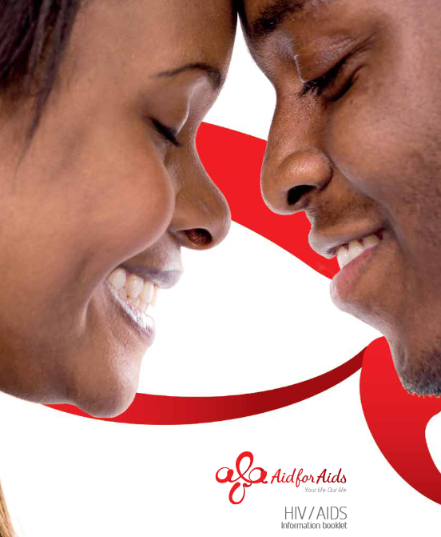
SCB VCT DAY 2021
This is a dynamic document.
Please enable macros in order to view full content.
HIV & AIDS information booklet

Slide 2
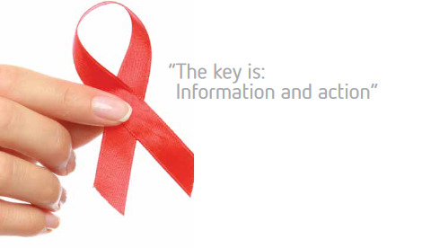
This is a dynamic document.
Please enable macros in order to view full content.
To register and win:
Please visit our site: https://www.unaids.org
Replay to our email that you are intrested in SCB VCT Day 2021
The gift code is included in later ’s slide

Slide 3
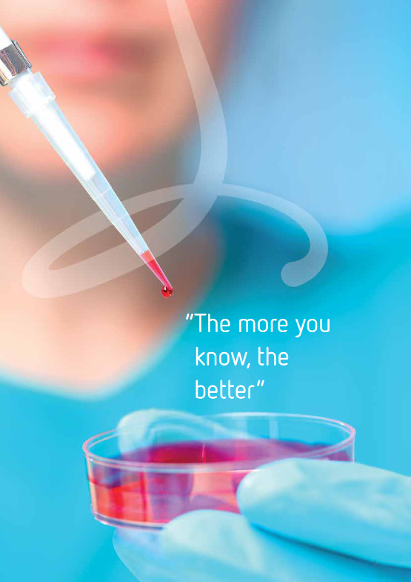
What is HIV & AIDS?
This is a dynamic document.
Please enable macros in order to view full content.
What is HIV?
HIV (Human Immuno Deficiency Virus) is a virus that enters blood. In HIV positive people, the virus can be found in the blood, sex fluid (such as sperm and vaginal fluids) and breast milk. HIV is too small to see with the eye.
What does HIV do?
HIV attacks and eventually destroys the body’s immune system. The immune system is like your body’s army. It normally fights germs, infections, bacteria and viruses that would make you sick. The body cannot defend itself against germs, infections, bacteria and viruses when this “army” gets weak.
What is AIDS?
HIV causes AIDS (Acquired Immuno Deficiency Syndrome). HIV slowly damages the immune system (the army) if it gets into a person’s body. This means that the body starts to lose its ability to defend itself against germs, infections and bacteria such as TB. When the immune system is weak, you are susceptible to certain illnesses like pneumonia and TB. This process may take many years to happen. You are then said to have AIDS. A person gets sick when HIV has destroyed most of his/her immune system. This can take many years to happen.

Slide 4

How is HIV spread?
This is a dynamic document.
Please enable macros in order to view full content.
HIV is spread in the following ways:
  Sexual intercourse
  HIV can be found in the semen and vaginal fluids of a person who is HIV positive. He or she can pass HIV onto another person through unprotected sex (not using a condom) vaginal, oral or anal sex
  Pregnancy
  HIV may be passed onto a baby from an HIV positive mother. Not all HIV positive mothers give birth to babies that are HIV positive. The risk of passing on HIV to the babies increases if the mother is sick with an AIDS illness or if the mother gets infected with HIV during pregnancy.
  Blood
  HIV can pass from one person to another through his or her blood. Sometimes sick people are given extra blood through a blood transfusion. In Asia blood transfusions are safe because blood is tested before it is given to sick people.

Slide 5
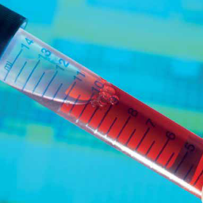
Testing for HIV
This is a dynamic document.
Please enable macros in order to view full content.
How will I know that I have HIV?
You can look and feel healthy for years when you first have HIV in your body. There is only one way to find out whether you are living with HIV - by having an HIV test.
Should I have an HIV test?
Finding out as early as possible after being infected with HIV is important. This way you can get help and avoid spreading HIV without knowing it.

Slide 6
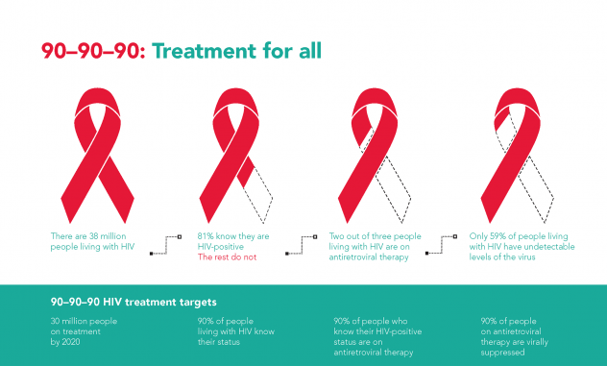
Gift code
This is a dynamic document.
Please enable macros in order to view full content.
SCB_VCT_DAY_2021!

