Slide 1
The Systems Team Update
Parker McLeod and Cory Brynds
1/12/2024

Slide 2
Progress Overview
Project Planning
Developed Profiling Toolkit
Custom OpenFHE Benchmarking Application
Scripts for Build/Test Automation and Administration
Parameter Combination Generator
Significantly Increased the Ambient Room Temperature in Dr. Wu’s Office

Slide 3
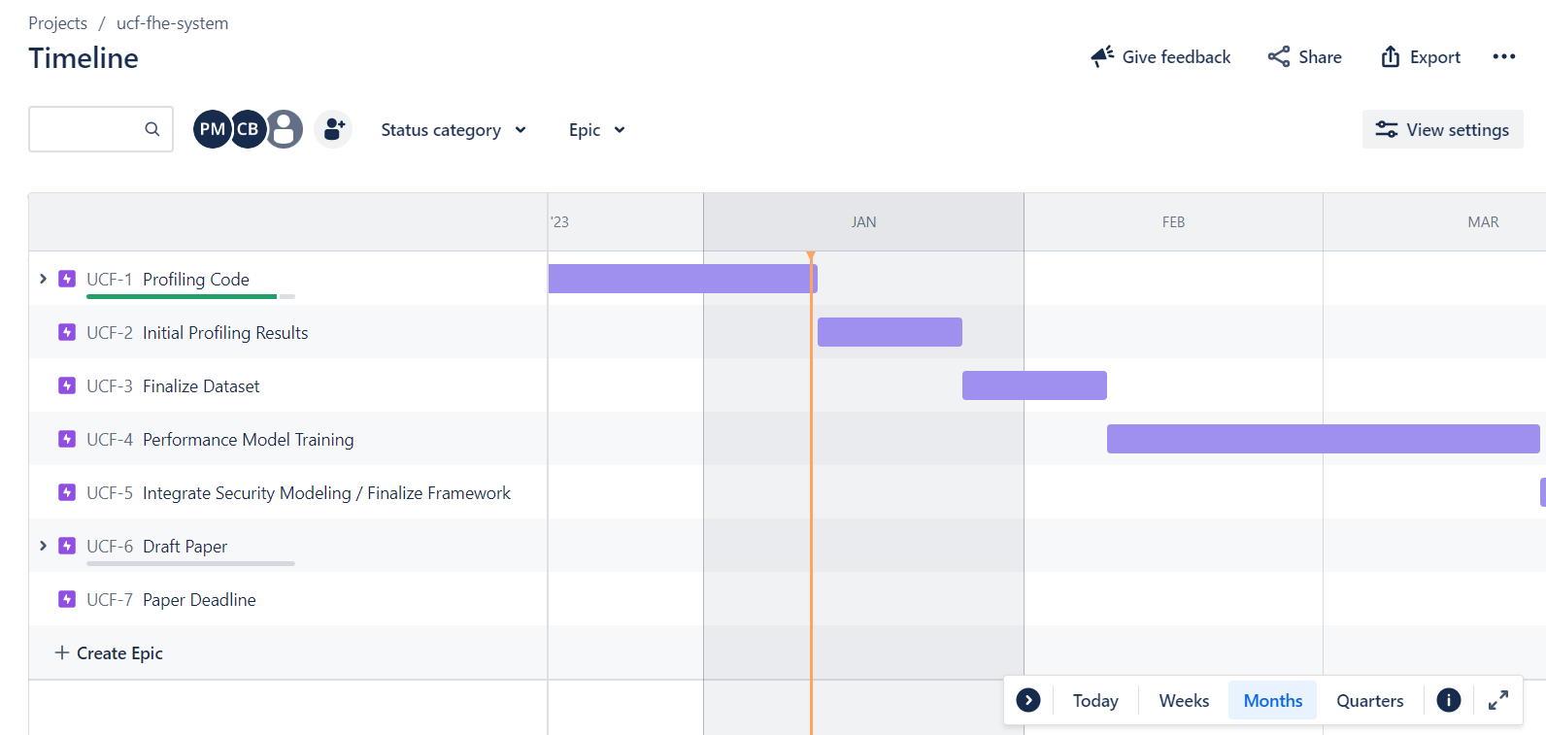
Project Planning

Slide 4
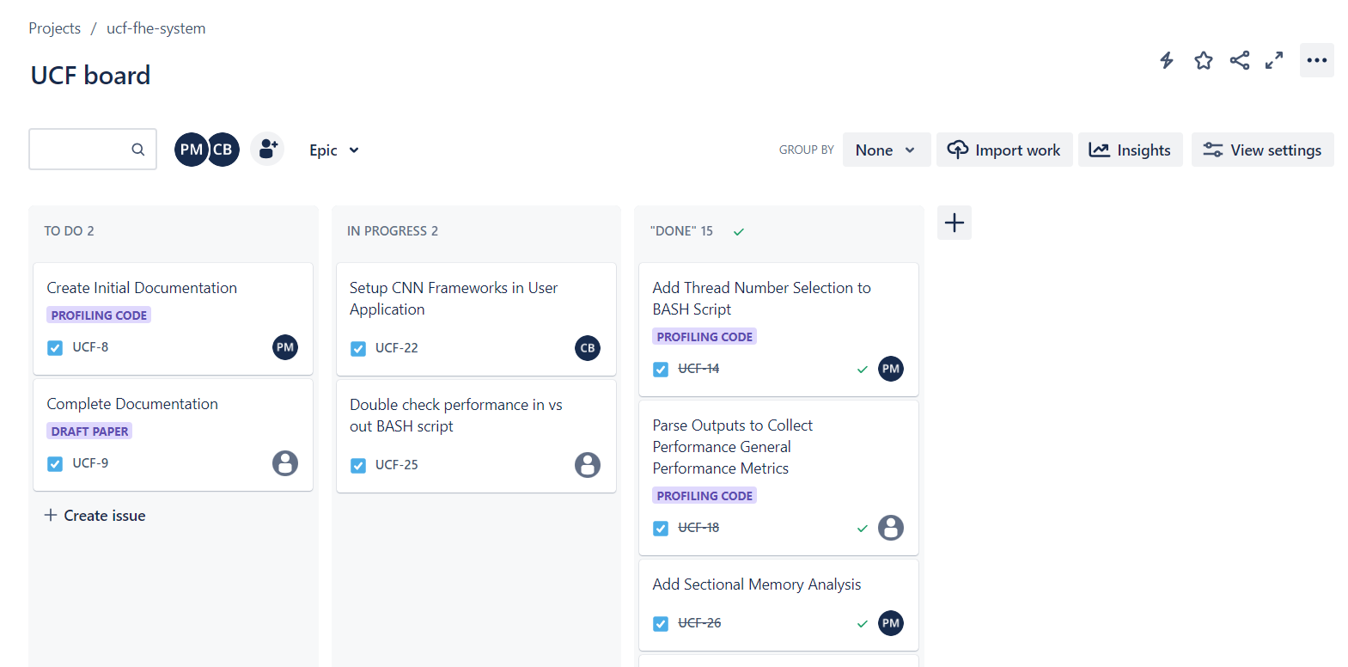
Project Planning

Slide 5
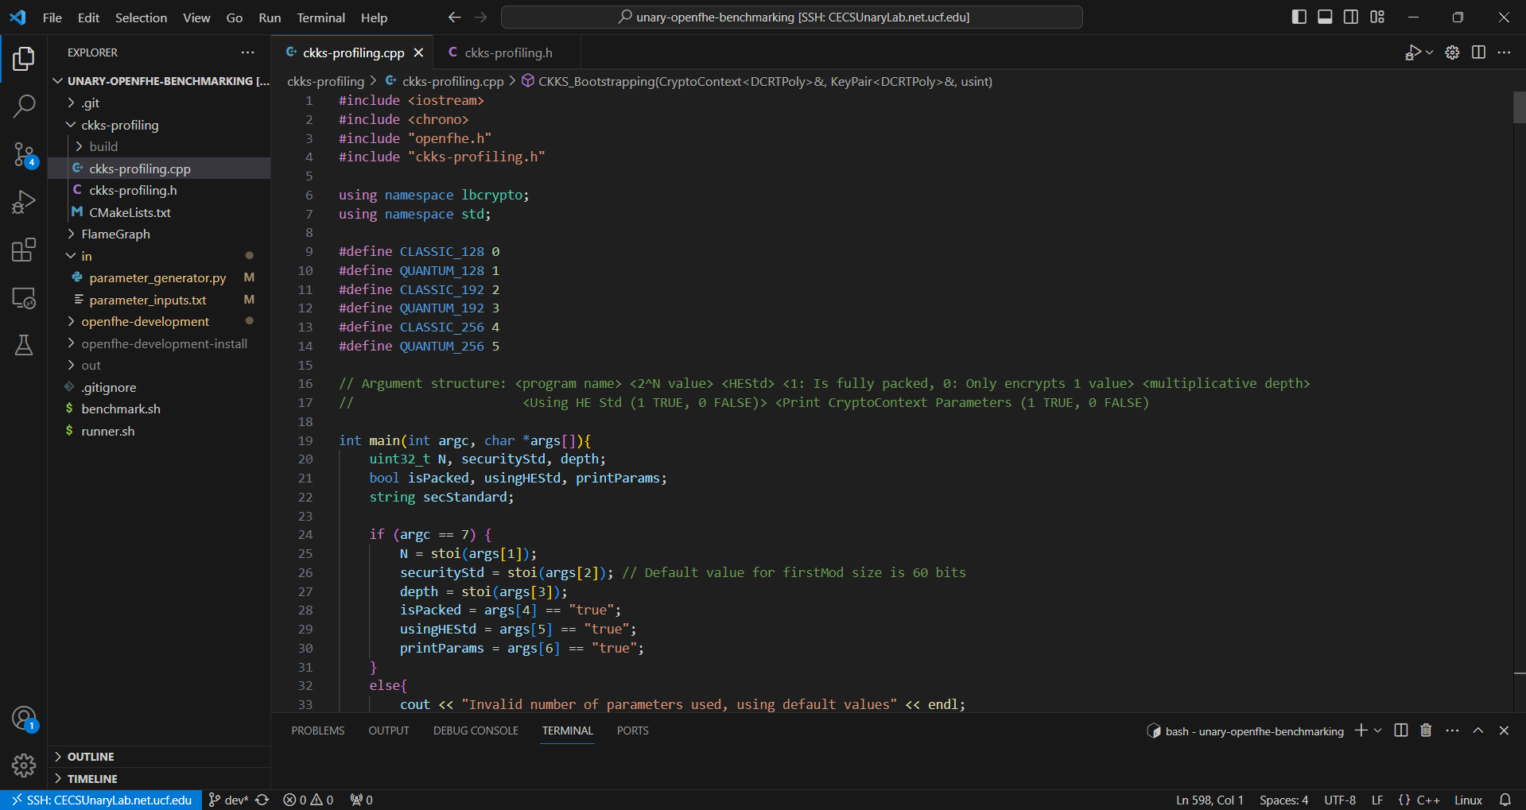
Custom OpenFHE Benchmarking Application
We (Cory) broke down CKKS operations into their basic parts and created a custom user application in OpenFHE!

Slide 6
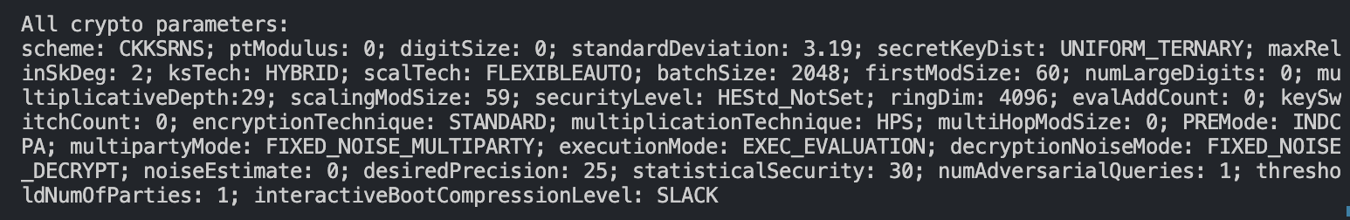
So Many CKKS Parameters!!!
Ciphertext Modulus Q = q0 * q1 * q2 * … * qi * q’
Where q0: firstMod, q’: the special modulus, q1-qi: scalingMod, and
i is equal to the multiplicative depth

Slide 7
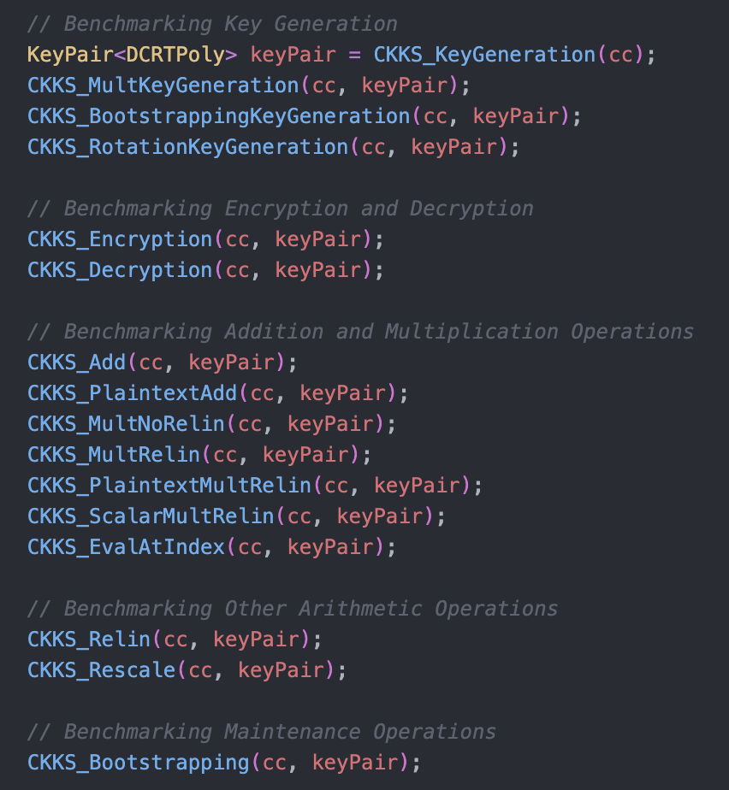
Operation Benchmarking
Sources: OpenFHE example documentation and FHE for Computer
Architects: A Fundamental Characterization Study

Slide 8
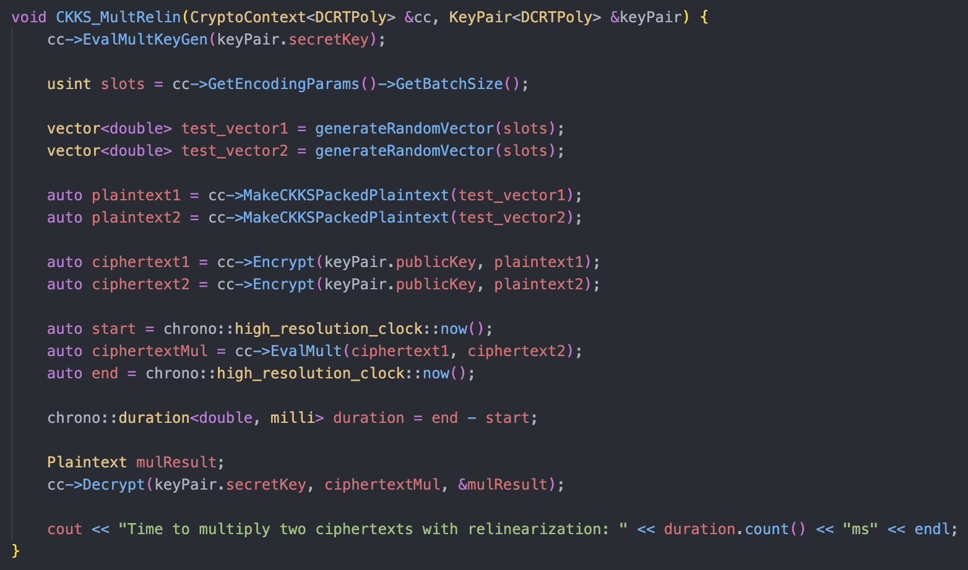
Example Benchmarking Function: CKKS_MultRelin

Slide 9
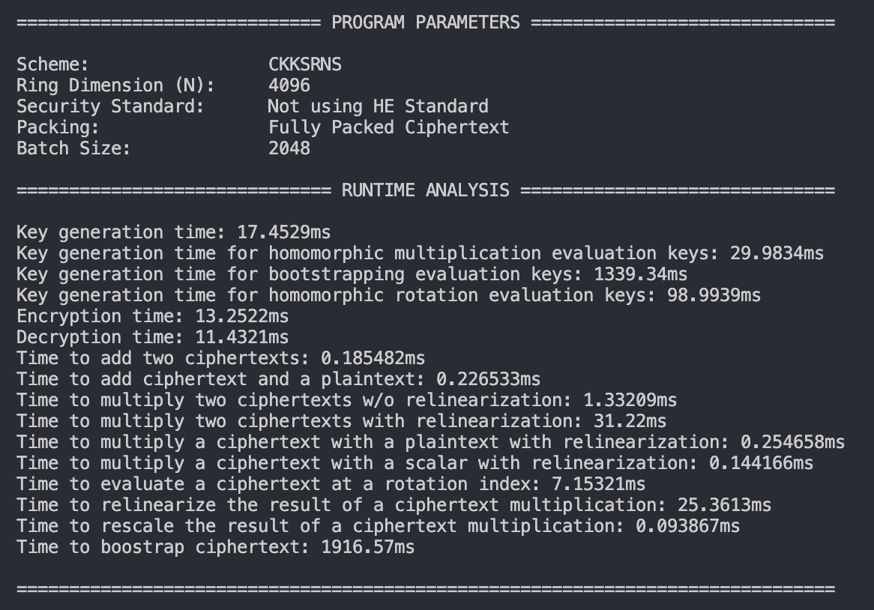
Sample Output 1

Slide 10
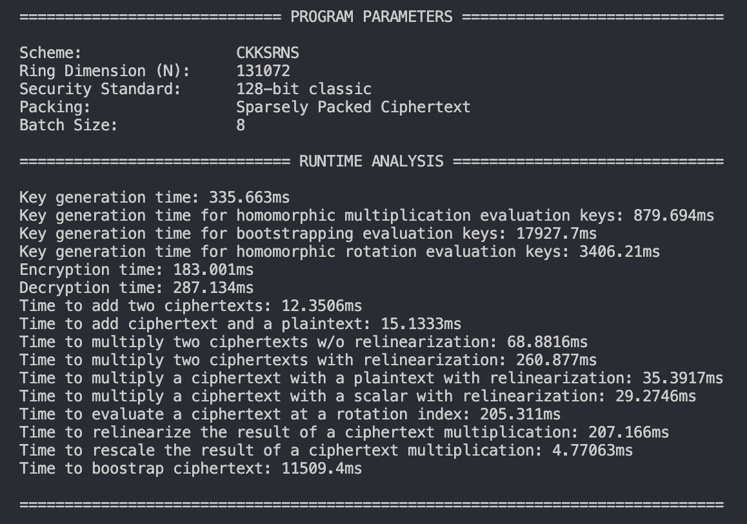
Sample Output 2

Slide 11
Scripts for Build/Test Automation and Administration
Benchmark.sh
Intakes LOTS of parameters
builds
runs
analyzes
saves to csv
Runner.sh
Takes generated parameters and supervises the execution of Benchmark.sh

Slide 12
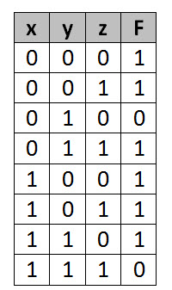
Parameter Combination Generator
We will be running our OpenFHE application with different build parameters and run-time test parameters
We need to test lots of parameters ranges and their respective combinations (think truth table)
How can we automate the generation of the parameters required for each build/test?

Slide 13
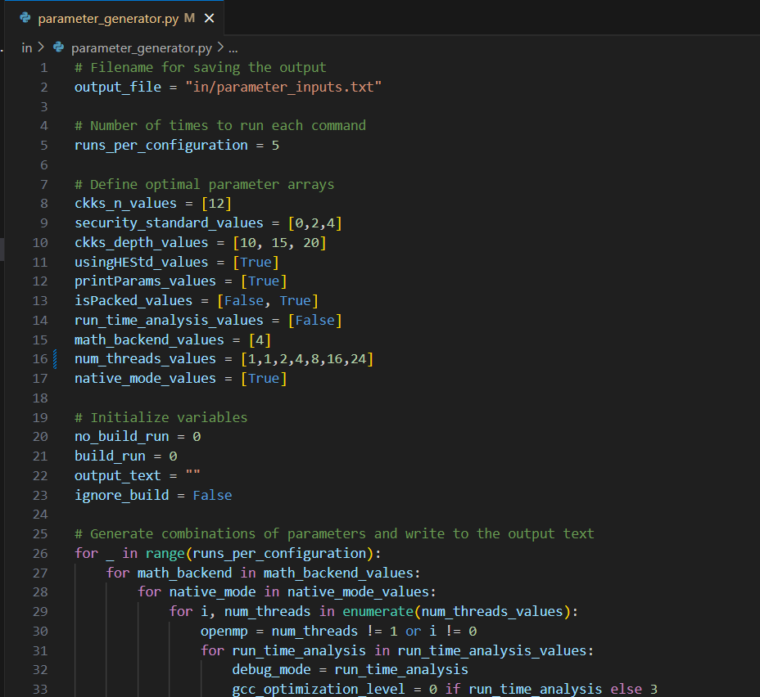
Parameter Combination Generator
Python! For-Loops!
Just select your parameter values and it outputs a combinational list for consumption by our testing toolkit!
Automation!

Slide 14
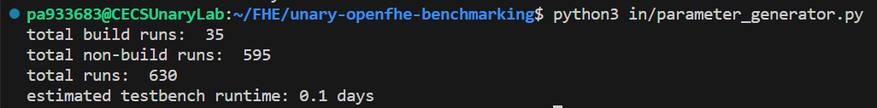
Parameter Combination Generator
It even minimizes rebuilds and estimates the runtime based on the number of builds/runs!
It’s very precise… but not accurate (the runtime changes wildly based on the parameters).

Slide 15
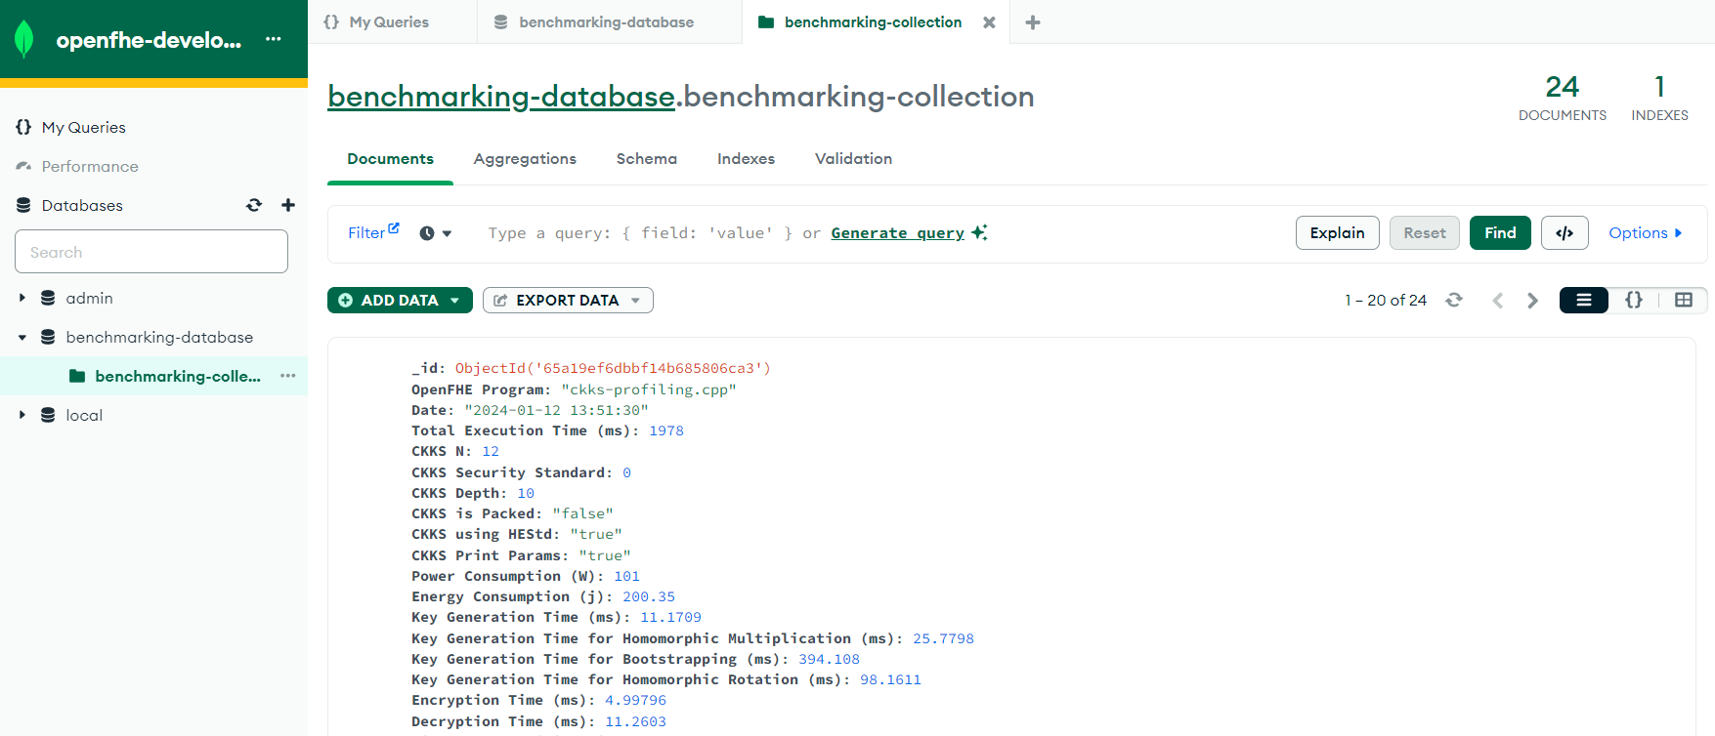
Database Uploading
We used MongoDB to host our database in the cloud
any pc can connect with the right certificate
Automatic benchmarking upload upon test suite completion

Slide 16
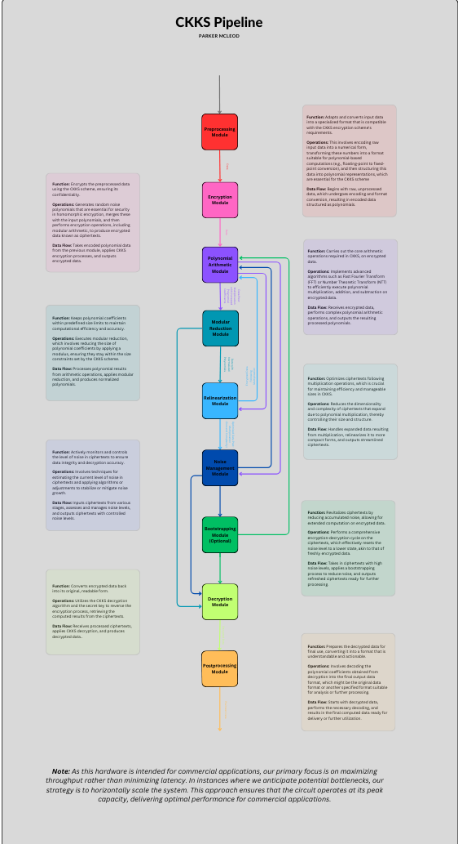

Next Steps for the Systems Team
Next Steps
Complete test program with final parameter list
Collect initial data with varied parameters and build settings
Share profiling data with Rex (and access to more processing power / varied CPUs)
Near future
Integrate the LWE Estimator tool into the benchmarking workflow
Train a neural network based on the profiling data

Slide 17
DEMO

