Slide 1

BarretT Multiplier Implementation
By Francisco Soriano
11.8.23

Slide 2

About
Implemented in Vivado
HDL used: Verilog
2 Versions: 32-bit & 64-bit
Restrictions: no division operations in hardware
Test bench focus: large Q

Slide 3
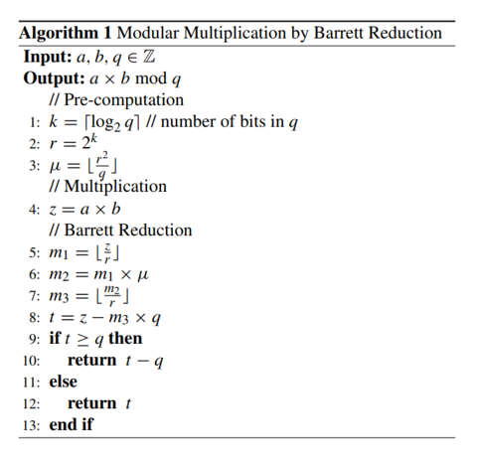
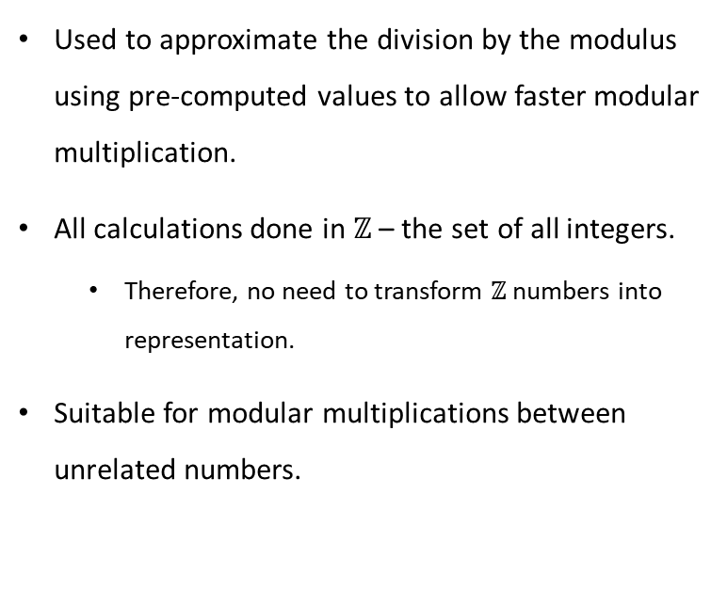
Barrett Multiplier
Used to approximate the division by the modulus using pre-computed values to allow faster modular multiplication.
All calculations done in $ℤ$ – the set of all integers.
Therefore, no need to transform $ℤ$ numbers into representation.
Suitable for modular multiplications between unrelated numbers.

Slide 4
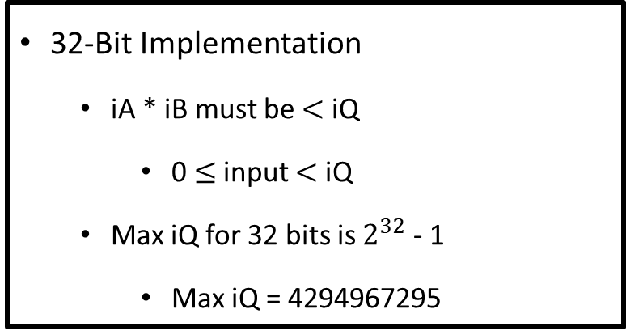
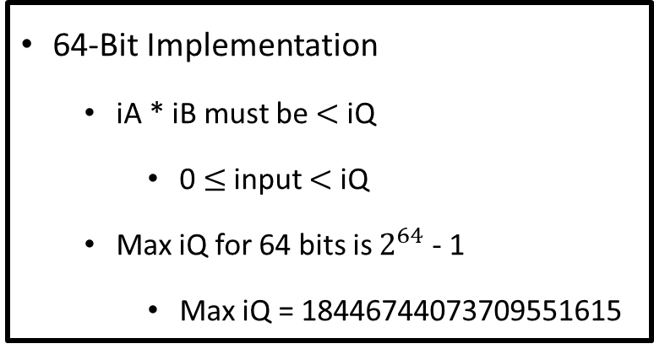
Considerations & Restrictions
32-Bit Implementation
iA * iB must be $<$ iQ
0 $≤$ input $<$ iQ
Max iQ for 32 bits is $2^{32}$ - 1
Max iQ = 4294967295
64-Bit Implementation
iA * iB must be $<$ iQ
0 $≤$ input $<$ iQ
Max iQ for 64 bits is $2^{64}$ - 1
Max iQ = 18446744073709551615
Truth: If large inputs return accurate results, then small inputs are expected to return accurate results as well.

Slide 5
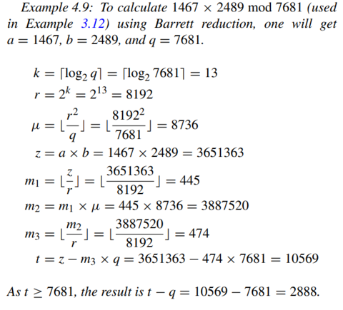
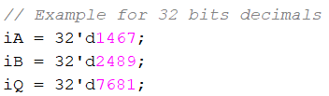
Test 1 Input (32-bit Version)
Provided by paper
Parameters
a = 1467
b = 2489
q = 7681
Expected Output:
Result = 2888

Slide 6
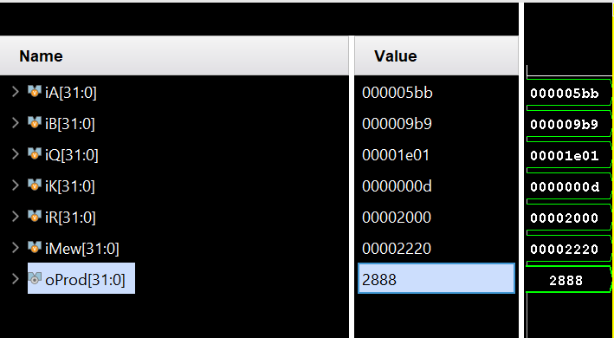
Test 1 Output (32-bit Version)
Provided by paper
Parameters
a = 1467
b = 2489
q = 7681
Expected Output:
Result = 2888
Outputs match

Slide 7
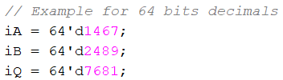
Test 1 Input (64-bit Version)
Provided by paper
Parameters
a = 1467
b = 2489
q = 7681
Expected Output:
Result = 2888

Slide 8
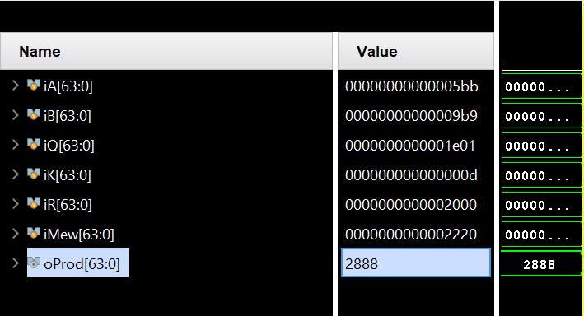
Test 1 Output (64-bit Version)
Provided by paper
Parameters
a = 1467
b = 2489
q = 7681
Expected Output:
Result = 2888
Outputs match

Slide 9


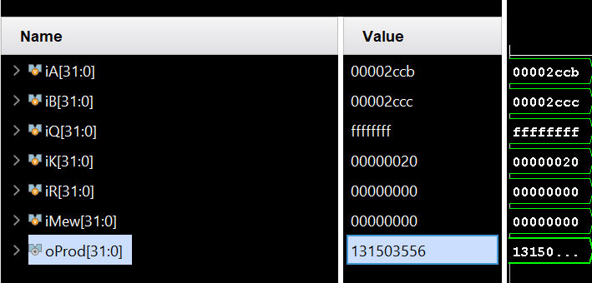
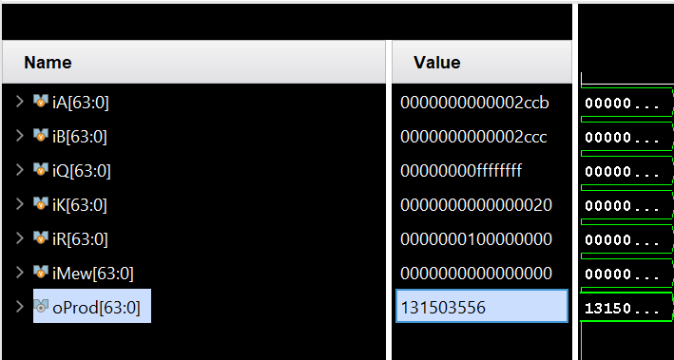
Test 2 Inputs & Outputs

Slide 10
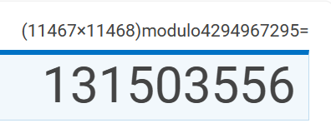
Validation of Test 2

Slide 11
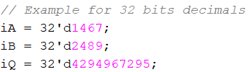
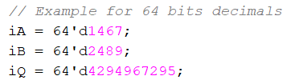
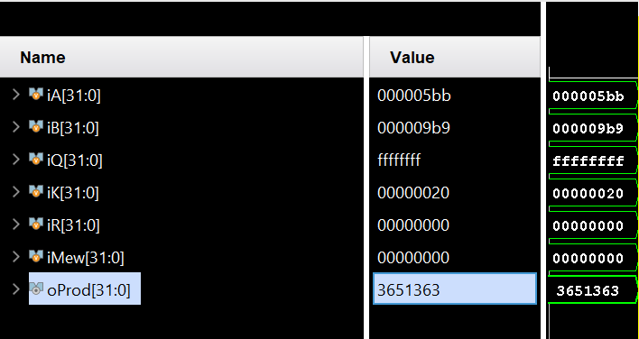
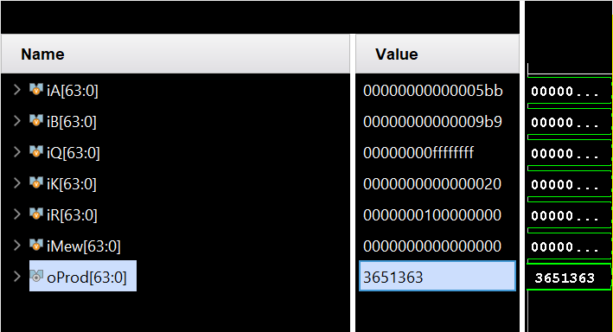
Test 3 Inputs & Outputs

Slide 12
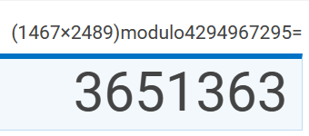
Validation of Test 3

Slide 13


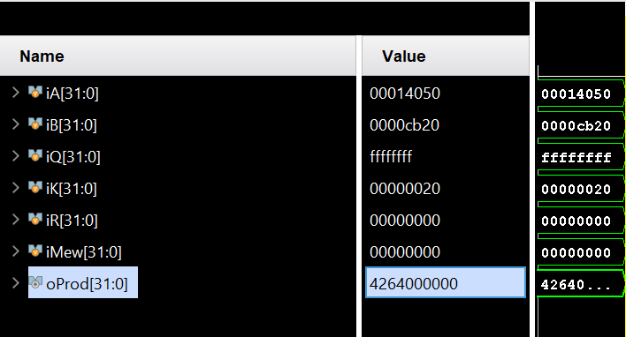
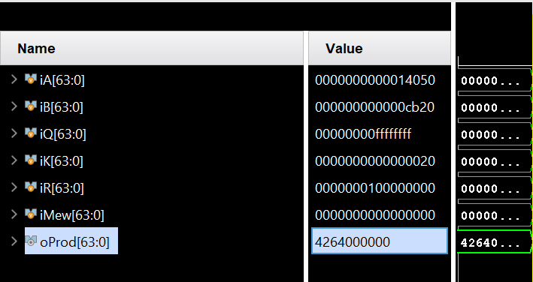
Test 4 Inputs & Outputs

Slide 14
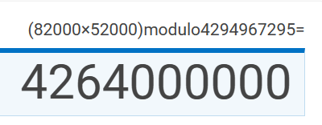
Validation of Test 4

Slide 15
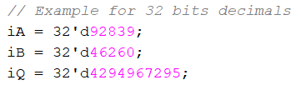

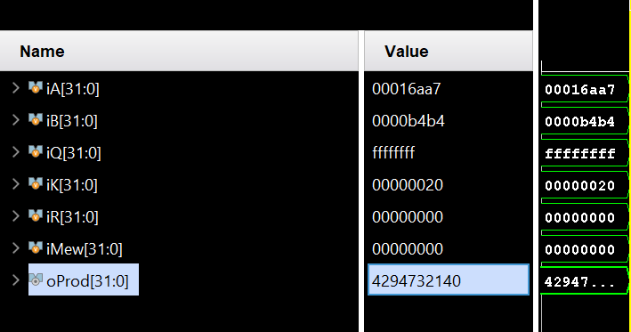
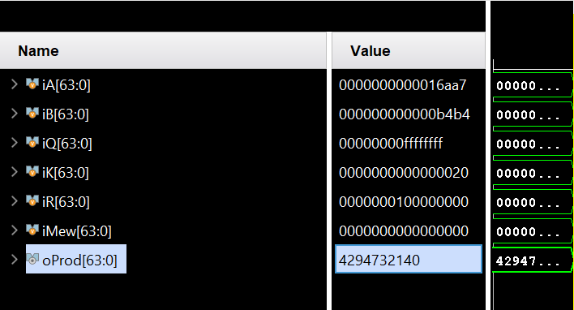
Test 5 Inputs & Outputs

Slide 16
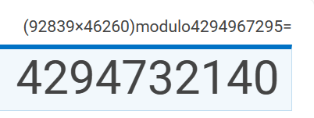
Validation of test 5

Slide 17


Test 6 Input & Output

Slide 18
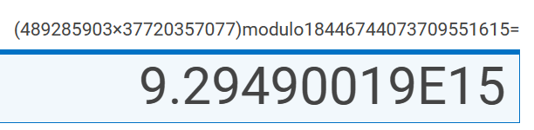
Validation of Test 6

Slide 19
Test 7 Input & Output

Slide 20
Validation of Test 7

Slide 21
Next StePS
Running and documenting multiple testbenches on an efficient Accumulator
Over the break goals
Serializer - convert an input with multiple words to subwords over multiple cycles (each cycle one subword)
Deserializer - convert an input of multiple subwords into a larger word over multiple cycles (each cycle one subword).
FIFO - a common first in first our scheduler
Crossbar - enable one input to go to one output every time

Slide 22



THANK YOU
FRANCISCO SORIANO
321-603-9123
fr015568@ucf.edu
www.linkedin.com/in/francisco-e-soriano

