Slide 1
The Systems Team Update
Parker McLeod and Cory Brynds
1/26/2024

Slide 2
Progress Overview
Project
Met with Asmita to discuss project implementation specifics
Implemented performance metrics per fundamental operation
Cache-References
Cache-Misses
Branches
Branch-Misses
Integrated LWE Estimator tool into profiling toolkit
Conferences
Submitted CryptOracle paper to YArch
Submitted application to UCF Student Scholar Symposium

Slide 3
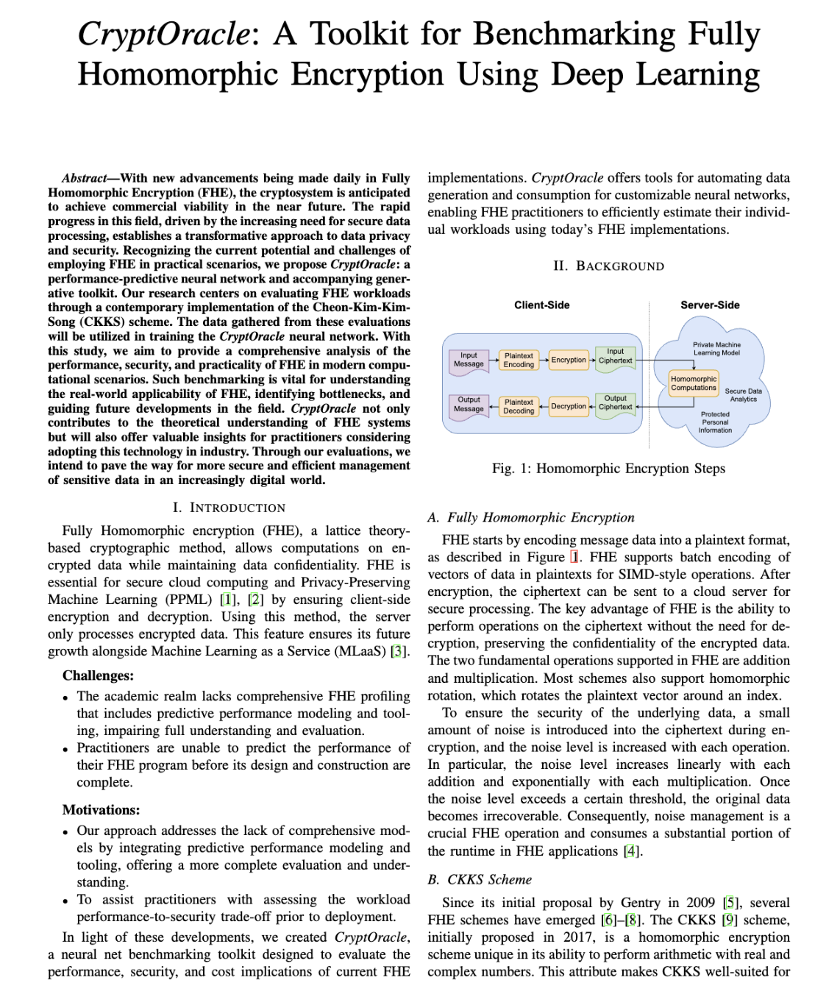
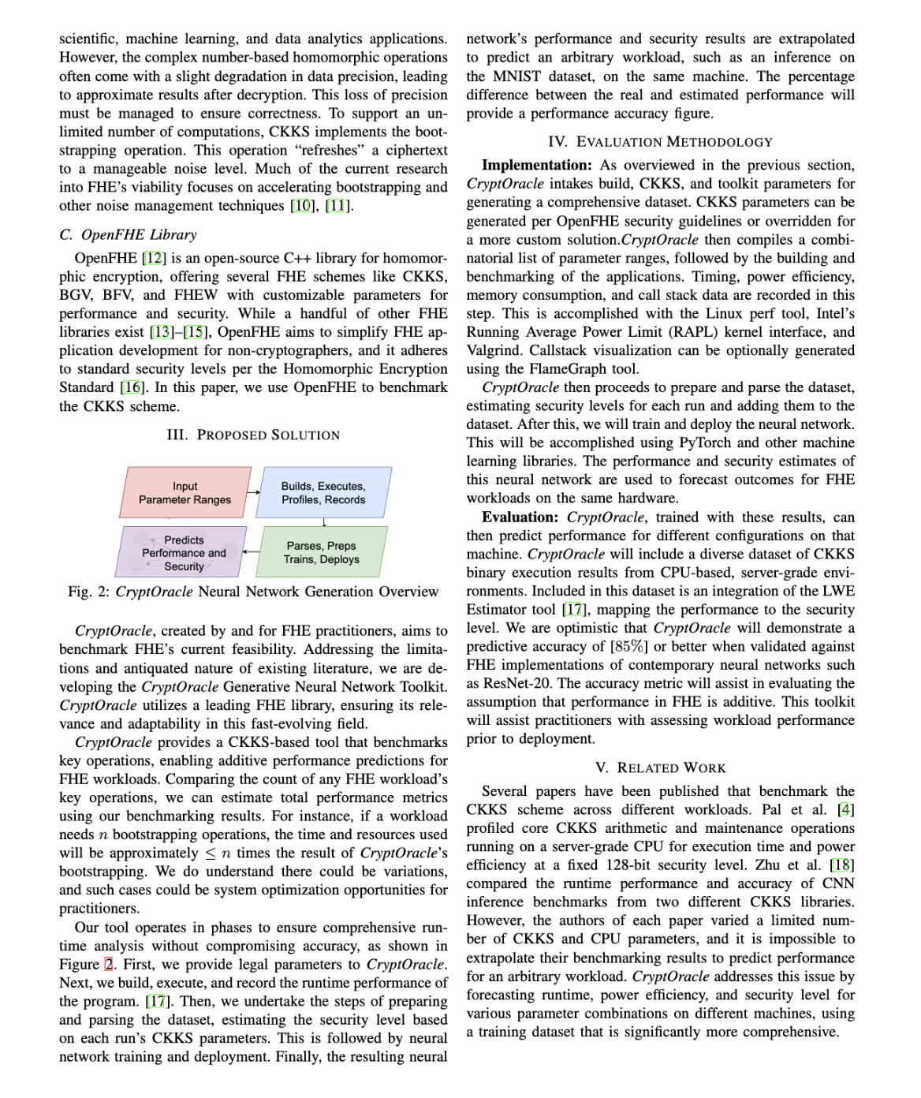
Presenting: CryptOracle

Slide 4
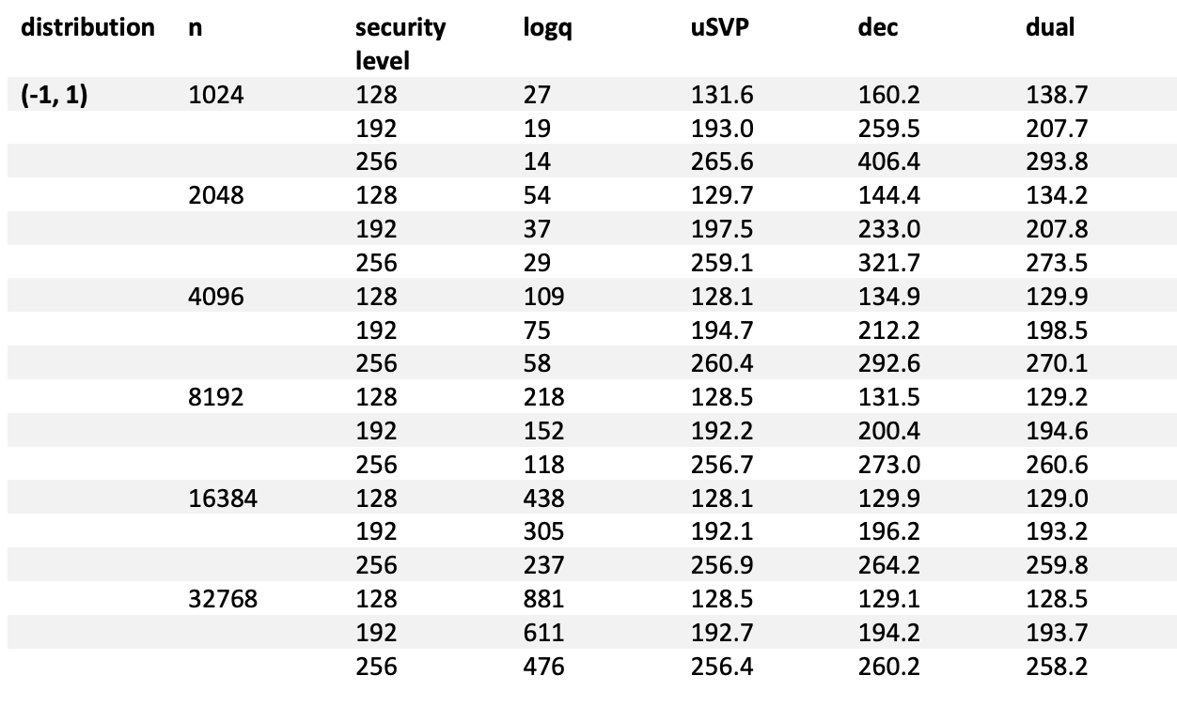
HE Security Standard
Running time (in bits) for LWE attacks
Source: Homomorphic Encryption Standard

Slide 5
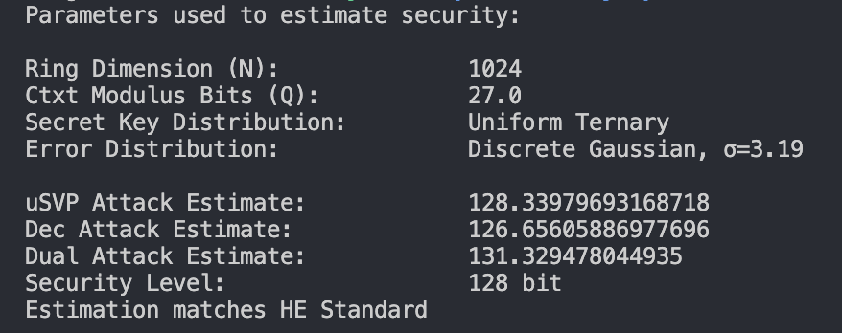
Security Estimation with LWE Estimator
Inputs:
Ciphertext ring dimension (N)
Ciphertext modulus size (Q)
Error distribution (Xe)
Secret key distribution (Xs)
Output:
Number of operations required to break encryption
Standard CKKS settings held constant during all runs

Slide 6

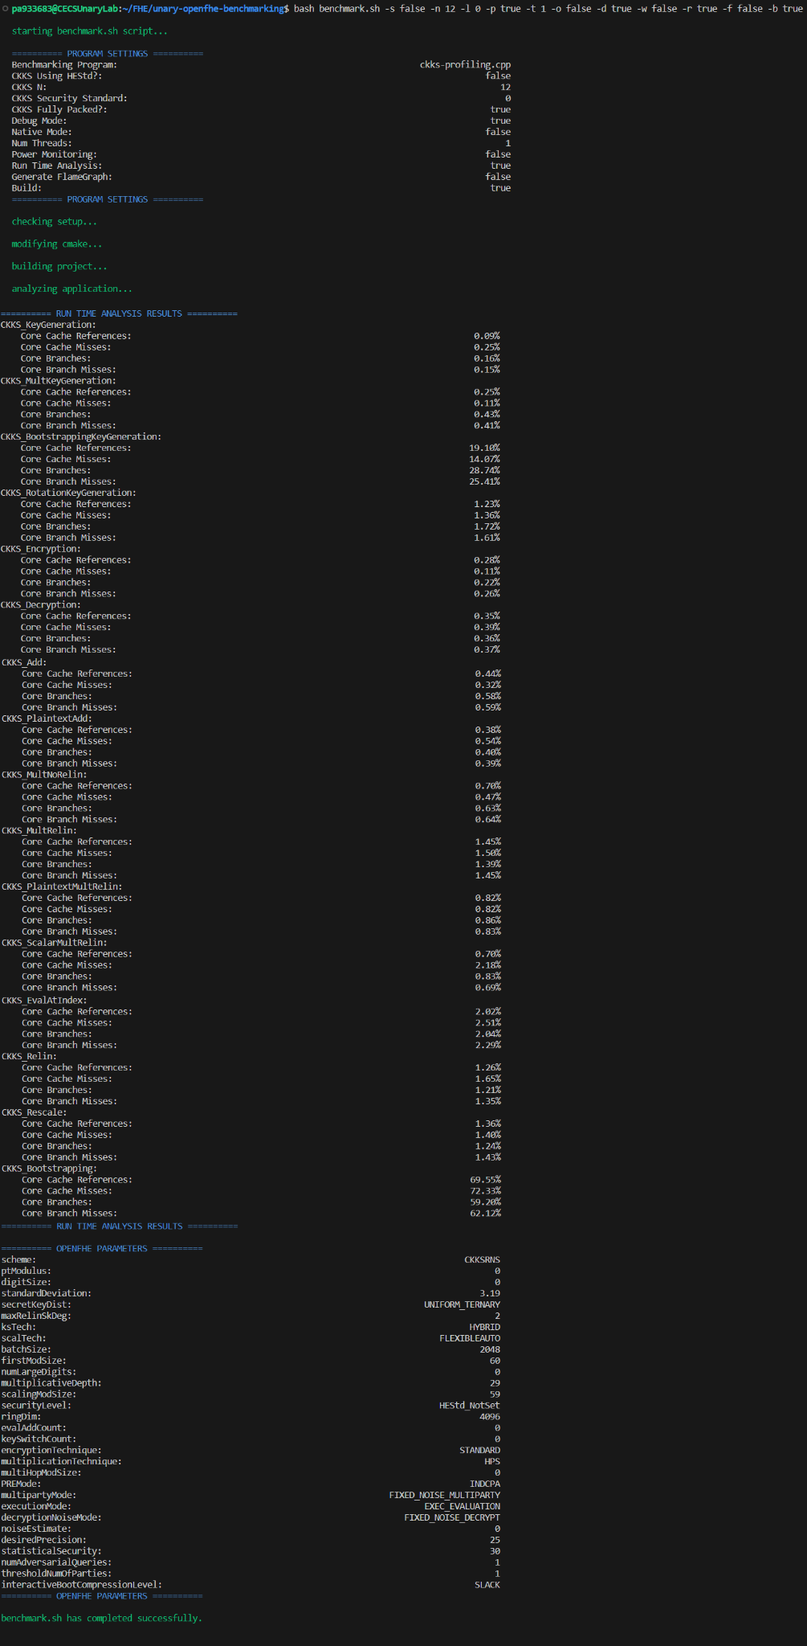
Current Terminal Output

Slide 7

Next Steps for the Systems Team
Next Steps
Parse Valgrind for memory usage per fundamental operation
Collect Bandwidth Utilization/Environment (cpu, memory, cache) information
Arithmetic intensity
Collect initial data with varied parameters and build settings
Share profiling data with Rex and an API diagram overview (and access to more processing power / varied CPUs)
Near future
Train a neural network based on the profiling data
Setup encrypted workloads to compare neural network results

