Slide 1


The Weekly John Update
John Gierlach
FHE Hardware Accelerator
ECE Department

Slide 2
Last Week Accomplishments
ASIP
Fixed bug with initial mod test
Built out functions for Tinycore2 processor
Mod
Mul
Div
Ran Butterfly code on Tinycore2 processor to see instruction calls
Discussed plans to design an ISA for an FHE-based processor
n-bit architecture
Pipelining primitive functions
FHE algorithms
Helped Francisco with Verilog Barrett Reduction

Slide 3
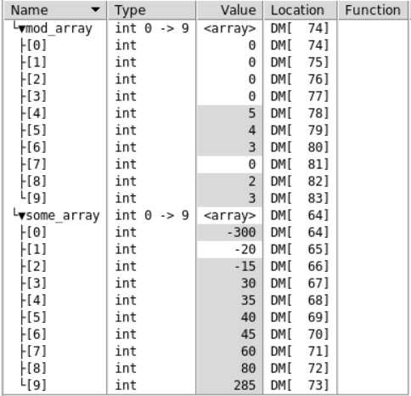
ASIP Debugging for Mod function
The main problem that I solved when going through the tinycore2 was not setting the opcode for the operation correctly & not re-building the tinycore2 architecture project (rename)
The mod operation uses the opcode (insert opcode here) to work and is declared within the nML

Slide 4
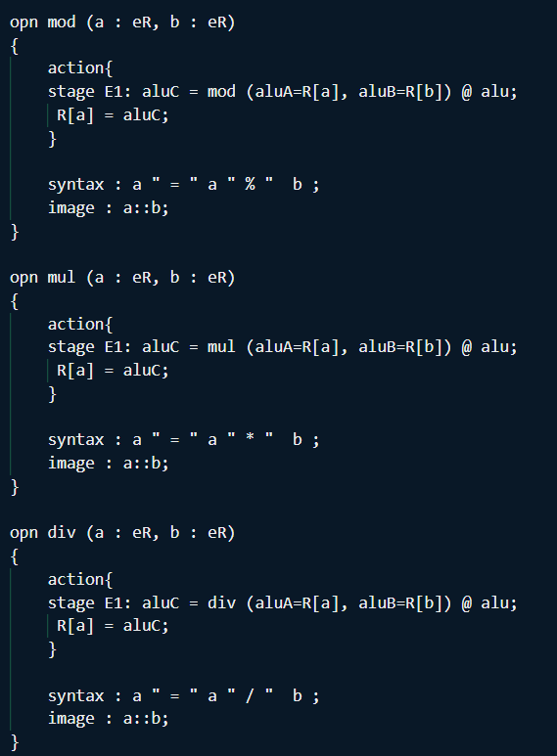
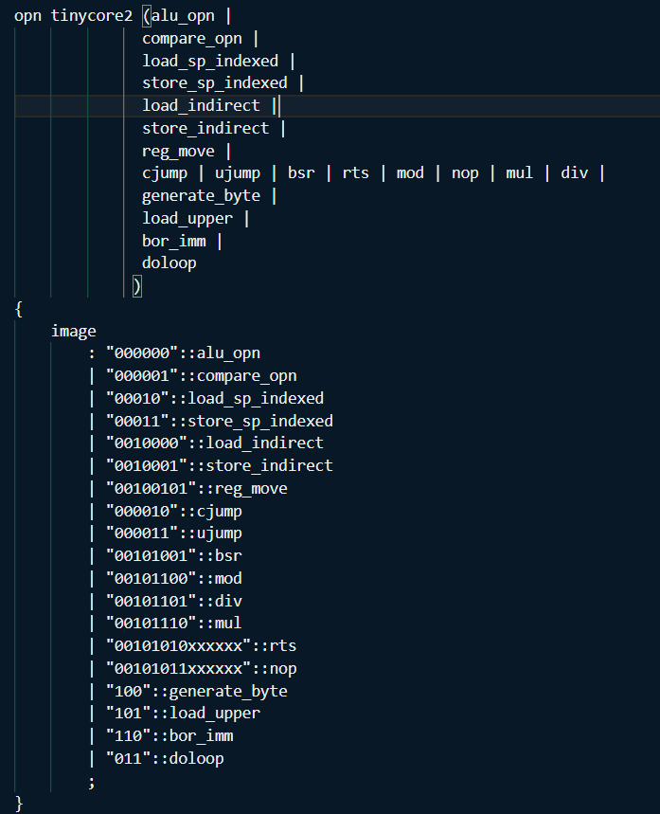
ASIP Mod, Mul, and Div Operation for Tinycore2
For the butterfly operation, multiplication, division, and modulus are needed.
As stated previously, we will need to add opcode functionality for these new instructions that is supported by the tinycore2 processor
The mul & div opcode are (mul op) and (div op) respectively

Slide 5
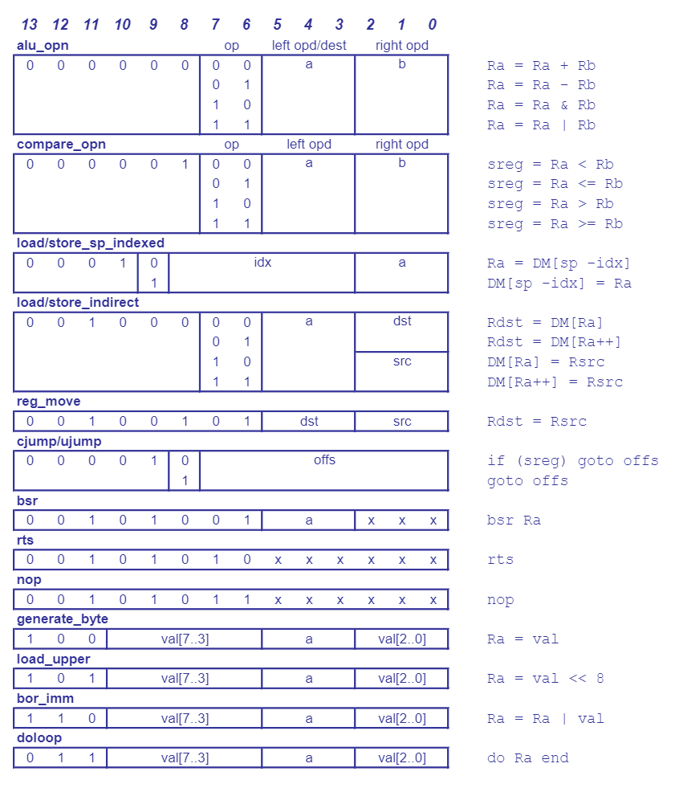
How we can create operations in nML with opcodes
We can use Tinycore2 as a model for how to create instructions and opcodes for designing our own architecture
The main ideas that we need to bring together is what algorithms we need to accelerate
NTT
Butterfly
Etc.
The branching and jumping between instructions can be mimicked from other architectures for now
Program Memory = 14 bits

Slide 6
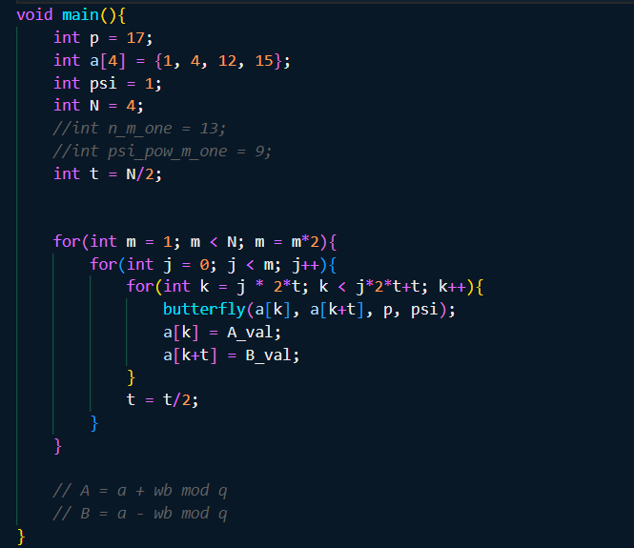
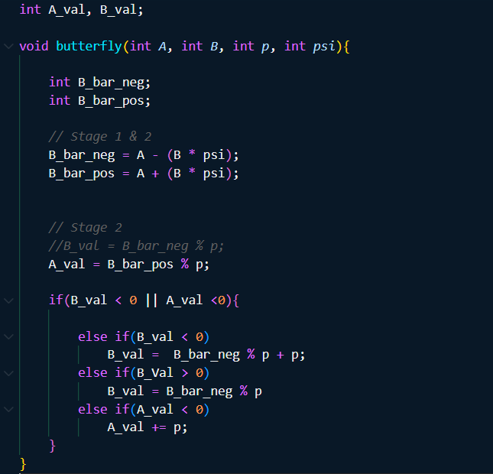
Code of Butterfly done by Tinycore2 processor

Slide 7
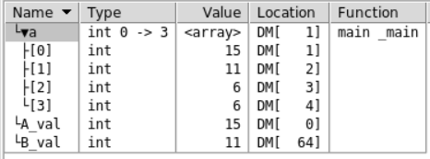

Output of Butterfly done by Tinycore2 processor

Slide 8
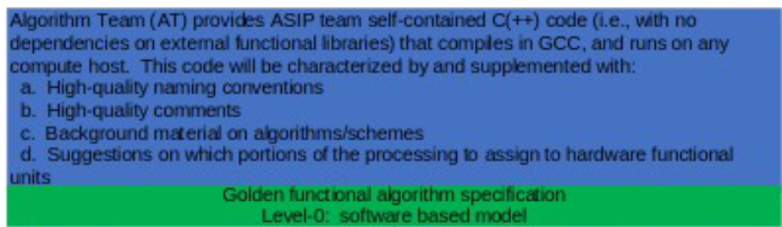
FHE ASIP Design Flow - Level 0
Level 0: Golden functional algorithm specification - software based model
Algo Team provide self-contain C/C++ code with no dependencies or external functional libraries
We must make sure that there are quality naming conventions and comments
Provided background material about

Slide 9
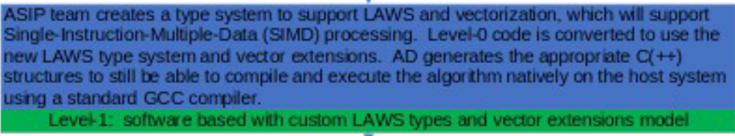
FHE ASIP Design Flow - Level 1
Level 1: Software based with custom LAWS & Vectors
Convert the Level 0 Software based model to a new LAWS type system and vector extensions
ASIP Designer will generate C/C++ code that will be able to compile and execute the algorithm natively on the host system using the GCC compiler

Slide 10
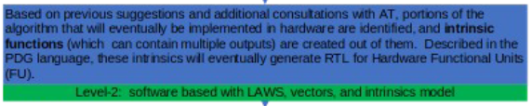
FHE ASIP Design Flow - Level 2
Level 2: Software based with custom LAWS, Vectors, and Intrinsics
Similar to level 1, some portions of the algorithm will be implemented in the hardware in the form of intrinsic functions
These intrinsic functions will be described in the PDG language which will then be turn into RTL as functionals hardware units (FUs)

Slide 11
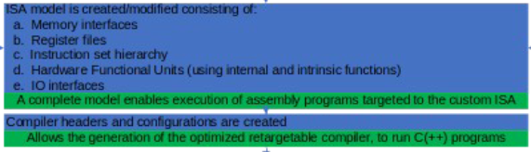
FHE ASIP Design Flow - ISA & Compiler
Custom ISA: Design ISA to support execution and assembly of programs that target our custom FHE algorithms
Memory Interfaces
Register Files
Instruction set hierarchy
Hardware Functional Units
IO Interfaces
Create Compiler headers
Allows generation of the optimized retargetable compiler, to run C/C++ programs

Slide 12
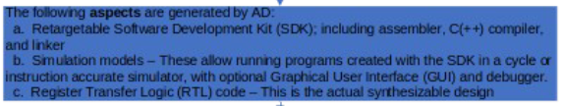
FHE ASIP Design Flow - ASIP Generation
Retargetable Software Development kit
Comes with C/C++ compiler and linker
Simulation models
Generate cycle accurate instruction simulator and debuggers
RTL
Generates synthesizable RTL design

Slide 13
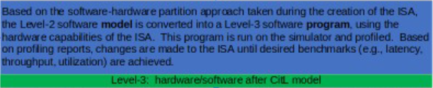
FHE ASIP Design Flow - Level 3
HW/SW Model (Compiler in the loop)
Software behavior to ISA
Convert Level 2 software model to a Level 3 software program using the custom ISA
Run & Analyze profiling reports to make any changes to the ISA until desired benchmarks are met

Slide 14
FHE ASIP Design Flow - Level 4
HW/SW Model (Synthesis in the loop)
RTL behavior to ISA
Run & Analyze RTL output to make any changes to the ISA until desired benchmarks are met

Slide 15
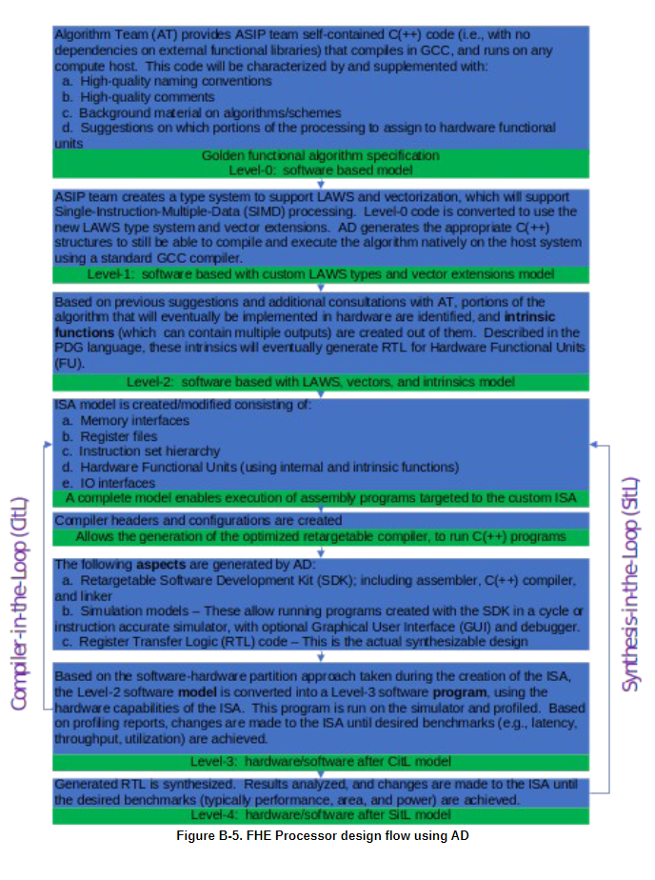
FHE ASIP Design Flow - Entire Flow

Slide 16
FHE ASIP Design Flow - Delegations
Level 0
Algo Team Exclusively
Level 1
ASIP Team and Algo Team
Level 2
ASIP Team and Algo Team
ISA & Compiler
ASIP Exclusively
Level 3
ASIP Team and Algo Team
Level 4
ASIP Team and Algo Team

Slide 17
Plans for this week
ASIP Designer
Design a specialized hardware operation for Butterfly
Attend ASIP Training virtual event on Nov. 15
Research ways to design FHE-based architecture
ASIP w/ Devaloy
Research papers
FHE Algorithms
Work with Mariam to continue to improve Butterfly C-sim to fully implement Cooley-Tukey algorithm

Slide 18


Thank you!

