Slide 1


The Weekly John Update
John Gierlach
FHE Hardware Accelerator
ECE Department

Slide 2
Last Week Accomplishments
ASIP
Attended ASIP University training
NTT application of butterfly method using montgomery reduction
Analyzed FFT Buttery application within ASIP
Research how to use intrinsics and how to design architectures around FHE
Most likely RISC-V based
32-bit or 64-bit
Algorithm
Assisted Mariam with designing code for twiddle factors to correctly go through the entire butterfly algorithm

Slide 3
Computer Security and Industrial Cryptography for Post-Quantum
Used a RISC-V processor model post quantum encryption algorithms (PKE , NTT, and Butterfly).
Used 2-way instruction-level parallelism and single instruction multiple data (ILP & SMID).
Saw x5.0 increase in speedup but an x3.0 in area from the ASIP generated design
Waiting on zoom post

Slide 4
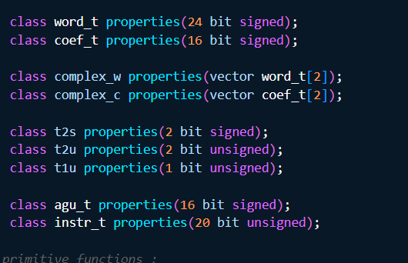
ASIP: LAWS and Vectors (C++ primitives)
Inside the processor header file is where we can define the LAWS and vectors needed based on the software model provided
There will be the essential building blocks for our intrinsic functions, ASIP software model, and primitive functions

Slide 5
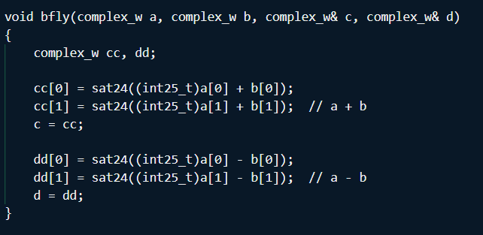
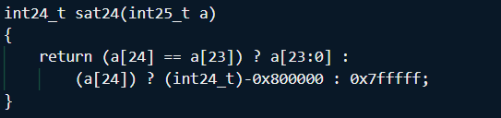
ASIP: Complex Primitives (PDG File)
When using ASIP we can make advanced primitives that allow us to make intrinsic functions for FHE algorithms
In this case, a butterfly algorithm is made for FFT (bfly) which calls the int24_t sat24 function
Based on an ideal integer size (Q & N values) we can create the word size parameters for our PDG primitives

Slide 6
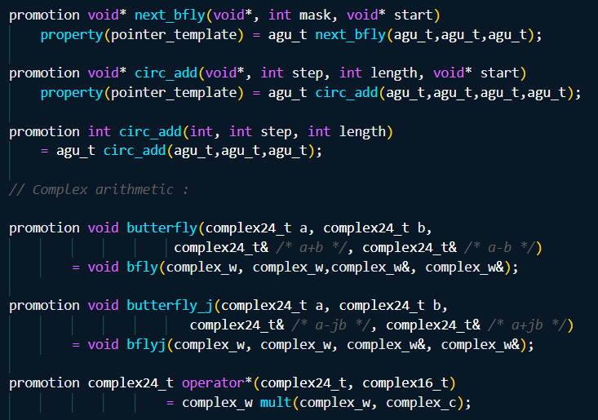
ASIP: Intrinsics (C++ Chess properties)
Writing these intrinsic functions allows us to write C code that will behave natively
This means we can write a test program directly to our hardware to analyze the cycle times, memory accesses, and more

Slide 7
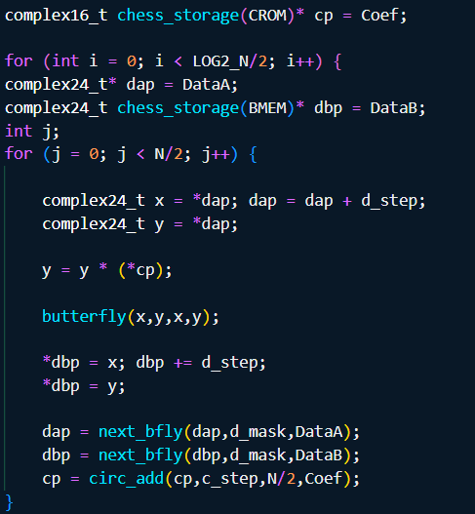
ASIP: Test code using Intrinsics
In this example, we have an exampek code that is calling the intrinsic functions that allow the test code to directly use the hardware primitives of the processor
Using this methodology would be best going forward for the design of our FHE accelerator

Slide 8
Plans for this week
ASIP Designer
Continue to research FFT based butterfly to understand ASIP design for FHE algorithms
Review NTT application within ASIP via the recorded videos
Analyze 32-bit and 64-bit RISC-V processor models in ASIP
FHE Algorithms
Work with Mariam to continue to improve Butterfly C-sim to fully implement Cooley-Tukey algorithm

Slide 9


Thank you!

