Slide 1
verilator

Slide 2

What is Verilator?
Compile HDL into a much faster optimized and optionally thread-partitioned model, which is wrapped inside a C++/SystemC module
(Snyder, W. 2003)
Notes:
But it do not direct translate HDL to systemC or C++, the HDL is turned wrapped inside a C++/SystemC module
This module can be instantiated and tested by a C++ or SystemC test code

Slide 3

Advantage
Performance
A single thread
over 10x faster than standalone SystemC
100 times faster than interpreted Verilog simulators such as iVerilog
Open-source
Support multithread
Using C++ and systemC
Error Checking and Optimization
(Snyder, W. 2003) (Kremeris, N 2021)
Notes:
Performance -> making it ideal for large or complex designs
closed-source Verilog simulators (e.g., Aldec Riviera-Pro, Cadence Incisive/NC-Verilog, Mentor ModelSim/Questa, Synopsys VCS, VTOC)
Open source and free
Open-source and performance make it become widely used in the industry
includes powerful linting and static analysis capabilities that help catch design issues early in the development cycle
In fact, it will not accept most non-synthesizable code, tt will force you to write better code for synthesis, then you will have fewer problems in the development process

Slide 4
Recommended setup for MacOS
XCode Command Line Tools(xcode-select --install)
Ninja
Homebrew
Bison
Flex
SystemC
GTKwave
WaveTrace
(K0nze, 2024)
Notes:
Ninja used to compile SystemC scatch
Homebrew used to compile GTKwave
Bison is a parser generator that is needed to parse Verilog files by Verilator flex is a lexical analyzer generator which is also needed by Verilator
SystemC is used for hardware system-level modeling
Test benchs are written in C++ using SystemC

Slide 5
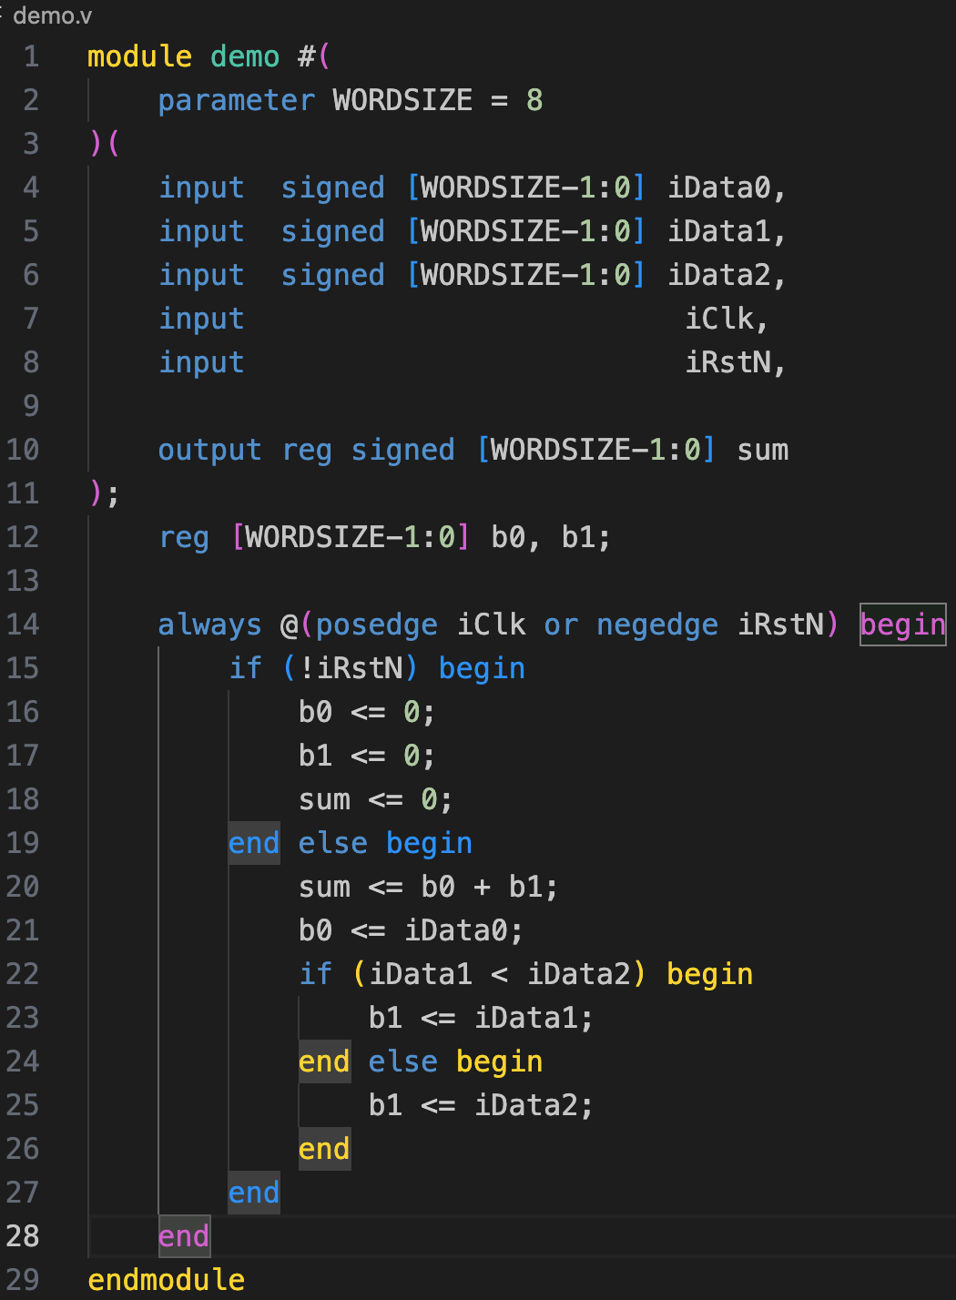
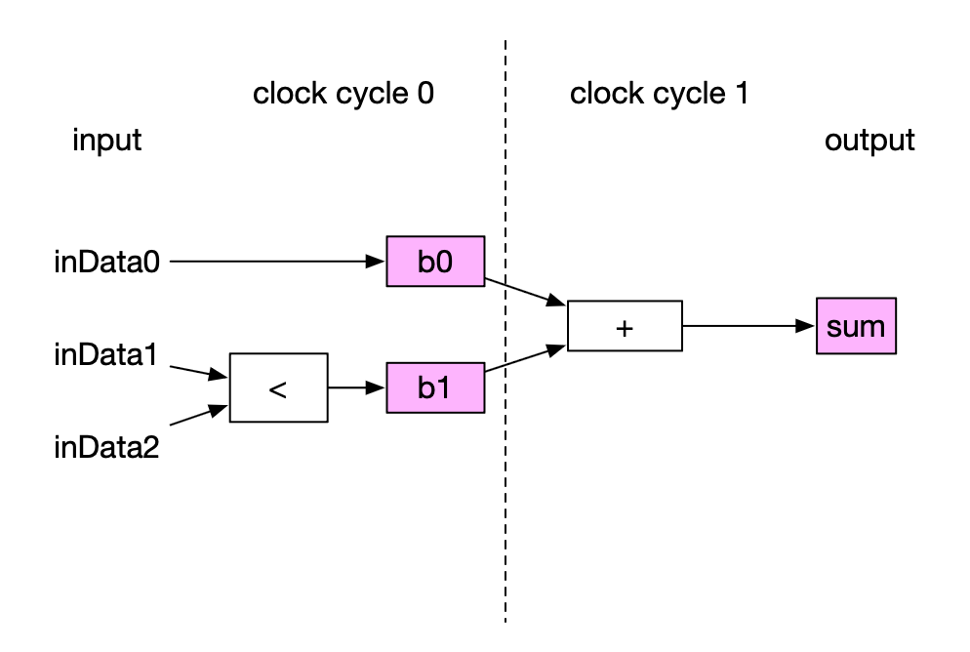
Basic Usage & Workflow
Hardware design:

Slide 6
Demo
verilator -Wall --trace --cc demo.v --exe tbDemo.cpp -GWORDSIZE=16
make -j -C obj_dir -f Vdemo.mk Vdemo
./obj_dir/Vdemo
Notes:
-Wall: enables all warning messages
--trace: enables tracing support, which allows the simulation to record waveform data
--cc demo.v: convert the Verilog file demo.v into a C++ model
--exe tbDemo.cpp: compile the C++ test bench file tbDemo.cpp along with the generated model
-GWORDSIZE: change parameter in the module
-j allows multiple jobs to run simultaneously,
-C option tells Make to change into the directory obj_dir before executing
-f Vdemo.mk directs Make to use the file Vdemo.mk as the makefile
Vdemo target specified in the makefile that you want to build

Slide 7
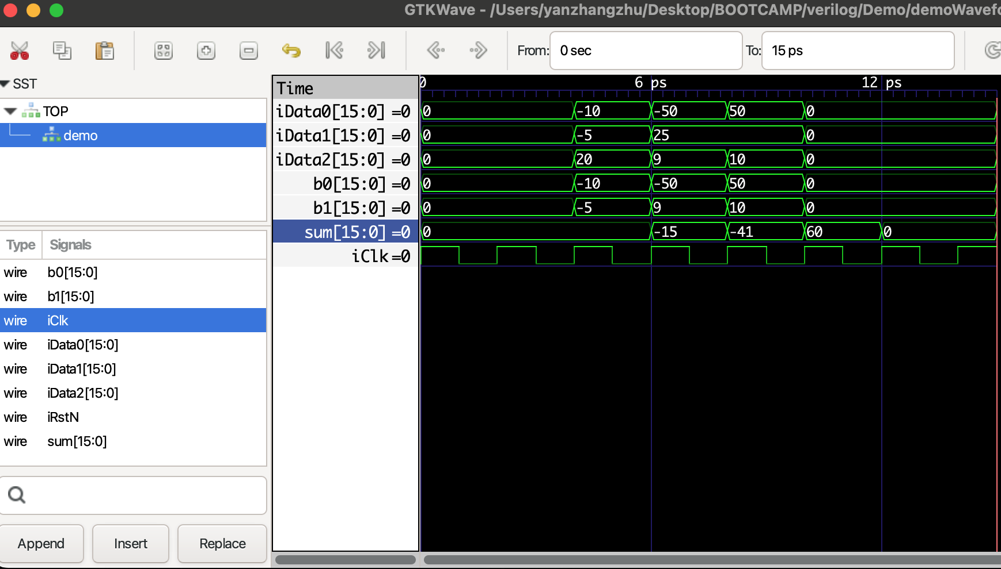
GTKWave

Slide 8
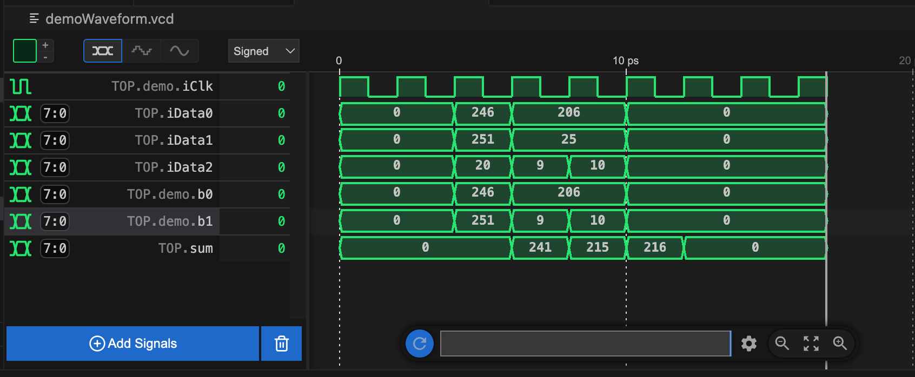
WaveTrace
Notes:
Signed values do not func properly

Slide 9
Detail installation process
Mac:
https://www.youtube.com/watch?v=Z0JxWjWCApA
Ubuntu:
https://verilator.org/guide/latest/install.html
Windows:
https://www.youtube.com/watch?v=_VYv4MZmKR0

Slide 10
Installation problem(MacOS)
fatal error: 'Vsimulator.h' file not found
Update the Xcode command line tool and Xcode
Check the newest version: softwareupdate --list
Install the newest version: softwareupdate --install -a
Unable to install system C
Update the ninja: brew upgrade ninja

Slide 11
citation
Snyder, W. (n.d.). Veripool. https://www.veripool.org/verilator/
Kremeris, N. (2021, June 13). Verilator pt.1: Introduction. It’s Embedded! https://itsembedded.com/dhd/verilator_1/
K0nze. (2024, January 30). Verilog Development on Apple Silicon Macs (M1/M2/M3) - A Step-by-Step guide to setting up Verilator, SystemC and GTKWave on MacOS. k0nze. https://k0nze.dev/posts/verilog-apple-silicon/

