Slide 1
Institute for Risk Management & Insurance Innovation (IRMII)
Severe Convective Storms Discussion
April 21st, 2025

Slide 2
Severe Convective Storms
Severe convective storms (SCS), represent an increasingly significant threat to communities and insurers alike.
SCS encompasses hail, tornadoes, and straight-line winds.
Unlike hurricanes, which occur infrequently but with devastating impact, SCS events manifest as "death by a thousand cuts".
More frequent, geographically dispersed events whose cumulative losses have been rapidly escalating in recent years.

Slide 3
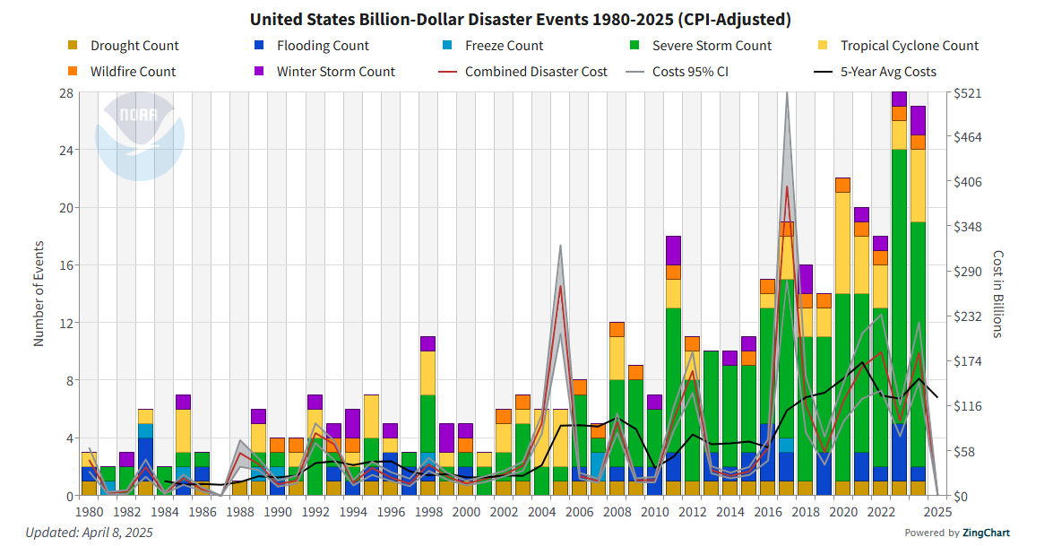
Climate Disasters

Slide 4
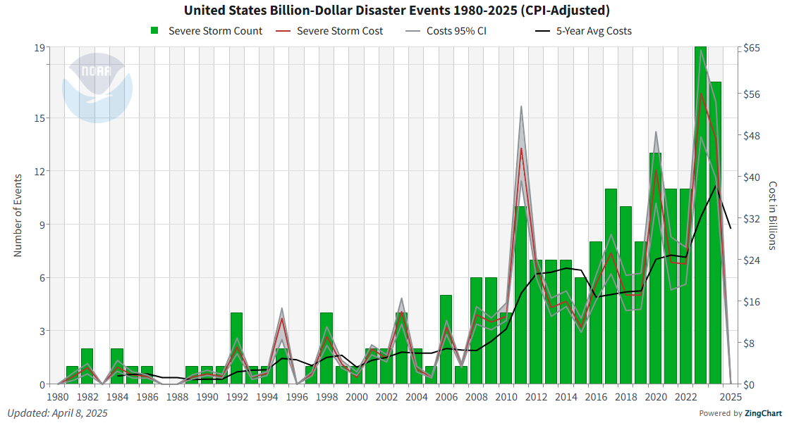
Severe Convective Storms

Slide 5
Severe Convective Storms
SCS events categorized as a "secondary peril" within Property & Casualty insurance lines, pose an ever-growing risk to residential properties across large parts of the American Midwest, Plains, and the South.
This rapid increase in associated losses has created urgent challenges for property owners and insurers alike

Slide 6
SCS Research Questions
The IRMII Severe Convective Storm Project is dedicated to understanding the fundamental drivers behind this growing risk profile and developing practical solutions:
Hazard vs. Exposure Analysis: Determining whether increasing losses stem primarily from changes in storm frequency/intensity or from expanding human development in vulnerable areas
High-Resolution Risk Modeling: Developing advanced models that operate at finer spatial and temporal scales to better capture SCS behavior and impacts
Real-Time Loss Estimation: Creating capabilities to model and assess losses in near real-time, enabling more responsive disaster management and insurance practices
Financial Risk Mitigation Tools Development: Creating practical financial tools and methods to reduce and transfer SCS risk across the industry

Slide 7
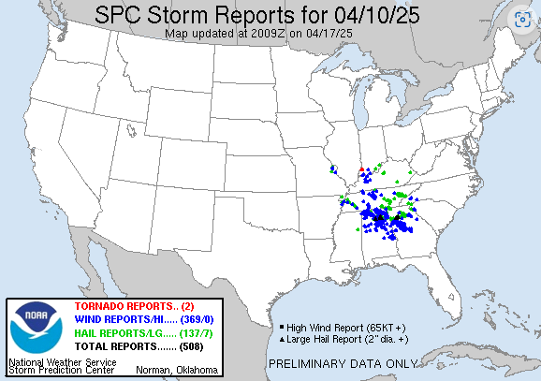
SCS Storm Reports Database
NOAA Storm Report Database will serve as the primary dataset for this project
Consists of tornado, hail and wind reports

