Slide 1

Bat Echolocation Detection
Bety Rostandy
Hadi Soufi
Kevin Keomalaythong
Thien Le
Yang Peng
CSC 505 | 09.12.2018
Notes:
everyone

Slide 2
Outline
Related Work
Goals
Overview
Data Desc.
Tasks
Notes:
Thien

Slide 3
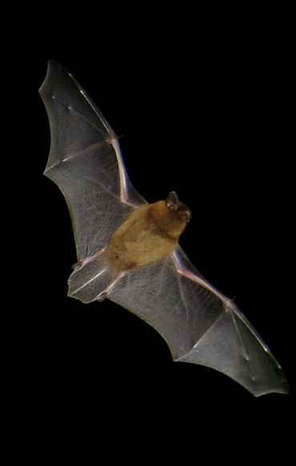
Overview
This project aims to categorize and identify bat calls for use in future scientific research.
These bat calls are recorded from over 100 sites across NC, including the UNCG wetlands. This generates hundreds of thousands of recordings.
Notes:
Bety-main / Kevin - part
Frequency recordings of bat calls at over 100 sites across the state or NC, including at the UNCG Wetlands. This generates hundreds of thousands of recordings, and extracted information from the recordings on bat species, and other behaviors like the production of social calls. •

Slide 4
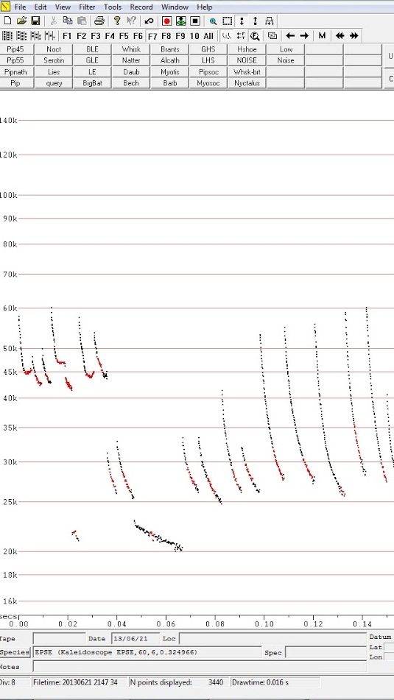
THE DATA
We will be working with bat calls stored in Zero-Crossing form.
In ZC form, the dominant frequency sweep of a pulse is easily visible.
Notes:
How is the data collected and what they are - Thien
---There are microphones set up all around nc for about a year.
---Use the kaleidoscope program to convert audio files to the zero crossing. We use the Analook program to observe those files.
---Frequency recordings of bat calls at over 100 sites across the state or NC, including at the UNCG Wetlands. This generates hundreds of thousands of recordings, and extracted information from the recordings on bat species, and other behaviors like the production of social calls. • The data is processed into a graph in which the dominant frequency sweep through time can be easily visualized. It’s stored as bytes which contain the time and frequency intervals between each point on the graph.
The challenges - Hadi

Slide 5
Goals
Extraction
Clustering
Classification
Extract meaningful signal from noise
Cluster the extracted calls into different types using clustering techniques
Classify if a Bat Echolocation(zero-crossing files) contains abnormal calls(i.e. social calls, foraging calls).
Notes:
Yang
To develop a method to automatically detect if a Bat Echolocation(zero-crossing files) contains abnormal calls(i.e. social calls, foraging calls).

Slide 6
Tasks - Yang Peng
Completed:
1. Did background study about Bat Echolocation and raw data;
2. Learned AnalookW and Anabat format 132;
3. Decoded the sample raw data using R and import to python.
To-do:
1. Data preprocessing ;
2. Bat Echolocation Classification;
3. Bat Calls Clustering (if time permitted).
Notes:
librosa data visualization package

Slide 7
Tasks - Thien Le
Completed:
1. Get familiar with Python and Github;
2. Do background study about the dataset
3. Observed the raw data through AnalookW
To-do:
1. Prototype of what a prototype should look like
2. Front end Designer
3. GUI
Notes:
librosa data visualization package

Slide 8
Tasks - Bety R
Completed:
1. Research background information about raw data;
2. Research data processing with automated algorithm;
3. Create workflow for tasks requirement.
To-do:
1. Perform available R-package and AnalookW data extraction;
2. Comparison of extracted information to make proceeding suggestions;
3. Automate the data extraction procedure or generate best practice procedure.
Notes:
librosa data visualization package

Slide 9
Tasks - Kevin K
Completed:
1. Brainstormed and analyzed all available algorithms for sorting through the data
2. Compared between algorithms based on the time taken to implement
3. Selected a suitable algorithm
To-do:
1. Determine the x- and y-axes of the data
2. Use a mathematical model based on slope calculation to determine a general direction of a curve
3. Use slope information to sort each curve into normal and abnormal groups
Notes:
librosa data visualization package

Slide 10
Tasks - Hadi S
Completed:
1. Learned AnalookW
2. Got familiar with Python and Github
3. Designed an algorithm for noise filtering
To-do:
1. Implement noise filtering algorithm
2. Research clustering algorithms
Notes:
librosa data visualization package

Slide 11
Related Works
Bat detective—Deep learning tools for bat acoustic signal detection
“We developed a convolutional neural network based open-source pipeline for detecting ultrasonic, full-spectrum, search-phase calls produced by echolocating bats. Our deep learning algorithms were trained on full-spectrum ultrasonic audio collected along road-transects across Europe and labelled by citizen scientists from www.batdetective.org. “ LINK
Notes:
Kevin

Slide 12

THANKS!
Any questions?

