Slide 1
G-SUITE METRICS CSC 505/605 Fall 2019
By: Advisor :
Lavanya Goluguri Dr. Somya Mohanty
Anusha Vanama Mentor:
Jackie Cuong Nick Young Henry Reichard
Hieu Vo

Slide 2
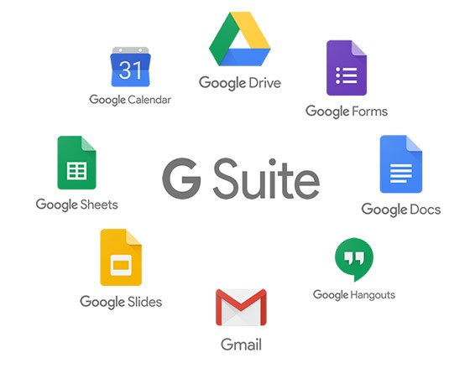
PROJECT OVERVIEW
G Suite is a set of cloud computing, productivity and collaboration tools, software and products developed by Google.
G-suite services include Google Accounts, Google Calendar, Google Hangouts, Gmail, Google+, Google drive/docs etc.
It gives us information about G-suite services usage, for all the users across an entire domain. Here the data is collected for the UNCG users.

Slide 3

OVERALL GOAL OF THE PROJECT
The Main goals of the project are:
- Basic Data Analysis.
- Finding Anomalies, Trends and Patterns in data.
- Predictive Analysis
- Dynamic Dash board development for Data Visualization using Google data studio.

Slide 4

QUESTIONS ASKED
We have followed a step by step procedure in which our questions are different at different steps.
Is there any correlation between two metrics?
In hypothesis testing – Is the drive: num_forms_created_ similar to the num_forms_edited ?
In Machine learning, Can we predict the data for this metric, can we do classification or clustering on the metrics?

Slide 5
RESEARCH OBJECTIVE
Our research objective for this project is develop a model for UNCG ITS, in such a way that they can use this in future for G-Suite data analysis or predictions.
To develop a dynamic dashboard model for ITS for its G- Suite data for better visualization.

Slide 6
TASKS FOR EACH MEMBER
We have broken down the tasks in such a way that each of work with a metric to do data analysis and predictions
Anusha : Google Meet
Lavanya : Google Drive
Henry : Google Mail
Jackie : Google Calendar and Dashboard development
Hieu : Google Accounts and Dashboard development

Slide 7
DATA DESCRIPTION
The data set size is 611,914 rows x 3 columns.
Data is from March 23rd , 2015 to August 17th, 2019. It has three attributes:
Time: The day for which the data is collected. (format: yy-mm-dd hr:min:sec:msec)
Metric_Name: it is name of the google service used with their parameter.
Metric_Value : It is no. of. Users the metric has on that day.
We have reshaped the data into separate data set for each metric.
Drive data set 831 rows X 144 columns.
Gmail data set 1545 row X 28 columns

Slide 8
METHODOLOGY TOWARDS RESEARCH OBJECTIVE
ACQUIRING THE DATA – We have extracted the data sets from the raw data .
DATA CLEANING – Nan values, zeroes, Missing data.
BASIC STATISTICS - Min, Max, Mean, Standard deviation of a attribute.
ADVANCED STATISTICS – Distribution Modelling, Point estimates, Correlation, Hypothesis Testing.
MACHINE LEARNING – Time series Analysis.

Slide 9
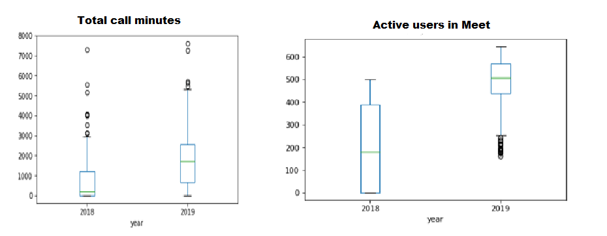
RESULTS
BASIC STATISTICS AND INSIGHTS

Slide 10
RESULTS
Advanced Statistics - Distribution Analysis and Insights

Slide 11

Statistical evaluation of data
Google Meet:
Maximum number of calls are 159 calls recorded on 2019-03-21.
Maximum number of meetings are 39 meetings recorded on 2019-03-21.
Observed that more number of calls and meetings are scheduled during fall advising period which was started on March 18th 2019.
Google Calendar:
1 outlier
May 4 2018 - 10979 daily active users
Cause?

Slide 12
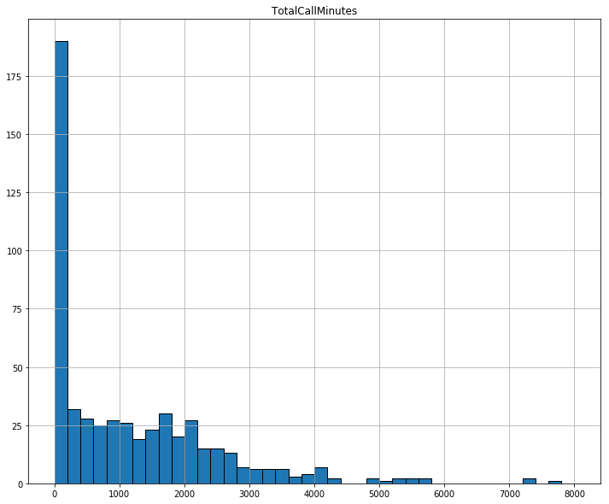
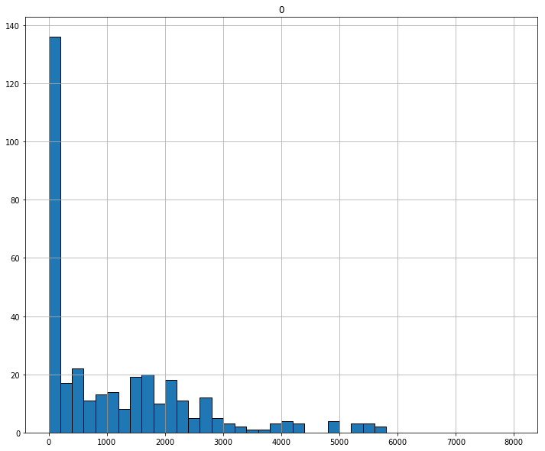
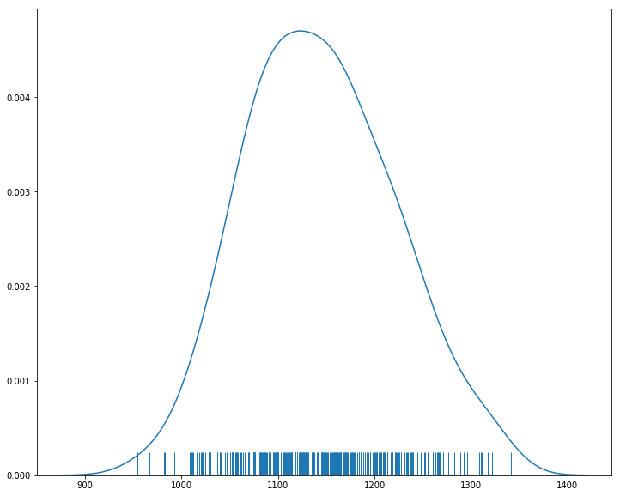
Point Estimates
Used Point estimates to estimate the mean of total call minutes for all days
Point estimate based on a sample of 400 observations overestimated the true call minutes mean by 22.560137 minutes and the distribution is not normal for sample data as well.
Created a sampling distribution by taking 300 samples from our call minutes data and then making 300 point estimates of the mean.
The sampling distribution appeared to be normal after applying Central Limit Theorem and the mean of the sampling distribution approached the true mean, there is only a difference of 3 minutes

Slide 13
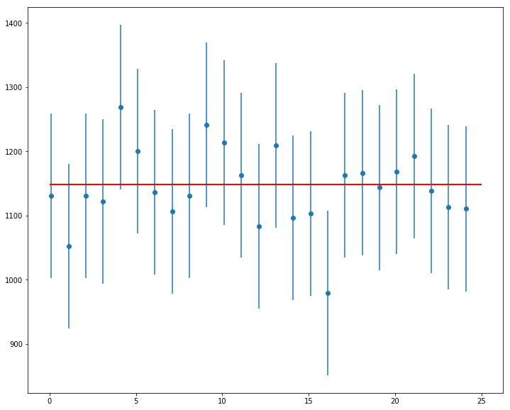
Confidence intervals
The confidence interval we calculated is very close the true call minutes mean of 1148.051565. 24 out of 25 Samples overlapped the red line marking the true mean in a 95% confidence interval.

Slide 14
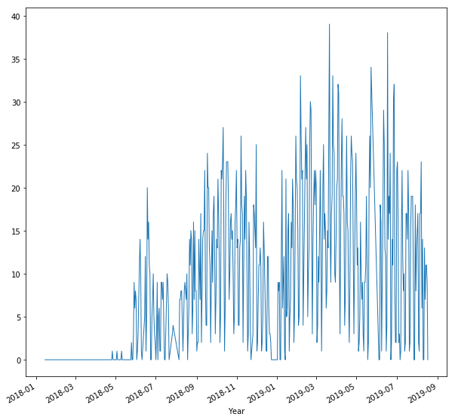
Distribution modeling
Observed that google meet application usage is very less in UNCG from Jan 2018 to June 2018. Metric values are 0 for most of the days. Eg: Number of meetings held using google meet is 0 for 159 days out of 543 days.

Slide 15
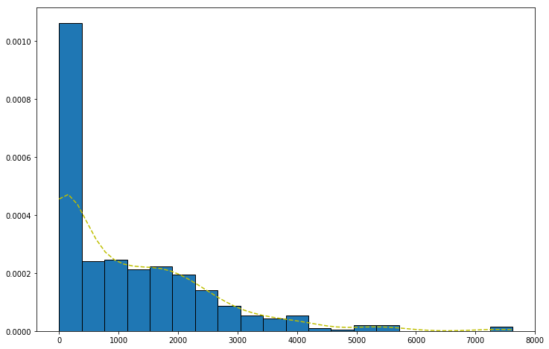
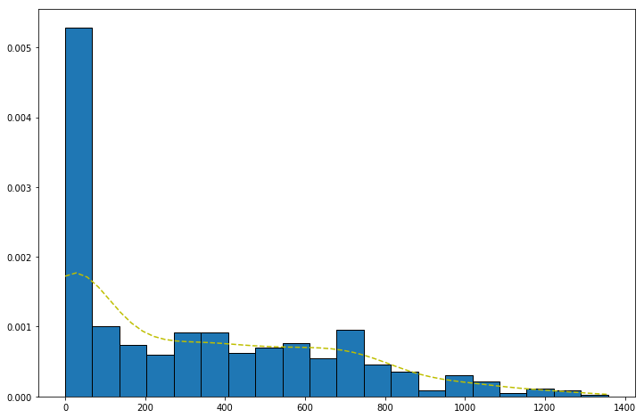
Google Meet Distributions
Plotted Total Call Minutes data using Histograms to observe what sort of distribution will fit my data. It followed exponential distribution.
Kernel Density Estimator is used to find probability density function (PDF) for Total Call Minutes and Total meeting Minutes data.

Slide 16
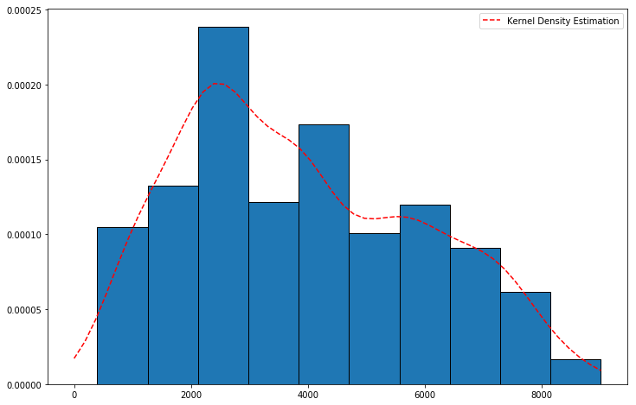
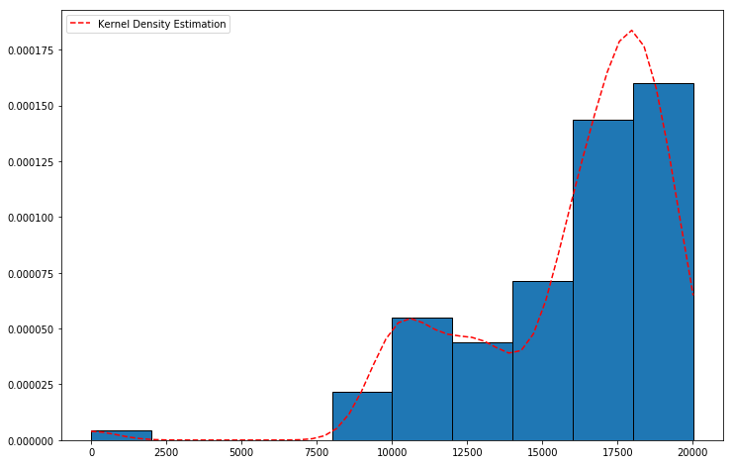
Google Drive Distributions
Both the 1day_active_users and 30day_active_users data is discrete so that distribution fit for both is Poisson distribution.

Slide 17
Correlation and Co-variance within the data
Correlation and Co-variance describe how two random variables are related.
Gmail:
Emails received and emails sent correlation: .95
Emails receive and inbound non spam emails correlation: .88
Emails sent and inbound non spam emails correlation: .83
These correlations are very strong since it very close to 1.
Google Meet:
Correlation of Android and Total: 0.23, Correlation of iOS and Total: 0.51.
Google Drive:
The 1day_active_users and 30day_active_users have a correlation of 0.45.
There is only a slight correlation between the two, It is not like every time there is a growth in 1day active users, there is growth in 30day active users.

Slide 18
Hypothesis Testing
One Sample t-test - A one-sample t-test checks whether a sample mean differs from the population mean.
Two Sample t-test - A two-sample t-test investigates whether the means of two independent data samples differ from one another.

Slide 19
Gmail Hypothesis
Hypothesis: The number of the 1 day active users in December is smaller when compared to active users for the overall year.
1 sample t test: mean of 1 day active users in December (sample) compared to mean of the 1 day active users for overall data(population).
Result: The p value is 1.22800432e-10, which is <0.05 which means we to reject the null hypothesis. Since the mean for December is 14764 and the mean for overall data is 17342, and the p value is much less than 0.025 it is concluded that month of December has less active users.

Slide 20
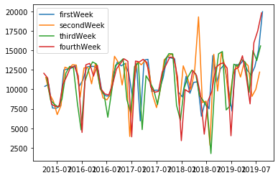
Calendar Hypothesis
Hypothesis: The third week of the month has a significant difference to the rest of the weeks.
T-test: mean of third week compared to mean of rest of the weeks
Result: p-value of 0.27, is greater than 0.05. Accept null hypothesis, concluded that third week of month is not significantly different.

Slide 21
RESULTS
Machine Learning Results
Goals: apply machine learning, specifically time series analysis, to G-Suite data for each service.

Slide 22
Gmail Machine Learning
Five attributes specifically picked by our mentor:
num_emails_received, num_emails_sent, num_inbound_rejected_emails, num_inbound_spam_emails, num_inbound_non_spam_emails
Other attributes of interest:
1day_active_users, num_emails_exchanged, inbound_delivered_emails, outbound_rejected_emails

Slide 23
Gmail Machine Learning
Gmail Machine Learning Summary:
Accurate 1-year predictions for majority of the attributes predicted.
MAPE was around 6%-25%
Fb Prophet found a declining trend for majority of Gmail attributes except for 1-day users. Maybe users are sending less emails, but the amount of users are growing.
2 anomalies found with inbound_non_spam_emails and inbound_rejected_emails.

Slide 24
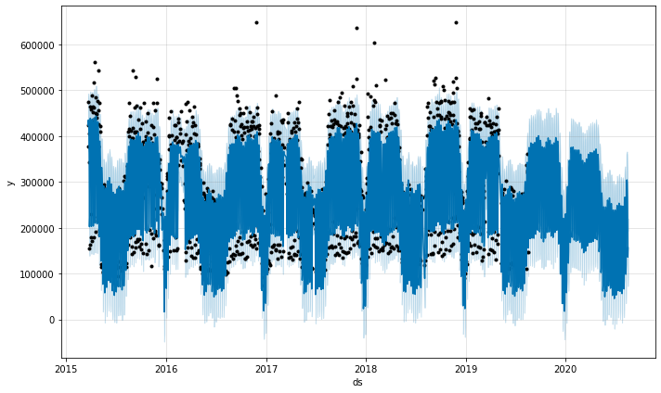
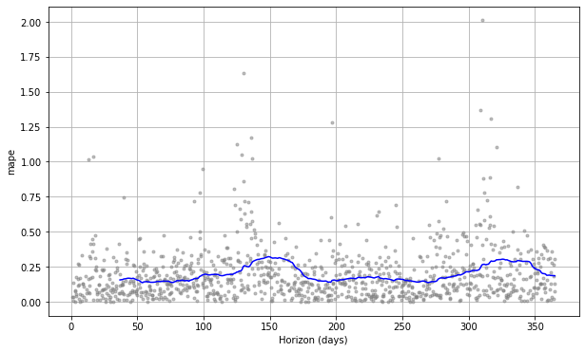
Gmail Machine Learning
Attribute emails_receive prediction and MAPE

Slide 25
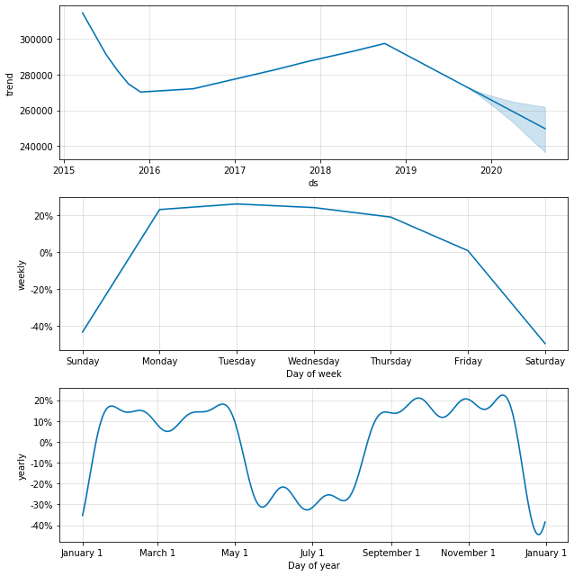
Gmail Machine Learning
Attribute emails_received trends

Slide 26
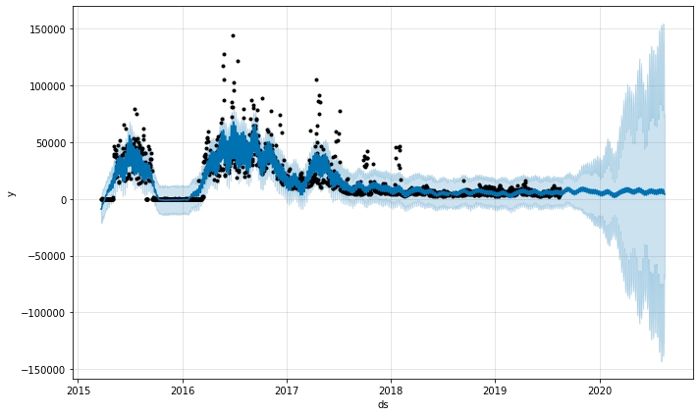
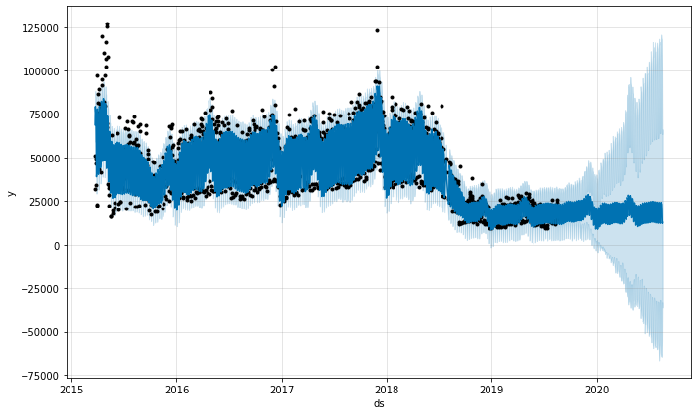
Gmail Machine Learning
Attributes with anomalies: inbound_non_spam_emails and inbound_rejected_emails. MAPE at the end of the prediction is over 100 or 300%!

Slide 27
Gmail Machine Learning
Explanations and Anomalies:
Why email usage (IE: emails sent or delivered) is declining when UNCG is a growing institution? Possible explanations
Students don't send emails as much as they used to 5 years ago.
People are possibly using chat more than email now.
Users using their own email instead of the school provided email, especially new users.
The anomalies found in inbound_rejected_emails and inbound_spam_emails can be explained by multiple of reasons:
First reason is that the ITS department used to be only reactive too attacks or spam but, over the years the ITS department became more proactive.
Additionally it is likely Google is doing a better job of handling rejections than they were before. The implication here is that there is progress being made to limit spam or hazardous emails and that is progress.

Slide 28
DRIVE Machine Learning
Main goal is to perform predictions on Drive data.
Attributes predicted:
30day_active_users
1day_active_users
Google_forms_created
Google_forms_edited
Google_documents_created
Google_documents_edited

Slide 29
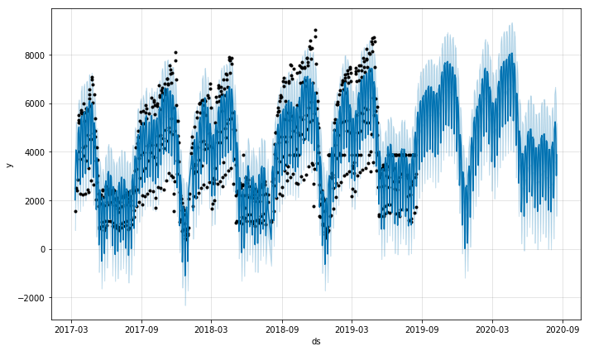
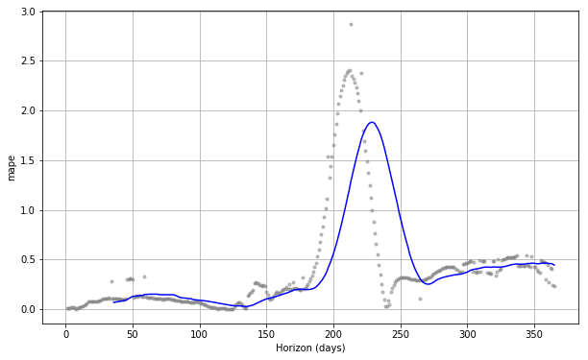
DRIVE Machine Learning
Attribute 1day_active_users prediction and MAPE

Slide 30
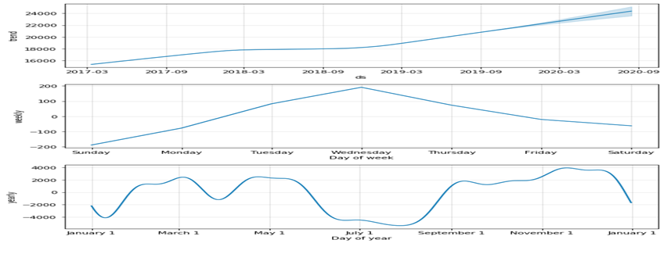
DRIVE Machine Learning
Attribute 1day_active_users trends

Slide 31
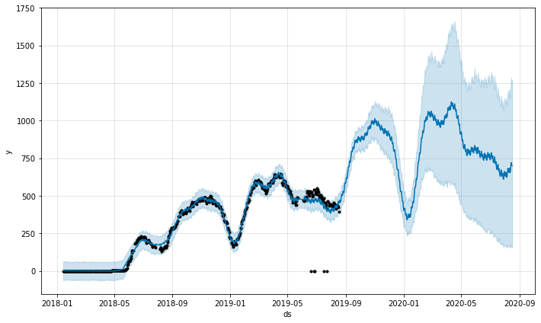
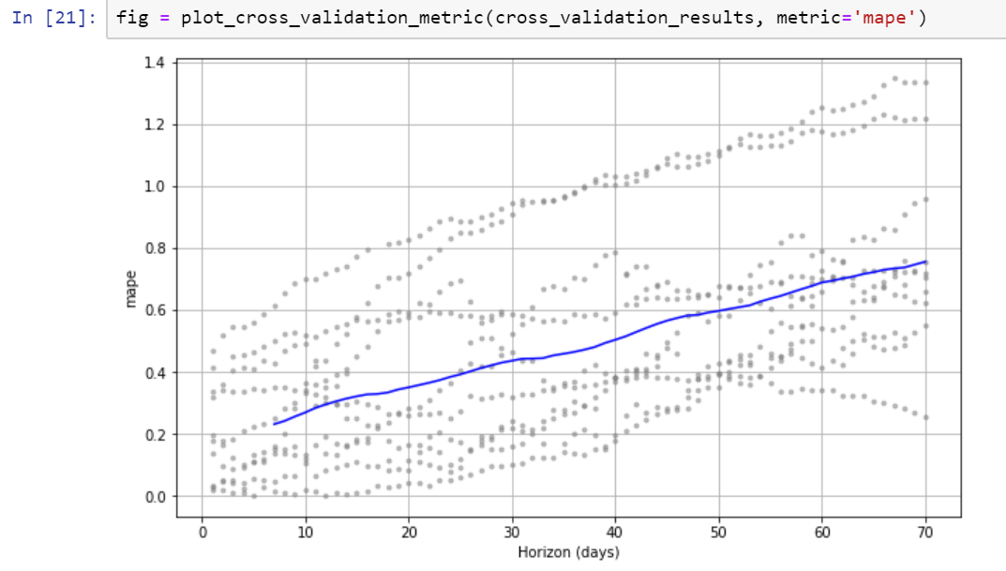
Meets Machine Learning
Attribute 30day_active_users prediction and MAPE

Slide 32
Meets Machine Learning
Reasons for Poor MAPE:
The metric values are zero from Jan 2018 to May 2018 for most of the Google Meet metrics. The mentor suggested it is likely that metric didn't exist then or google discontinued temporarily. The mentor suggested to perform time series analysis by ignoring them. MAPE value is greater than 20 percent.
Additionally, MAPE does not give good results as we have a low volume of data or the values are small. This explains why MAPE is not so good here because all the actual values in Google Meet metrics are very small (in which can greatly inflate MAPE) and Google Meet has low volume of data.

Slide 33
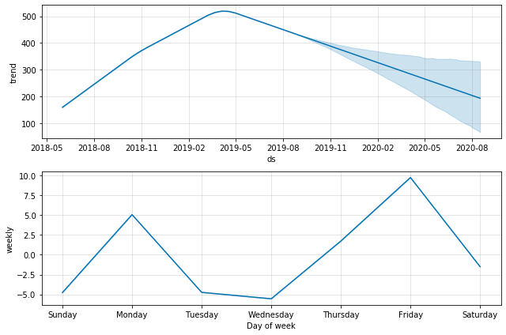
Meets Machine Learning
Attribute 1day_active_users trends

Slide 34
Accounts and Calender Machine Learning
Attributes predicted using fb prophet:
Google.calender:num1_day_active_users
google.accounts:num_1day_logins
google.accounts:num_7day_logins
google.accounts:num_30day_logins
Attribute predicted using linear regression:
google.accounts:num_users(independent) and google.accounts:drive_used_quota_in_mb (dependent)

Slide 35
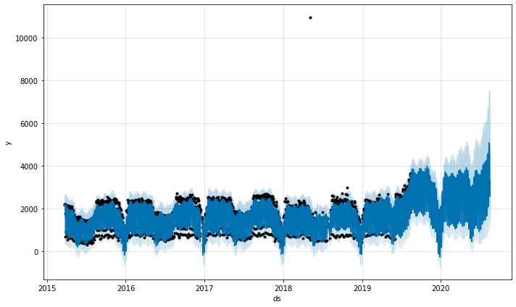
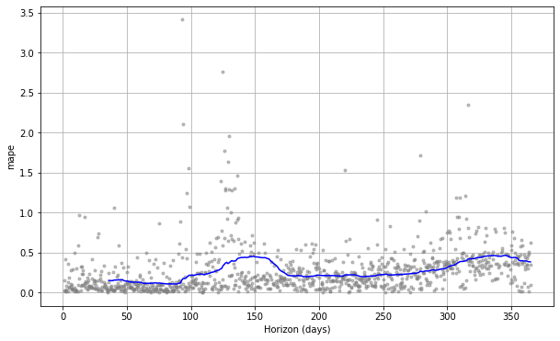
Accounts and Calendar Machine Learning
Attribute 1day_active_users prediction for Accounts and MAPE

Slide 36
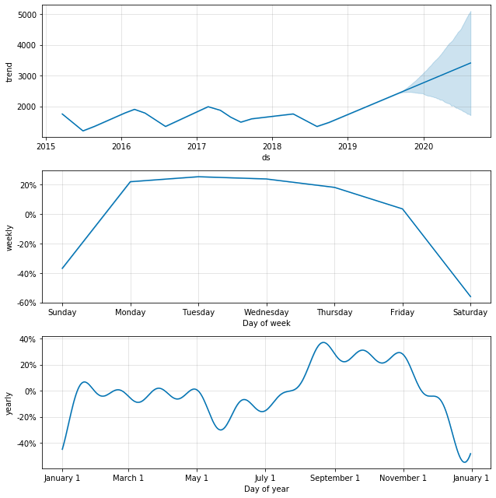
Meets Machine Learning
Attribute 1day_active_users for Accounts trends

Slide 37
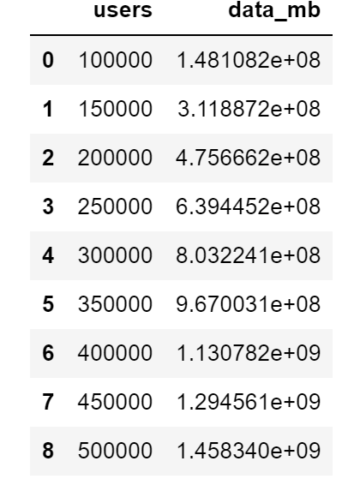
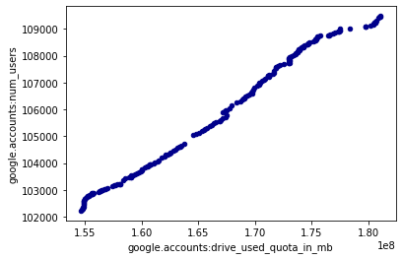
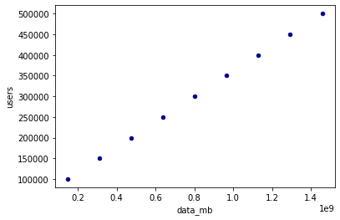
Accounts and Calendar Machine Learning
Linear Regression with google.accounts:num_users and google.accounts:drive_used_quota_in_mb

Slide 38
Machine Learning Implications
Implications:
The decent predictions will give the ITS department a firm understanding what is happening with G-Suite data throughout the year and allow the ITS department to prepare in advance to seasonal and overall trends.
The trends that are seen the current data are also seen in the future data like increase in usage in the semester end and almost no activity during semester breaks.
Allows ITS Department to understand how much data will be consumed by its users.

Slide 39
RESULTS
Dashboard

Slide 40
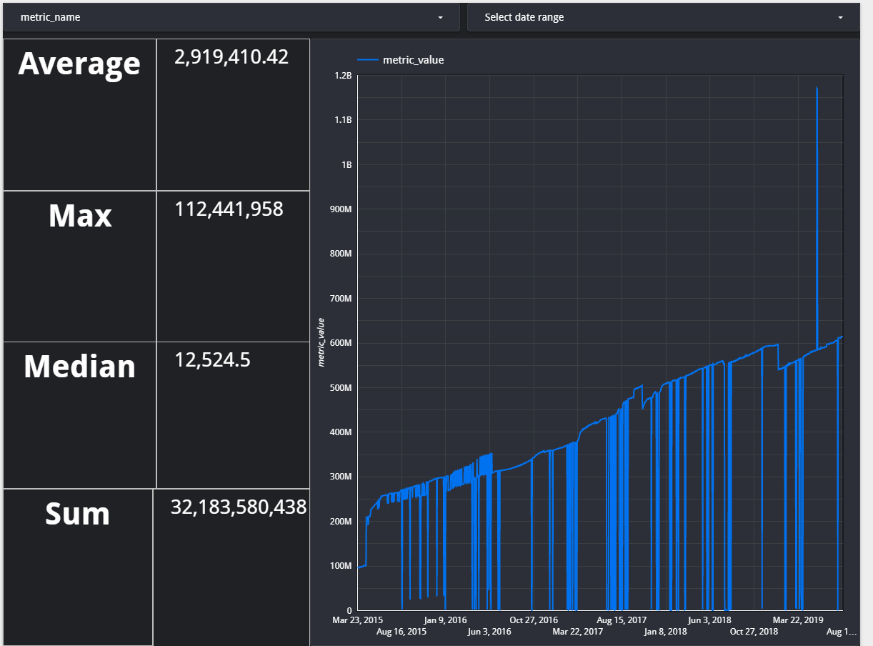
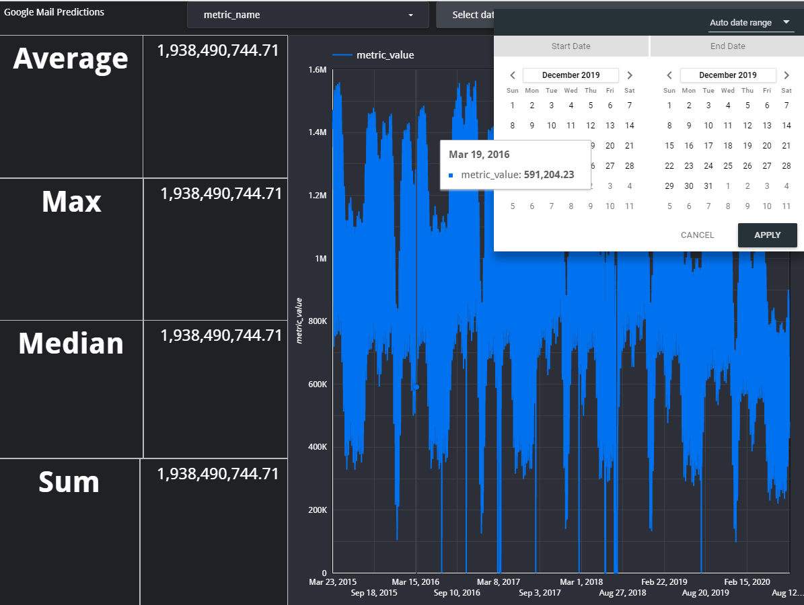
Dashboard
DASH BOARD RESULTS AND DEMO

Slide 41
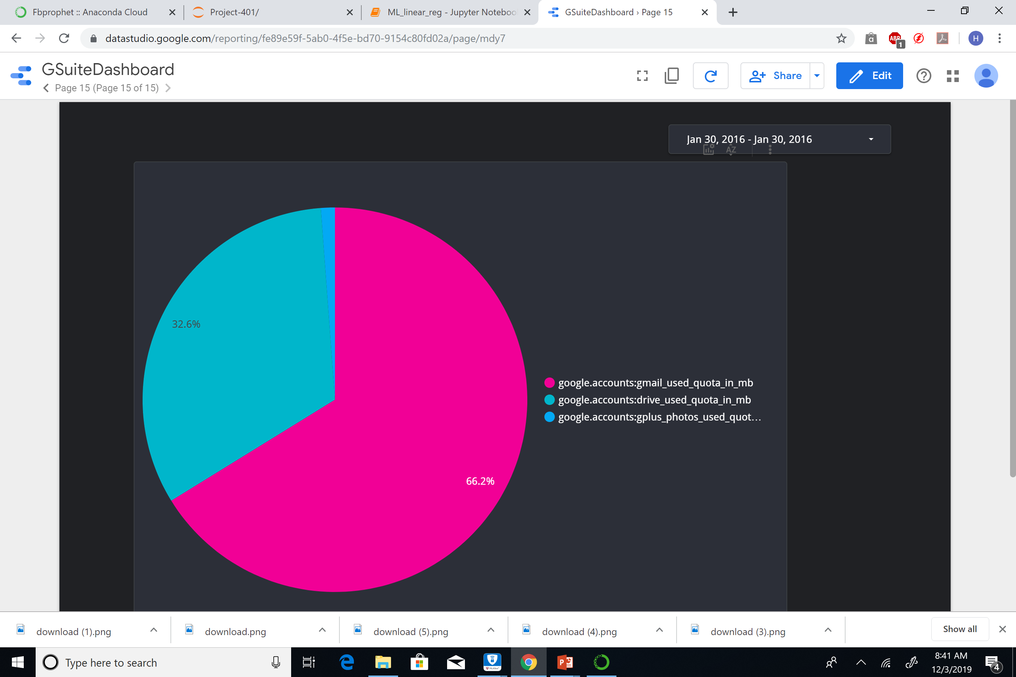
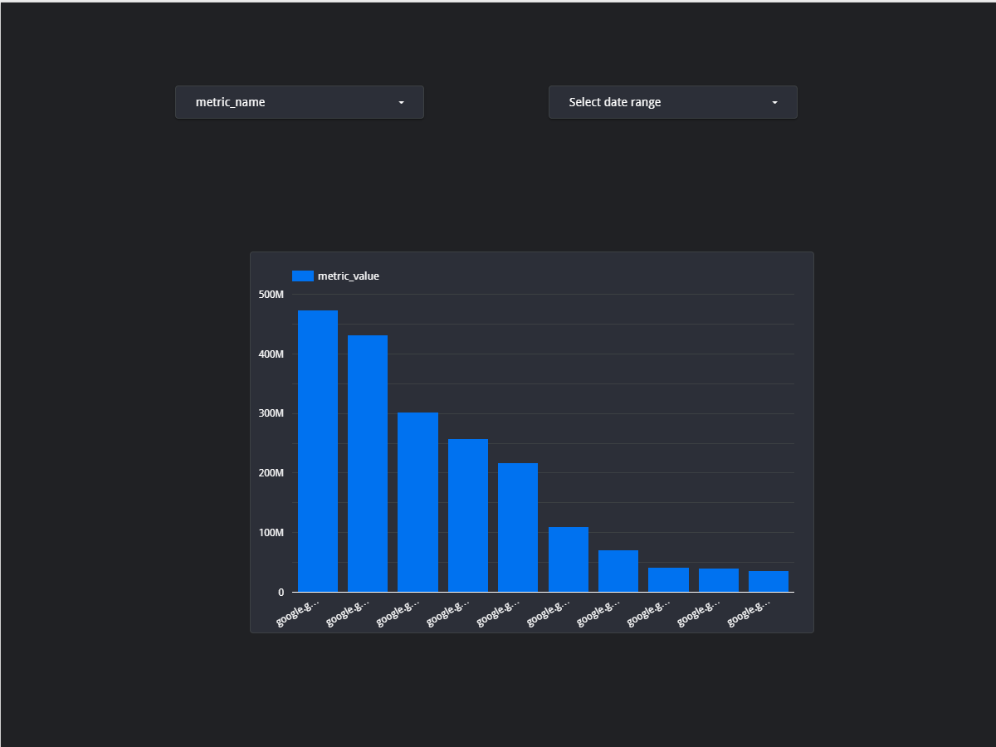
Dashboard
Dashboard Link:
https://datastudio.google.com/reporting/fe89e59f-5ab0-4f5e-bd70-9154c80fd02a

Slide 42
CONCLUSION
In conclusion, team has worked in analyzing the raw data that has been provided to us by UNCG ITS.
We have cleaned the data, performed statistical analysis, did the time series prediction for the year 2020
We also predicted the trends like on what day the usage is more, on which months the usage is more and so on. These results are helpful for UNCG ITS to make decisions regarding the G-suite metric services, like planning down time, providing the resources based on usage.
We have also developed the dashboard using google data studio which can help in better visualization of the G-suite data.
The machine learning model, the dashboard can be used even for the future data of the G-suite metrics to do the analysis, prediction and visualization.

Slide 43
QUESTIONS ?

Slide 44
THANK YOU

