Slide 1
Public Safety Data

Slide 2
Overview
EMS Data set:
This data set has Emergency Medical Services (2012 to current and still get updated once a week)
This includes:
GCSD Guilford County Sheriff Department
GCF Guilford County Fire Department
EMS Emergency Medical Service
ACO Animal Control
This data set include things Nature of the call, time. Service, agency, district, seconds until arrival, seconds until dispatch and more seconds
We are taking out the ACO nature that is Transport because it isn’t very accurate, because some animals aren't always from Guilford County they maybe be brought from outside the county.

Slide 3
Data Description
Datasets are available through: opendata.guilfordcounty.com
Primary Dataset: Public Safety Calls for Service July 1, 2012 - Present
Notable features: Call related: call-time, call-source, secs2di(Seconds to call dispatch) Location related: city, district, geoprox Reason for call: nature, priority Responsibility assigned to: agency -ACO/EMS/GCF/GCSD
Most of the features are pre-established strings (not free form strings), the few others are seconds to call route, dispatch, first arrival, ...
Geocoded (longitude, latitude) data is gonna be provided, however, a feature called geo-proximity is publicly available.

Slide 4
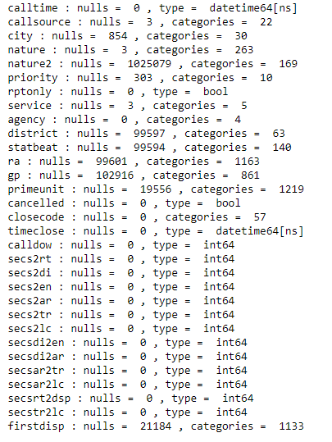
Data Description
Things worth mentioning:
Natures names changed over time
Nature has default priority value that can be modified by the dispatcher
Filter out rows where certain features have certain values such as: cancellCall = True, etc

Slide 5
Goals
The goals of the project are related to the major feature of the data, calls:
Trending natures for calls and reasons for trending?
Are the emergency resources used efficiently or poorly?
Suggestion for improving the resources usage?
To get answers to the questions, here are the established goals:
To find relationships between different natures of the calls and agencies.
To find high call volumes and correlate that to events, areas, or agencies.
To find relations between high call volumes and socio-economic factors

Slide 6
Tasks for each Person
Data cleaning and manipulation
On the new dataset that has geo-locations:
Filter out where cancelled calls field = True, report only field = True, nature = Transport to Animal Shelter,
Remove unnecessary fields related to location as: statbeat, ra
Associate codes for text fields
Manipulate calltime field: split into 2 fields: year, time
Topics/Hypothesis
Relationships between trending natures for calls and each agency; patterns between geographic area and leading calls’ natures; identification of predictors of emergency call categorization as “sick person”-later on if time permits.(Oana)
Correlate time of the call with the nature of the call(Jason said this was a big interest for them)(Saed)
Response reaction time based on nature(Jason said this was a big interest for them)(Linh)
Nature and matching priority(priority always based on operator, is it over time changed)(Daniel)
Later - need more Data for these topics
Geo location and natures( multiple people will probably work on this)
Social economics and calls/ nature(not sure we want to do this topic)
Notes:
Saed - DaysOfMonths, DaysOfWeeks, MonthsOfYears, and Years. We’re gonna correlate that with the nature of the call to understand the patterns in terms of time and so on.

Slide 7
Related Work
Why and when citizens call for emergency help: an observational study of 211,193 medical emergency calls https://www.ncbi.nlm.nih.gov/pmc/articles/PMC4632270/
The difficult medical emergency call: A register-based study of predictors and outcomes https://www.ncbi.nlm.nih.gov/pmc/articles/PMC5333377/
Data Analysis Report Fire and Emergency Medical Services Hermosa Beach, California August 2013 http://www.hermosabch.org/modules/showdocument.aspx?documentid=3314
Notes:
The study analyzes the major reasons for emergency calls along with the priorities assigned to each reason; they suggest improvements for conducting the phone calls to avoid nonspecific call reasons
The study used machine learning - to investigate predictors for emergency call categorization as “unclear problem” in contrast to “symptom-specific” categories and the effect of categorization on mortality.
The study analyzes EMS and Fire calls, put them into more specific categories, and evaluate the performance and the reaction of the public agencies.

