Slide 1
EMS Update
Daniel(81wingo)
Linh (ltran1109)
Oana (odumitr)
Saed (SaadMTSA)

Slide 2
Daniel

Slide 3
Priorities
Add more dimensions besides just nature and priority
Adding agency, sec2ar and district to see if the accuracy will increase

Slide 4
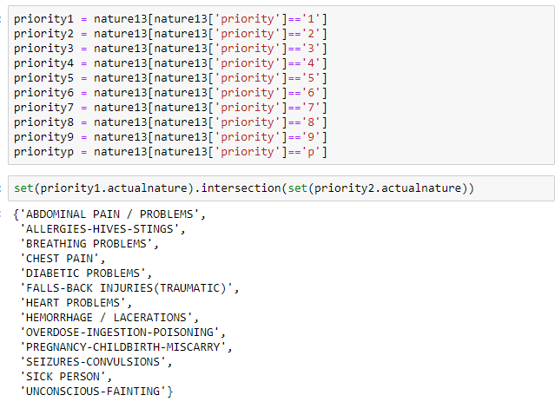
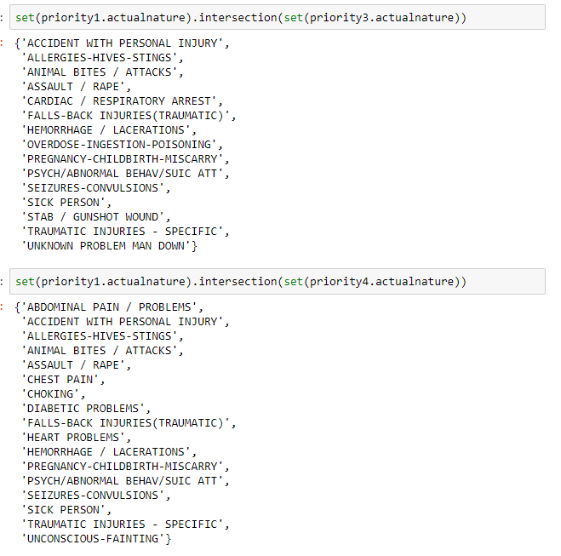
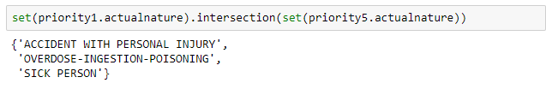
Original Question
Do the Priorities change over the years?
PROBLEM!
This shows us that the idea that the priorities being solely based on the nature is FALSE. If there are overlapping in priorities with in the first year it would be very difficult to find a way to show how priorities have changed throughout the years. I understand why they would overlap after looking at the natures that did overlap. We assumed they would have similar titles. We just don't assume they would have them same titles. I understand it priority would be based on the nature and the severity of nature.

Slide 5
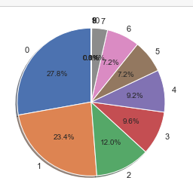
Ways to fix this:
Possibly find the mean Priority of each Nature and set natures of that type equal to the mean value.
Distribution of Priorities

Slide 6
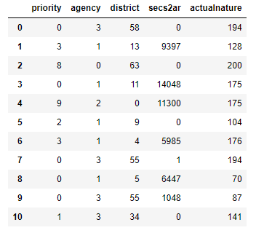

First i broke the data set into only 5 columns
And found the Rsquared value is .25 so a regression line model may not be the best for the data.

Slide 7
Saed

Slide 8

Geocoded Data
To utilize the geocoded data, we used carto.com
You can use it for free with your github student developer pack.

Slide 9
Geocoded data
https://saadmtsa.carto.com/builder/ce7172a8-47c9-44db-adba-516c4fe870e2/embed
https://saadmtsa.carto.com/builder/9aad782c-c3d3-4340-830f-92f3bcc26064/embed

Slide 10
Predicting the agency
Trying to predict the agency that relates to the call before any word is said.
Type: Classification problem.
Features: Call time (Hour, DayOfWeek, DayOfMonth) Location (Longitude, Latitude) CallSource (e.g. E911, W911, SELF, XFER, PHONE) - initially, wasn’t considered.
Output (Prediction): Agency

Slide 11
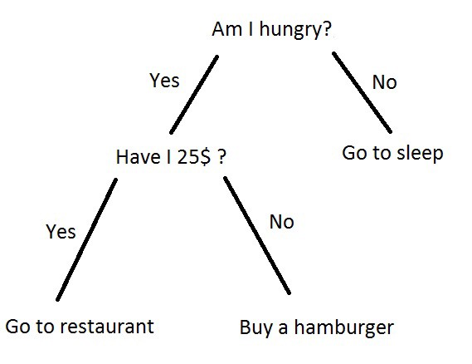
Predicting the agency
Done with a Random Forest Classifier.
Random Forest Classifier consists of multiple decision trees.
A decision tree looks like this
source: becominghuman.ai

Slide 12

Predicting the agency
So, a Random Forest would look like this!
source: medium.com

Slide 13
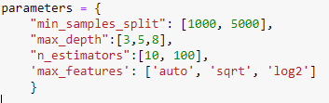
Tweaking the model
Used GridSearchCrossValidation.
You give it two things, and it gets the job done for you.
# of cross validations.
Set of parameters.

Slide 14
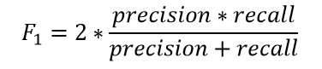
Results
Our performance measure was F1 scores.
 | F1 Score
Initial model (before adding callsource) | 68.8%
Before GridSearchCV (after adding callsource) | 77.8%
After GridSearchCV | 78.7%
* Higher is better

Slide 15
Hypothesis testing
Hypothesis #1: Calls for Greensboro & High-Point are received at different hours (0-23). H0 would be that calls are received at the same hours. Result: p-value ~= 2.78E-70. So the H0 is definitely rejected; which means they are different.
Hypothesis #2: Calls for Greensboro & Guilford county are received at different hours (0-23). H0 would be that calls are received at the same hours. Result: p-value ~= 264E-73. So the H0 is definitely rejected; which means they are different.

Slide 16
Hypothesis testing
Hypothesis #3: Greensboro & High-Point have different call rates per agency. H0 would be that they have the same call rates per agency. Result: p-value = 0. So the H0 is definitely rejected; which means they are different.
Hypothesis #4: Greensboro & Guilford county have different call rates per agency. H0 would be that they have the same call rates per agency. Result: p-value = 0. So the H0 is definitely rejected; which means they are different.

Slide 17
Hypothesis testing
Hypothesis #5: Calls for EMS & GCSD are received at different hours (0-23). H0 would be that they have the same calls per each hour. Result: p-value ~= 2.78E-70. So the H0 is definitely rejected; which means they are different.

Slide 18
Linh

Slide 19
Nature vs. response time
Further clean up:
Remove records with label “ Traffic Stop”
Check the Distribution of the of response time and see patterns
Check Relationships of response time and number of calls

Slide 20
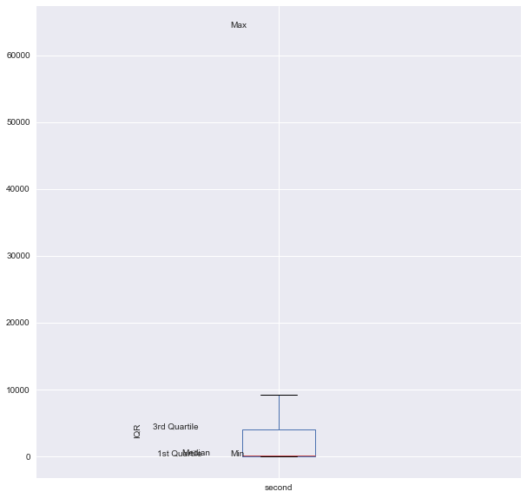
EMS - Guilford county Emergency Medical Service
Mean 5229.659341 Std 11453.974392 Min 1.000000 25% 4.000000 50% 206.000000 75% 4038.500000 Max 64109.000000

Slide 21
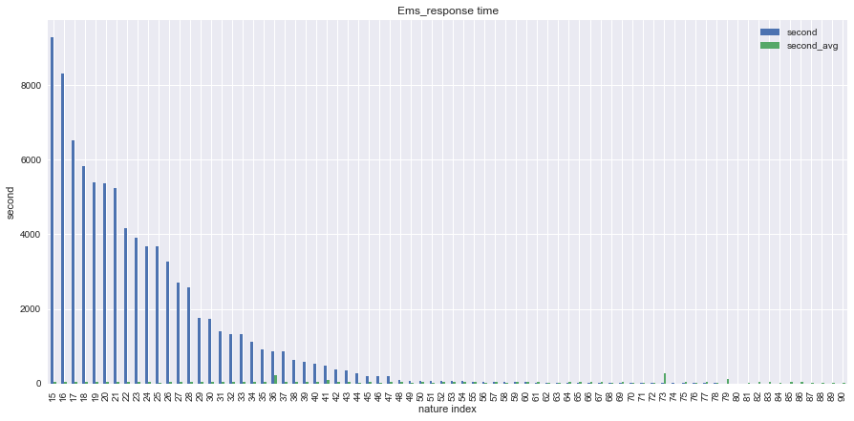

Slide 22
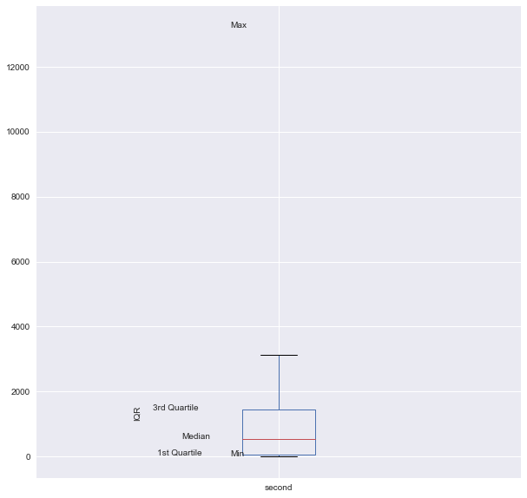
2.1 ACO - Animal control
Mean 1653.583333 Std 2719.360335 min 1.000000 25% 52.250000 50% 543.500000 75% 1440.000000 max 13207.000000

Slide 23
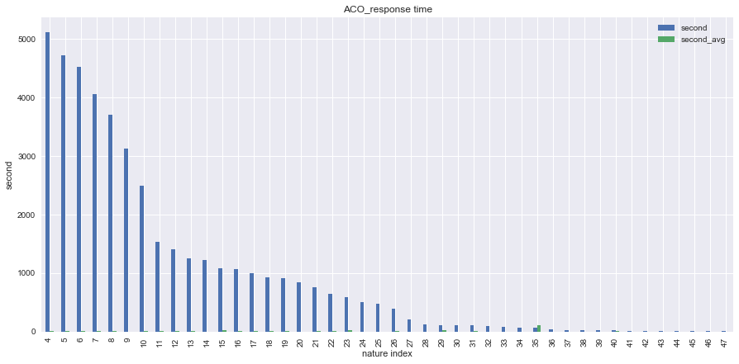

Slide 24
3.1 GCSD -Guilford County Sheriff Department
mean 1653.583333 std 2719.360335 min 1.000000 25% 52.250000 50% 543.500000 75% 1440.000000 max 13207.000000

Slide 25
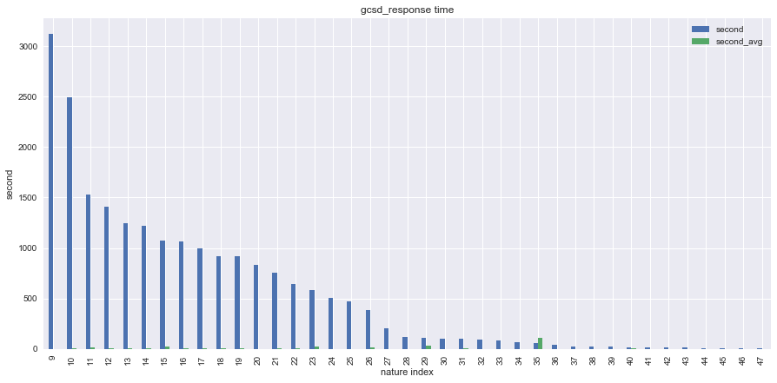

Slide 26
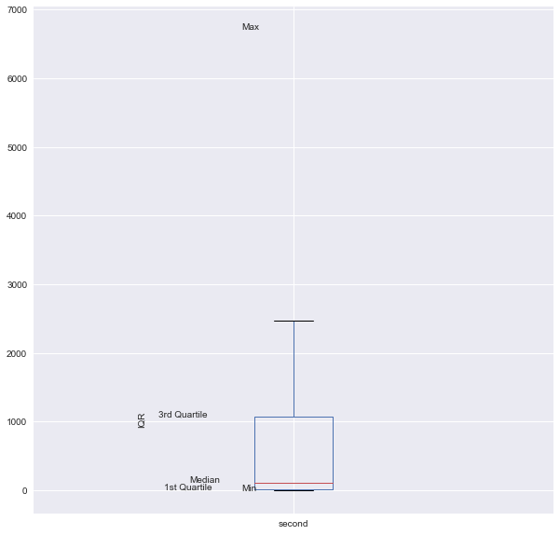
4.1 GFD - Guilford County Fire Department
mean 955.670588 std 1746.353053 min 1.000000 25% 13.000000 50% 113.000000 75% 1077.000000 max 6705.000000

Slide 27
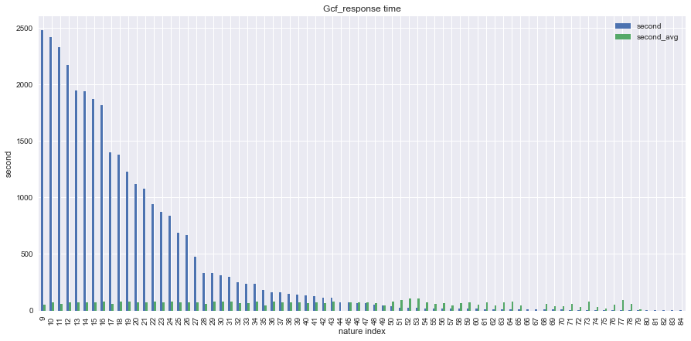

Slide 28
Future Tasks
Response time vs. nature and month of the years ( note: did you work on this but the results are not representable)
Use key feature to apply machine learning

Slide 29
Oana

Slide 30
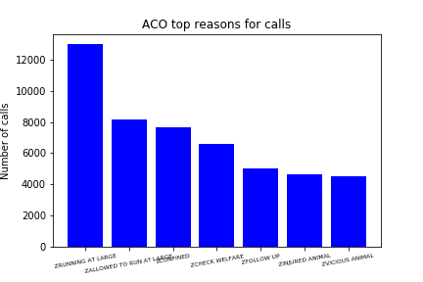
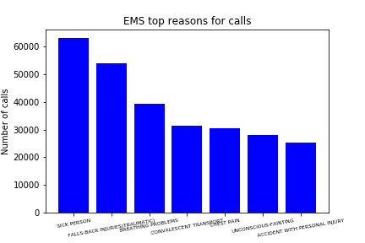
Top reasons why people call per agency

Slide 31
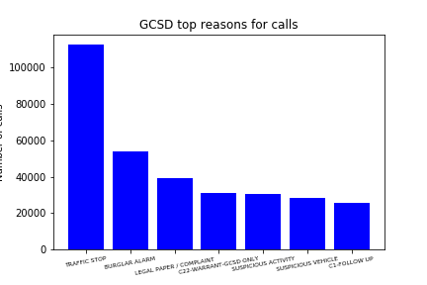
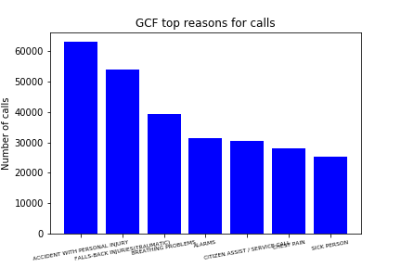
Top reasons why people call per agency

Slide 32
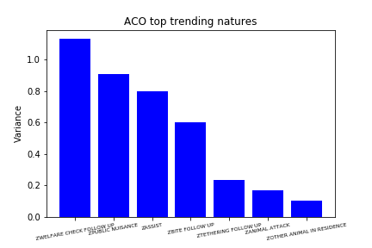
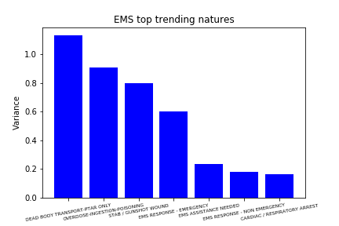
Natures with the biggest variance in calls

Slide 33
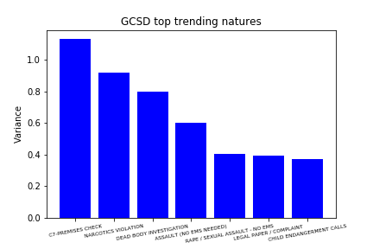

Natures with the biggest variance in calls

Slide 34
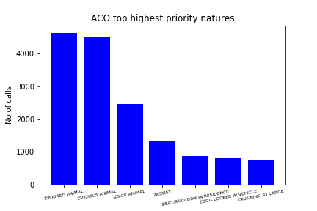
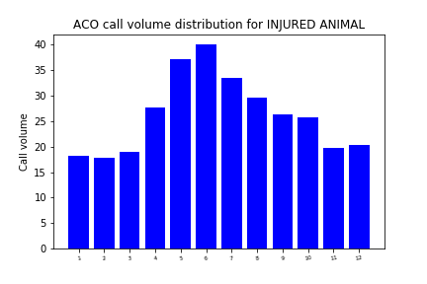
Natures with highest priority per agency-ACO

Slide 35
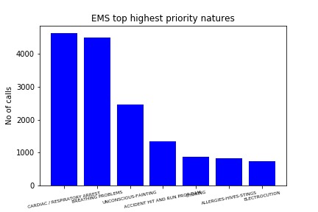
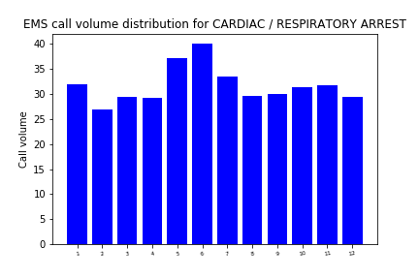
Natures with highest priority per agency-EMS

Slide 36

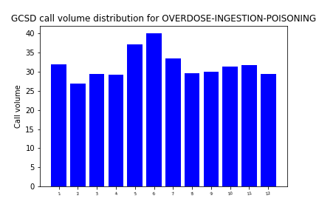
Natures with highest priority per agency-GCSD

Slide 37
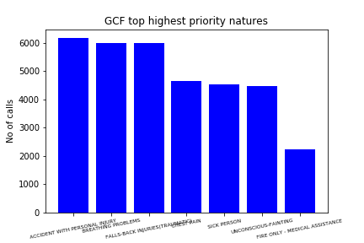
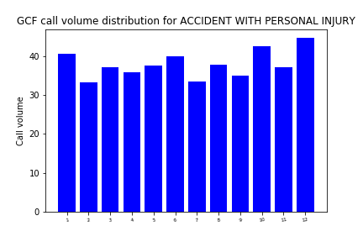
Natures with highest priority per agency-GCF

Slide 38
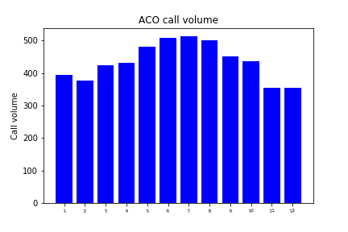
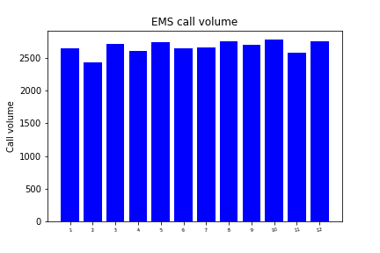
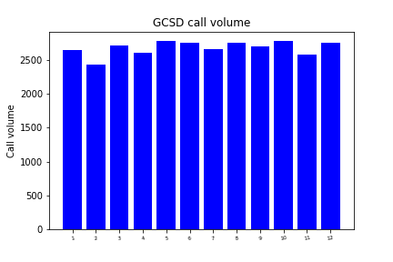

Bussiest months for each agency

Slide 39
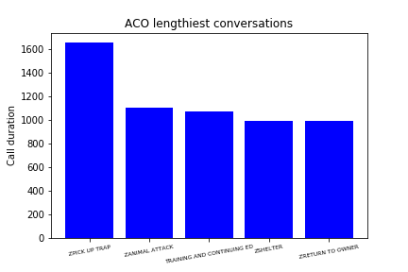

Phone call duration statistics per agency
ACO mean call duration-587 sec
Mean call duration for highest P nature INJURED ANIMAL-344 sec
EMS mean call duration-68 sec
Mean call duration for highest P nature CARDIAC / RESPIRATORY ARREST-26 sec

Slide 40


Phone call duration statistics per agency
GCSD mean call duration-51 sec
Mean call duration for highest P nature OVERDOSE-INGESTION-POISONING-42 sec
GCF mean call duration-23 sec
Mean call duration for highest P nature ACCIDENT WITH PERSONAL INJURY-21 sec

Slide 41
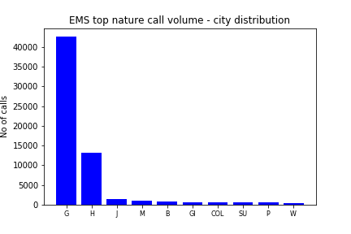
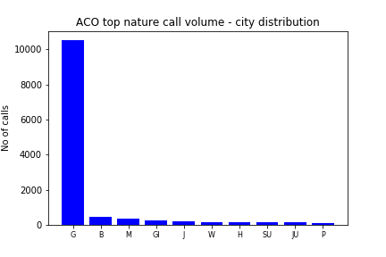
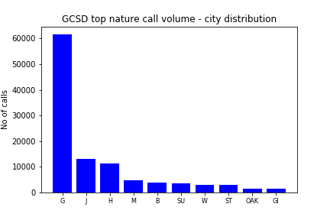

Patterns between geographic areas and top natures

Slide 42
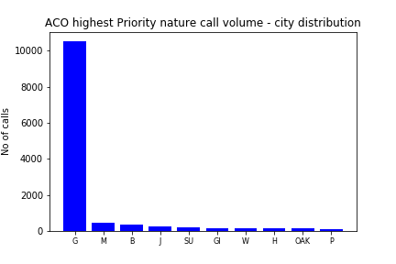
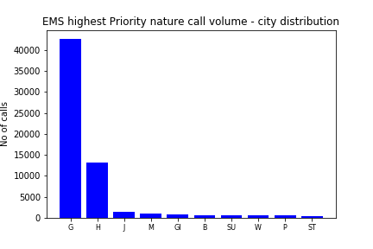
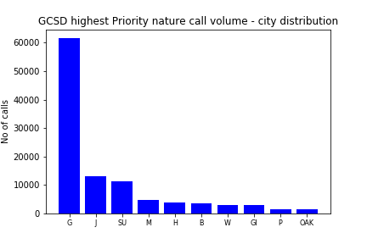

Patterns between geographic areas and highest Priority nature

Slide 43
Hypothesis testing
scipy.stats.ttest_ind
H2. Time needed for nature identification for calls received for Agency x are the same as the ones for calls received for Agency y.
2 Tailed test:
H1. Hours at which phone calls were received for GCSD are the same as the ones for calls received for GCF.
2 Tailed test:
t-statistics is -27.869819 p value is 0.000000000000000000000000000000000000000000000000000000000000000000000000000000000000000000000000000000000000000000000000000000000000000000000000000000000000000000000000008
Agencies | t-stat | p-value
ACO/EMS | 102.740235 | <<<0.05
ACO/GCSD | 174.731262 | <<<0.05
ACO/GCF | 71.651993 | <<<0.05
EMS/GCSD | 305.754329 | <<<0.05
EMS/GCF | 128.314612 | <<<0.05
GCSD/GCF | -50.955215 | <<<0.05

Slide 44
Future work
For some ‘key’ natures, apply machine learning to predict them (Oana)
Use k-nearest neighbours to predict where new hospitals/fire dept/animal shelters should be built based on the location from where the calls are made (Oana)
Use geolocation data to identify clusters and for public interest clusters (UNCG, downtown, etc) identify which are the top/highest priority reasons people call about(Oana)

